Slide 1
SLOVENIA

Slide 2
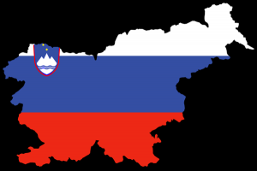
SLOVENIA
Slovenia is small country
Populaton (2000000)
Capital city is Ljubljana
Natiol anthem is Zdravljica
The highest peak in Slovenia is Triglav (2864m)
Our president is Borut Pahor
Peter Prevc is our best ski jumper

Slide 3
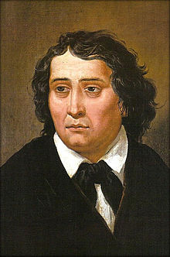
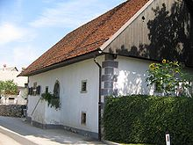
France Prešeren
Born : 3 December 1800
Died : 8 February 1849
He rides our national anthem Zdravljica
He was born in this house

Slide 4
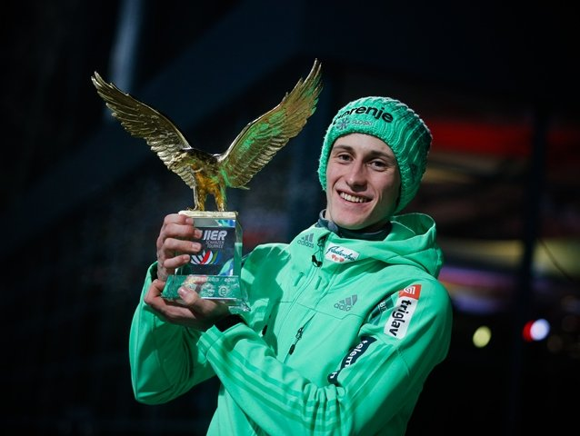
PETER PREVC
Best ski jumper in Slovenia
Born 20 september 1992
Height: 1.82m
Ski club SK Triglav Kranj
Best: 250m

Slide 5
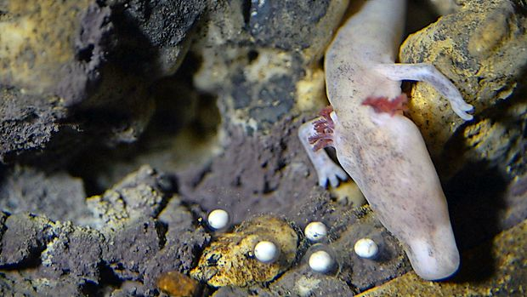
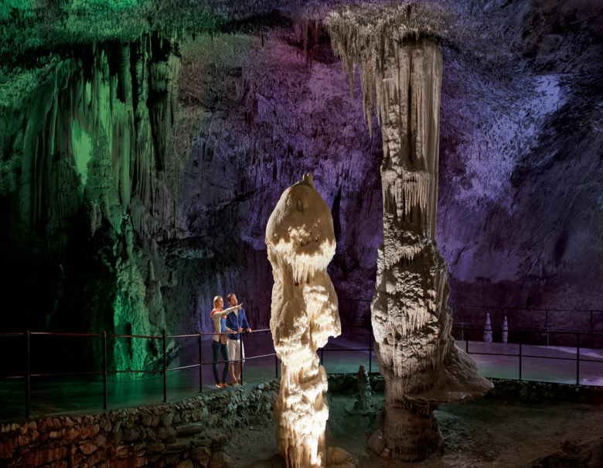
Postojna cave
Depth:115m
Olm
Long: 24,120m

Slide 6
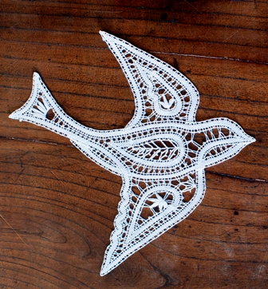
Idria lace

Slide 7
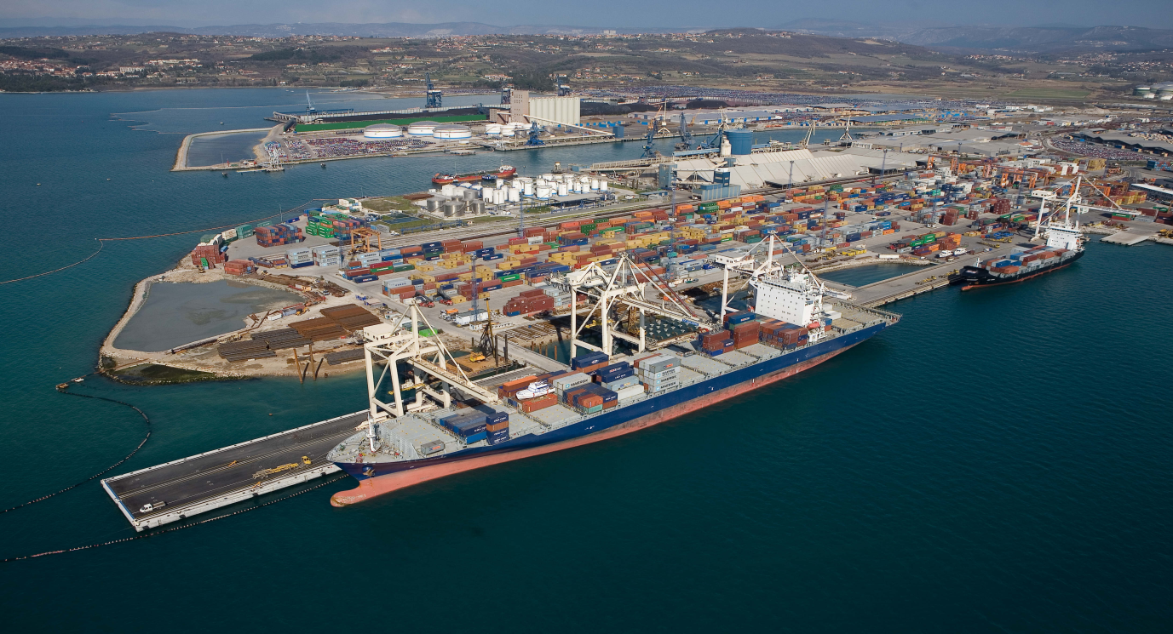
Luka Koper
Central Europe connection with the sea
Record year 2015:more than 20 million tons of cargo.

Slide 8
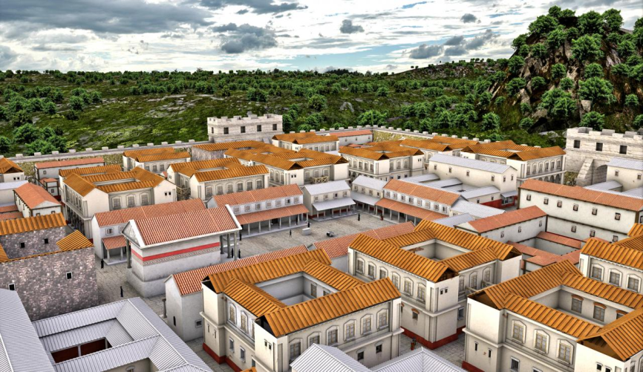
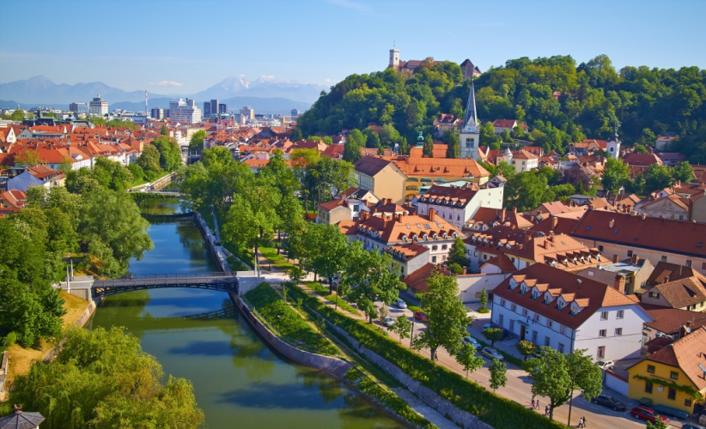
Ljubljana
Our capital city….sometimes Emona where the Romans lived

Slide 9
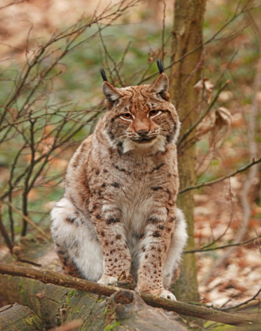
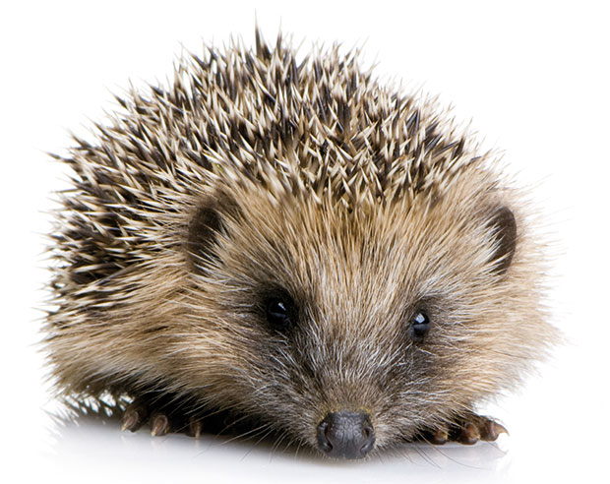
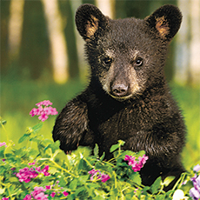
Animals
Endangered animals

