Slide 1
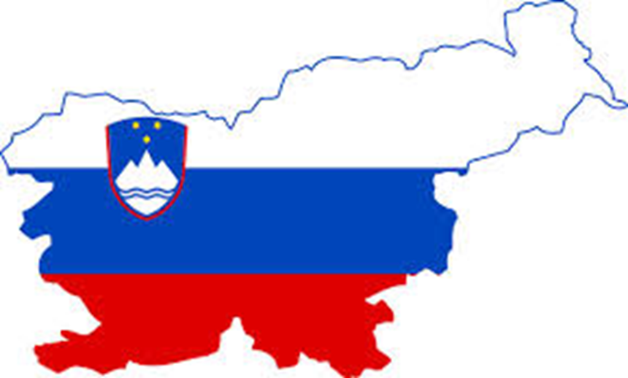
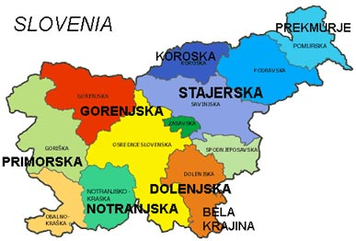
SLOVENIA

Slide 2
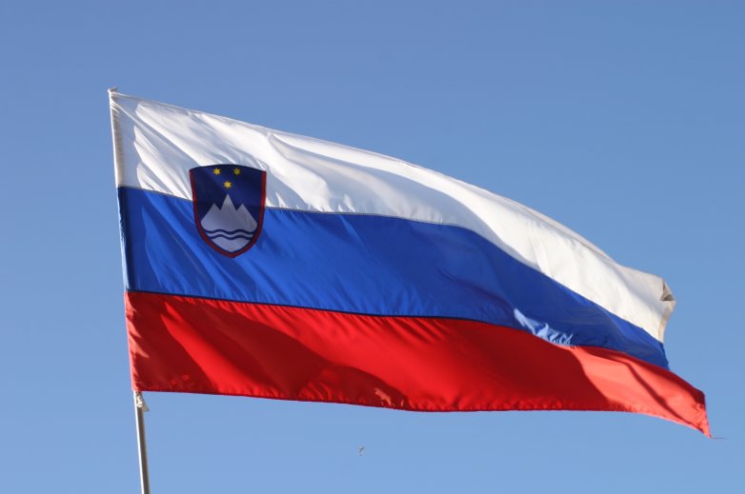
FLAG AND COAT OF ARMS
Slovenian flag is white, blue and red.
On coat of arms we can see triglav-Sloveian highest mountan, three sixt branch stars and sea.

Slide 3
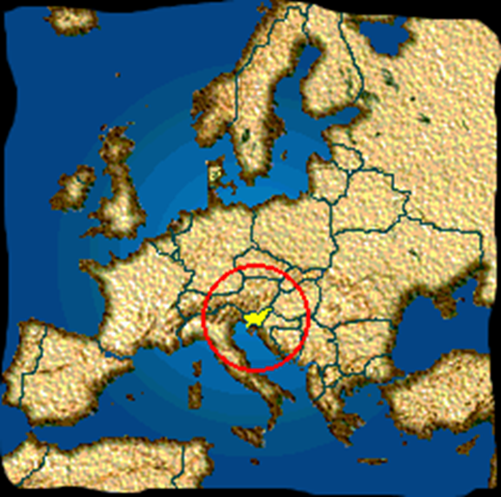
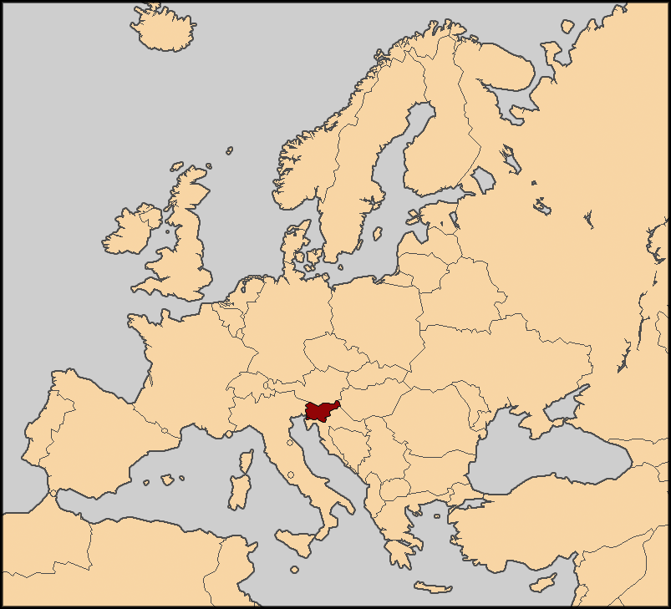
POSITION
Slovenia is between: CROATIA, HUNGARY, ITALY and AUSTRIA
It is positioned in the middle-east Europe

Slide 4
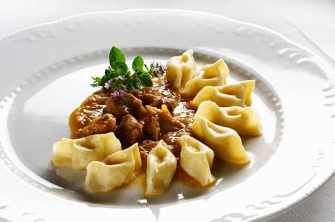
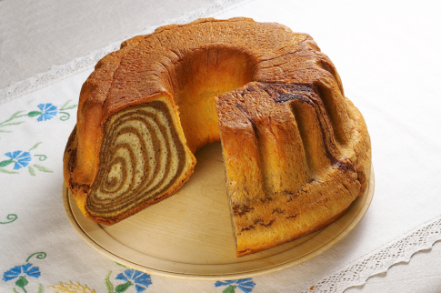
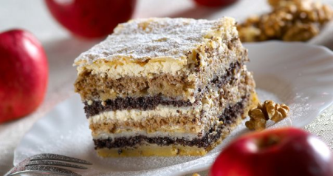
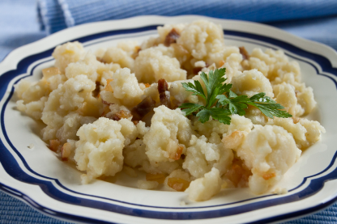
SLOVENE TRADITIONAL FOOD
Ajdovi vlivanci
Kranjska sausage
Šunka v tünki
Beef soup
Jota
Ričet Žlikrofi Potica
Prežganka
Bograč
Mineštra
Golaž
Apple mouse(čežana)
Kraški pršut Prekmurska gibanica Žganci
Potica

Slide 5
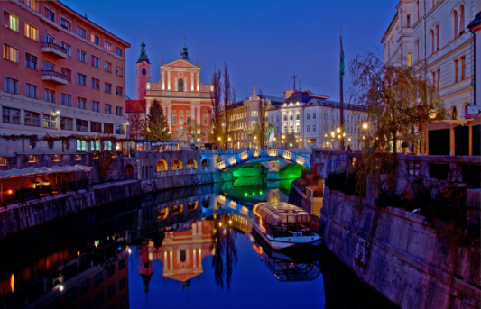
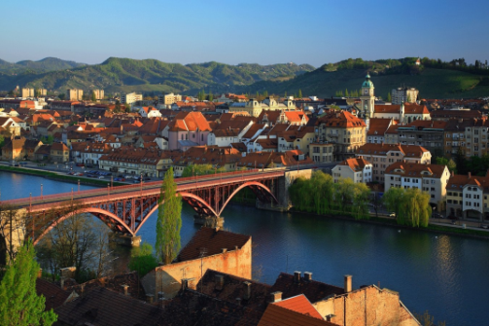
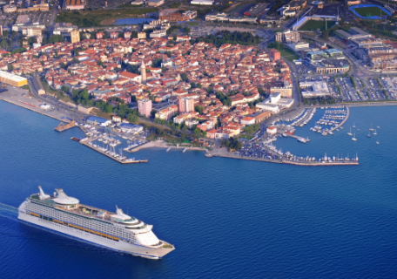
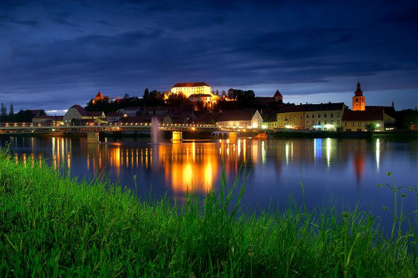
IMPORTANT TOWNS
Ljubljana
Maribor
Koper
Novo mesto Ljubljana Maribor
Celje
Kranj
Velenje
Ptuj
Murska Sobota
Koper Ptuj

Slide 6
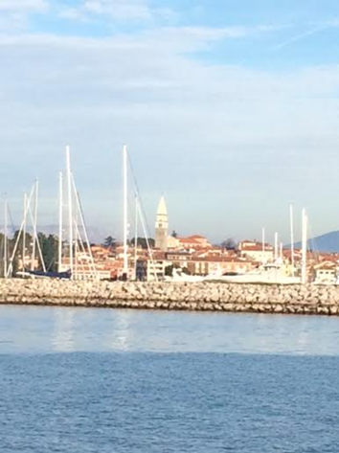
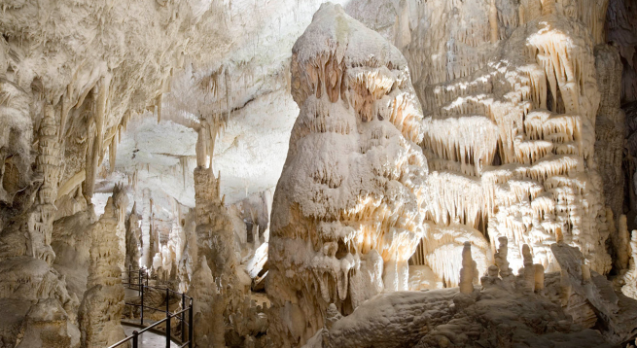
TURIST ATTRACTIONS
Postojna,
Bled,
Bohinj,
Portorož,
Lipica,
Ptuj, Postojna cave Izola
Idrija,
Kamnik,
Cerknica,
Slovenija has mountains, caves, lakes and a beautiful sea side.

Slide 7
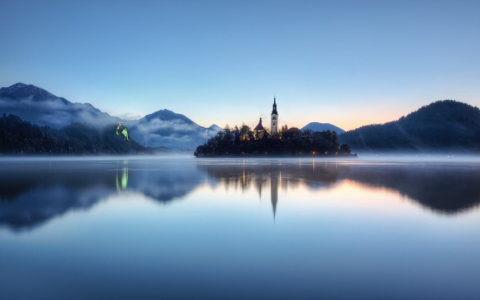
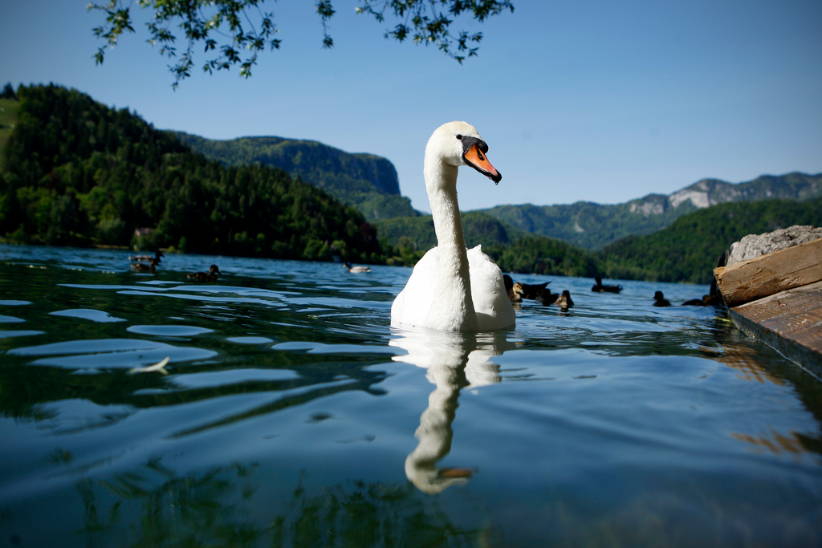
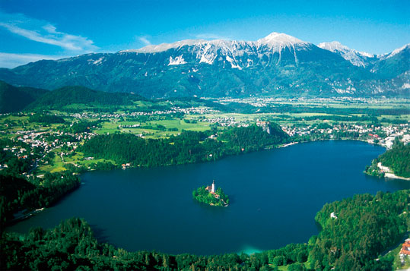
LAKE BLED
In Bled there is Blejsko jezero (lake Bled)

Slide 8
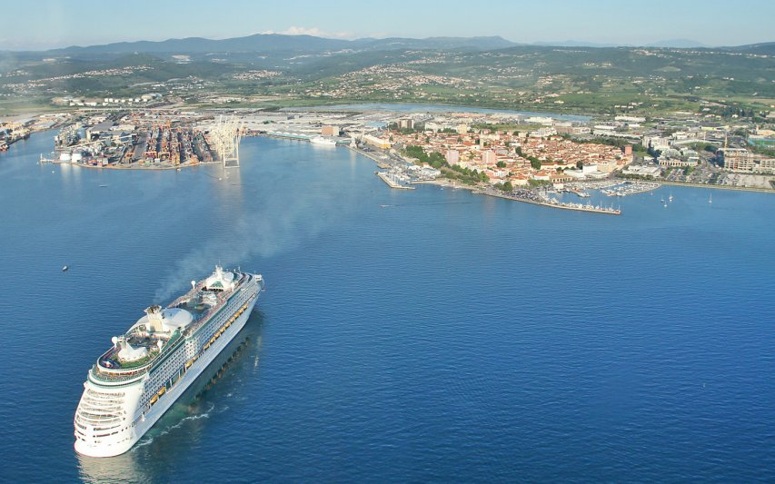
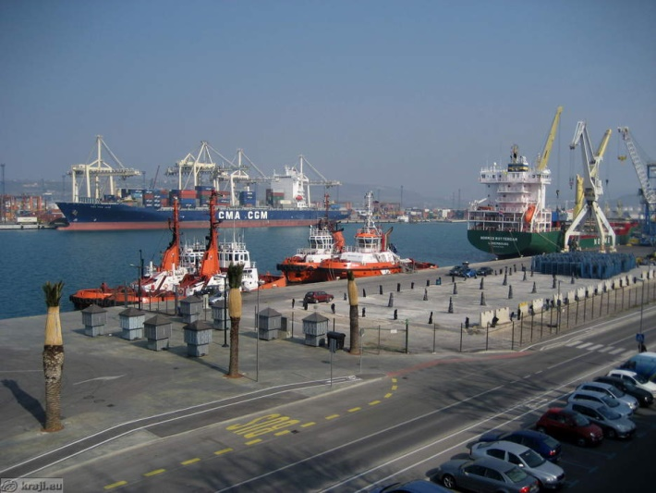
KOPER
In Koper there is a port Koper is 3 km long and is really important for Slovenia and Evrope.
It is also the capital of Primorska and it has 24996 inhabitants.

Slide 9
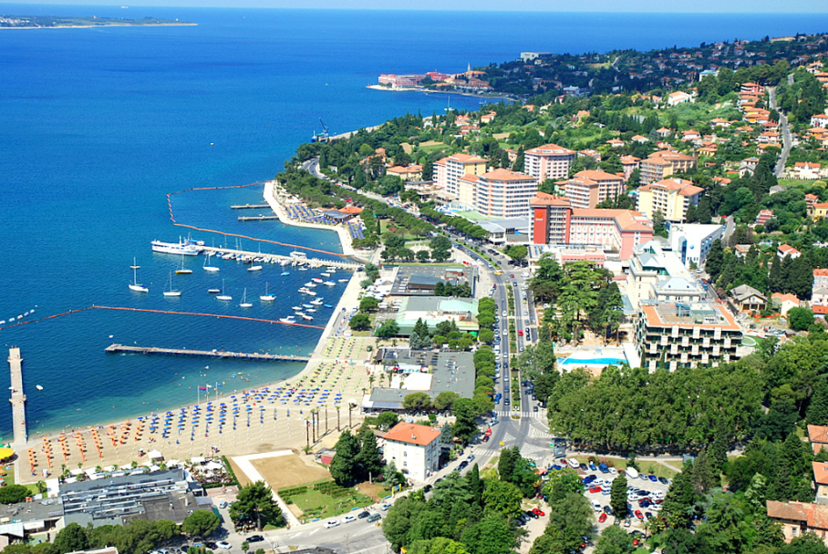
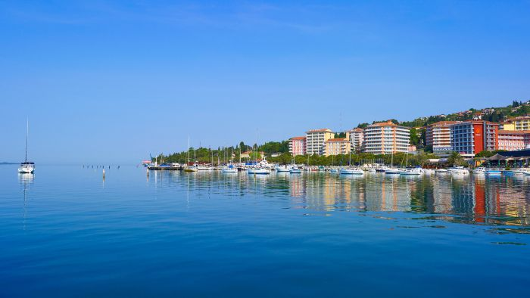
PORTOROŽ
Is a touristy town with a lot of hotels.
It has 2849 inhabitants.

Slide 10
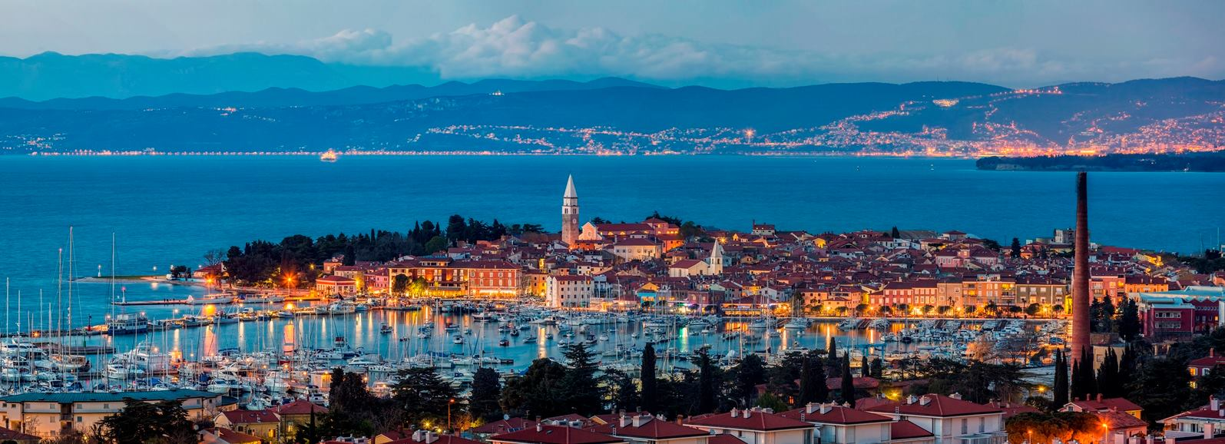
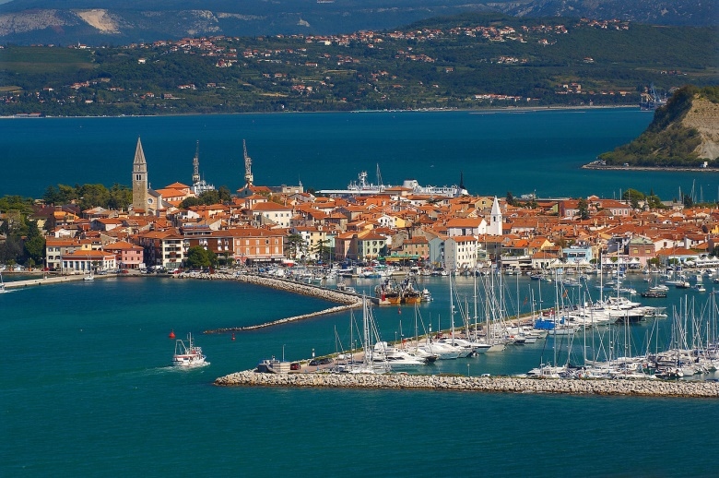
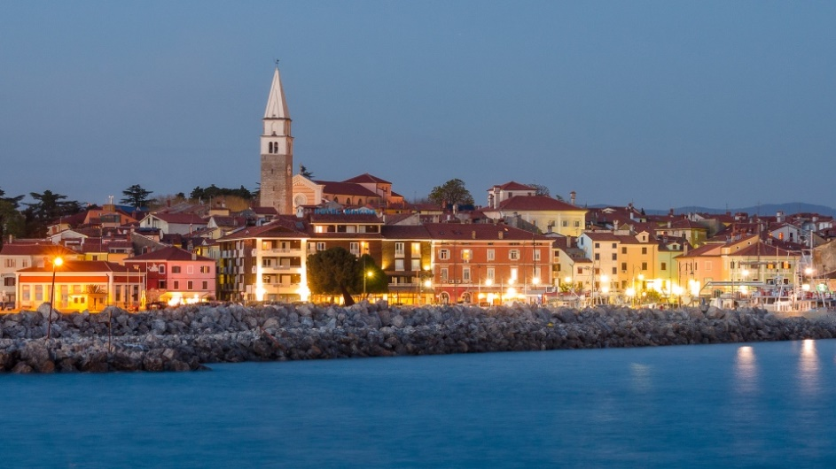
IZOLA
It has 15687 inhabitants.

Slide 11
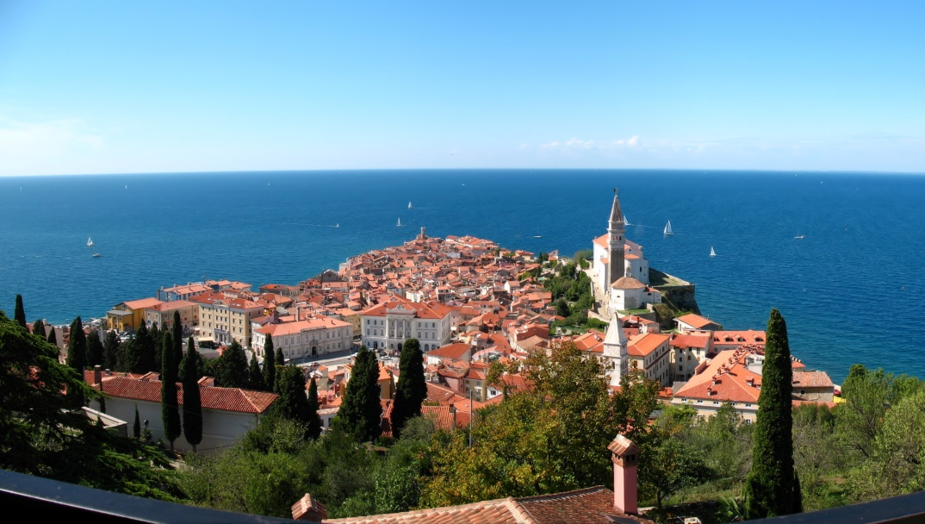
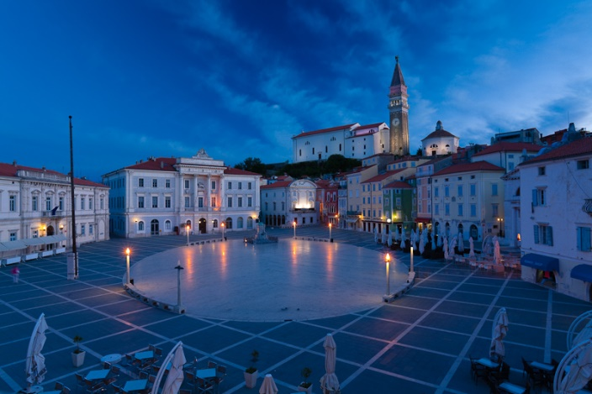
PIRAN
Is one of the oldest towns in Slovenia.
It was populate alredy in 670.
Piran has 4092 inhabitants.

Slide 12
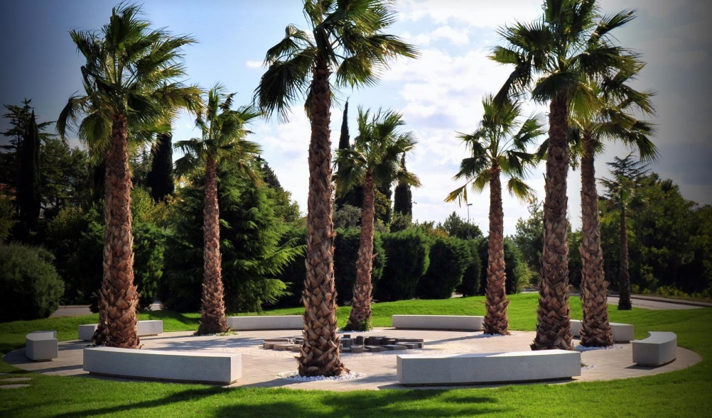
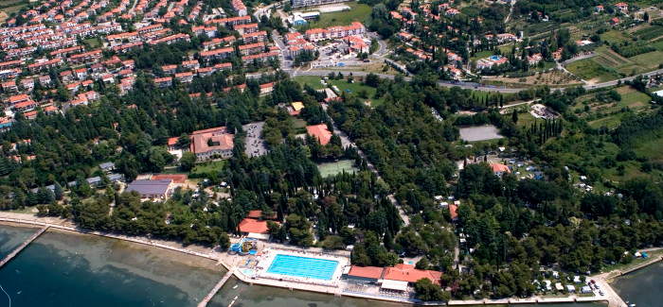
ANKARAN
It has 2984 inhabitants.
Is a touristy town.

Slide 13
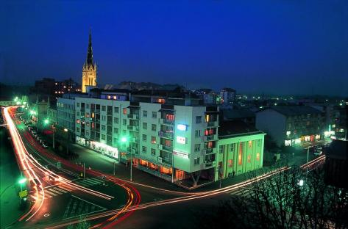
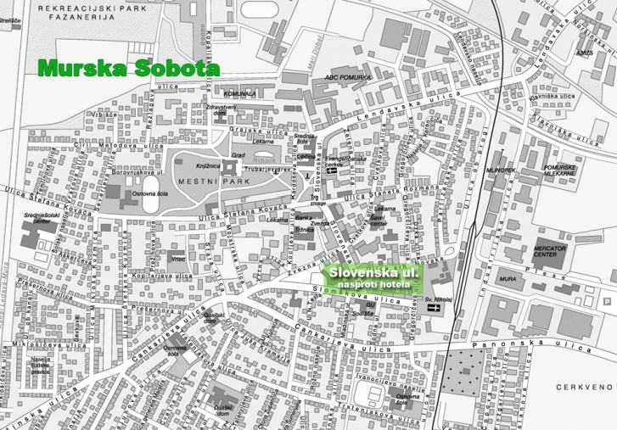
MURSKA SOBOTA
Is capital of Prekmurje.
Murska Sobota is along the river Mura.
It has 20.080 inhabitants.

Slide 14
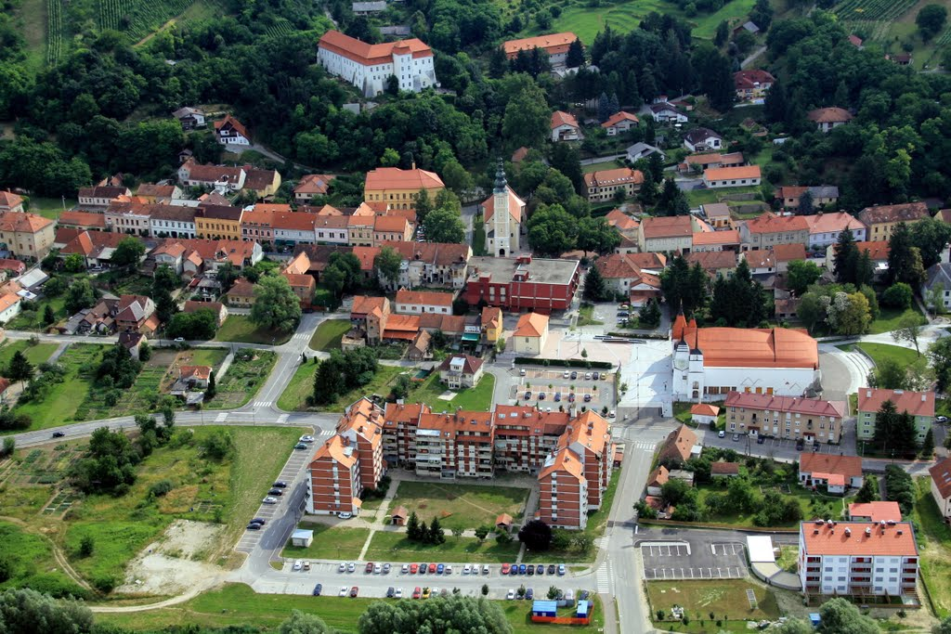
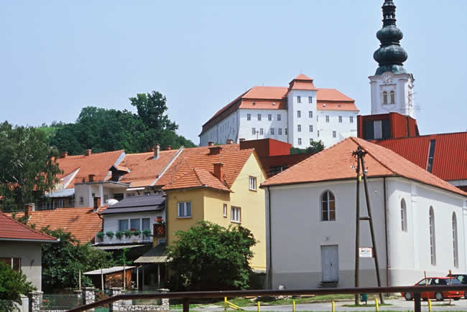
LENDAVA
Is a small touristy town in Prekmurje.
It has 11151 inhabitants.

Slide 15
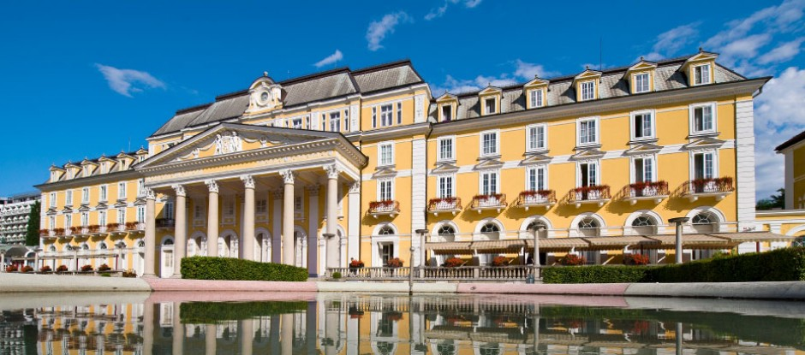
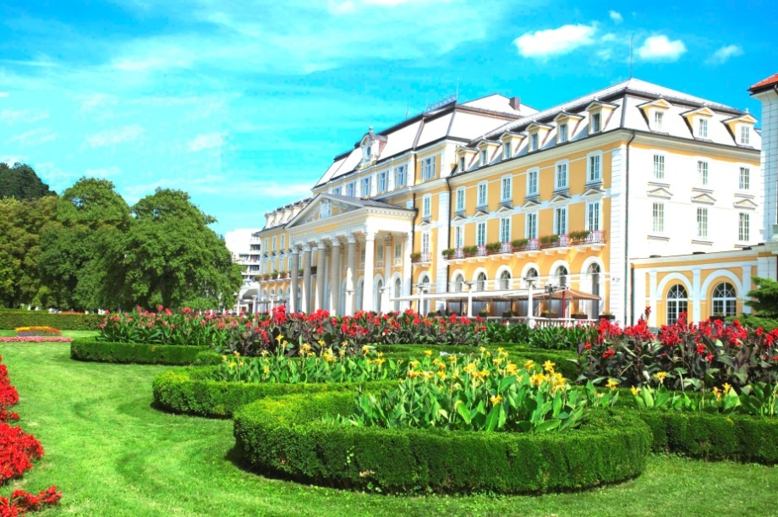
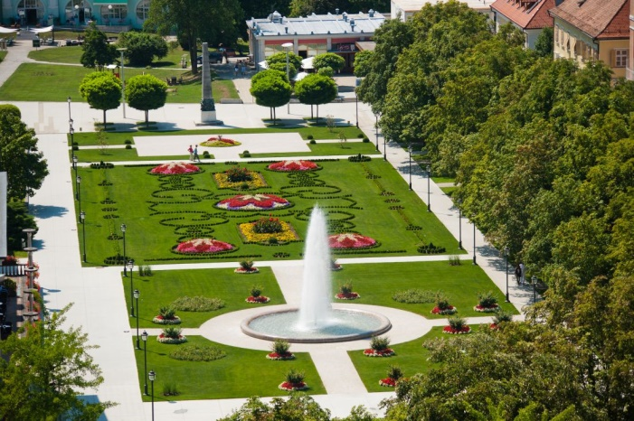
ROGAŠKA SLATINA
It has 5041 inhabitants.
It is in Štajerska.
It is well known about its
healing water, spas and
crystal craftwork.

Slide 16
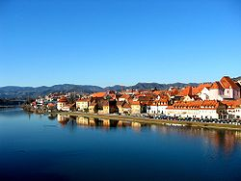
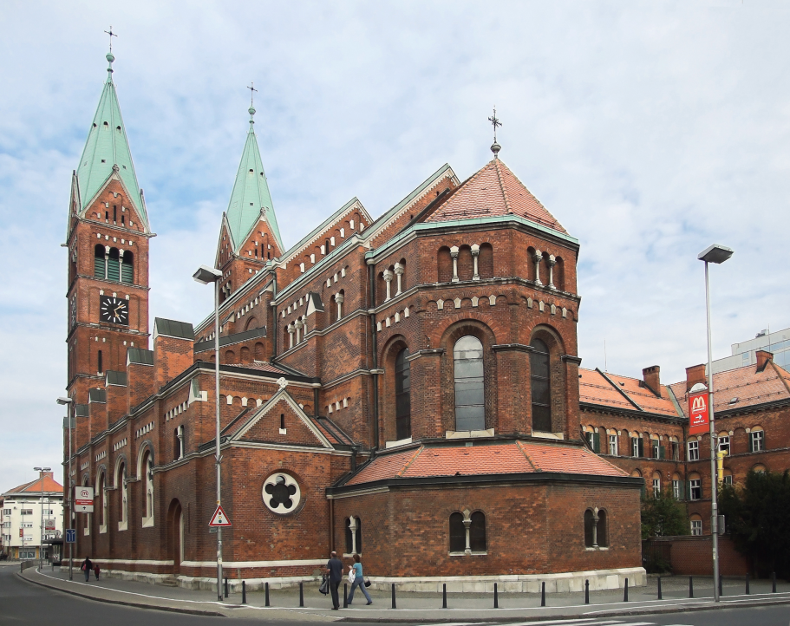
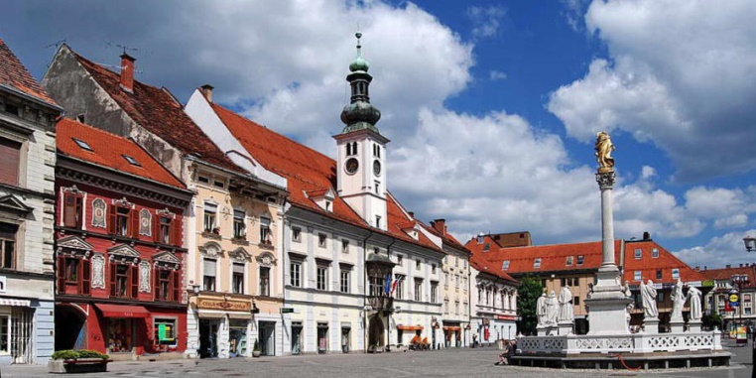
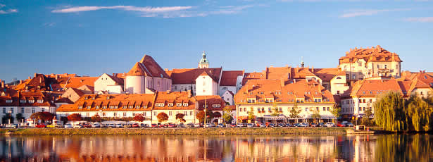
MARIBOR
Is the capital of Štajerska.
It has 112088 inhabitants.

Slide 17
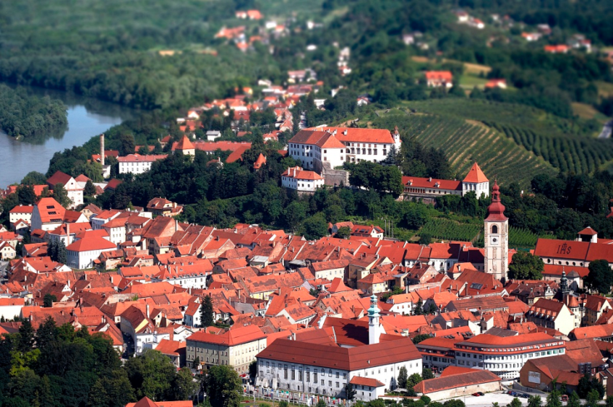
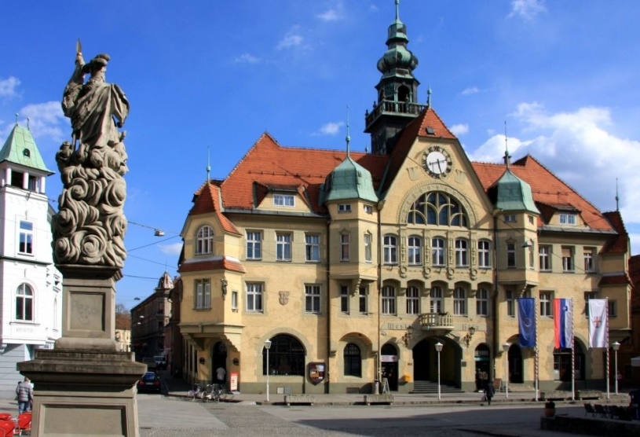
PTUJ
Is one of the oldest towns in Slovenia
It was populated already in yung stone age.
Ptuj has 17972 inhabitants.

Slide 18
