Slide 1
Priest Jan Twardowski’s
Gymnasium
in Rozogi
School in Klon

Slide 2
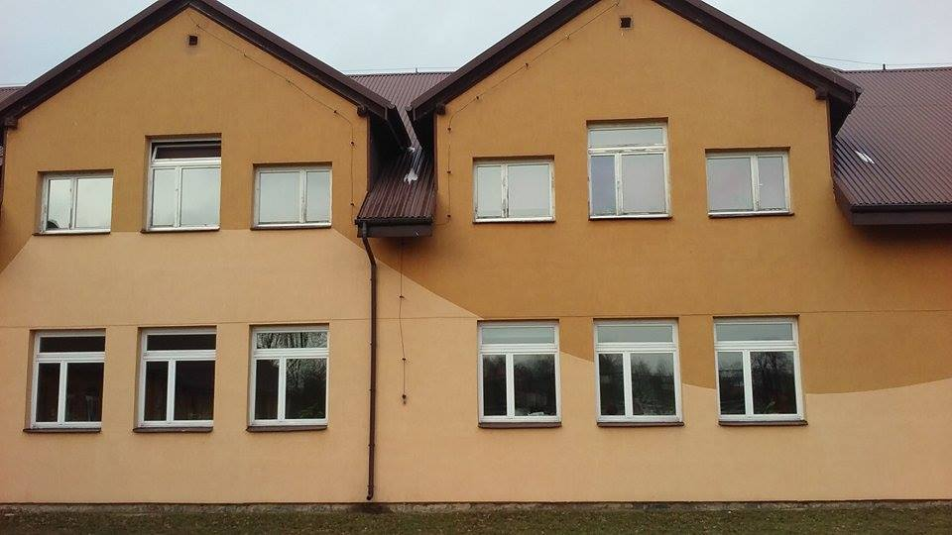

Slide 3
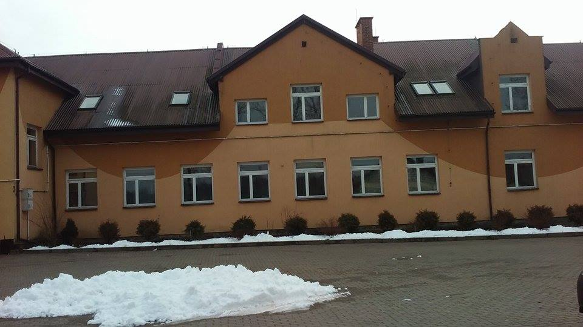

Slide 4
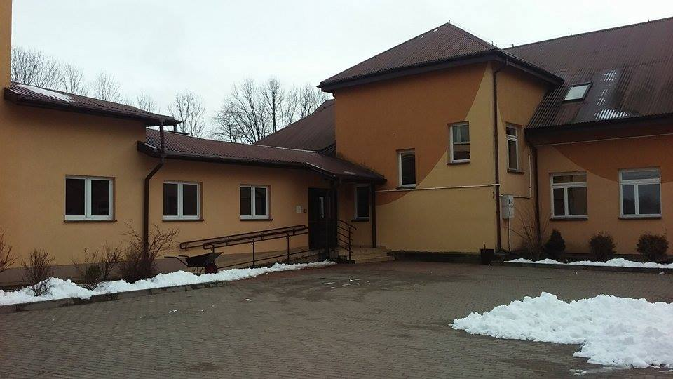

Slide 5
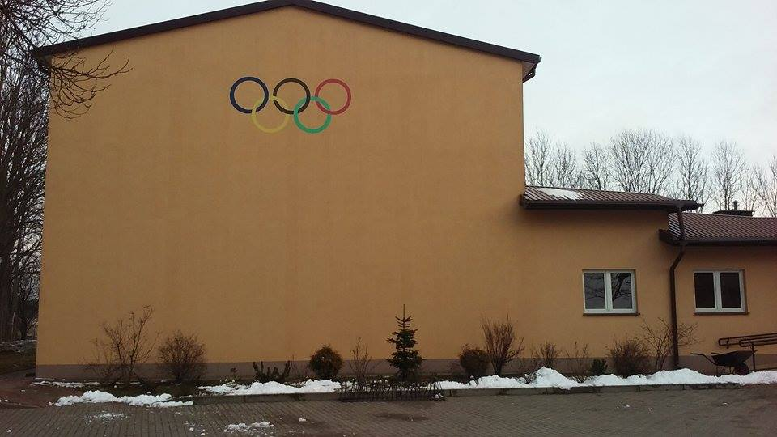

Slide 6
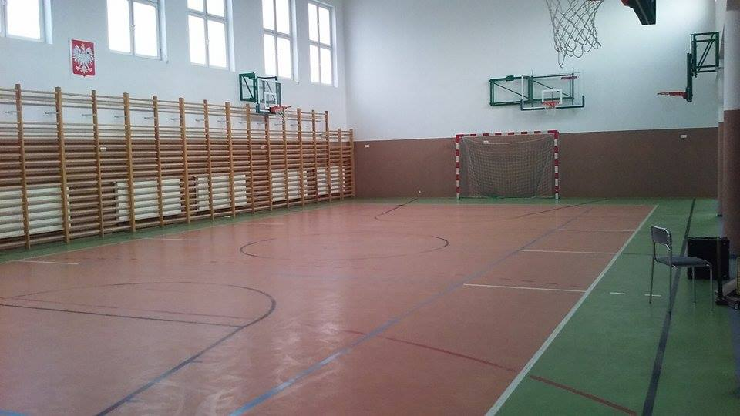
Our gym

Slide 7
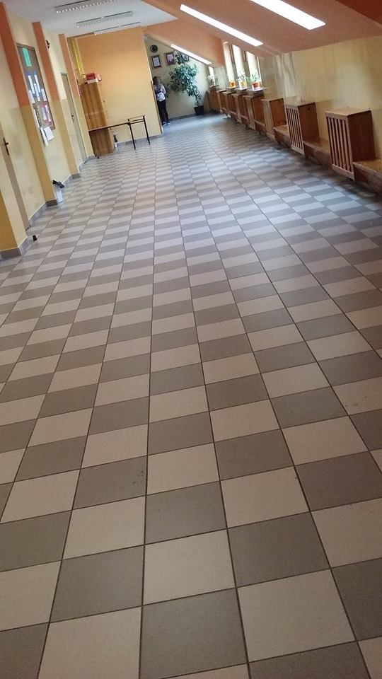
The hall

Slide 8
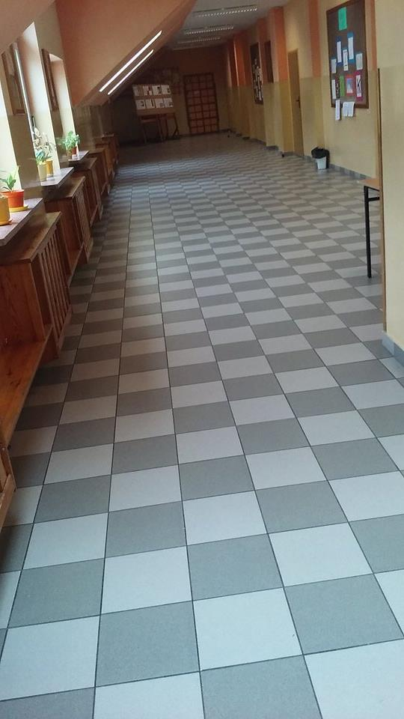

Slide 9
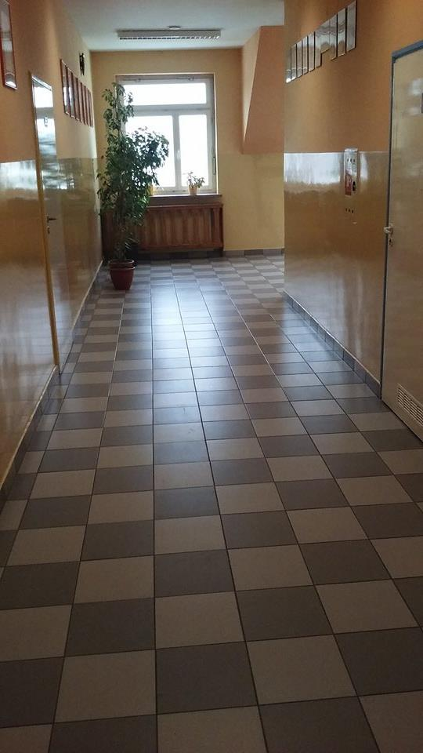

Slide 10
Priest Jan Twardowski
Jan Twardowski was born on June 1, 1915 in Warsaw, Congress Poland. His parents were Jan Twardowski and Aniela Maria Konderska.
Several weeks after his birth, due to the events of World War I, his family moved to Russia.
After 3 years, they returned to Warsaw. He finished middle school in 1935. In 1932 he began working with the youth newspaper "Kuźnia Młodych" ("Forge of the Young"). He had his own column there, for which he wrote poems, short stories, and interviewed various writers.
After middle school, he began studying literature at the Józef Piłsudski University (University of Warsaw). In 1937 he published his first book of poetry.
During World War II he took part in various operations organised by the Armia Krajowa and fought in theWarsaw Uprising.
After the war, he joined a seminary and began studying theology at the Warsaw University. He became a priest in 1948.

Slide 11
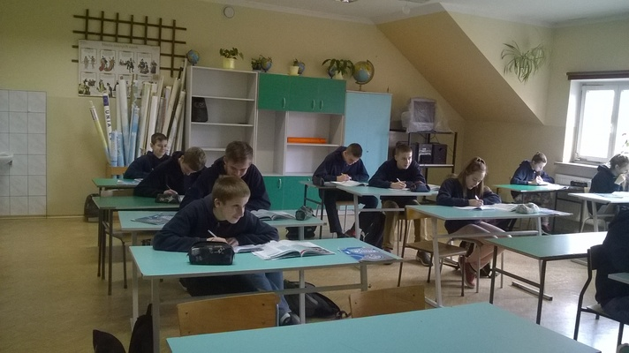
Our class

Slide 12
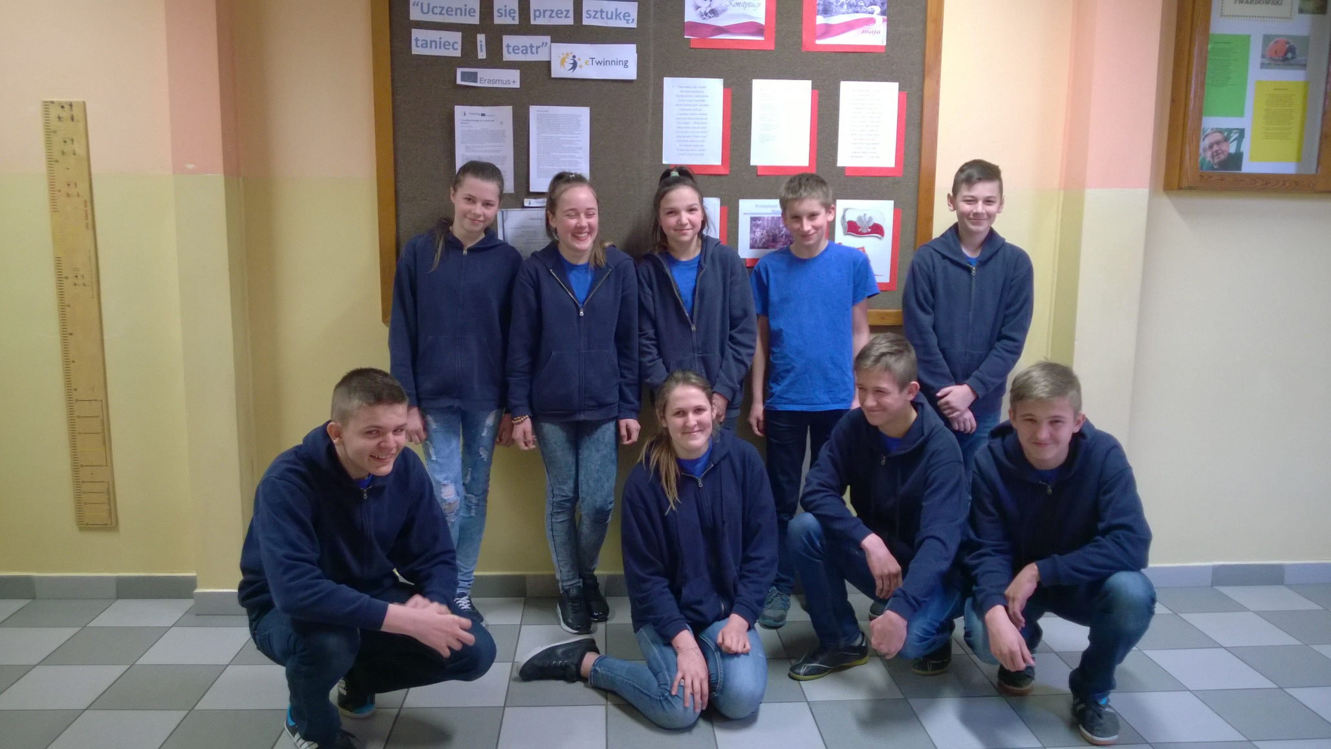
And this is our group

