Slide 1
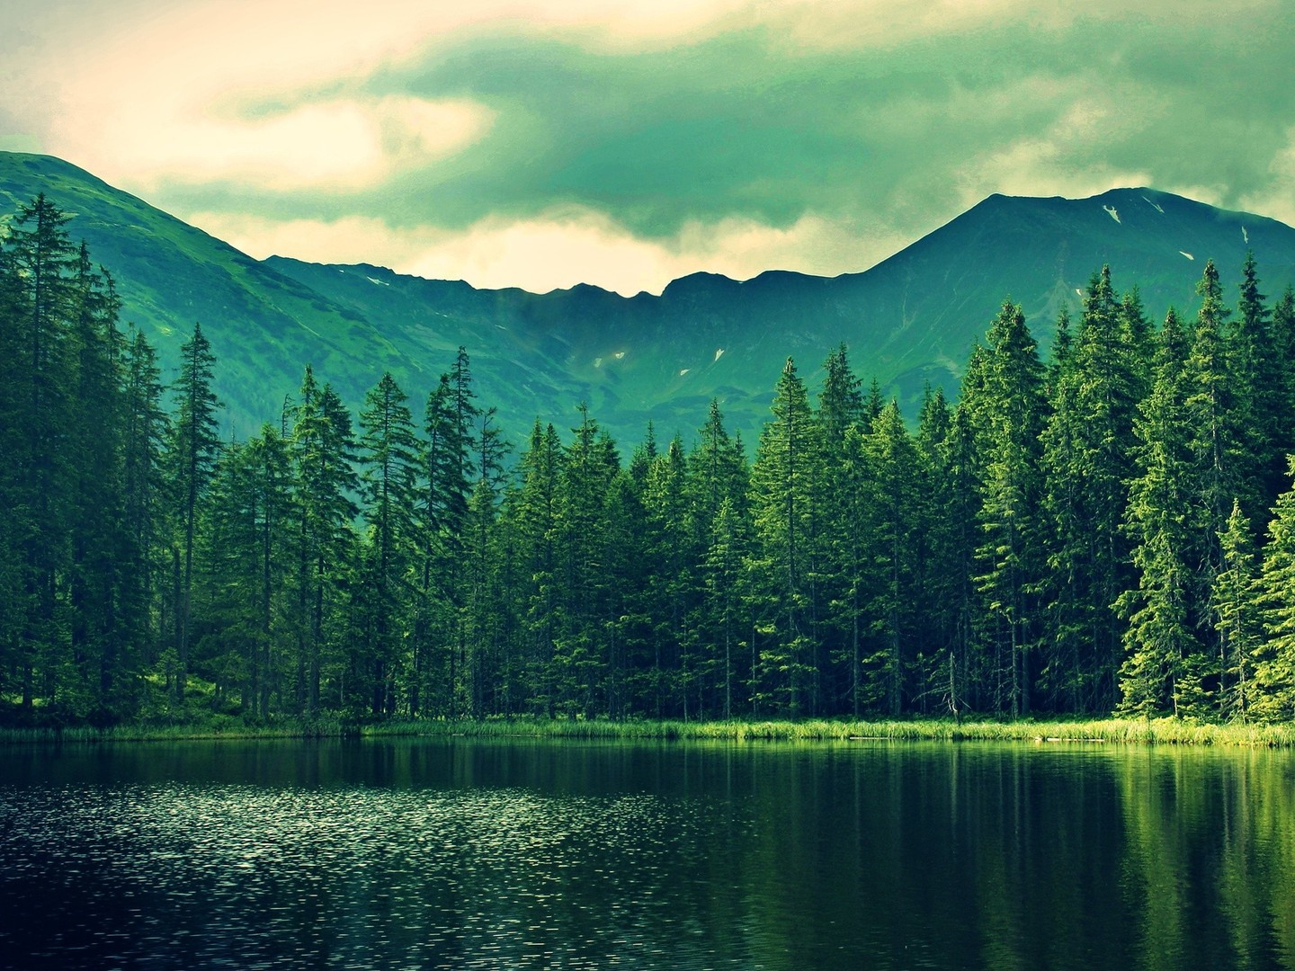
Our forests – Our future.
Made by Vytautas Bakanas

Slide 2
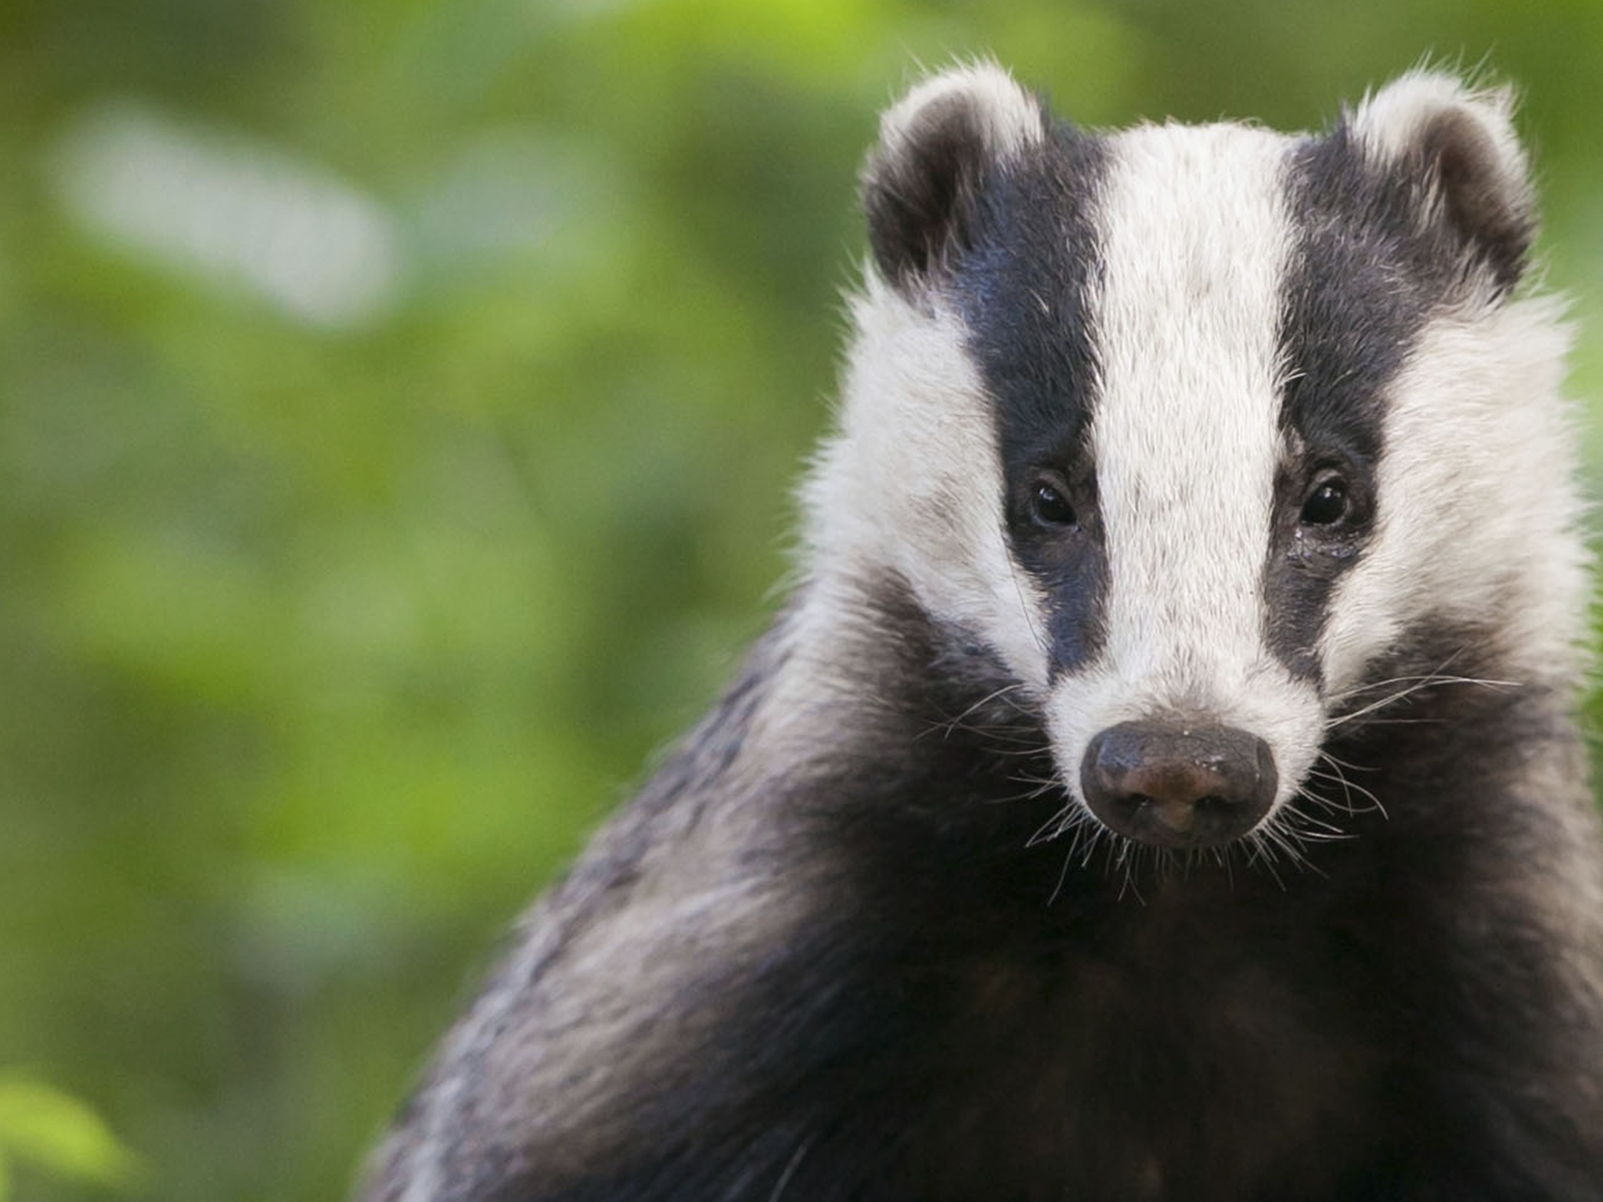
Eurasian Badger
The large underground catacombs in which they live are called "setts". Badgers inherit these setts from their parents, who inherited them from theirs and so forth. It is believed that some setts are actually centuries old.

Slide 3
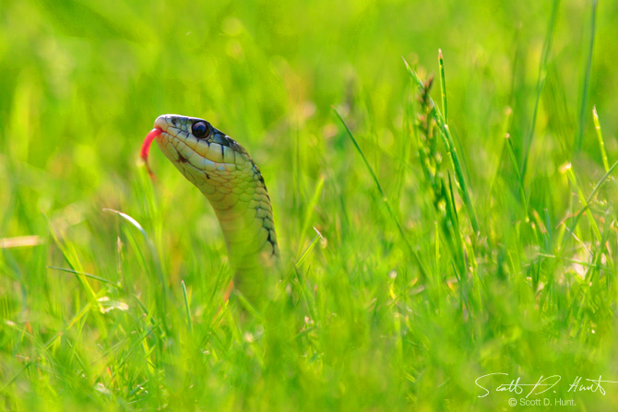
GRASS-SNAKE
This is a very important snake. Back in a day lithuanian people believed that this non-poisonous snake is a spirit of dead ancestors who bravely fought in war for their country. It also represents health and wealth and it was considered to be a great honour if this snake lived in someones house.

Slide 4
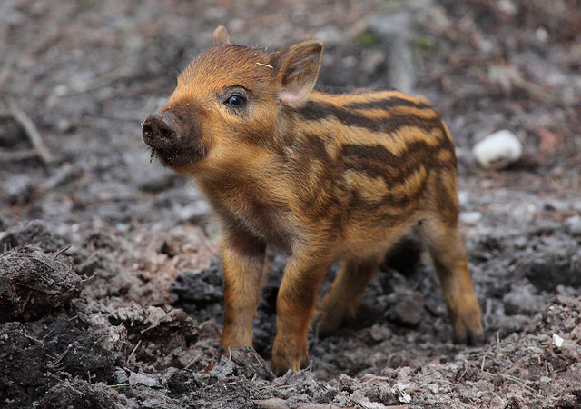
Wild Boar
The Wild Boar is the ancestor of the domestic pig. Its weight can reach up to 300 kilograms!

Slide 5
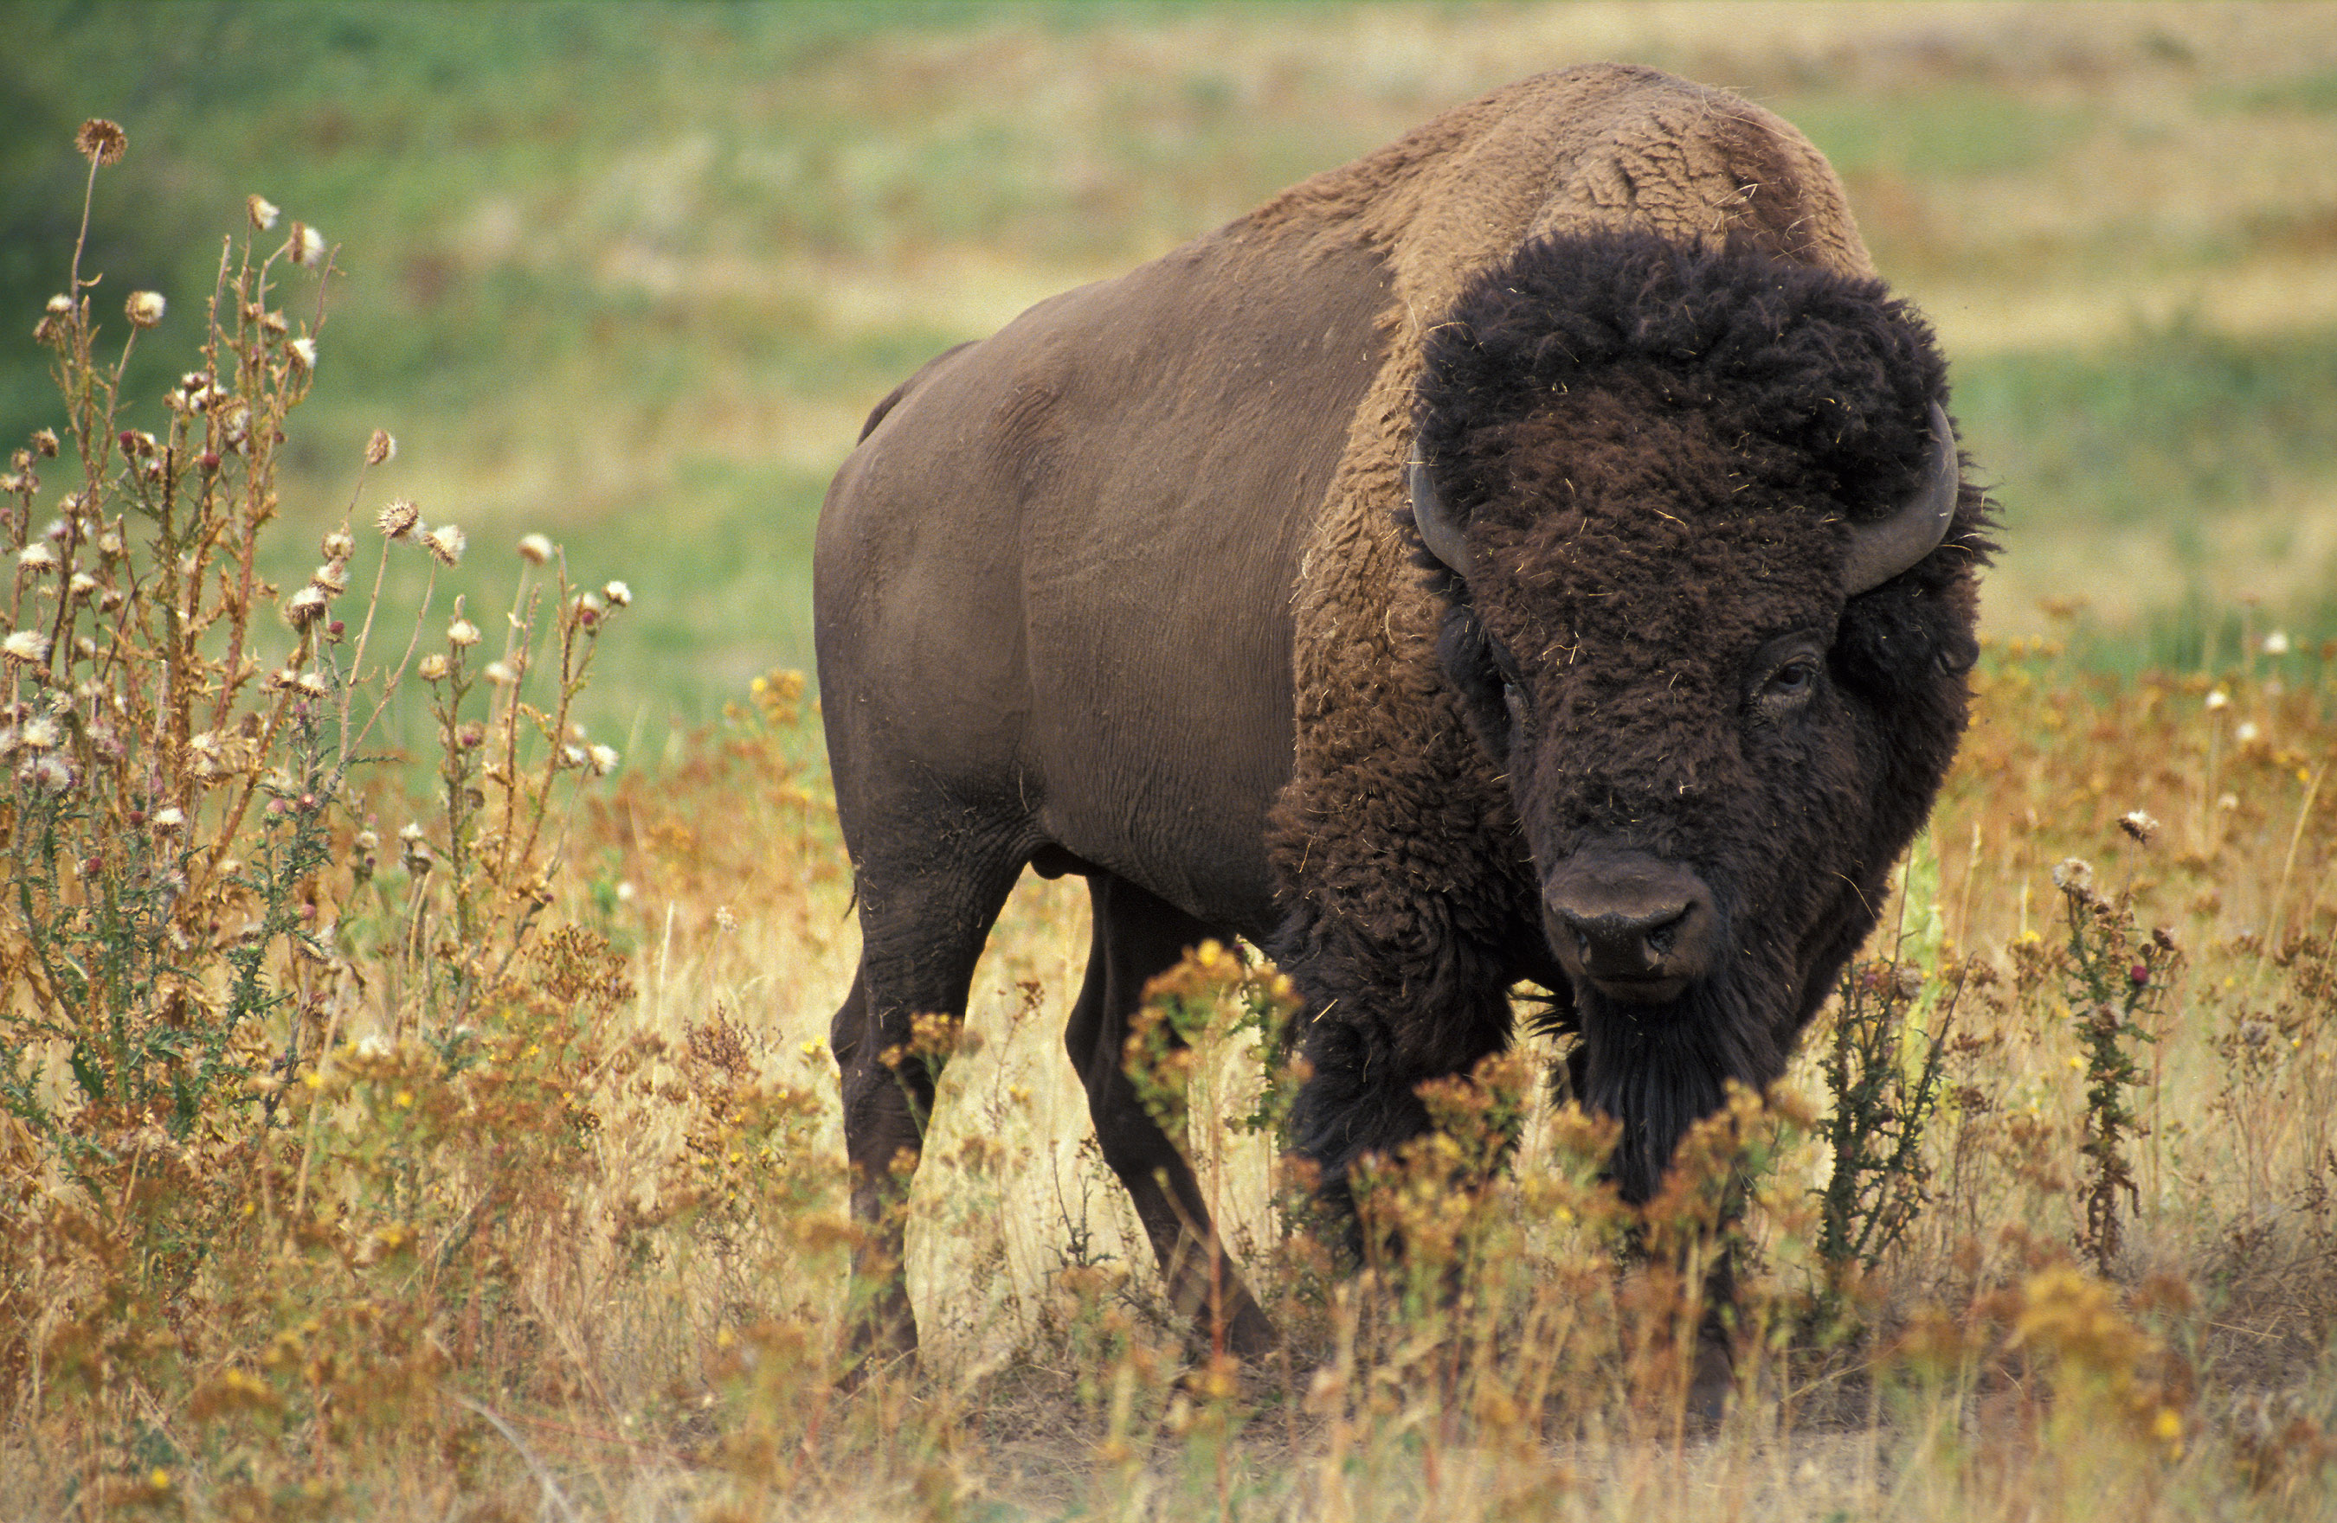
For many years the European Bison was known to roam throughout the southeastern, central, and western regions of Europe. Unfortunately, due to advances in agriculture and hunters this animal went extinct. Today this rare animal only can be found in Russia, Ukraine, Belarus, Poland and Lithuania.
EUROPEAN BISON

Slide 6
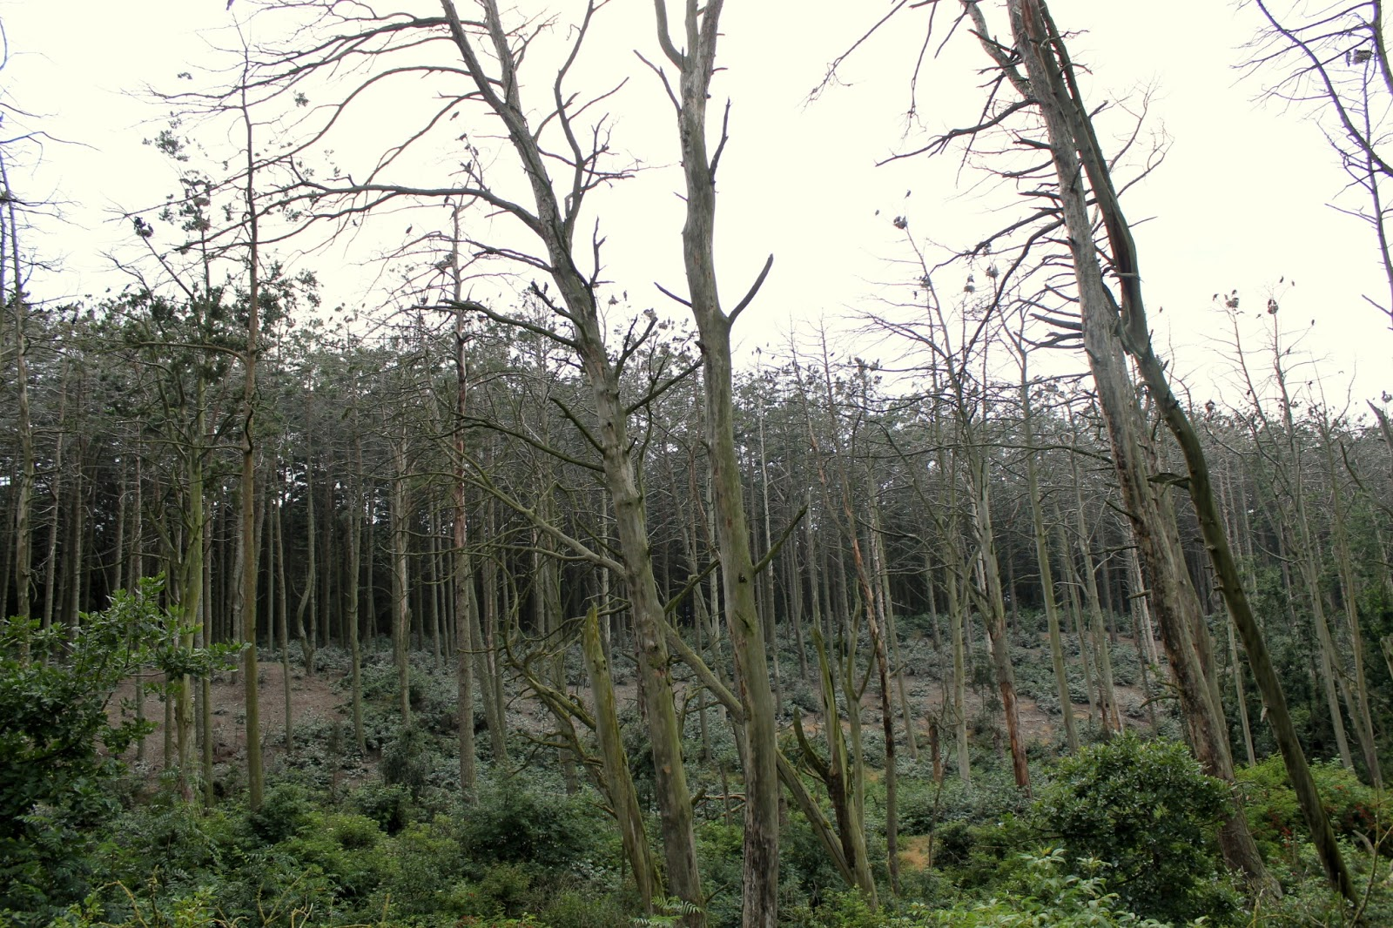
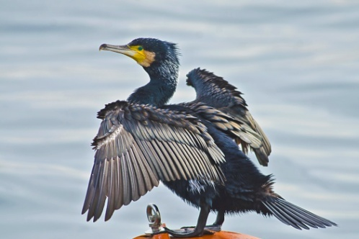
GREAT CORMORANTS
This is how it looks like.
These bird don’t actually live in Lithuania. But they come here in March-April to lay eggs. They leave forests damaged by their dropings.

Slide 7
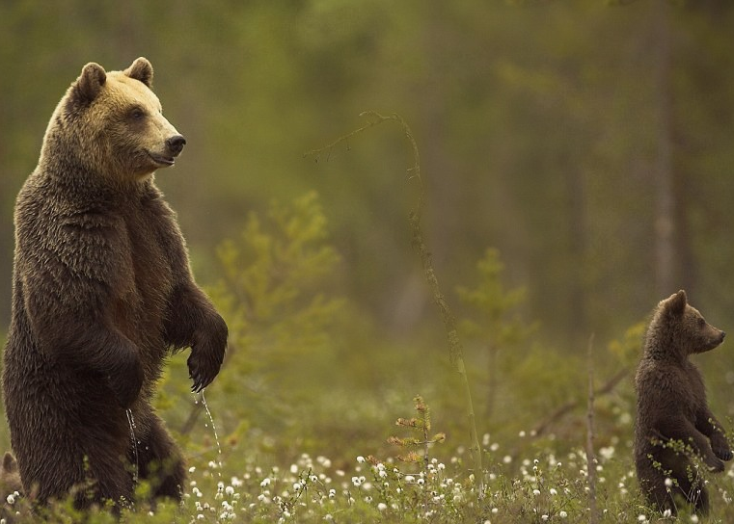
Brown Bear
The everybodys well known brown bear's range includes parts of Russia, India, China, Canada, the United States, Scandinavia. It is the largest predator in Europe and is recognized as a national and state animal in several European countries. In 16'th century this bear became a symbol for Soviet Union, on occasion it was used to imply that it is "big, brutal and clumsy".

Slide 8
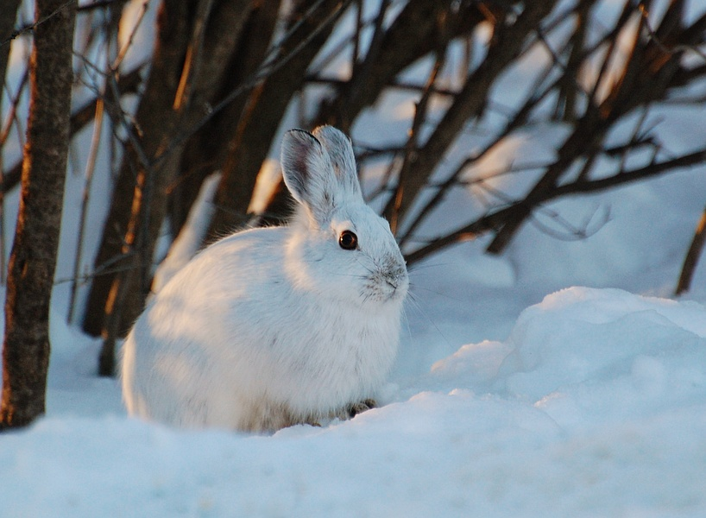
HARE
This animal started the tradition of the Easter bunny. In 13‘th century german kids would go to the forest and look for hare’s eggs. Later on this egg-giving idea was picked by US in 18‘th century and the „Easter bunny“ tradition was born.

Slide 9
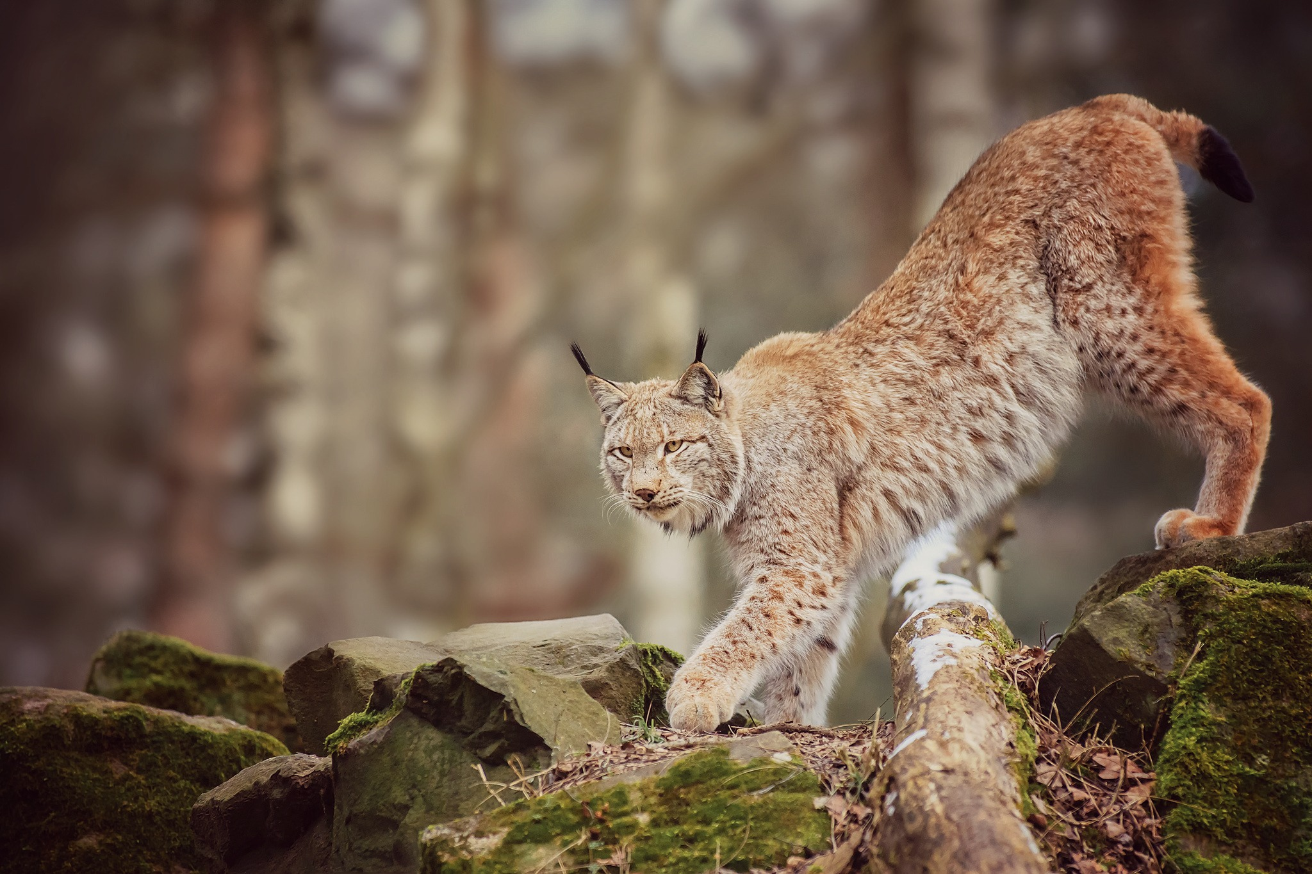
Eurasian Lynx
The Eurasian Lynx is the third largest predator in Europe after the brown bear and the grey wolf. It eats about 1 kg of meat every day. During the summer, the Eurasian lynx has short, reddish or brown coat which is replaced by a silver-grey to brown coat during winter.

Slide 10
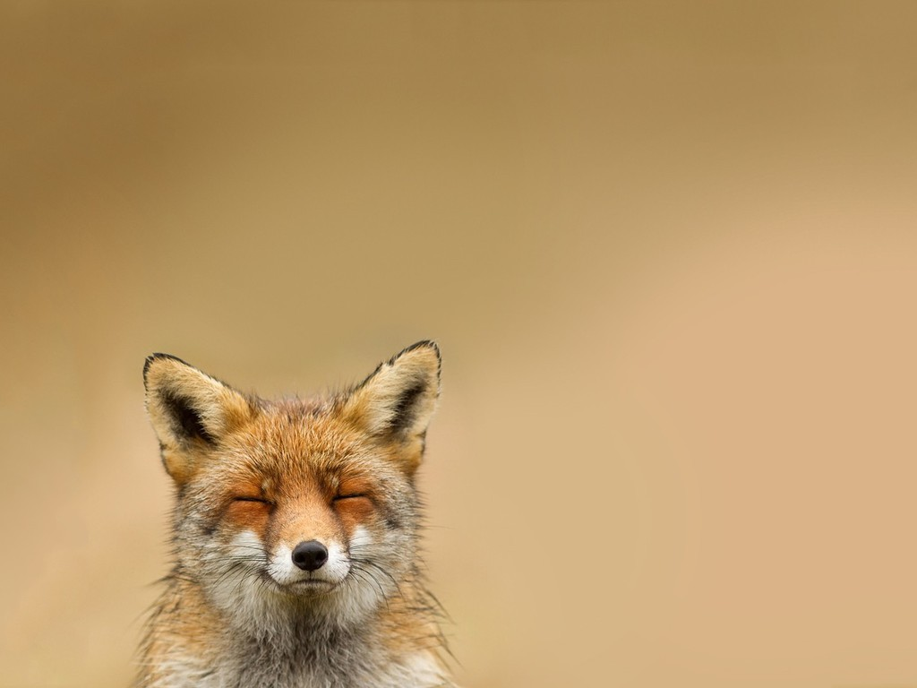
Fox
In fairy tales and media foxes are portrayed as smart animals. I think they definitely earned that title. Foxes are brave and quick to adapt to the enviroment. They even started leaving their natural habitat so they could get some easy food in the streets.

Slide 11
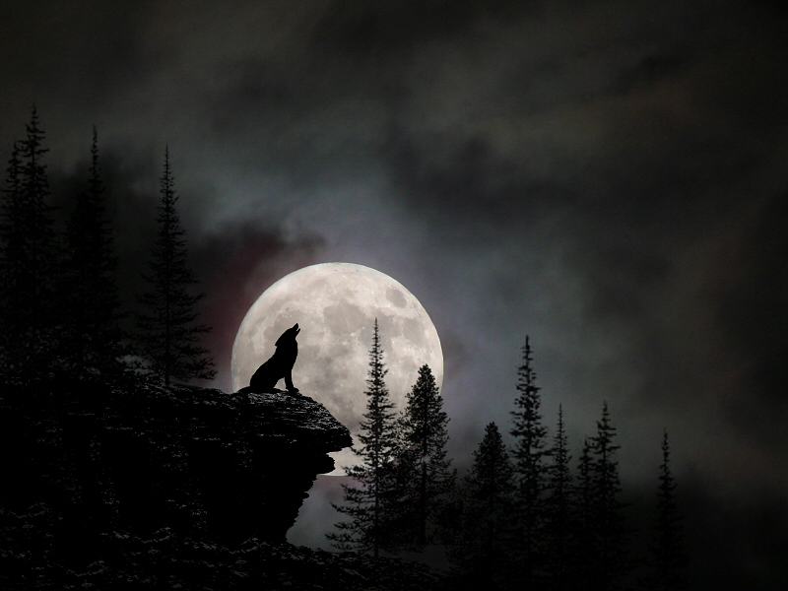
Grey Wolf
In the Baltic states until the middleages woolves were considered to be kind and were treated with respect. But christianity brought a negative view on them. This religion portrayed it as a sinfull and dangerous animal. Some people thought that wolves were actually humans obsessed by demons and started hunting them. Thats how legends about warewolves were created.

Slide 12
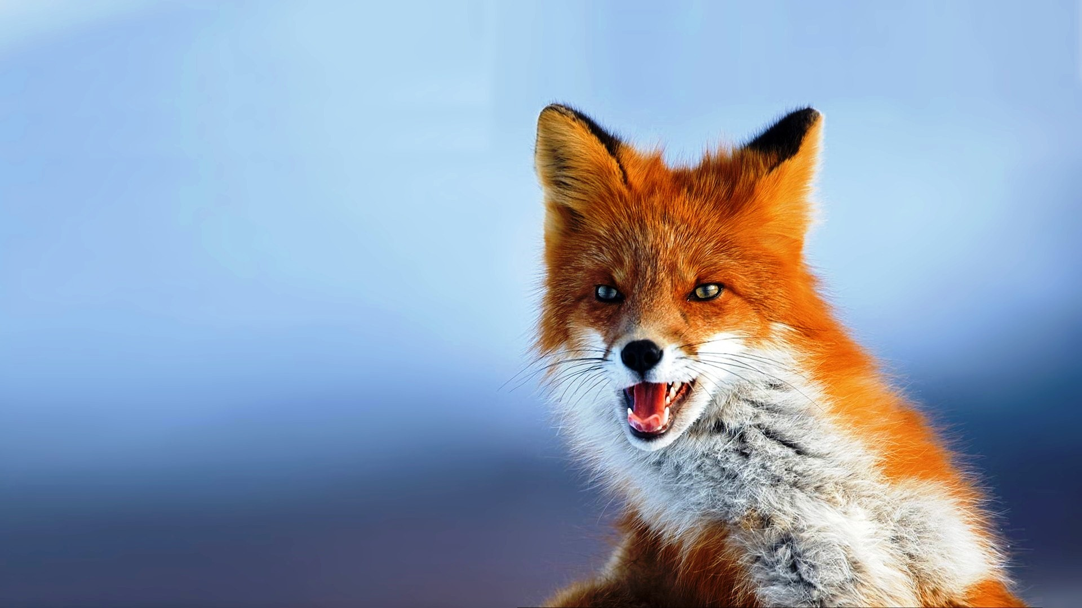
Thanks for you attention!

