Slide 1
Kazluų Rūdos Pagrindinė mokykla. About lithuania‘s forests.
By Almantas Paplauskas 7a.

Slide 2
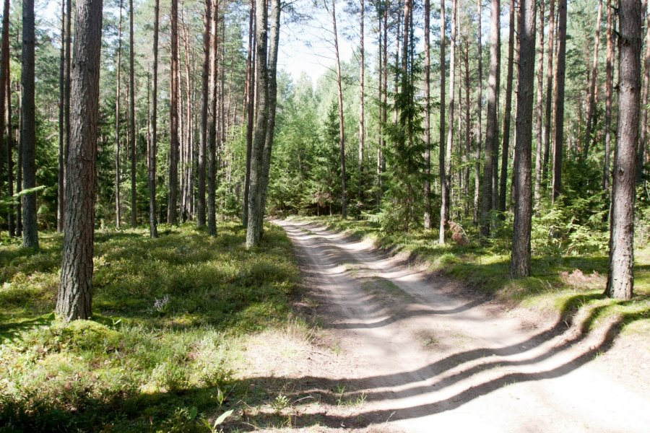
How much space does it take up?
As you may know we have alot of forests. For example Lithuania‘s forest‘s take up about 33,3% of our land.

Slide 3
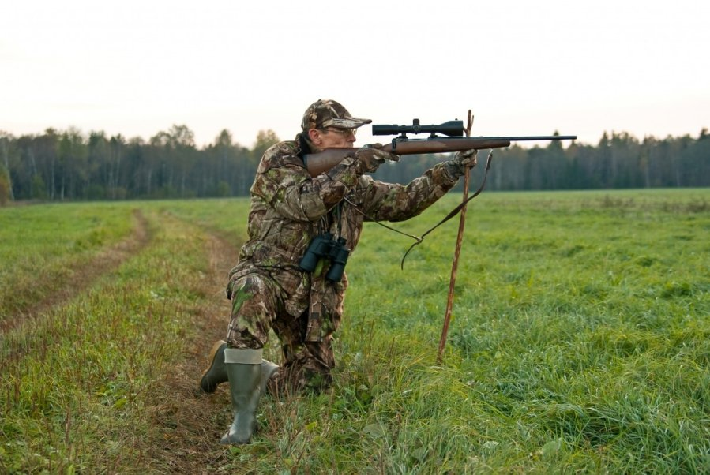
Now about the people making profit because of forest’s
People do these kinds of things to make money:
Hunting
Collecting mushrooms, berries.
Chopping trees
And so on.

Slide 4
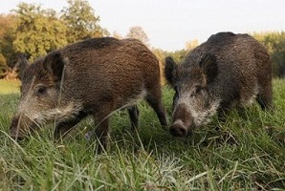
About hunting in lithuania
In Lithuania a lot of wild boars gets killed each year. Wolves, deers get killed a lot too.

Slide 5
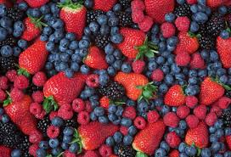
Collecting berries, mushrooms
A lot of people from countries collect berries, mushrooms to make some easy money. They collect all kinds of mushrooms, berries. Then they sell it at markets.

Slide 6
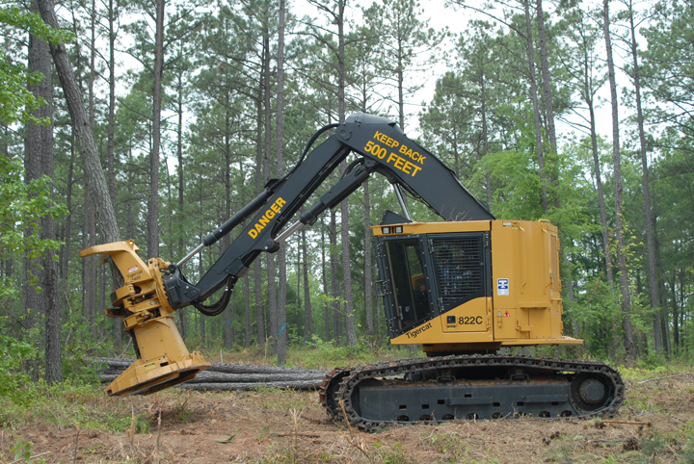
Chopping trees.
A lot of tree’s gets cut down every month for money ofcourse. The main thing that we sell is wood in Lithuania. People use chainsaw’s, axe’s and all that other stuff.

Slide 7
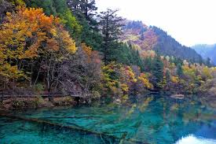
A couple of questions for you
What do you think about people cutting down trees?
What limit should be for cutting down trees?

Slide 8
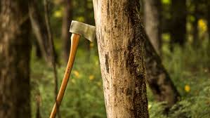
My opinion about cutting down tree’s
I think there will be a shortage of trees in the near future because a massive amount of tree’s gets chopped down. I want people to think before they hit it with an axe.

Slide 9
Lithuania’s Famous tree’s
Their names in Lithuanian language:
Lampėdžių liepa gražuolė
Sandariškių ąžuolas
Aukštadvario kaštonas
Raganų eglė
Rumšiškių miško pušis
Liepa motinėlė
Mingėlos ąžuolas
Storasis ąžuolas
Raganos uosis
Senoji kriaušė

Slide 10
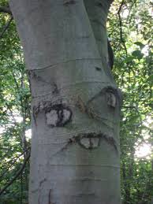
Thanks for you’re your attention
I hope you liked these slides. Think about the trees.

