Slide 1
trees in festivals of Lithuania

Slide 2
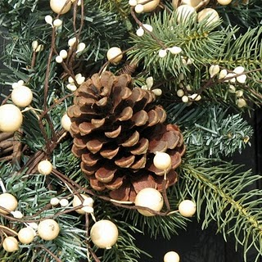
Christmas and New year Kalėdos ir Naujieji metai

Slide 3
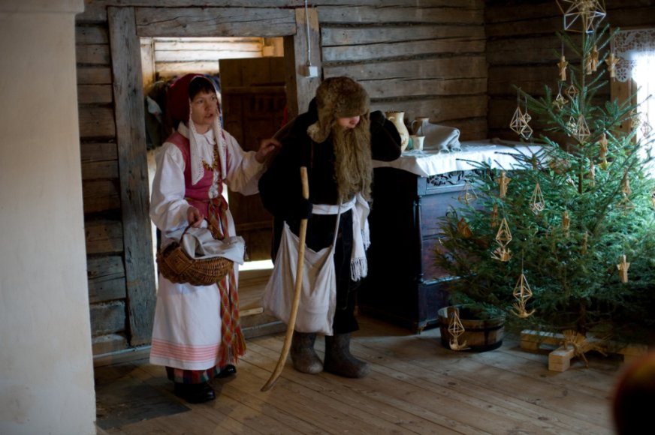
Christmas

Slide 4
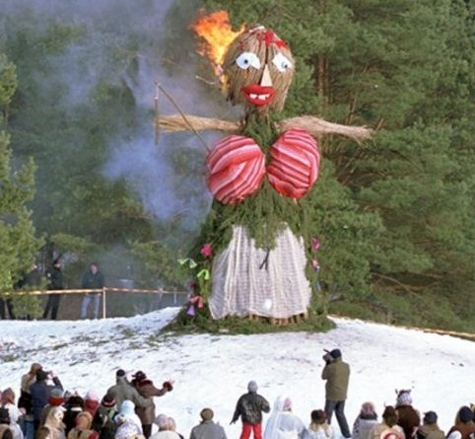
Pancake Day (Shrove Tuesday) Užgavėnės

Slide 5
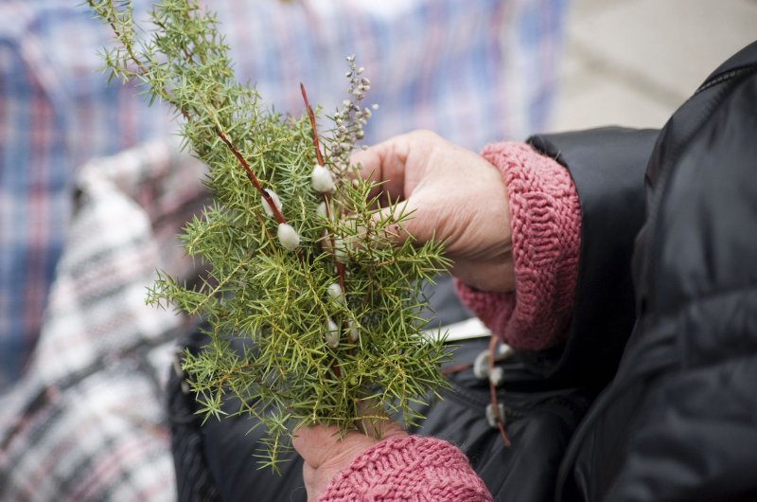
Palm Sunday Verbų sekmadienis

Slide 6
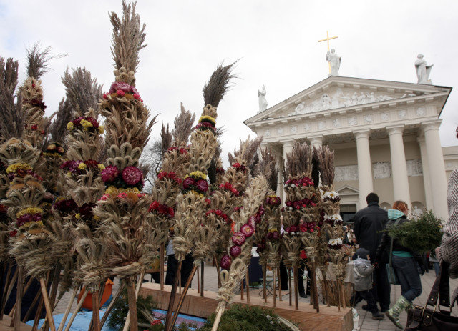
Palm Sunday

Slide 7
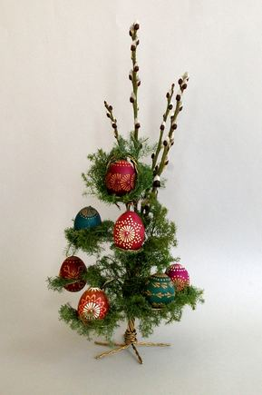
Easter Velykos

Slide 8
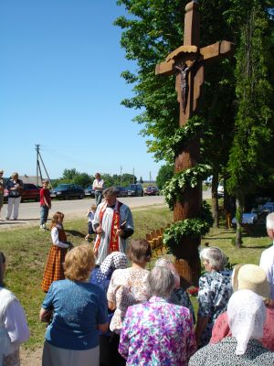
Ascension Thursday Šeštinės

Slide 9
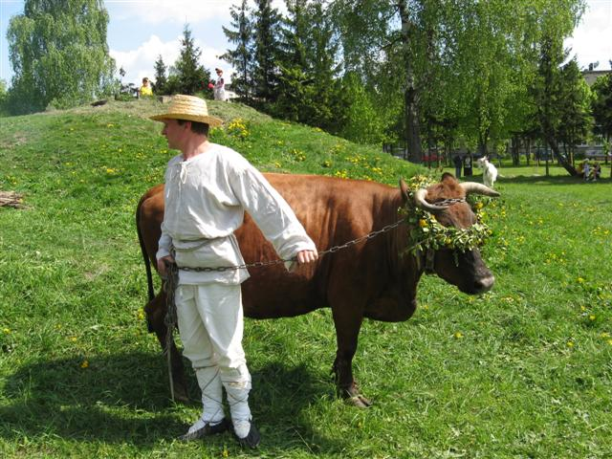
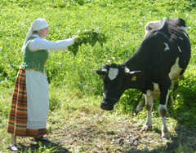
Pentecost Sekminės

Slide 10
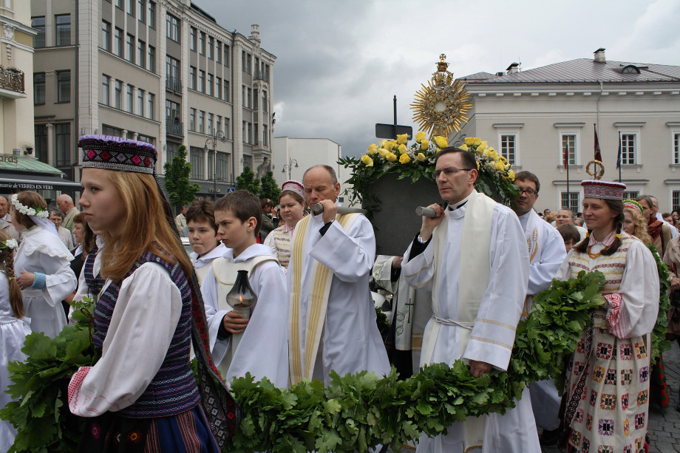
Feast of Corpus Christi Devintinės

Slide 11
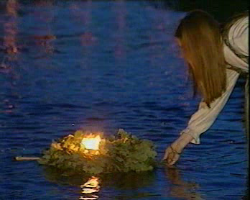
Saint Jonas' Festival (Midsummer Day or st.john’s day) Joninės

Slide 12
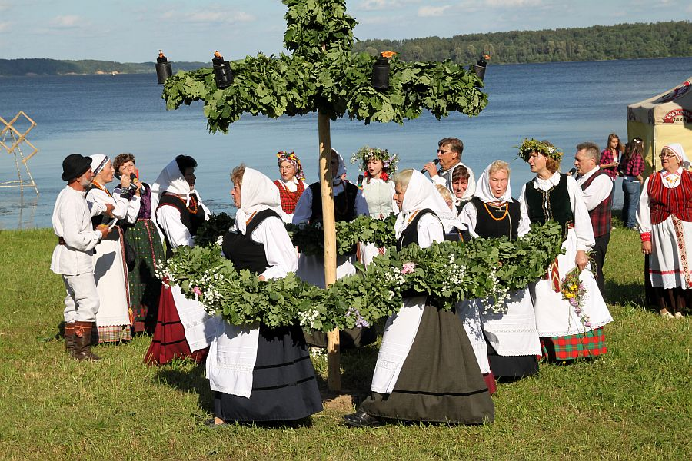

Slide 13
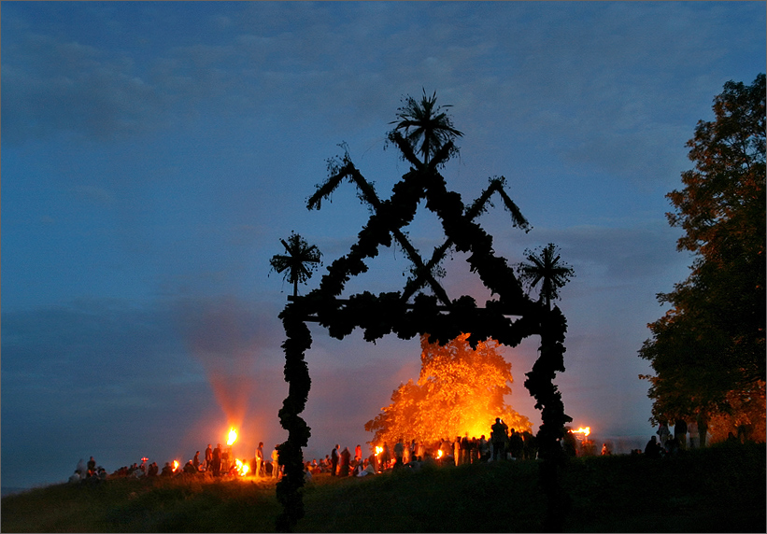

Slide 14
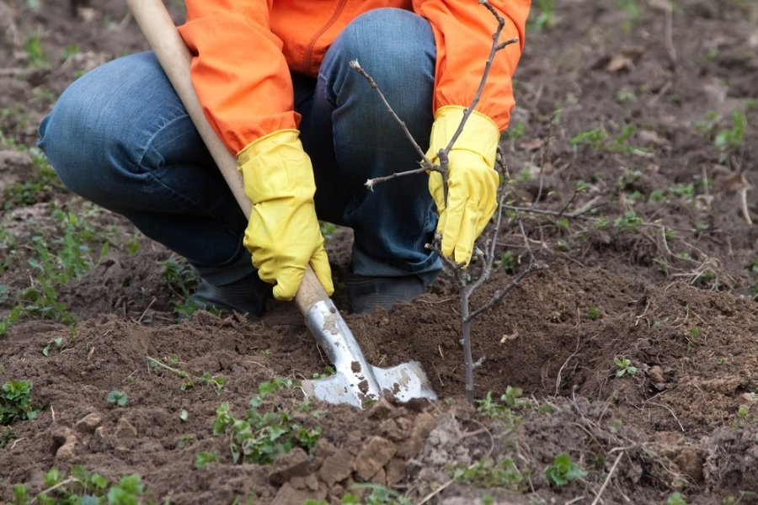
Family traditions
After the birth of a boy, parents had to plant an oak or a maple.
After the birth of a girl, parents had to plant a lime.
It was forbidden to cut that tree as it could cause the death.

Slide 15
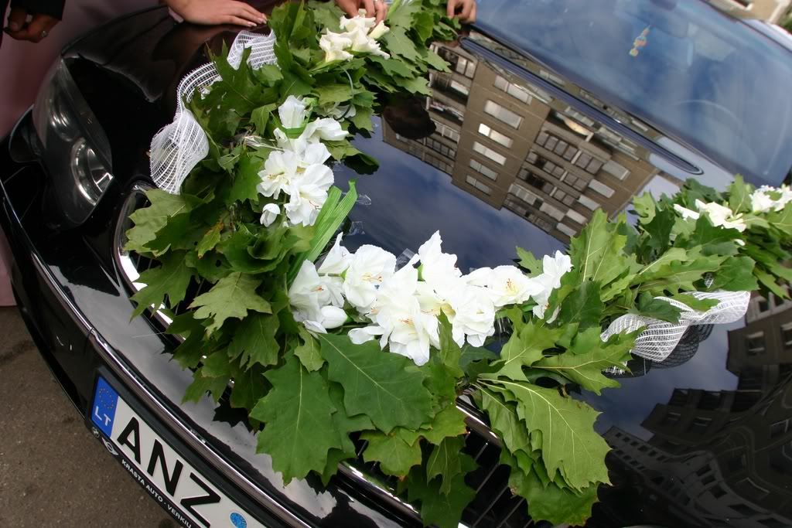
Wedding

Slide 16
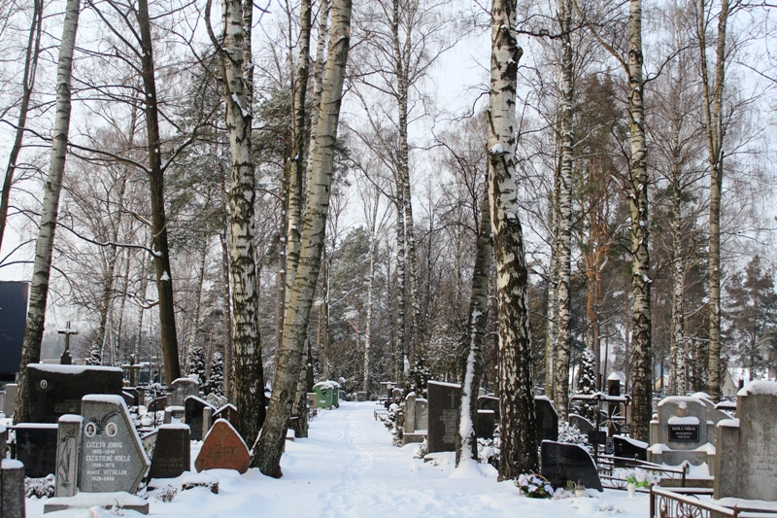
Funeral

Slide 17
respect to a tree
Small children were taught not to cut or break trees, not to kill animals or birds.
People believed that our nature feels like a human.

