Slide 1
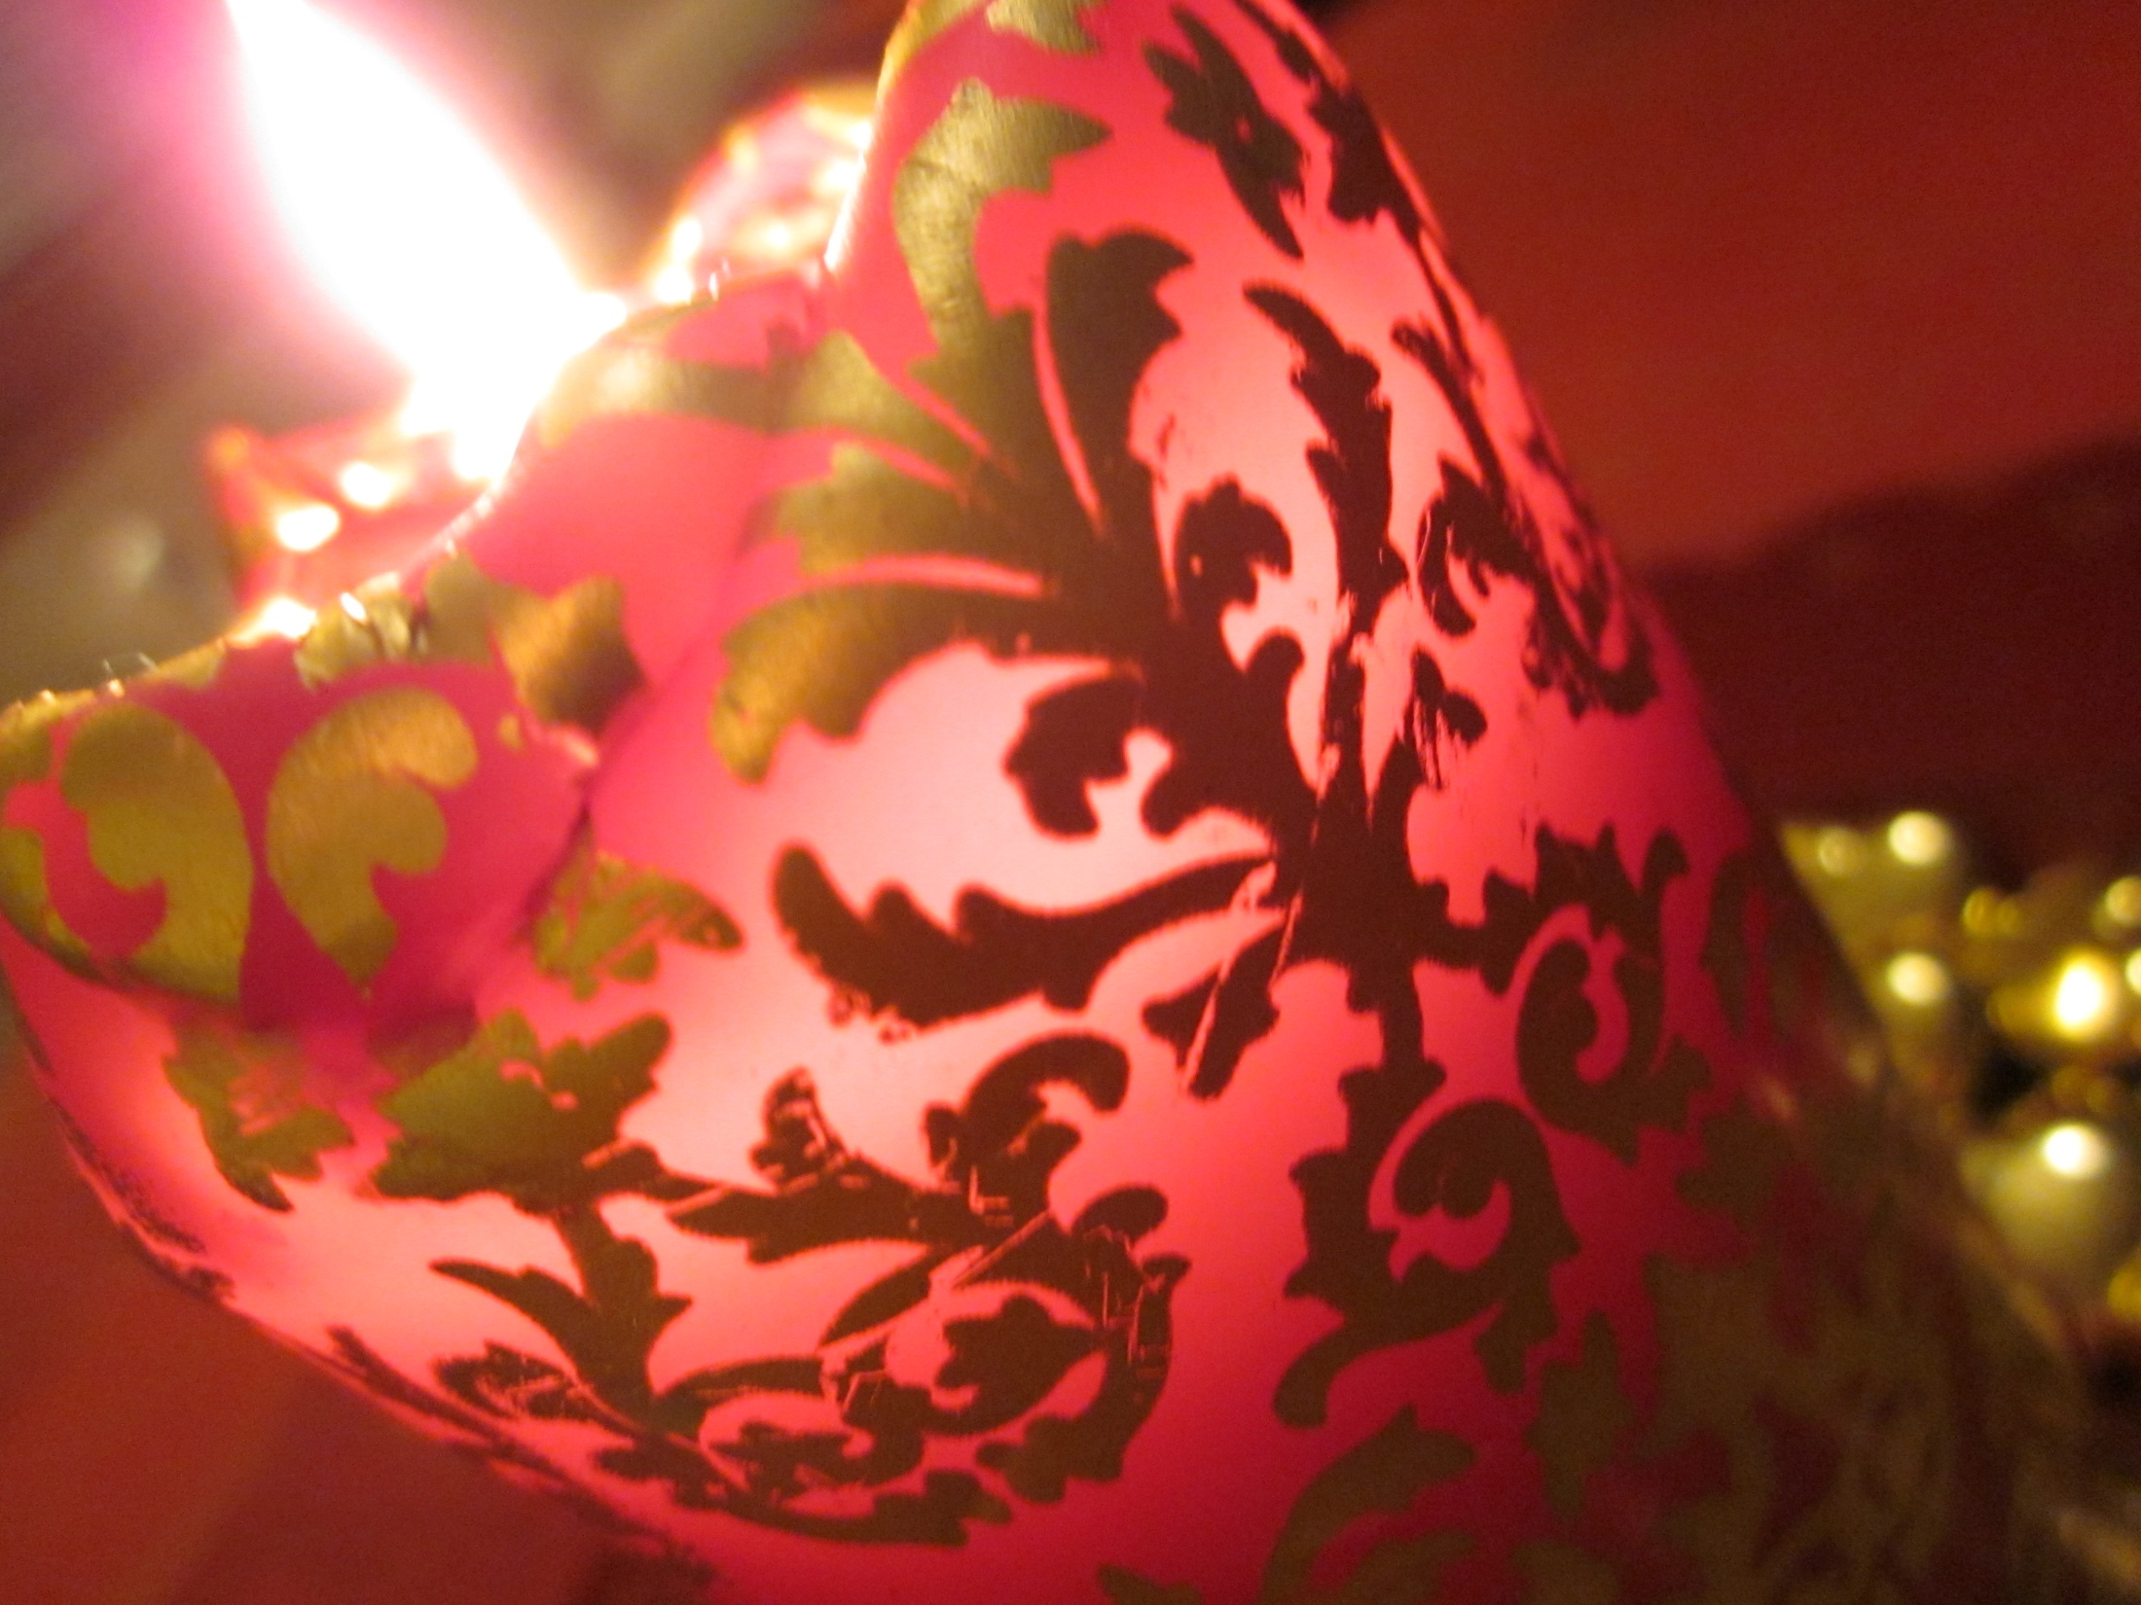
Finnish Christmas

Slide 2
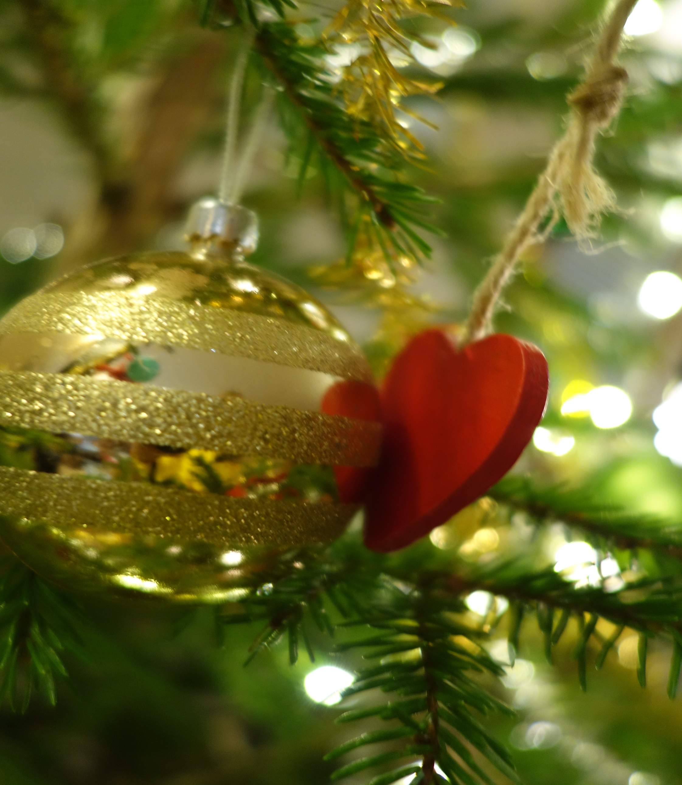
Preparations
Cleaning
Getting the presents
Putting up the christmas calendars
Making food
Advent candles on 4 Sundays before Christmas
In 2014 Finns sent 37million Christmas cards
Decorating the house

Slide 3
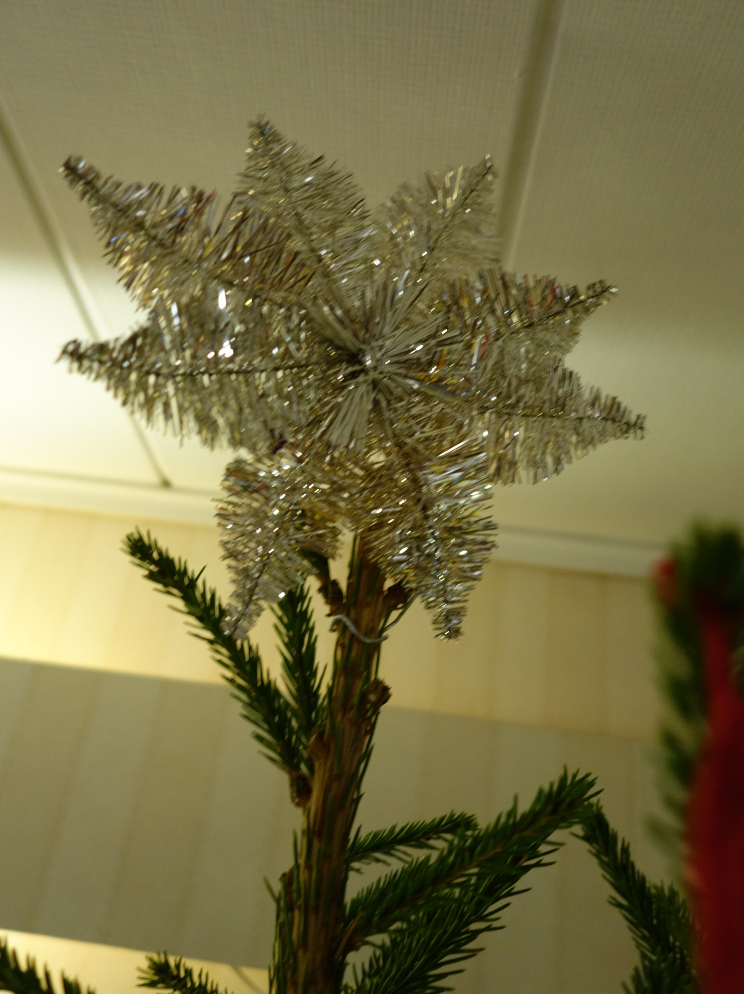
Decorations
Lights
Christmas tableclothes
Flowers: tulips, amaryllis, poinsettia, hyacinth
Wreath
Most important: the Christmas tree

Slide 4
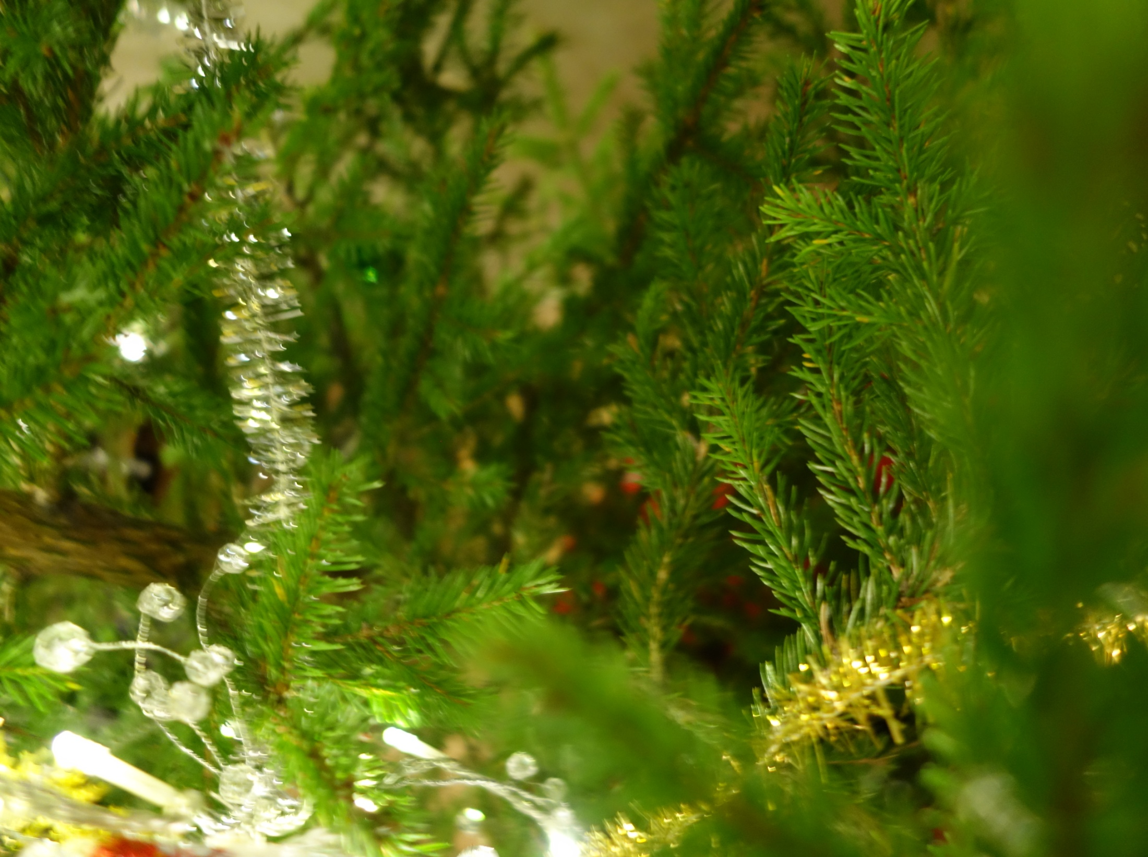
Christmas tree
We bring the tree in a couple of days before Christmas Eve
Decorations:
Ribbons
Balls
Angels
Lights
Star

Slide 5
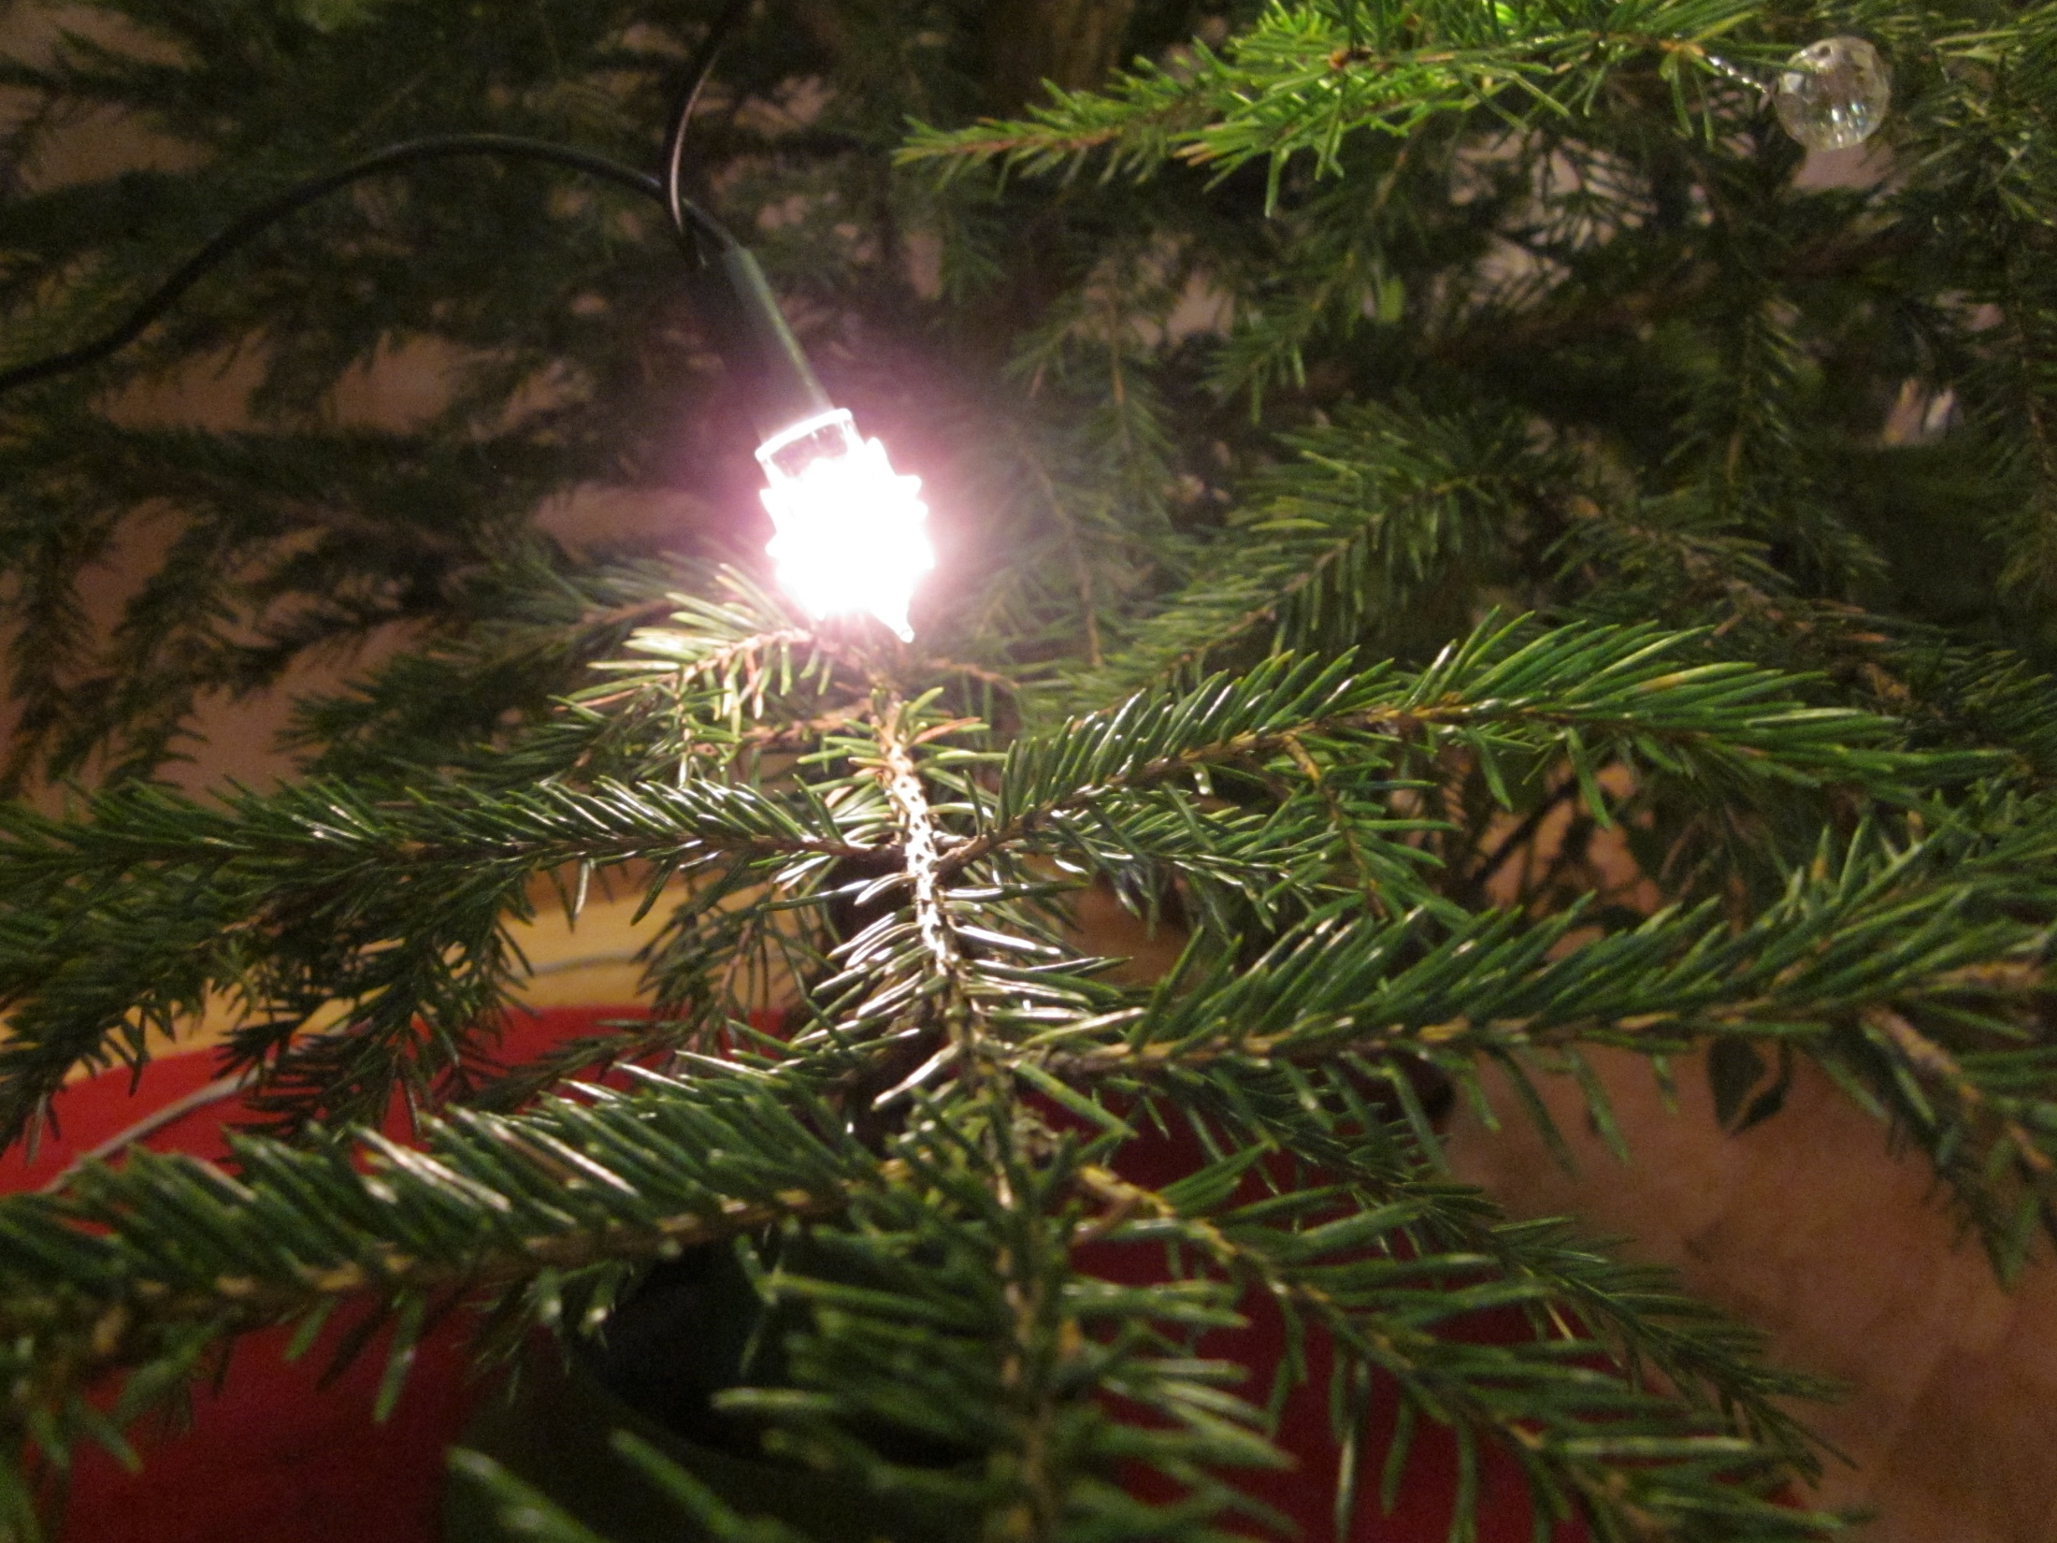
History of the Christmas tree
The Christmas tree comes from the 1500's Germany.
Trees were initially small and they were hung up on the ceiling or were held on the tables.
The decorating began in the early 1600’s and people begun to use candles in the late 1600’s.

Slide 6
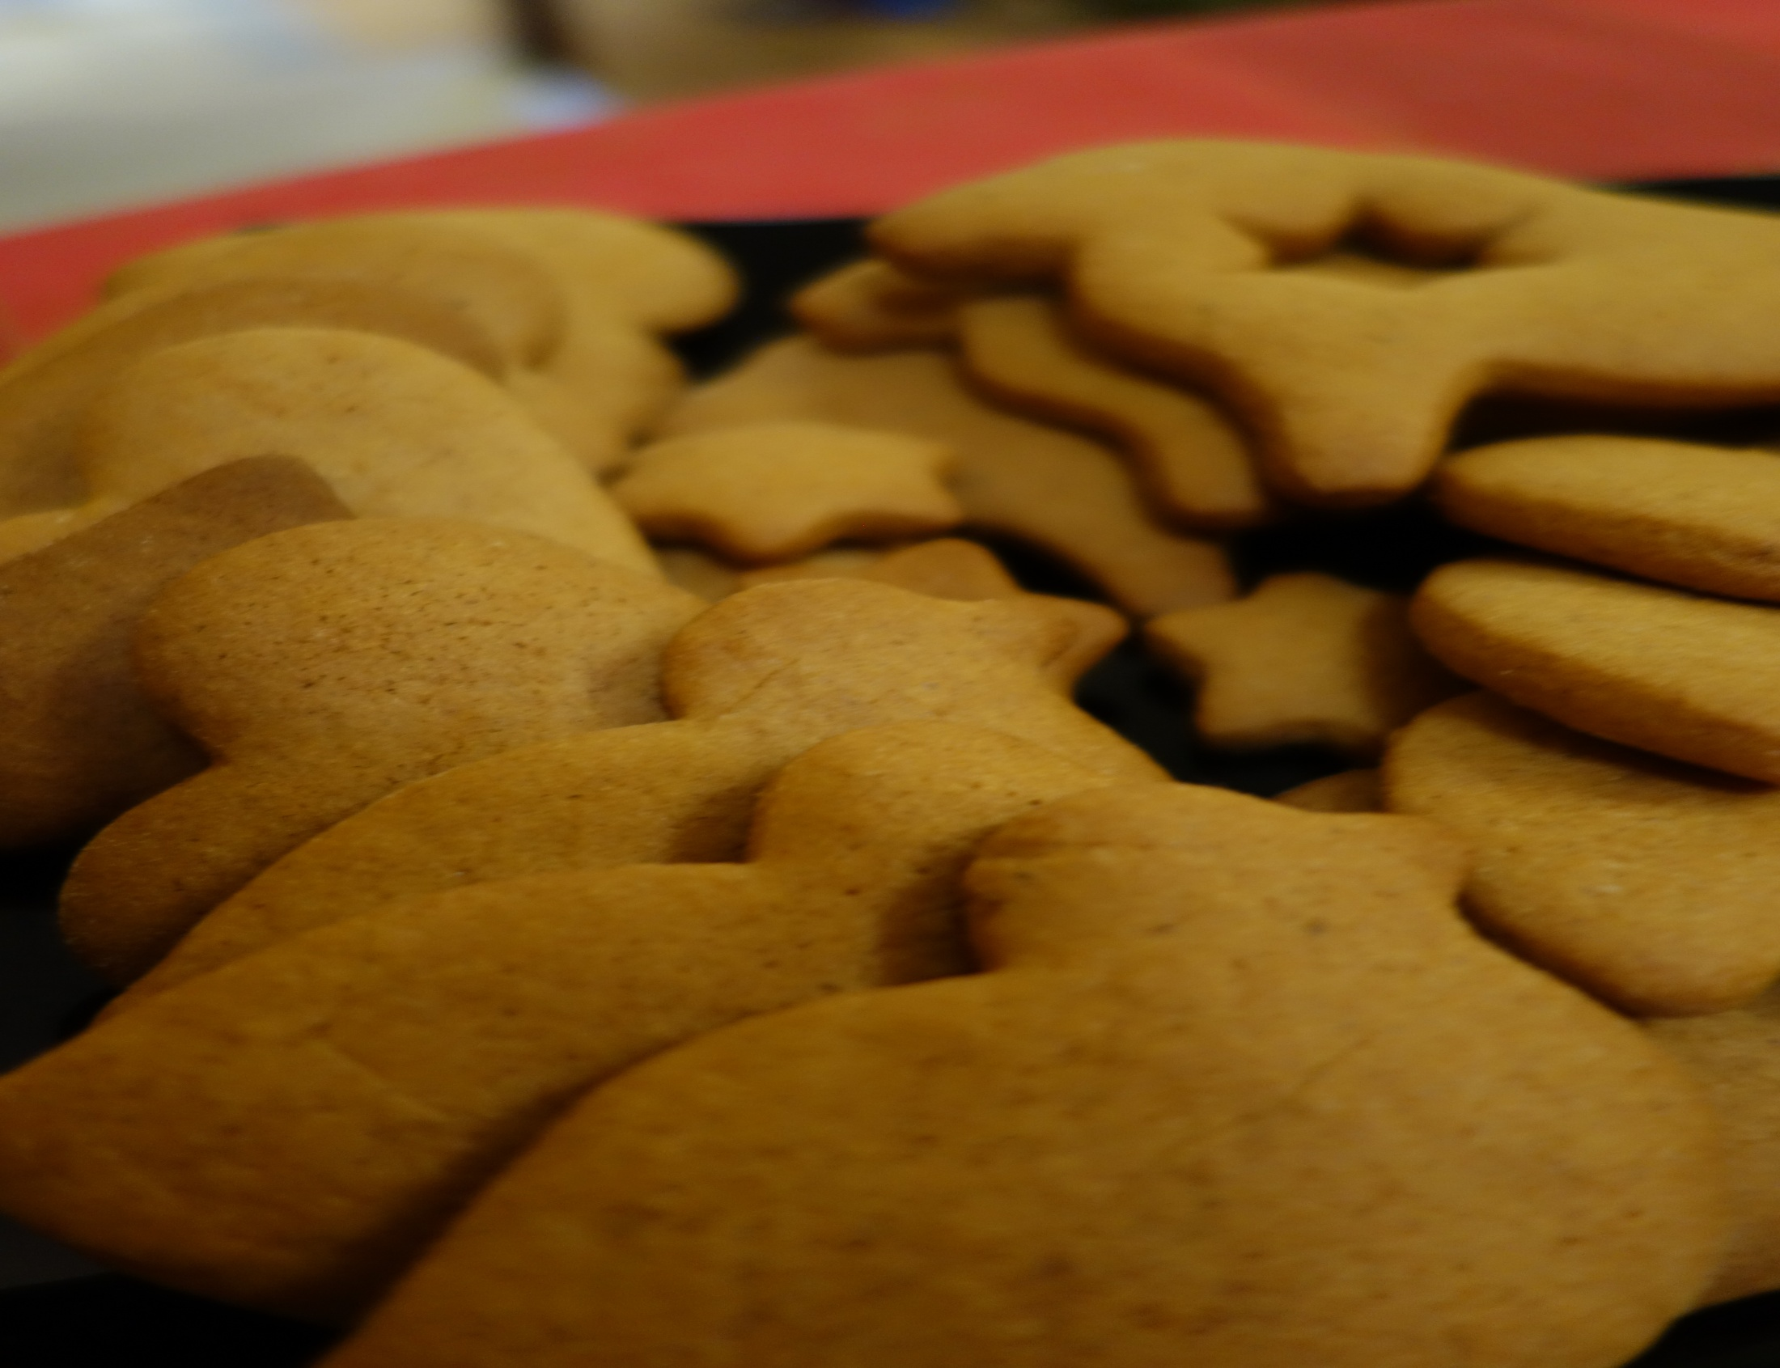
Christmas meals
Rice porridge in the morning
Traditional meal includes: ham, casseroles, herring, mustard, lye-and saltfish
Desserts: mince pies, gingerbread cookies, chocolate and nuts

Slide 7
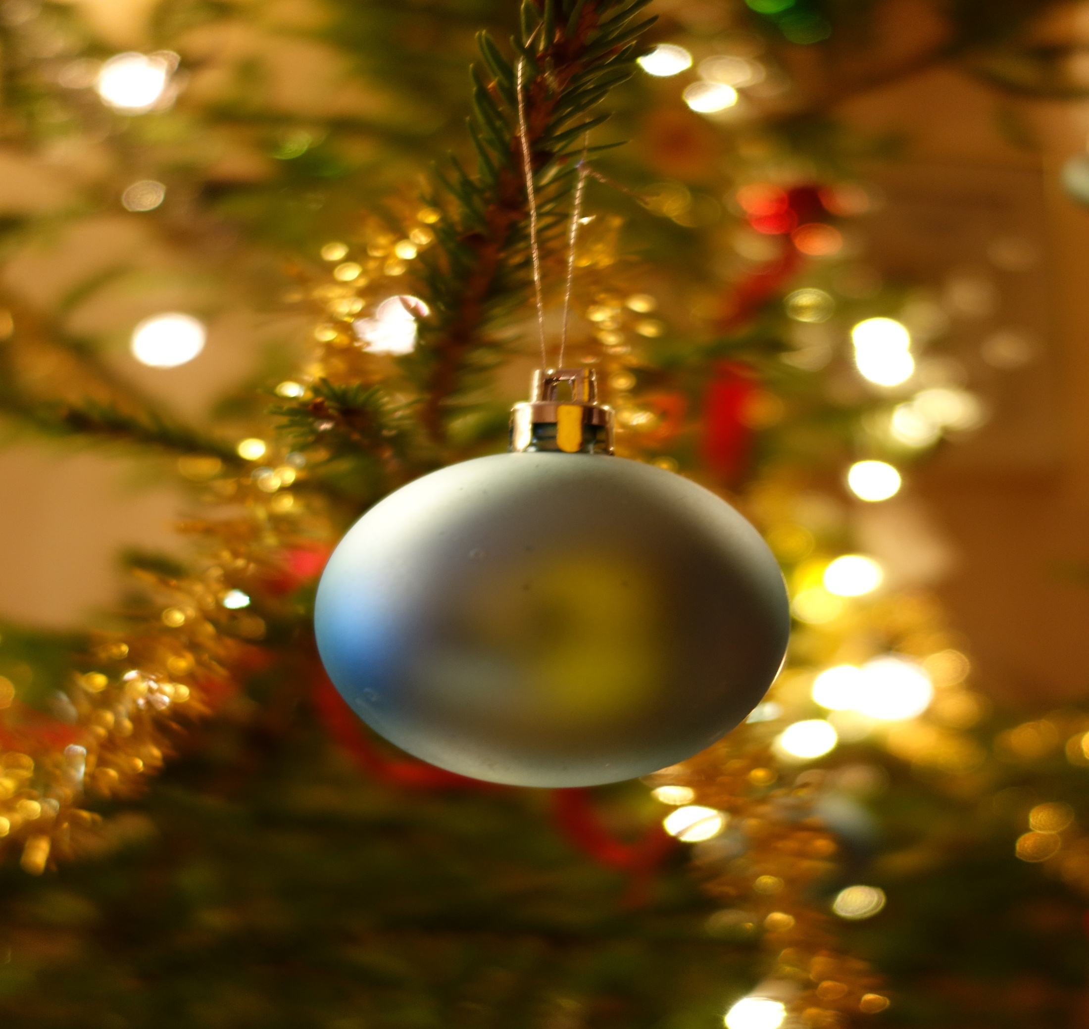
Celebrating Christmas
In Finland, the 24th day is important:
We visit the grave yard and leave candles and fir branches
we eat the Christmas meals
In the evening, give and open our gifts
Usually we spend this day with our family
On Christmas Day is the morning church
On Boxing Day we visit friends and family

Slide 8
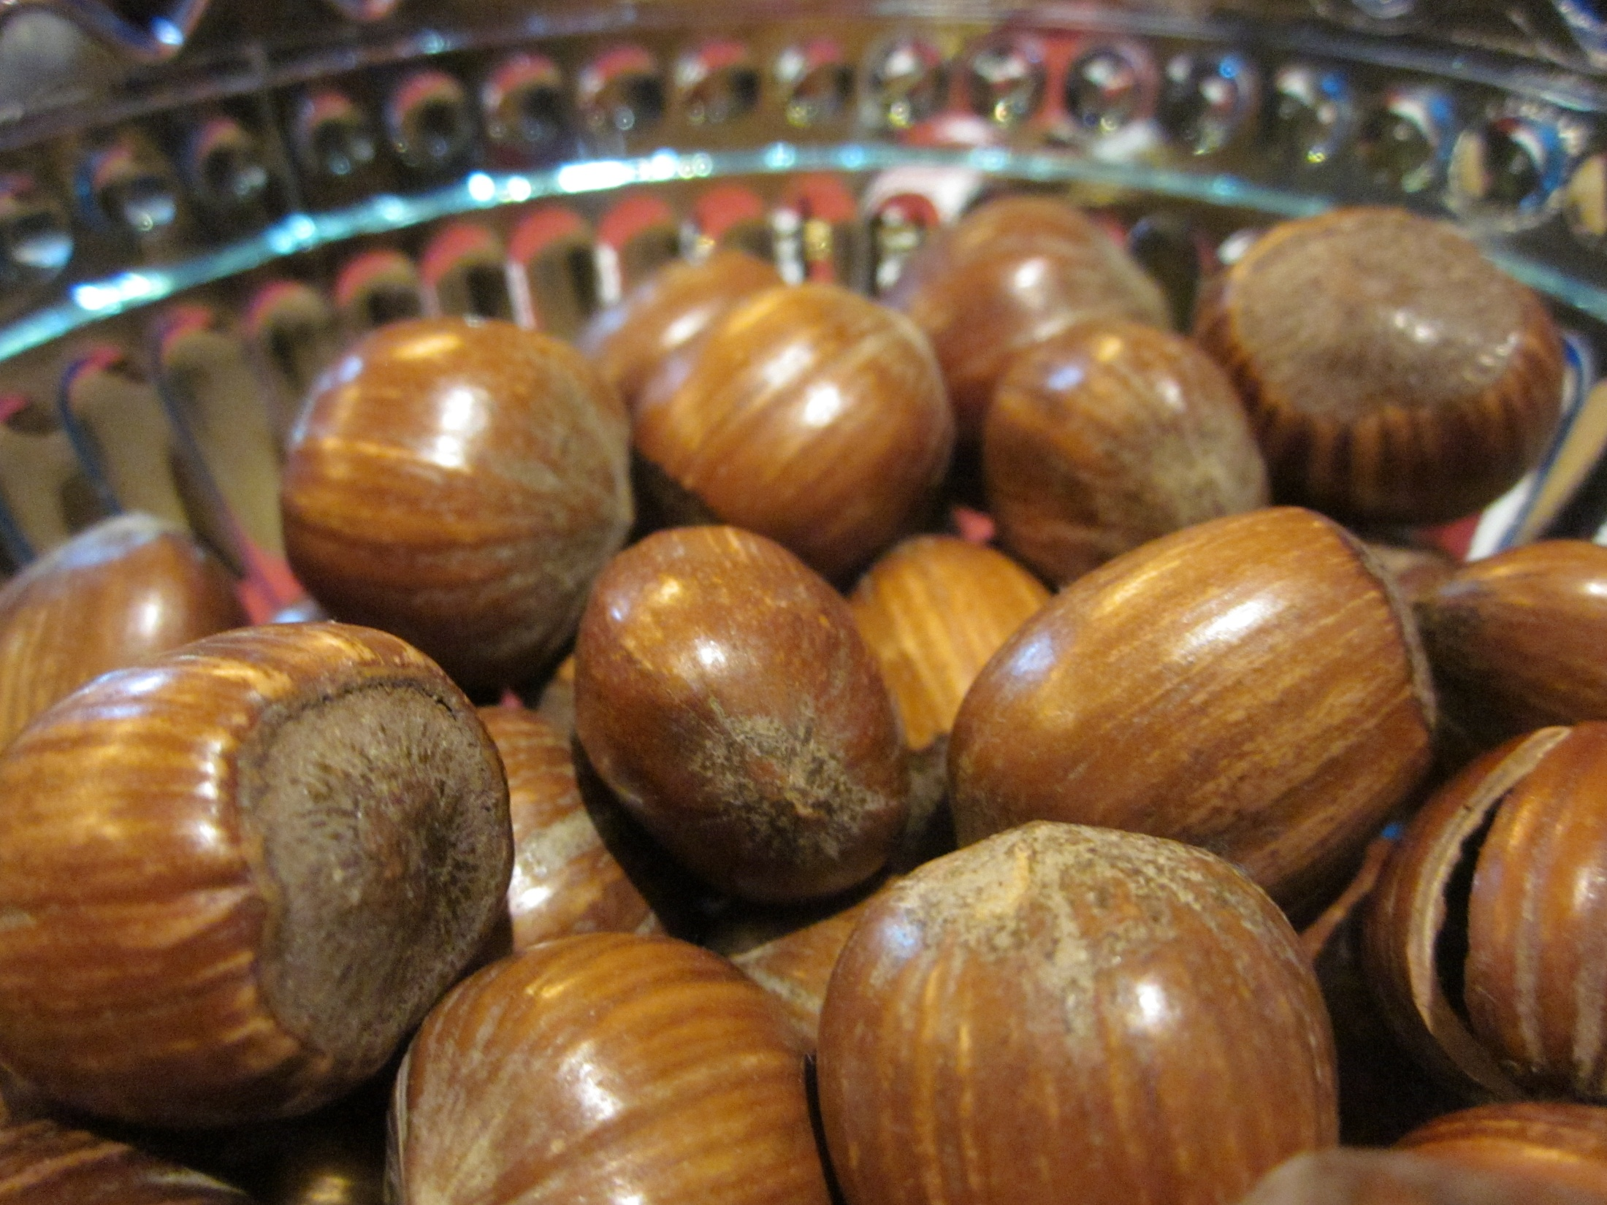
Epiphany
we remove decorations
We take the Christmas tree away
By: Silja Rytkönen

