Slide 1
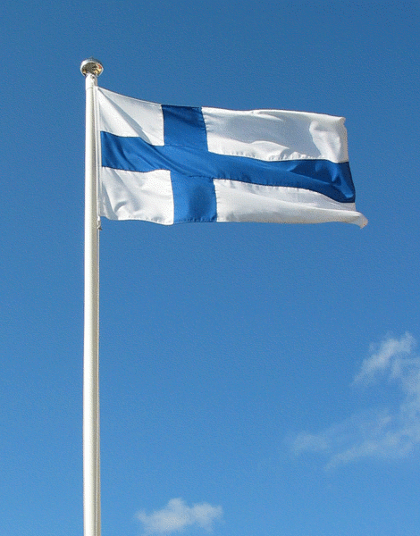
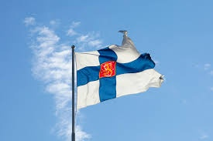
Independence Day

Slide 2
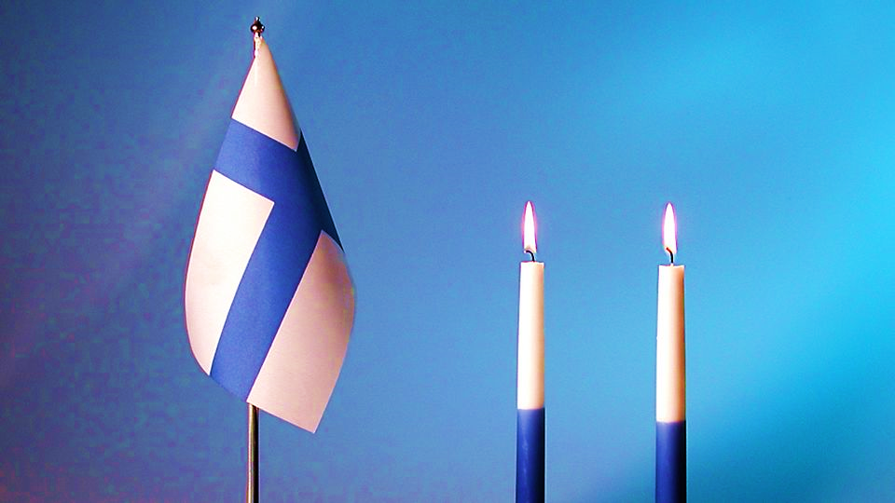
Independence Day
Finnish National Day
December 6th
Finnish Declaration of Independence was signed by the government
The Parliament accepted the Declaration on December 6th, 1917.
The Russian government accepted the declaration on December 31st, 1917.

Slide 3
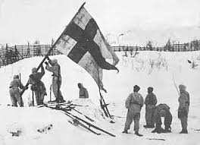
History
Finland has belonged to Sweden and Russia before it became independent
Finnish forests were full on pine, spruce and other trees so people had work in forest
Finns usually work in forest and they get livelihood from there

Slide 4
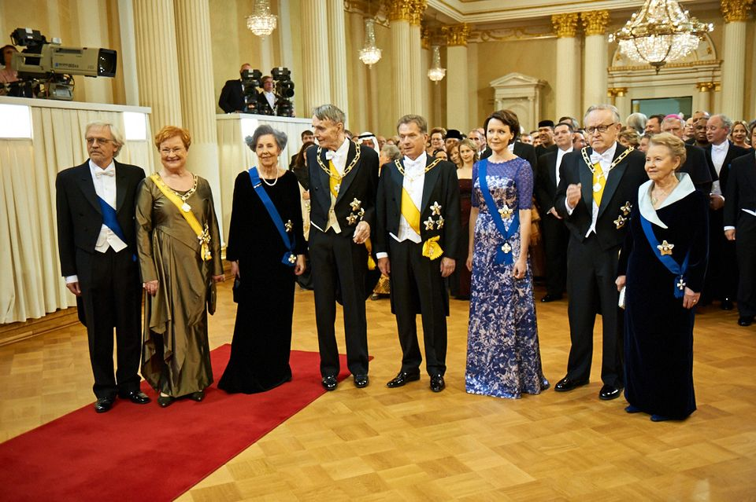
Finnish traditions on December 12th
Castle Festivities in Presidential Palace (Picture)
Candles burning
Flagging
Edvin Laine- movie: Tuntematon sotilas (The Unknown Soldier)
Blue and white flowers
Independence Day’s parade

Slide 5
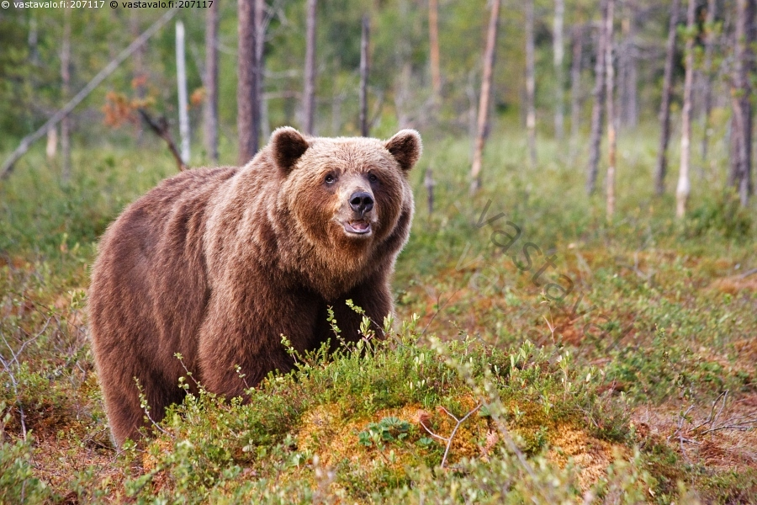
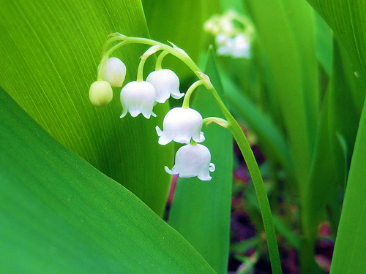
National things
National song: Maamme- laulu
National istrument: Kantele
bear lily of the valley
National animal National flower

