Slide 1
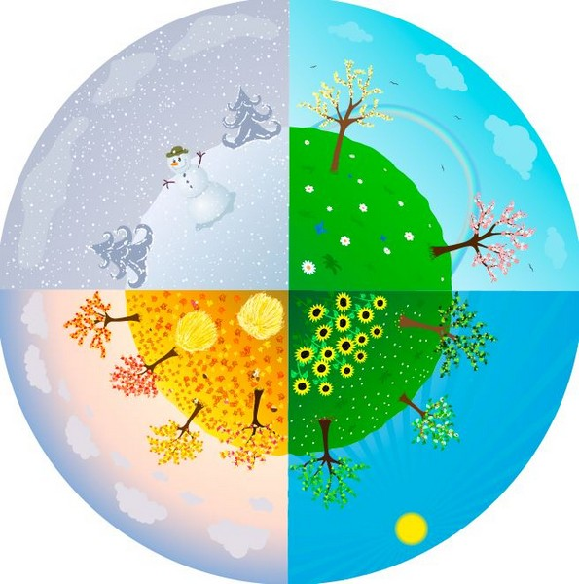
The four seasons in Finland

Slide 2
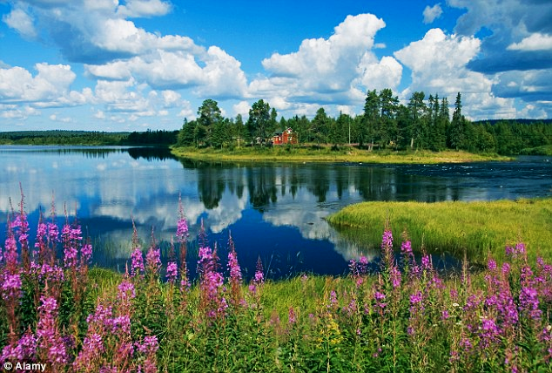
Finnish Summer

Slide 3
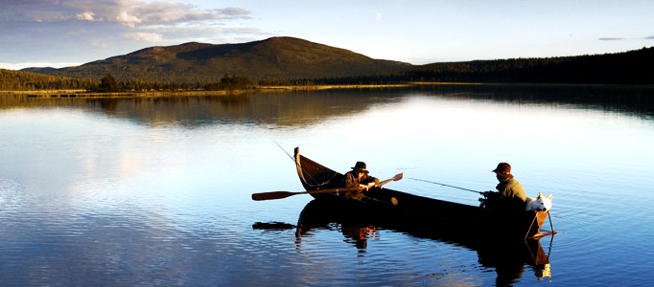
Summertime
In summer people barbecue and kill bugs
The sun never goes down in the summer
Youngsters usually go to summer camps
Finns would like to swim, but the water is too cold
Finns like fishing

Slide 4
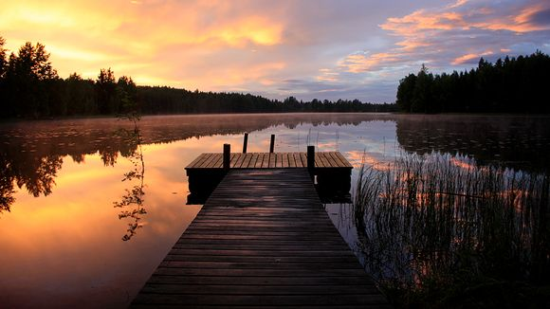
the weather
In Finland there is cold and warm weather, but mostly it’s cold
When it’s warm, people complain about how hot it is and how you can’t do anything because of the hotness

Slide 5
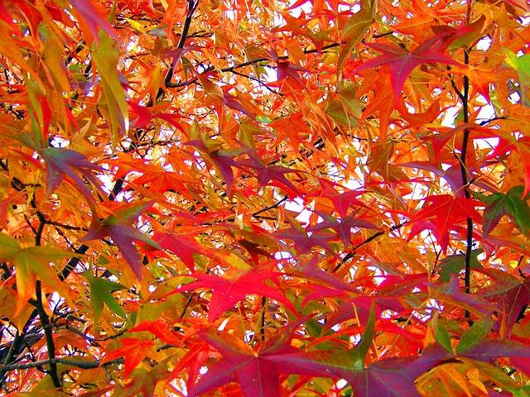
Autumn

Slide 6
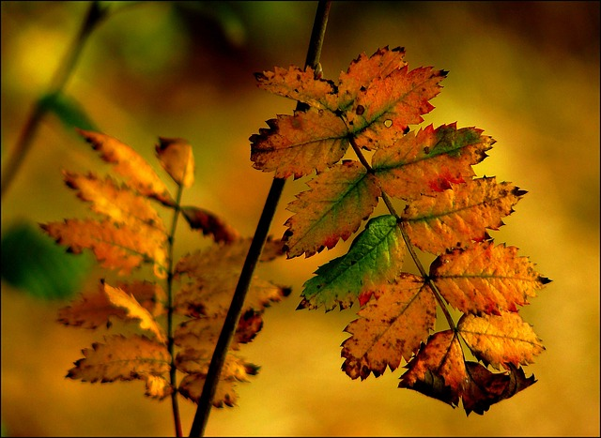
Nature
-The fall colors in Northern Lapland are at their best in September and October
-The autumn may stretch up to the winter months
-in the autumn it gets cooler
-the leaves fall from the trees
-some animals hibernate
-some animals change color in the autumn
-the water freezes in the autumn

Slide 7
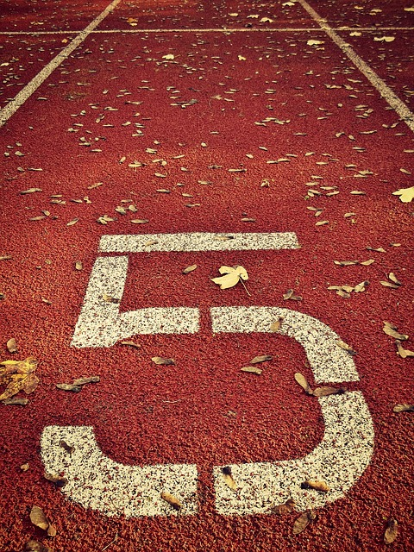
Sports and hobbies💪🏃🏊
Lots of sports seasons start in autumn.
For example, ice-hockey, skating, swimming, floorball, basket ball, dancing. These hobbies usually end in autumn: football, athletics, trampoline, swimming in the sea or lake.
.

Slide 8
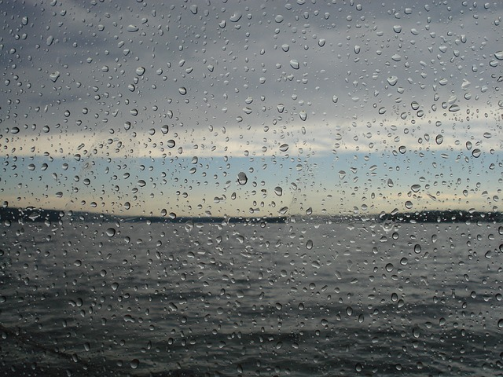
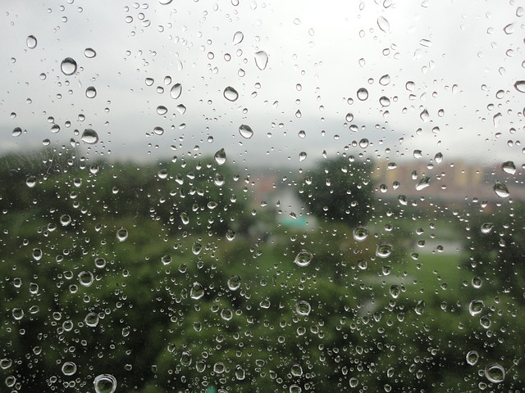
Autumn Weather
-The weather is cool👺
-It rains a lot and it’s windy.
-The temperature varies between
+10 and -10 degrees.

Slide 9
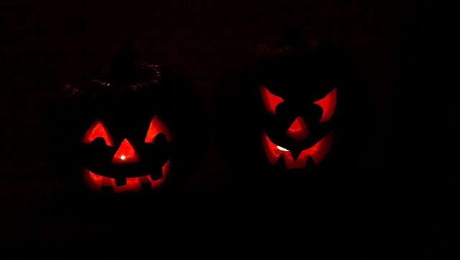
Halloween👻👽💀👿👾✌
-halloween was celebrated for the first time in Finland during the 1950s.
-celebrated on the 31st of October
-The 1st of Nove,ber is All’hallows eve
Pumpkin lantern has become the most important symbol of halloween over the years

Slide 10
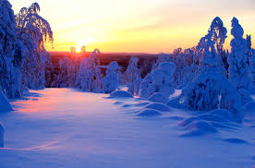
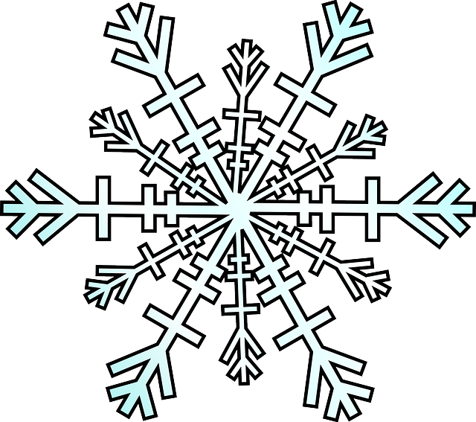
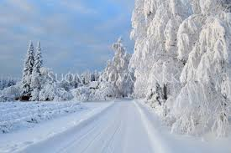
Winter

Slide 11
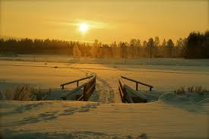
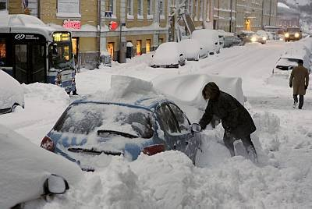
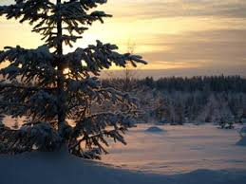
Winter in Finland
The winter in Finland is very beautiful. There is lots of snow and ice. Winter is the coldest season of the year.
Some animals sleep through the whole winter, for example bears and badgers.
The lowest recorded temperature in Finland is−51,5 °C

Slide 12
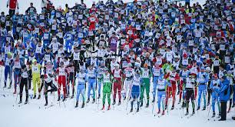
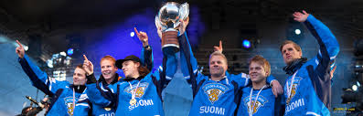
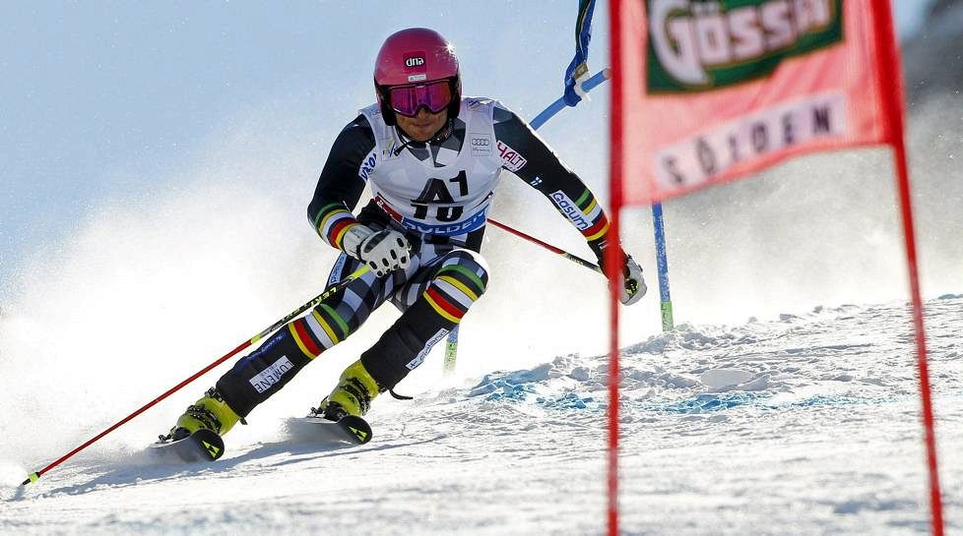

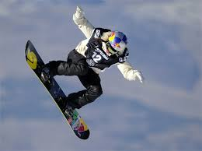
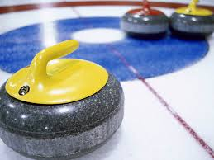
Winter sports
Every year there is a skiing competition called Finlandia in Finland.
In 2014 there were more than 5,000 skiers in the competition.
Finlandia skiing was organized for the first time in 1974.
In 1984 there were about 13 000 participants. It was the largest mass skiing event and reached the Guinness Book of Records.
Finland has been successful in alpine skiing, snowboarding, curling and hockey
Finland won the ice hockey world championship gold in 1995 and 2011

Slide 13
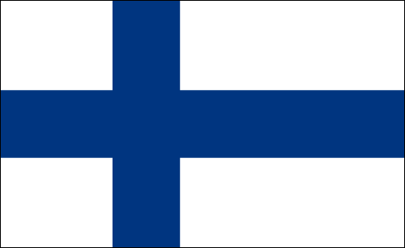

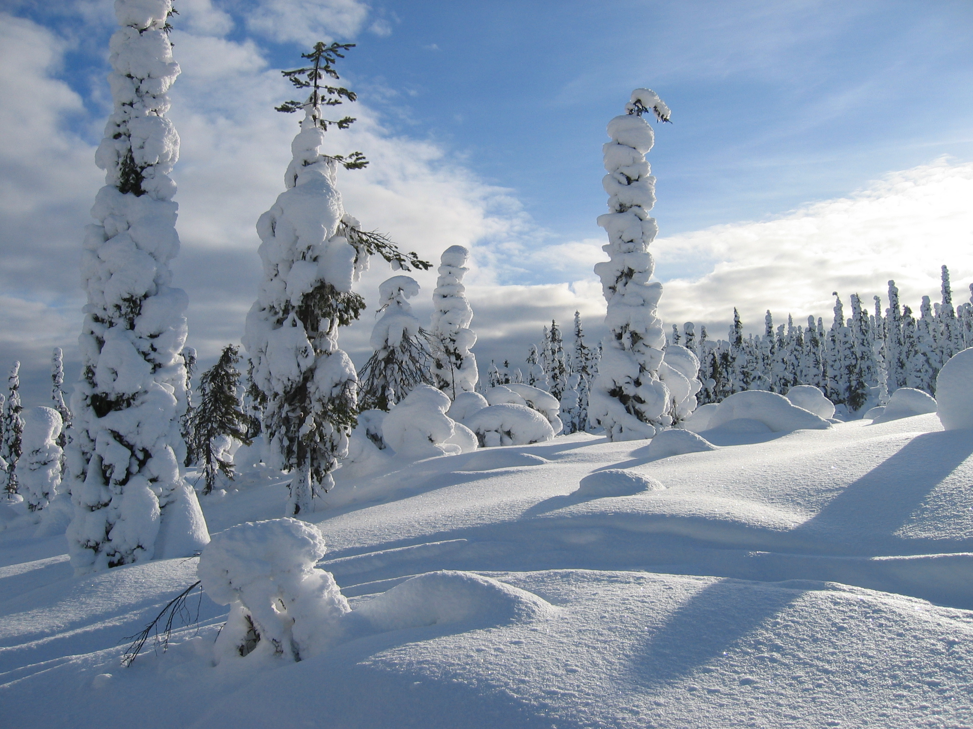
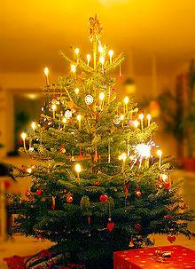
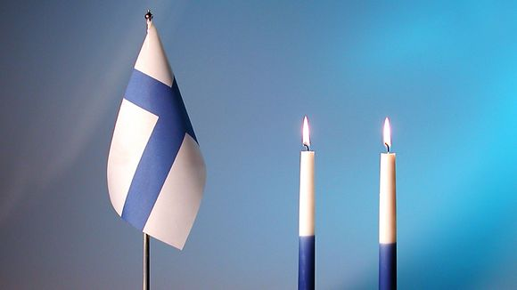
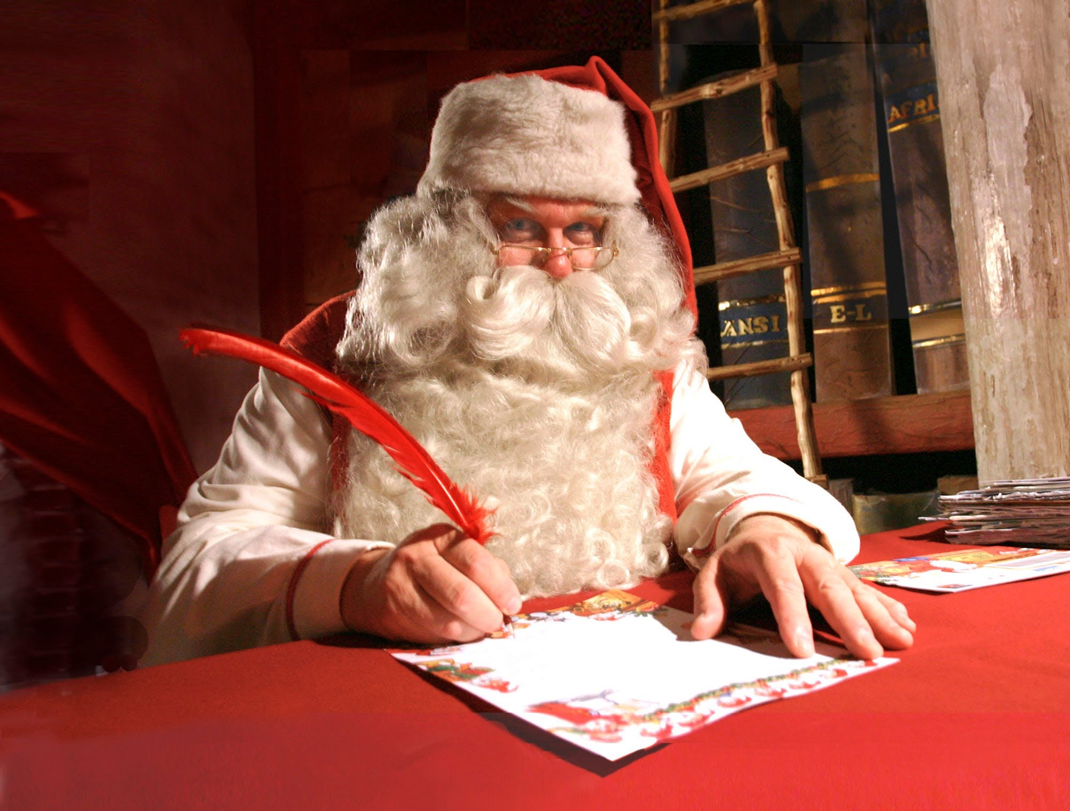
Events
Christmas
-On the 25th of December
-Celebrating Jesus’ birthday
-In Finland it is celebrated on the 24th of December
-Santa Claus visits on Christmas eve
Independence Day
-On the 6th of December
-Finns put two blue and white candles in front of the windows
-Secondary school graduates walk around with torches in Helsinki
-Finns also visit graveyards to see people who died in wars
-Some Finns march around and sing songs together

Slide 14
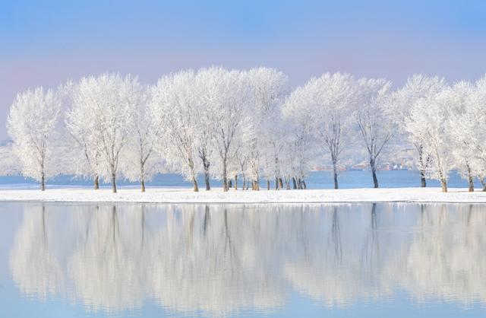
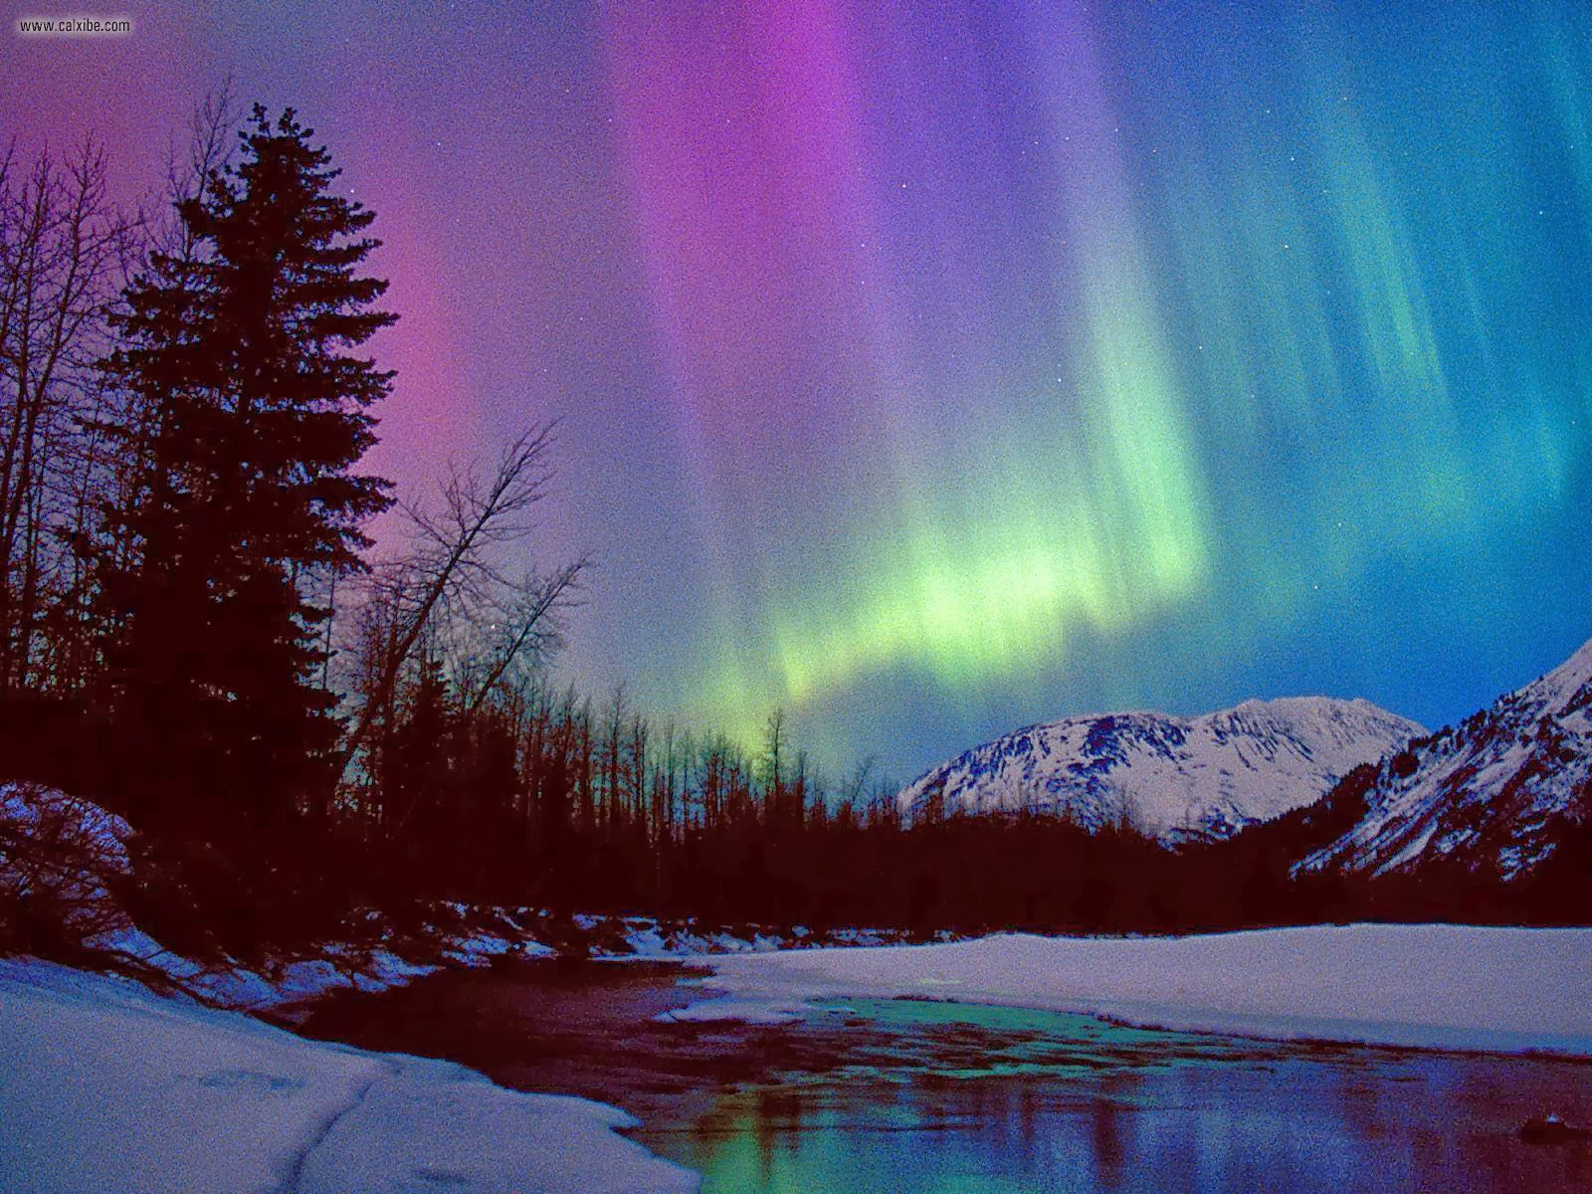
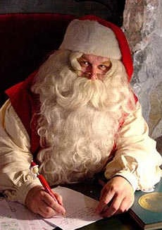
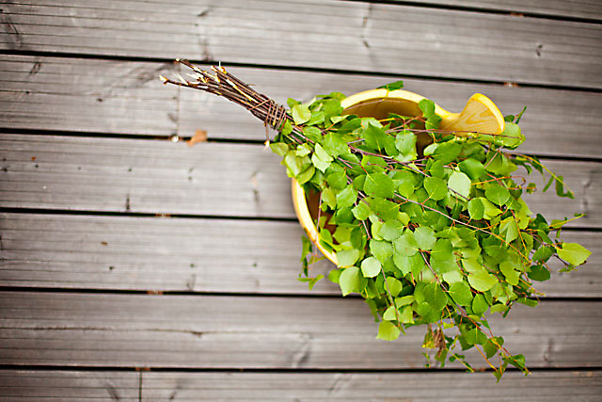
Finns’ Winter
Finnish people like to go to the sauna
Finnish people like to swim in the hole in the ice
You can see the Northern Lights in Lapland
Many people from other countries come to see Santa Claus in The Arctic Circle

Slide 15
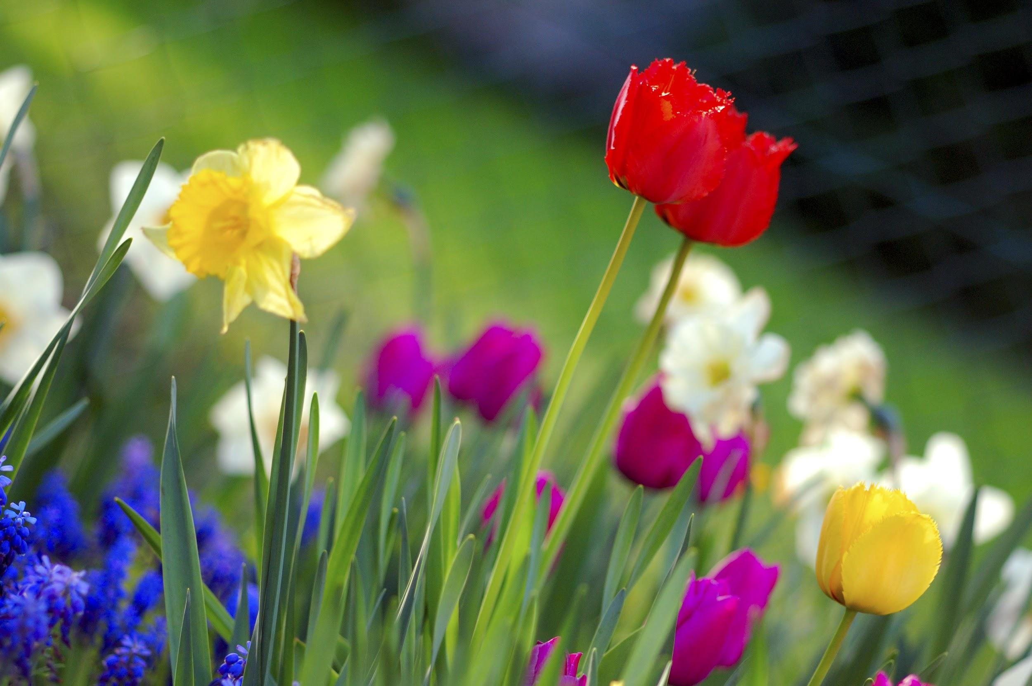
FINNISH SPRING

Slide 16
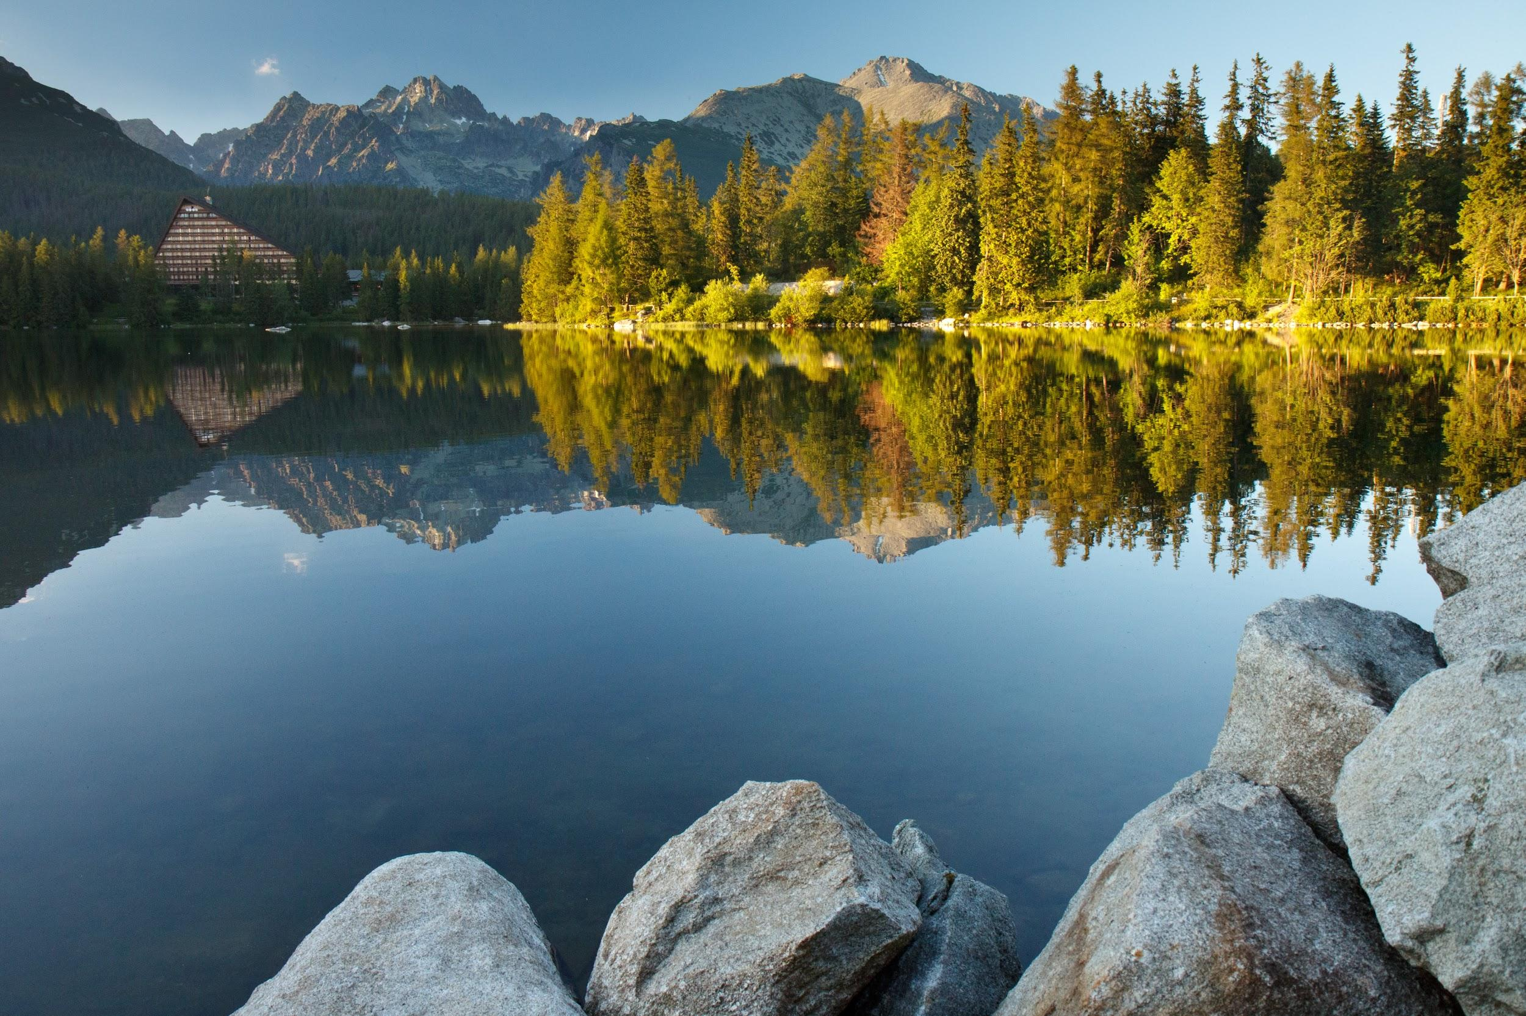
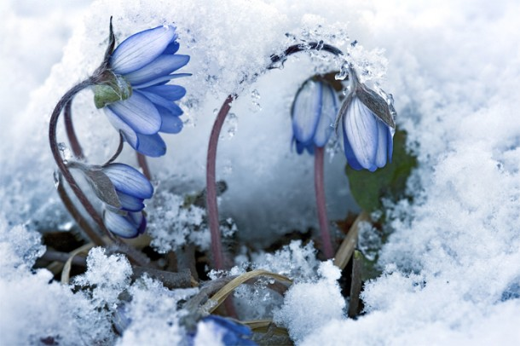
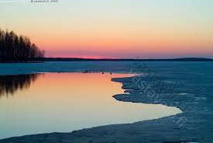
NATURE
Finnish spring is on March, April and May
Nature and animals wake up
Water systems are still frozen

Slide 17
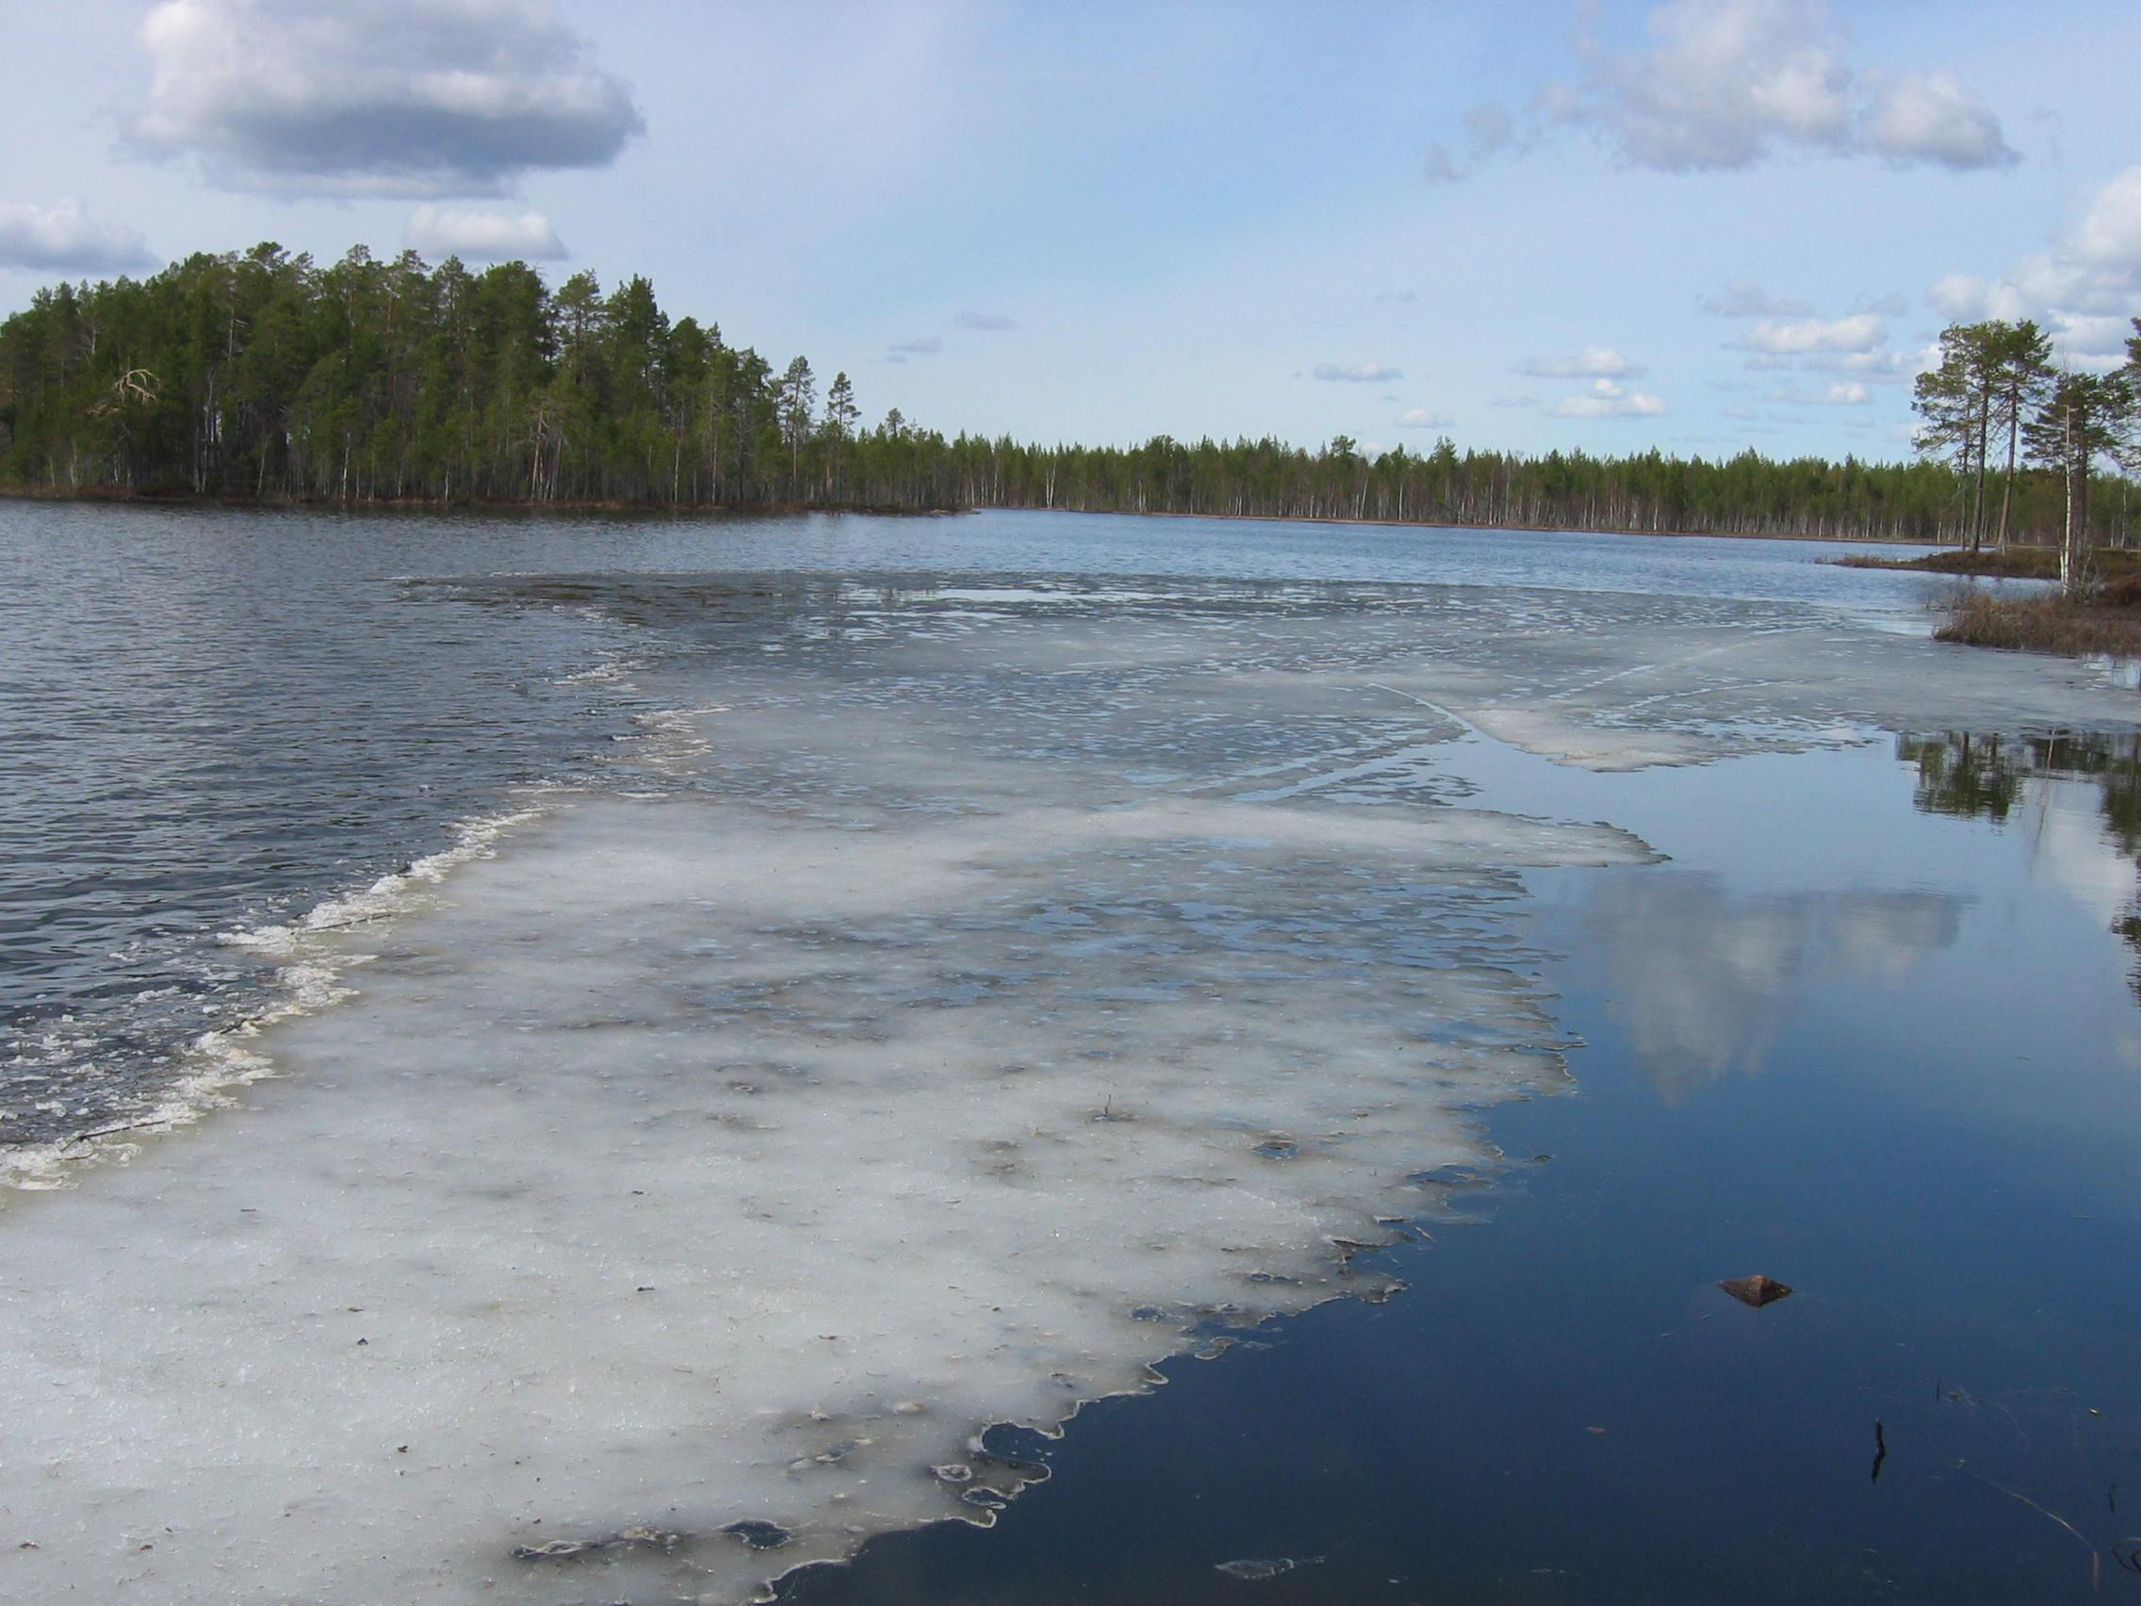
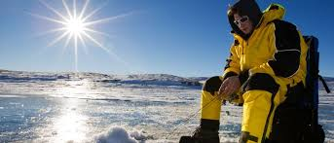
HOBBIES
In Finland we downhillski in the spring, we also go ice fishing
We have beautiful weather for crosscountry ski
We also play ice hockey

Slide 18
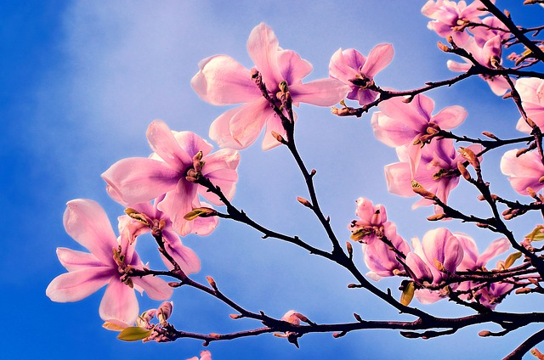
FESTIVITIES IN THE SPRING
Minna Canth’s day and Equality day 19.3.
April Fools’ day 1.4.
Easter
Mikael Agricola’s day and Finnish Language day 9.4.
May Day Eve 30.4.&MayDay 1.5. Work day
Ascension day 5.5.
Mother’s day 8.5.

Slide 19
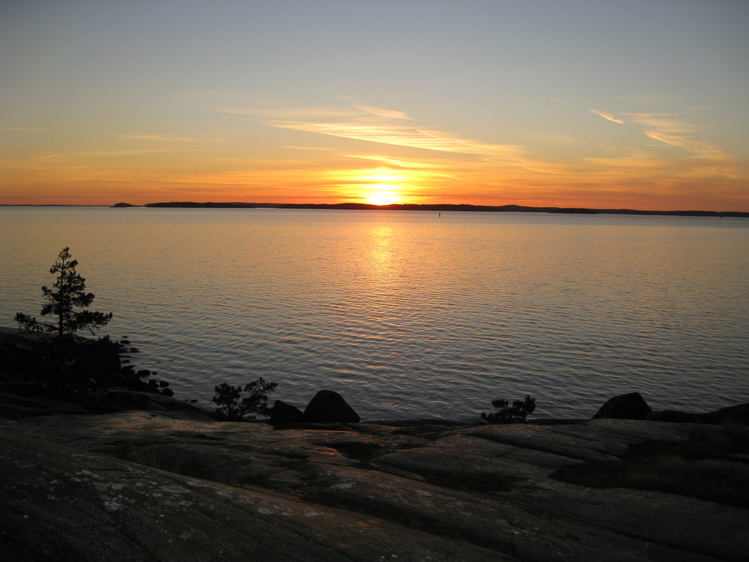
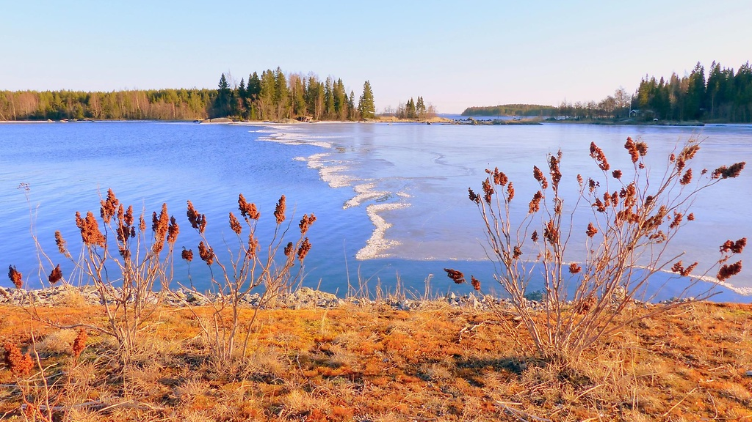
Spring WEATHER
The warmest month is April
Spring is the shortest season of the year
The average temperature is +5 degrees

