Slide 1
Pre-tasks presetations

Slide 2
The teachers’ voices
The idea behind the movie was to hear the voice of the actual teachers and their reasons behind becoming teachers in the first place. It gave us the possibility to hear their stories, the problems they encounter everyday but also what they find the most rewarding in their field.

Slide 3
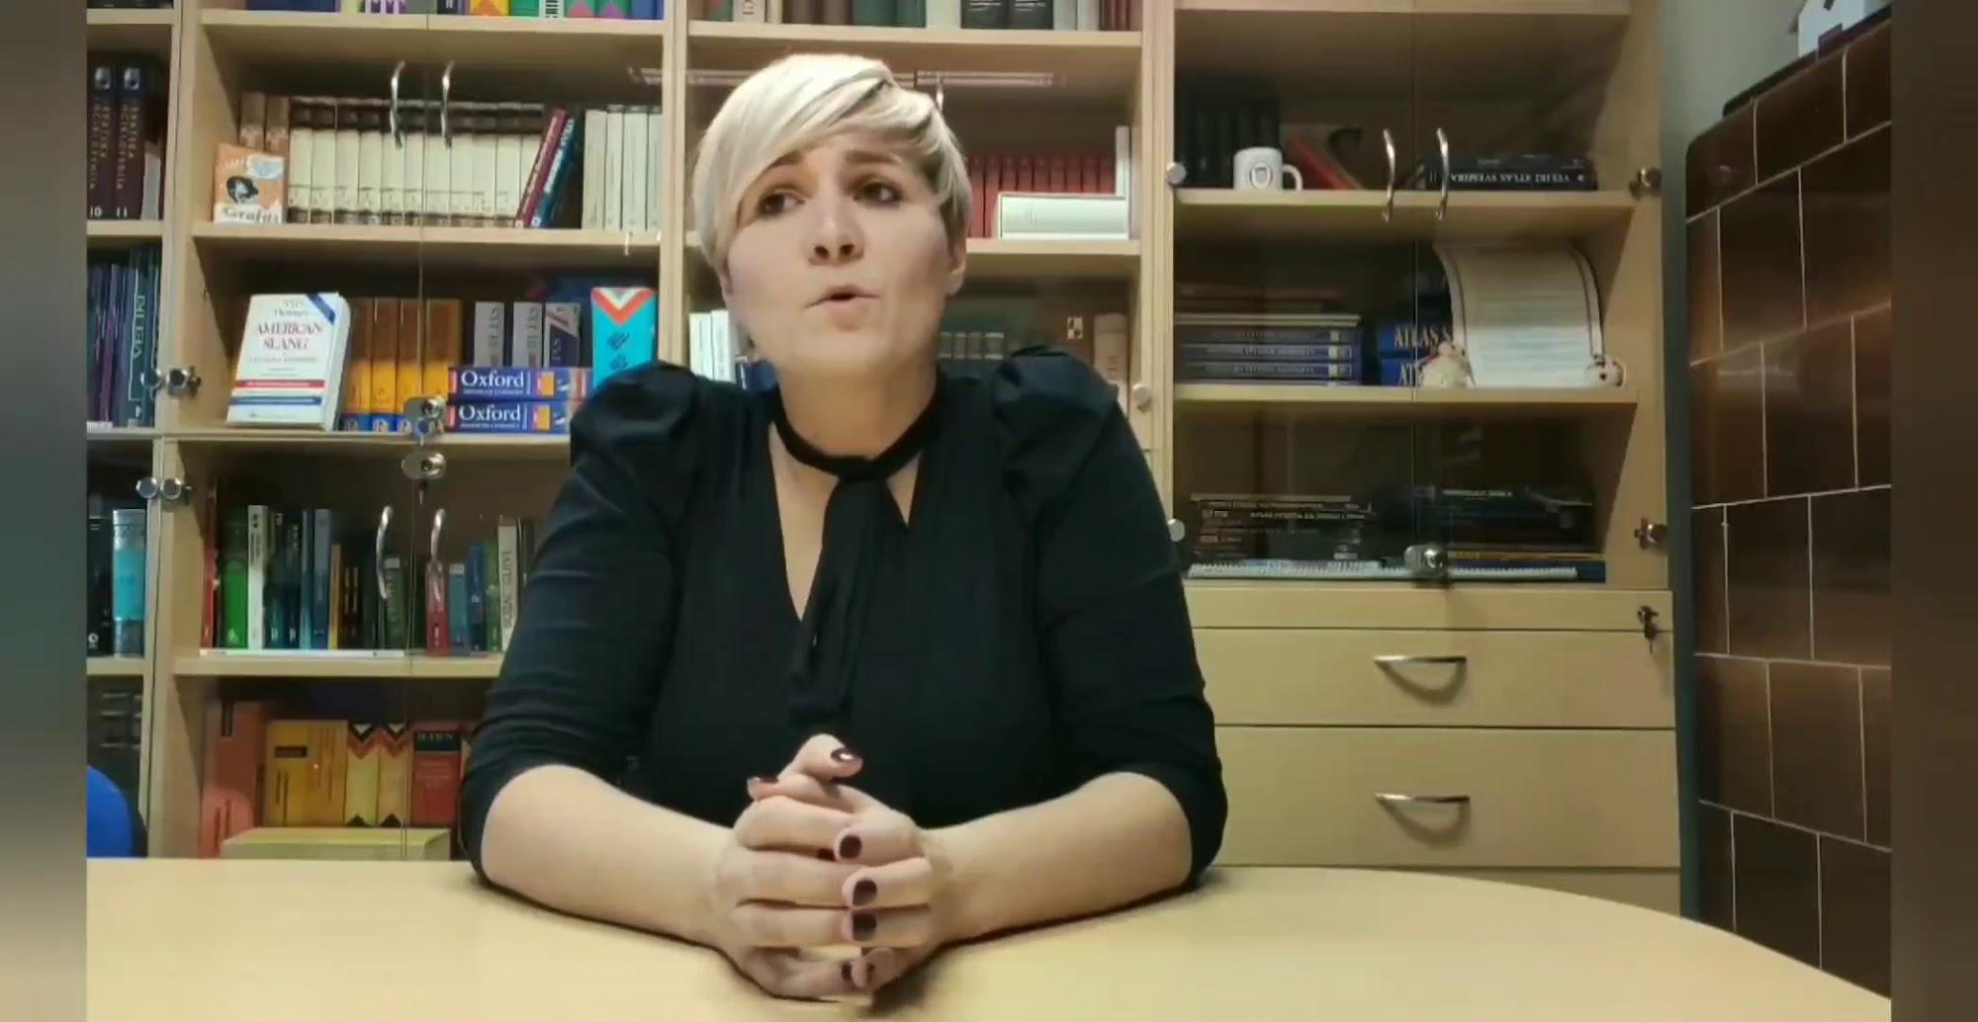
Croatia

Slide 4
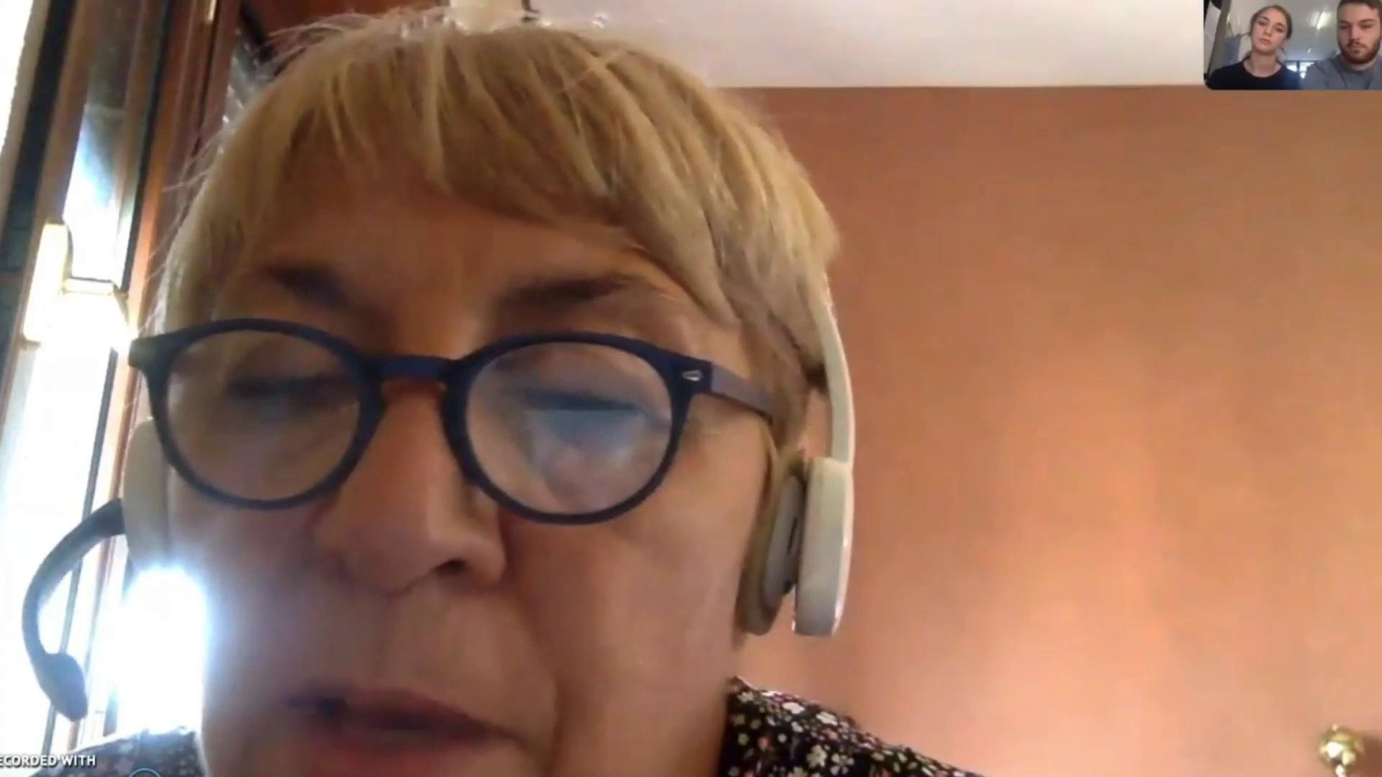
Italy

Slide 5
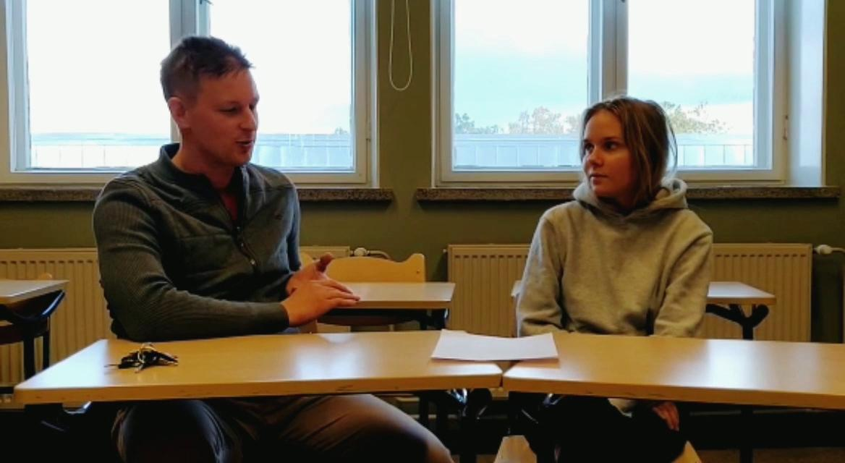
Finland

Slide 6
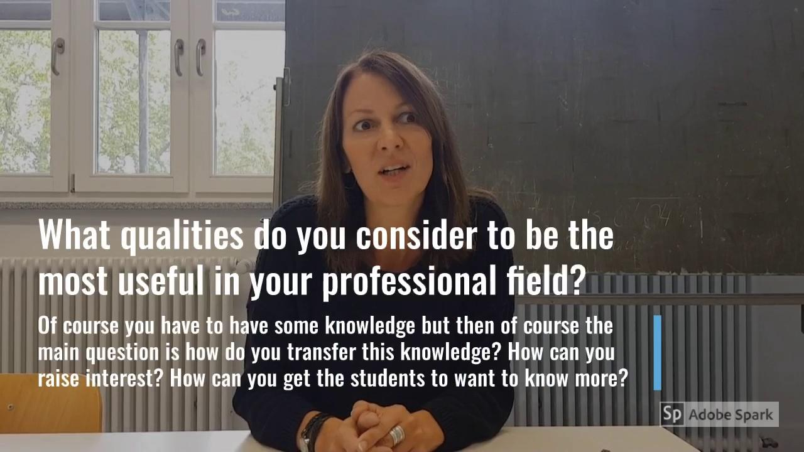
Germany

Slide 7
Spain

Slide 8
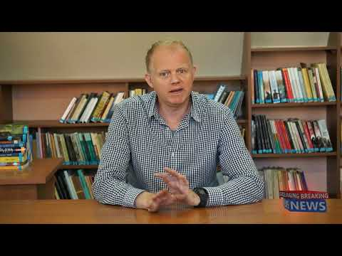
Poland

Slide 9
Even though the interviewees came from countries from all over the Europe, their interviews sounded quite similar. That gives yet another reason to continue projects supporting educational aspects

