Slide 1
Pre-tasks presetations

Slide 2
The Perfect Teacher- posters
The students were to consider the idea of the „Perfect Teacher”, discuss it in their schools and prepare posters that would represent the topic from their point of view. The chosen forms were different but the ideas presented on them were quite similar.

Slide 3
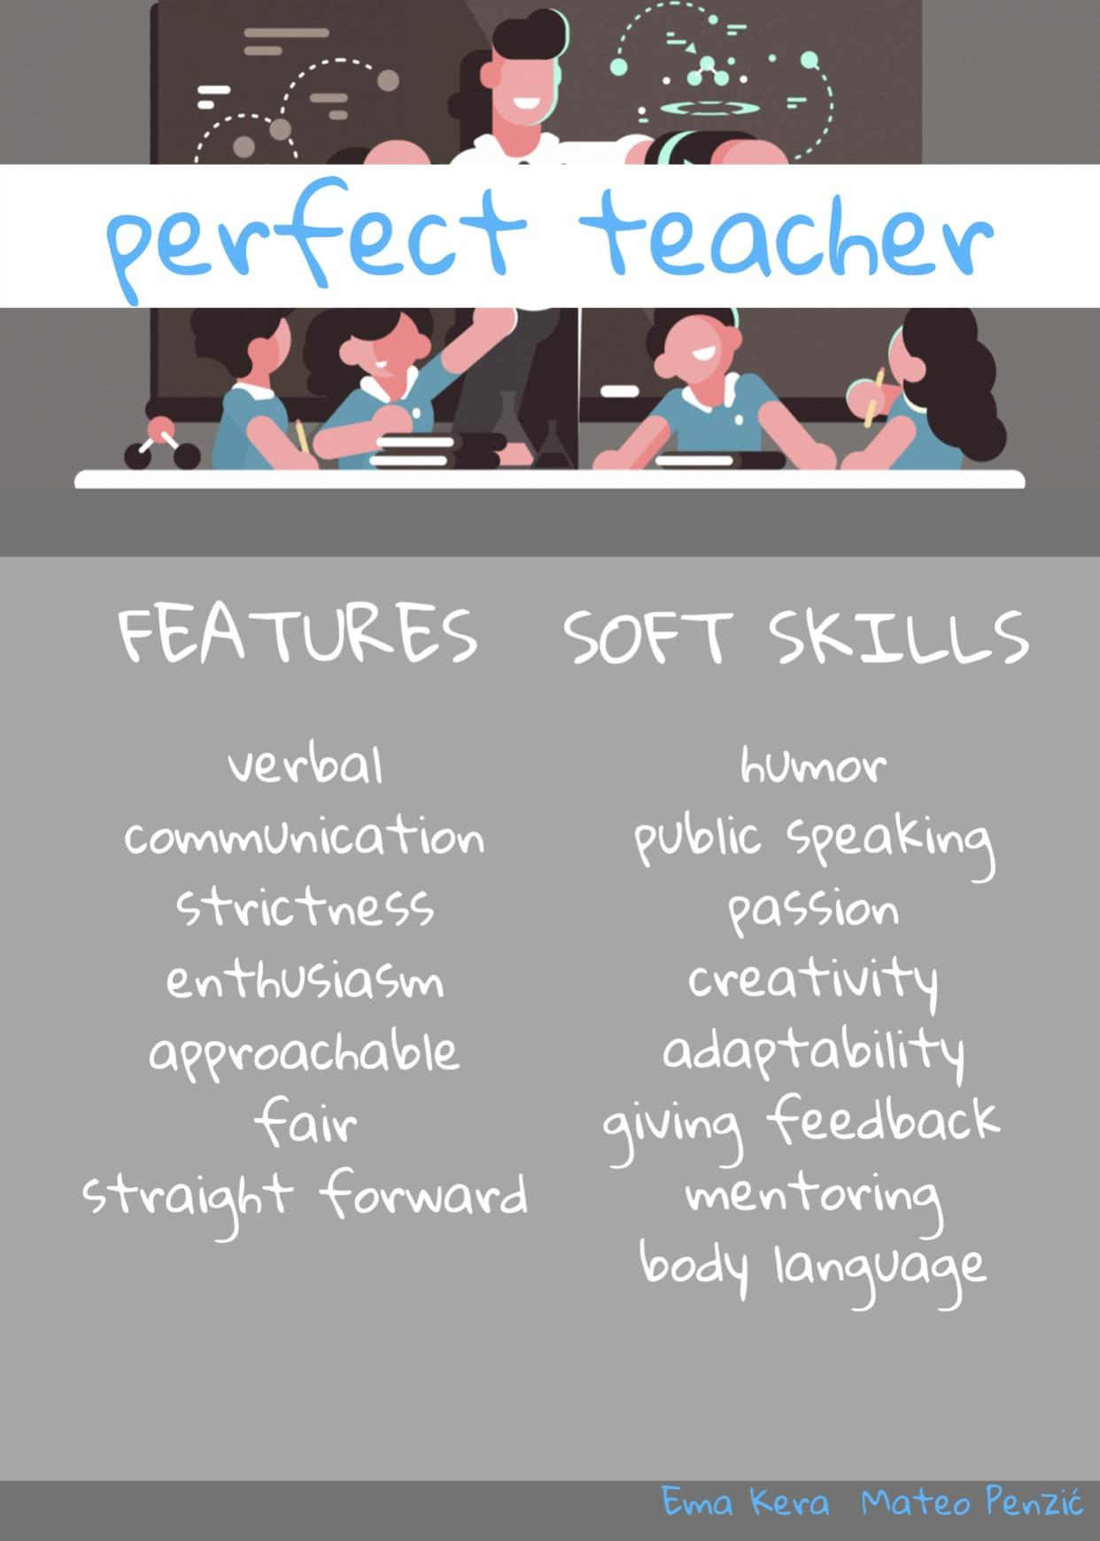
Croatia

Slide 4

Italy

Slide 5
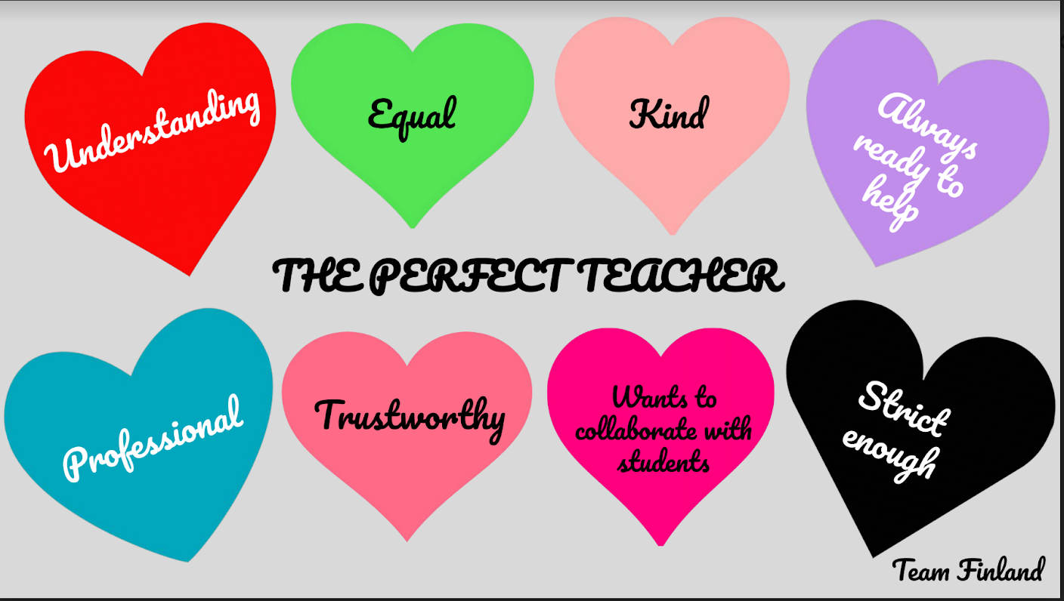
Finland

Slide 6
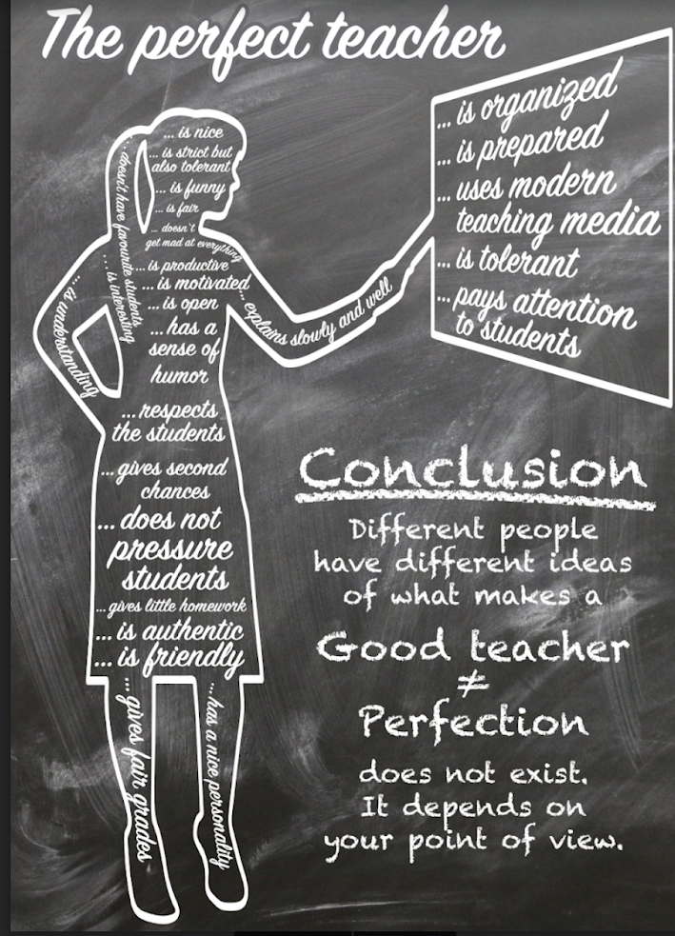
Germany

Slide 7
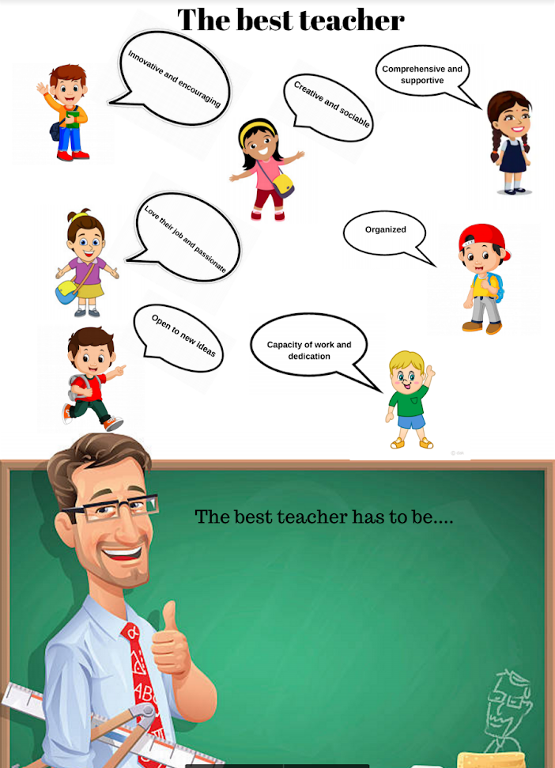
Spain

Slide 8
Poland

Slide 9
The international students want their teachers to be:
· Understanding
· Kind
· Always ready to help
· Professional
· Trustworthy
· Ready to collaborate with students
· With just the right amount of strictness
· Innovative and encouraging
· Creative
· Comprehensive and supportive
· Open
· With passion for his/her job
· Positive
· Fair
· Modern
· Emphatic
· Is authentic

Slide 10
However, after presenting the posters the students came to the conclusion that Perfect teacher does not exist. Not because there are no good teachers but because it all depends on our point of view so each one of us will consider a different set of qualities as a perfect one.

