Slide 1
Astronomers’ team Planet Diversity, eTwinning 2015-2016
8th Primary School of Pyrgos 6th grade

Slide 2
Johannes Vermeer - The Astronomer (1668)

Slide 3
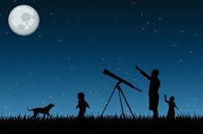
The profession of astronomers
Studies
Skills
Work
Equipment

Slide 4
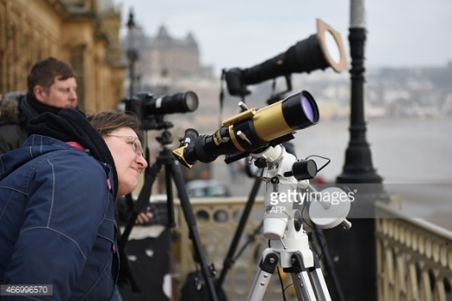
Skills
good powers of observation
logical approach to work
work with abstract ideas
do complex calculations
patience
good attention to detail
the ability to analyse problems
strong IT skills
Studies
maths
physics
astrophysics
geophysics
astronomy
space science

Slide 5
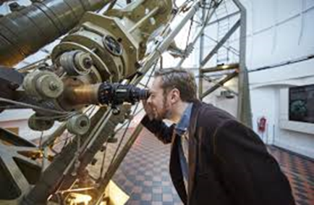
Equipment
collecting data from satellites and spacecraft using radio and optical telescopes
Telescope
Camera
Work
Analysis of observed phenomena, along with making predictions as to the causes of what they observe
designing, building, testing, and flying various scientific instruments
You could work long and irregular hours, including weekends, evenings and nights

Slide 6
The profession of astronomers
An Astronomer in Little Prince
The Turkish Astronomer
He discovered the prince’s
home, Asteroid B-612

Slide 7
Planetariums

Slide 8
Links
R
E
F
E
R
E
N
C
E
S
http://astronomy.swin.edu.au/~dforbes/mercury.pdf
http://imagine.gsfc.nasa.gov/ask_astro/profession.html
https://en.wikipedia.org/wiki/Astronomer
https://nationalcareersservice.direct.gov.uk/advice/planning/jobprofiles/Pages/astronomer.aspx

Slide 9
Planet Diversity, eTwinning project
2015-2016

