Slide 1
Socrative
IT in evaluation: Methods and Tools

Slide 2
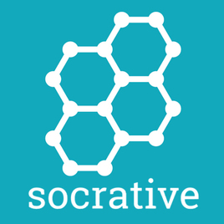
an easy-to-use tool for building assessments and seeing results in real-time.

Slide 3
How to start?
You should create a teacher‘s account
Go to www.socrative.com and click “Teacher Sign Up.”
Enter an Email and Password. After that, you’ll receive a unique Room Code, which your students will use to access your activities.
Create and edit your quizz ☺

Slide 4
Advantages of using Socrative
It offers variety of questions that the teacher can diversify teaching and assessment.
short answers
multiple choice
true/fals tasks
it allows you to implicate different strategies and games in the educational process (race mode, answers with explanation, etc.).
It can make the assessment easier and more entertaining.

Slide 5
Our experience
Socrative tool represents an alternative to Kahoot games that do not offer so many options in its settings.
You can use it either for longer reading tasks or for quick reactions and short writings.
It does cannot entirely replace other traditional ways of evaluation tools but it can make it different and more entertaining.
I use it at least once every month and the pupils are still really interested.
It can help you identify the strengths and weaknesses of the students but it important not to overestimate the validity of these tools at the same time.
It might be definitely a helpful tool to make the lessons more likeable.

Slide 6
Our practical example in Erasmus + see PDF file

