Slide 1
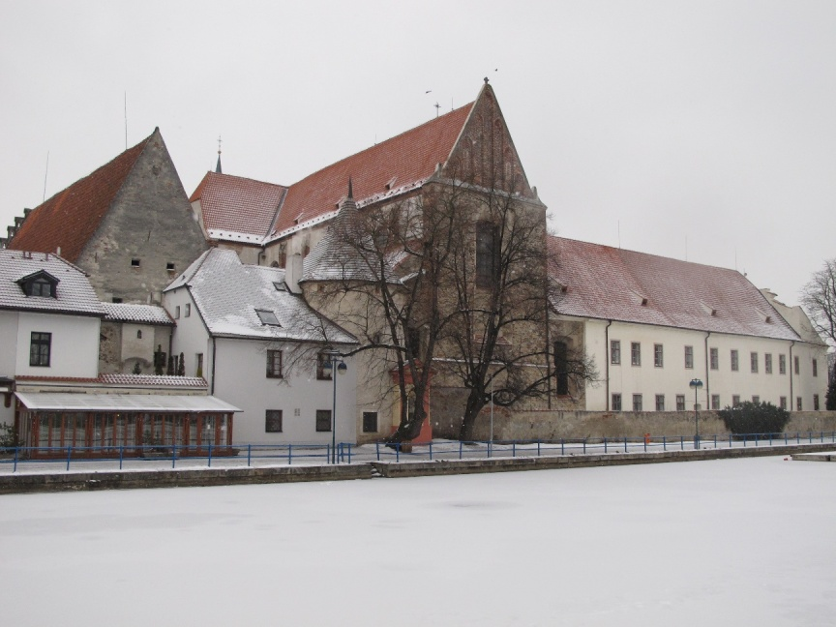
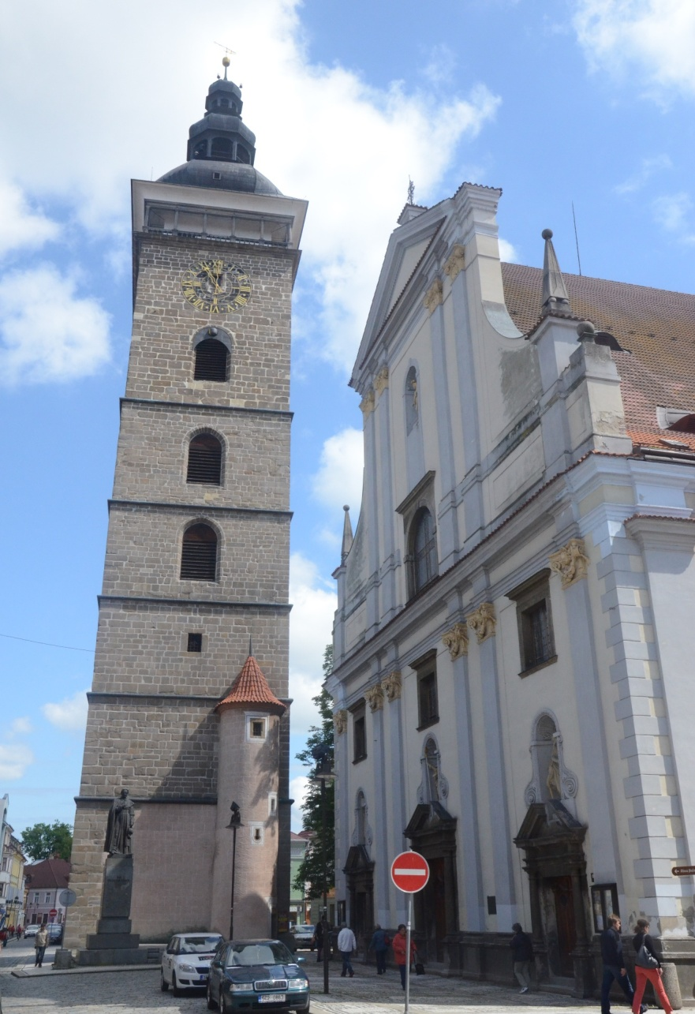
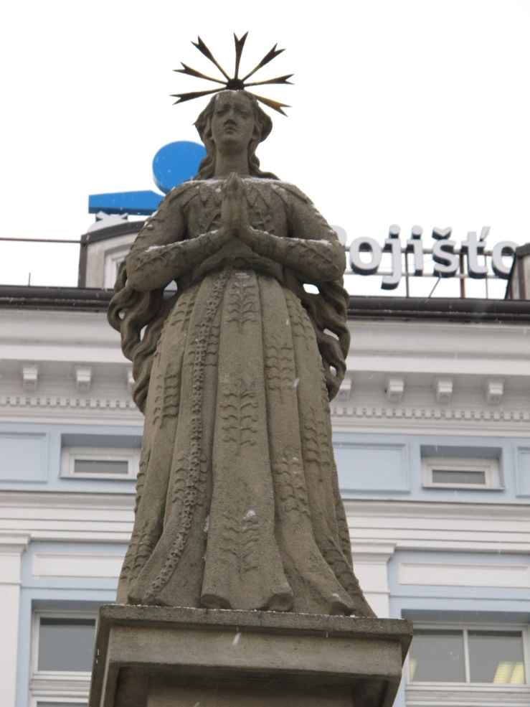
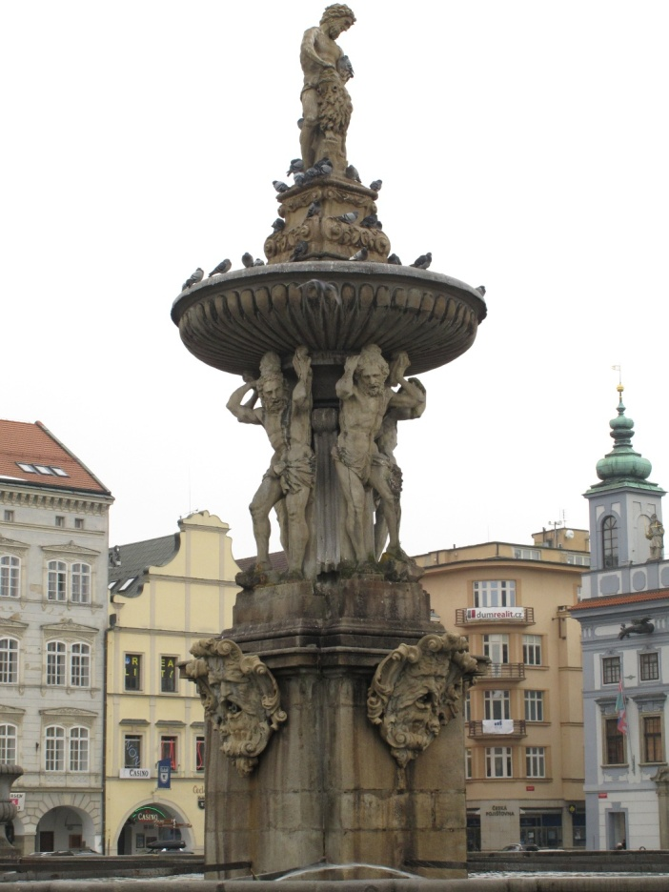
Encyklopedie CZECH MONUMENTS

Slide 2
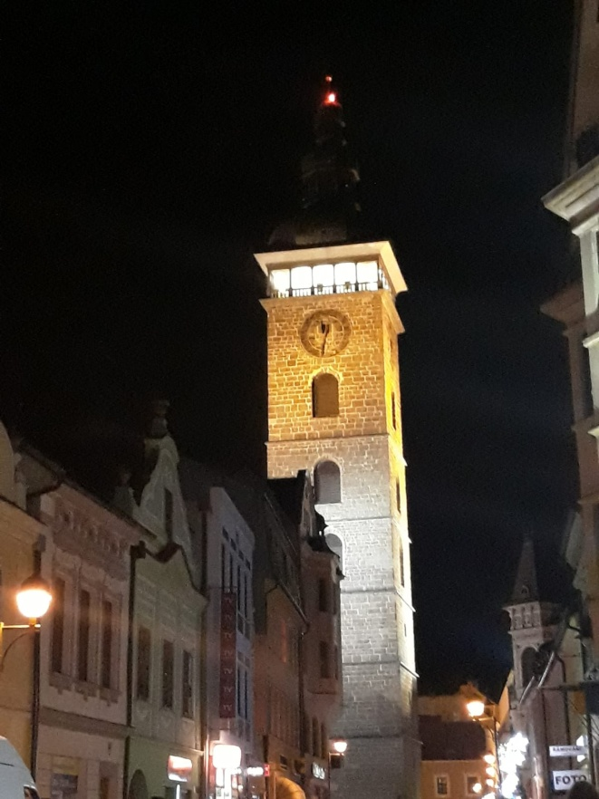
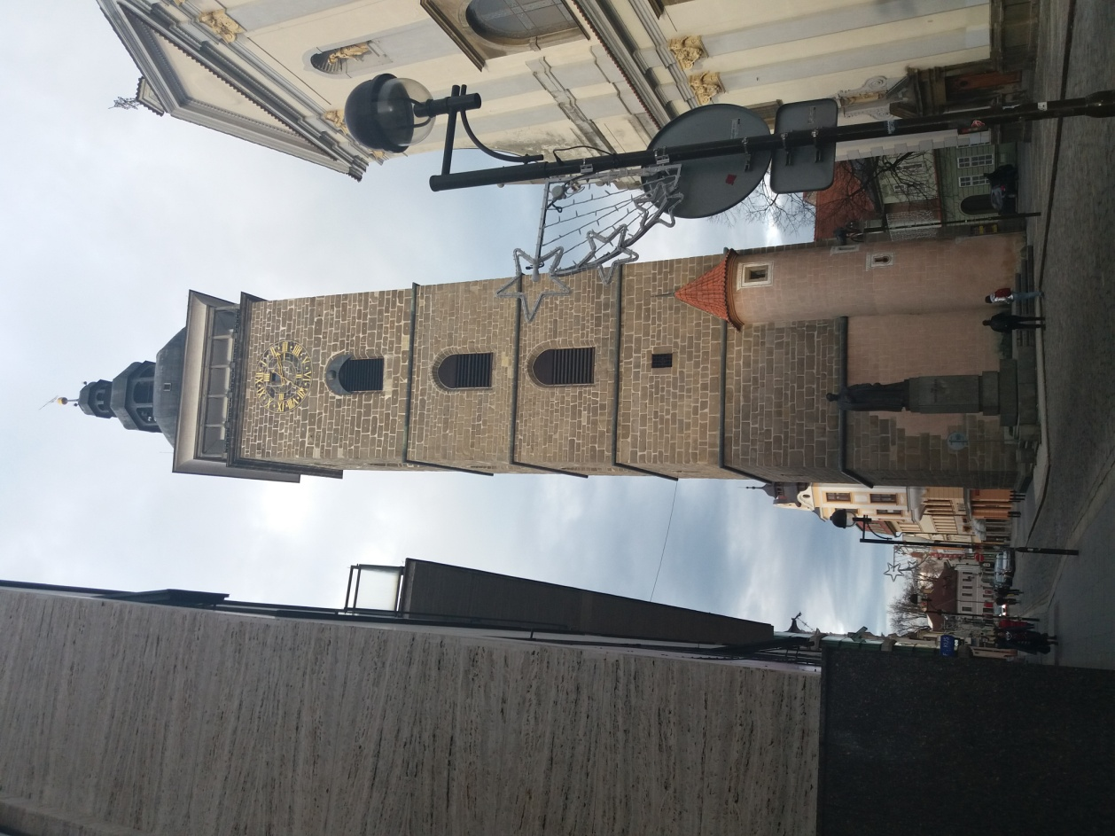
Monuments
Name: Black tower
Century: XVI
Style: gothic, renaissance
Typology: tower
Town: České Budějovice
Geographic coordinates: 48°58´32´´ N
14°28´32´´ E

