Slide 1
Celtic oppidum
Třísov

Slide 2
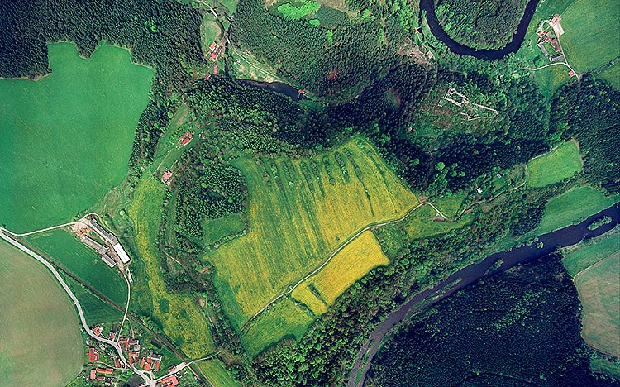
History of the the hillfort
Established around 150 BC.
It was located on the trade route from the north of Italy to the central Bohemia
It also served as a centre of crafts
Celts abandoned it between the years of 50 and 30 BC.

Slide 3
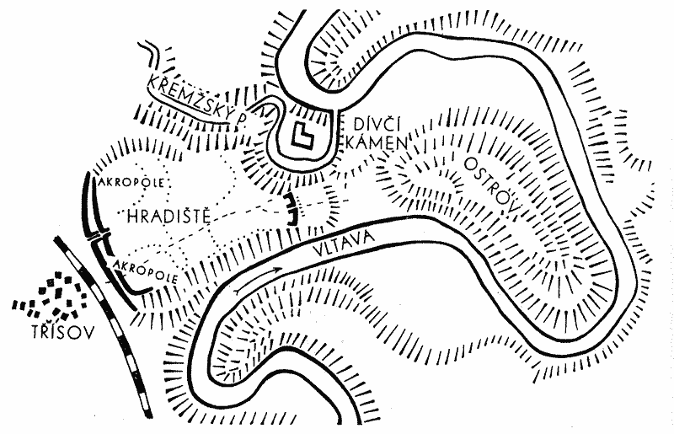
There were no ramparts in the direction of the Vltava, because there was a steep slope
Similarly to the stream of Křemže
The double wall covered the forehead
A simple wall then the space between the stream and the Vltava river

Slide 4
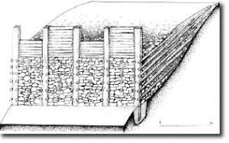
Defensive mounds
The ramparts consisted of clay and stone structures interlaced with tree trunks
The front wall was made by Celts from dry-laid stones, separated by tree trunks
There was a wooden palisade above

Slide 5
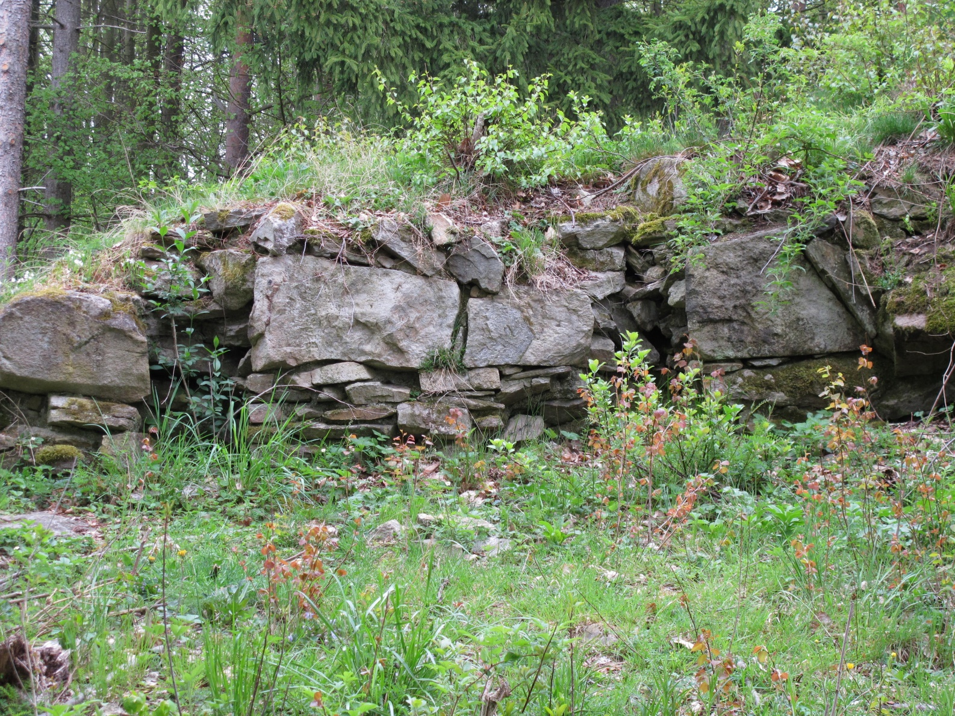
Inner defensive mound
Archaeological probe
It shows a wreath of large stones, which probably had an aesthetic function

Slide 6
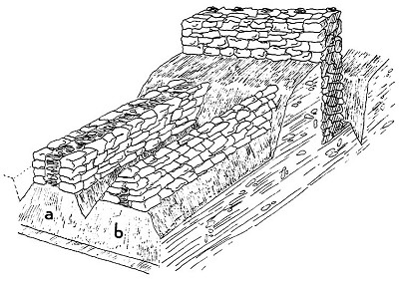
Internal defense system
The space between the ramparts was divided by transverse stone walls
It was supposed to crush the enemy attack
This system is absolutely unique in Europe

Slide 7
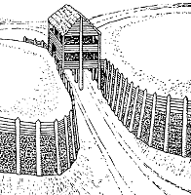
Pincer gate
The wooden gate was covered on both sides by a long rampart
Therefore, it was called clamp
in the area to the right of the gate between the ramparts there was a spring supplying water to the fort

Slide 8
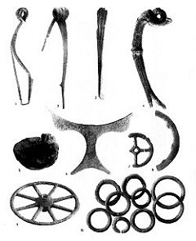
Crafts
the fort was the place producing metal objects - buckles, craft products and probably weapons

Slide 9
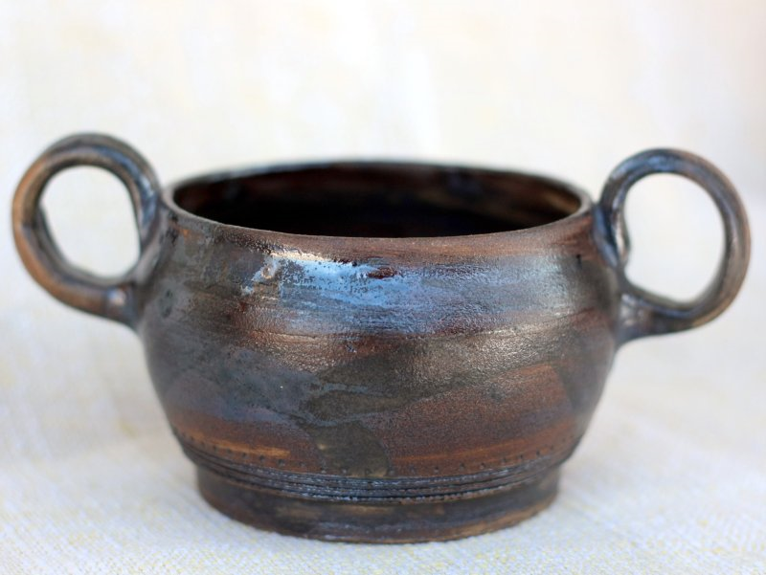
Ceramics
The caramics were exported from the fort of Třísov to the other regions
It was made of clay and graphite
Graphite gave the containers the specific matt shine

Slide 10
Extinction of the hillfort
Between 50-30, Celts left the hillfort
Causes: perhaps the pressure of the Germans from the north
Perhaps the decay of Celtic society in general
According to the archeologists the fort had never been conquered

