Slide 1
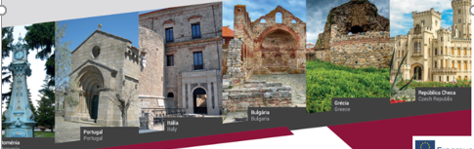
DNA Encyclopedic
Europe´s Architectural Diversity

Slide 2
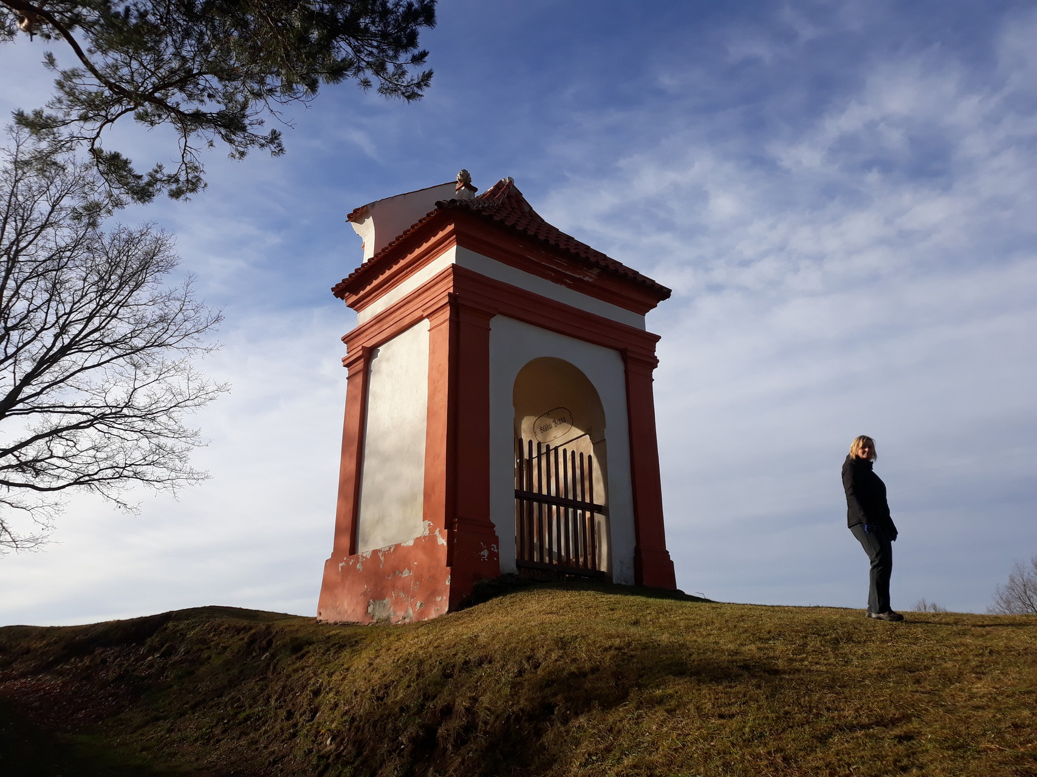
Czech Monuments
PHOTO
Name: Passion journey
Century: XVII - XVIII
Style: Baroque
Typology: Cross path
Town / village: Římov
Geographic coordinates: start of the cross path 48.8573519N, 14.4848406E

