Slide 1
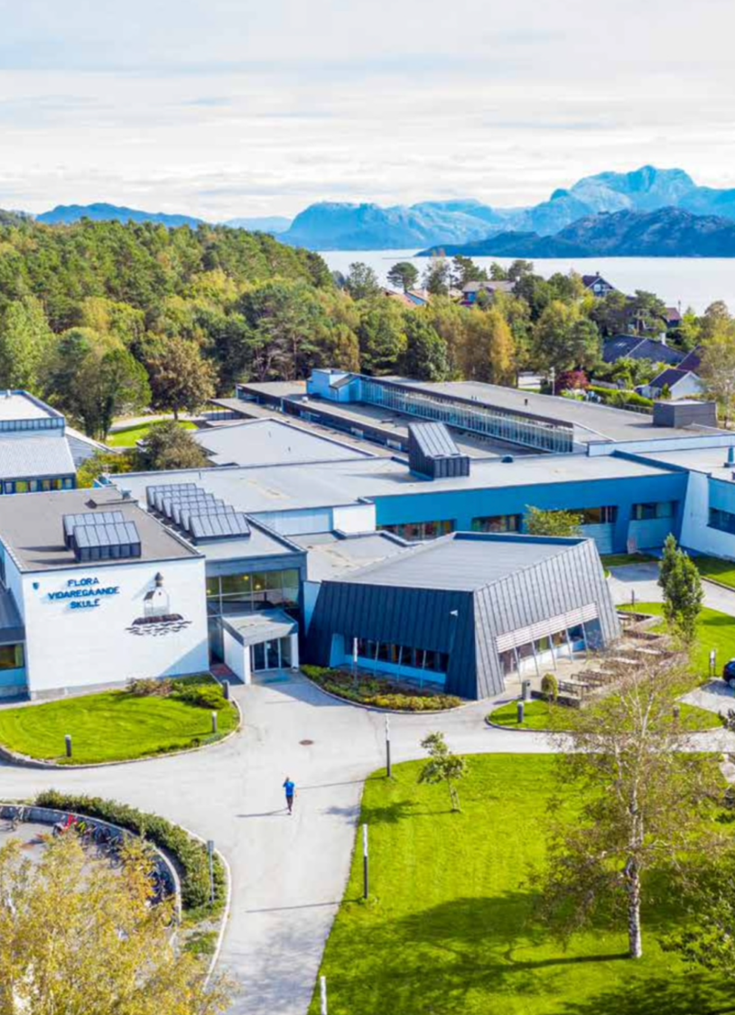
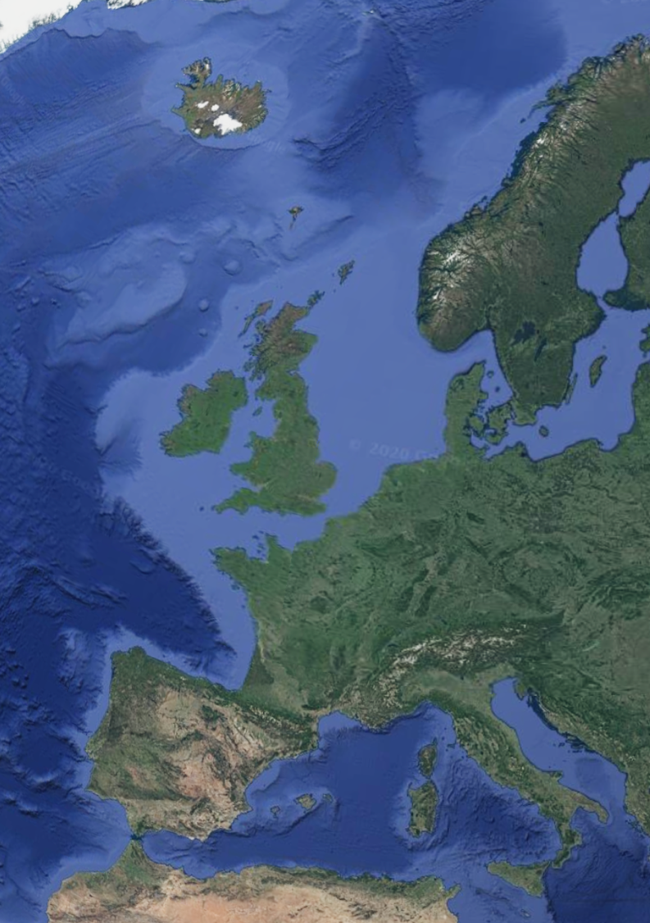
Flora upper secondary school:
Knowledge, inspiration and personal growth for all
550 students
7 programmes (general and vocational)
The Florø area:
On the coast of western Norway
Strong community culture for personal initiative and entrepreneurial mindset both in business and socially
Thriving industries based on recourses like fish, oil, gas, mining and cutting edge technologies within sea farming, hydrogen and maritime construction.
Small public government sector except from social services, health care and education
Demographics:
12 000 people
Lower birth rates
Older population
14% immigrant population
Students from vocational studies find work locally
Students from general studies generally move to larger cities

Slide 2
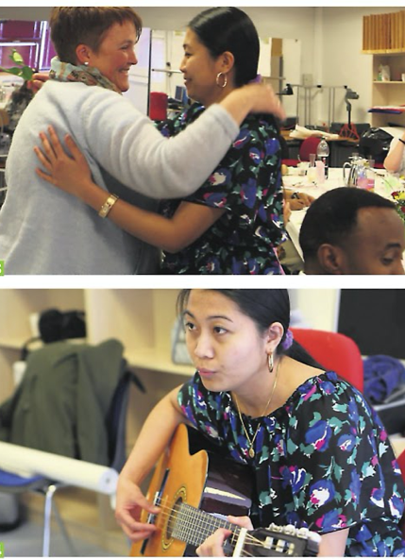
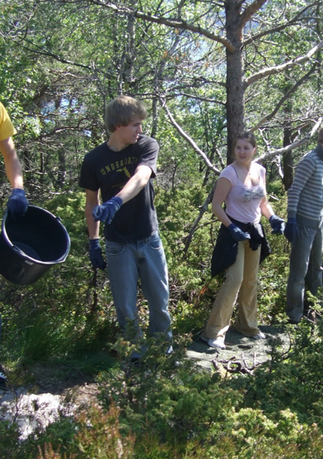
Flora upper secondary: Examples of best practice in building sustainable local communities
School run projects
Preparing young immigrants for upper secondary education
Educating migrants to become certified health care workers in collaboration with local community
Maintenance work on nature trails for the benefit of the local community
THE MALAWI – project – more later …

Slide 3
UsingYouth businesses to facilitate the entrepreneurial mindset for students 16-19
From 1997 and onwards.
Linked to the national curriculum from 2001
We live in a business driven community– and YB contributes to reproduction ofentrepreneurial mindset

Slide 4
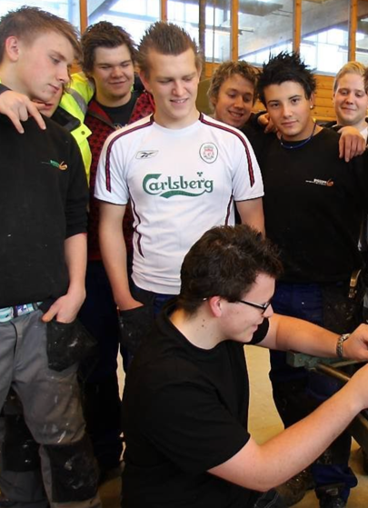
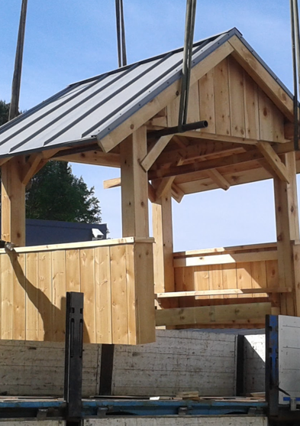
Flora upper secondary: Examples of best practice in building sustainable local communities
Student run projects as Youth Businesses
Students in our Building and construction programme make benches, tables, bus stop shelters and rest huts for the benefit of our local community

Slide 5
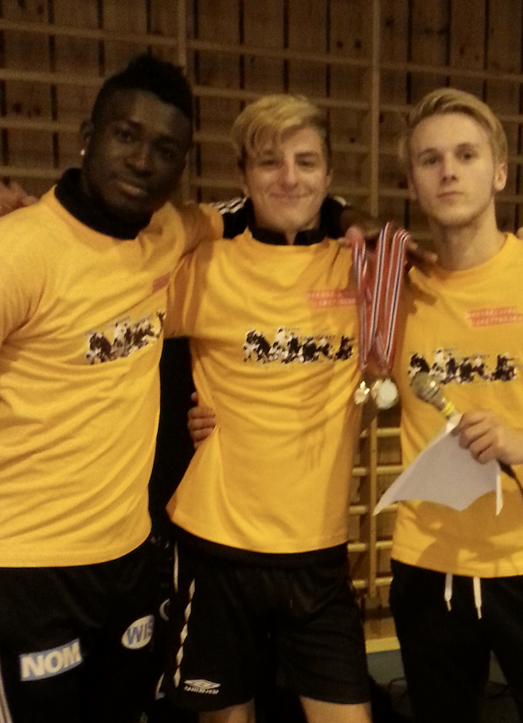
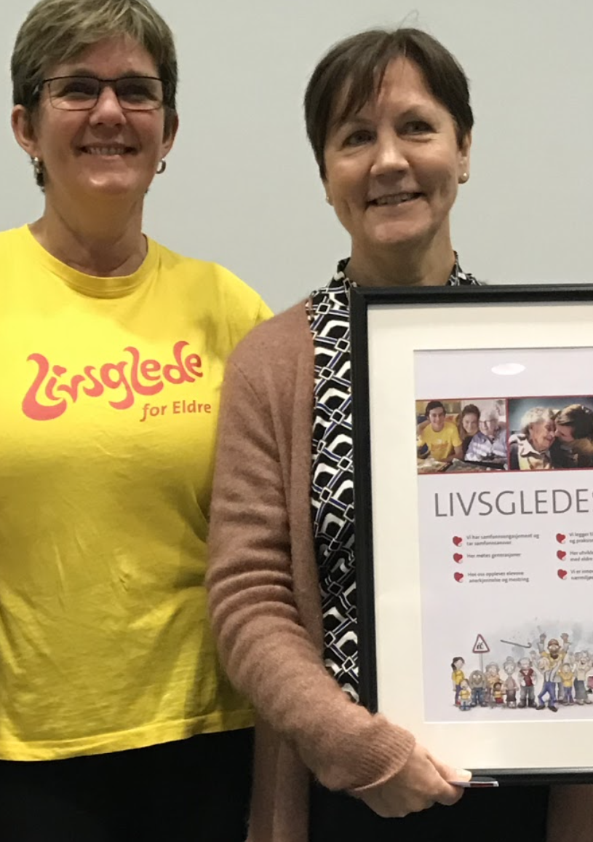
Flora upper secondary: Examples of best practice in building sustainable local communities
Student run projects as Youth Businesses
Students in our sports programme deliver Physical Education (PE) for young immigrants preparing for upper secondary education
Students in our Healthcare, child & youth programme deliver homework assistance to kids in primary school
Students in our Healthcare, child & youth programme as «Yellow angels» visiting homes for the elderly
And organizing “Birthday parties and events” for kids.
THE MALAWI – project – more later …

Slide 6
Local stakeholders in our entrepreneurship projetcs
Students and teachers in upper secondary school (16-19 y)
Youth in general in our area
Industries interest groups facilitating networks and business clusters
Voluntary groups
Immigration and Integration centre
Local government and youth workers
Regional Youth Entrepreneurship association.
Partners in Malawi

Slide 7
Tools in our toolbox and tools in the making in other ERASMUS projects.
Design models to strengthen bond between students and local businesses to
increase return to local labour market after completed studies
make learning more relevant
YB – Youth business, and entrepreneurship as method and identifier of business opportunities
Models for teaching which incorporates local contribution
Models for engaging in social entrepreneurship
Models for integration of immigrants in upper secondary education
Enhance mental models of “me in my area in 3 or 6 years”

