Slide 1
Trond-Ole Hjorthaug
Entrepreneurship teacher
Advisor of Youth Companies

Slide 2
Entrepreneurship
Lot of theory
Youth Company as a way of teaching
Challenges
Youth Companies

Slide 3
Anette Kent Vågene
CEO
Prosjekt Malawi UB
(Project Malawi Youth Company)

Slide 4
Torgeir Halvorsen
Specialized in international social entrepreneurship
and
mentor for
Prosjekt Malawi UB
(Project Malawi Youth Company)

Slide 5
Prosjekt Malawi UB
10 students and 2 teachers (number of studetns varies from year to year)
Hired through interview
Each student gets a fixed position
Students learn basic entrepreneurship
Collaborating with Norwegian donors
Holding several lectures about our activities throughout the year
Traveling once a year to Malawi on a follow up trip

Slide 6
How students are engaged in international social entrepreneurship through Prosjekt Malawi UB
Anette´s background:
CEO of a Youth Company with 10 employees
In charge of board meetings
Human resource manager
Mentored by a responsible teacher and a mentor
How to start a company with all the paperwork
Looks good on my CV

Slide 7
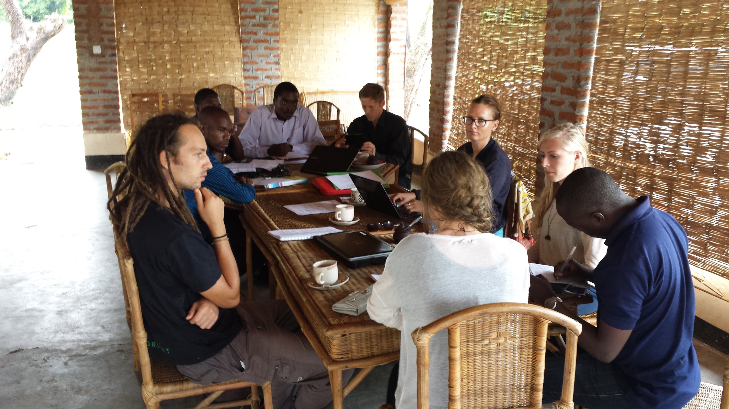

Slide 8
How students are engaged in international social entrepreneurship through Prosjekt Malawi UB
Fundraising day
Each student at school earn 400 NOK
International Day
Transforming the School´s Assembly Hall into an African Market Place
Selling international food made by International Students
Entertainment and dancing

Slide 9
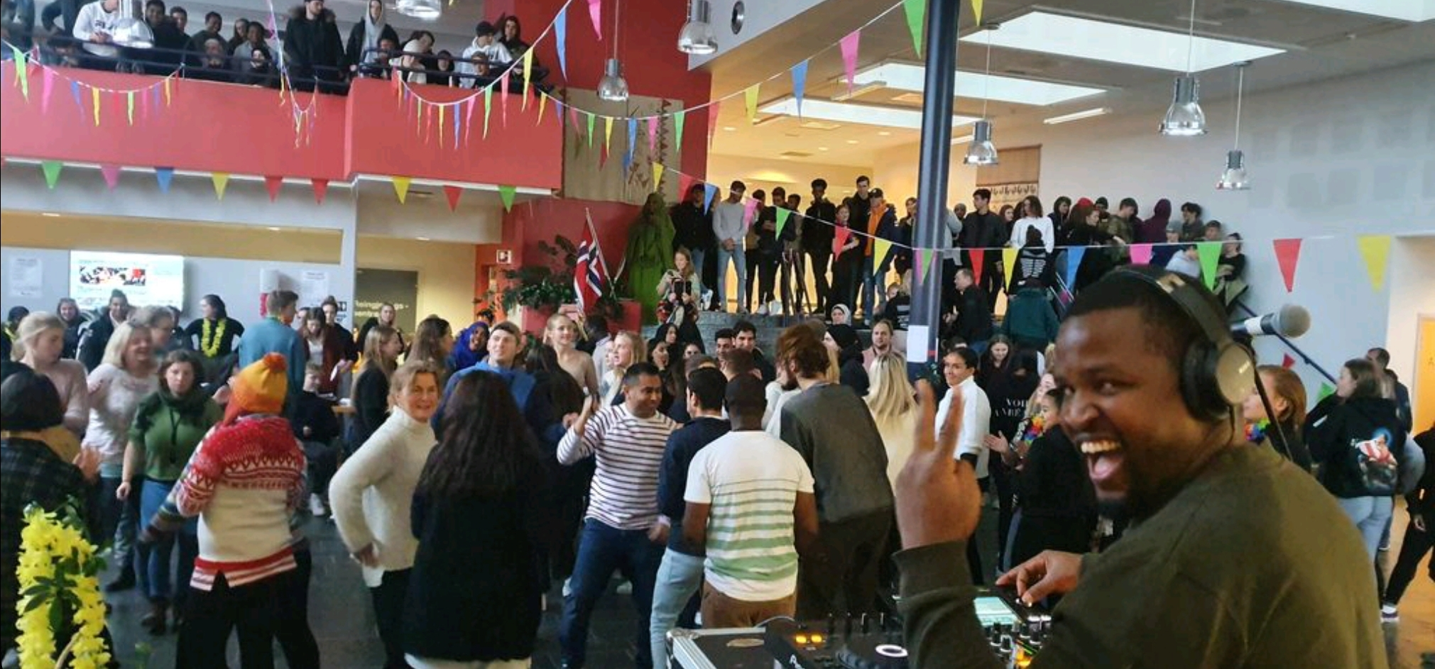

Slide 10
What do you get for 400 NOK in Norge?
What do you get for 400 NOK in Malawi?
23 bottles of 0,33 litre Coca-Cola
19,5 litres of milk
25 litres of gasoline (16 NOK/litre)
1/325 of the yearly cost of a student at upper secondary school (Half a day at school)
Salary to a substitute teacher for one lesson
112 bottles of 0,33 litre Coca-Cola
45 litres of Milk
48 litres of gasoline (8,20 NOK/litre)
Cost of a vocational skill student for half a year
1/3 monthly salary for a vocational skill teacher in Nkhotakota

Slide 11
Achievements for Flora Upper Secondary School and YouthCode in Nkhotakota in Malawi through the work of Prosjekt Malawi UB
Torgeir´s background:
Malawi 16 times since 2012
Internet café and two vocational skills
Built a summer hut (2012)
Expanded to 5 vocational skills (2014)
Cultural centre (2013)
Helped start Kumudzi Kuwale Ltd (2013)
Solar power company (80 employees)
Small and big installations (UN village)
Provided electricity for more than 10.000 people in rural areas
Students (girls especially) can study at night after doing their chores

Slide 12
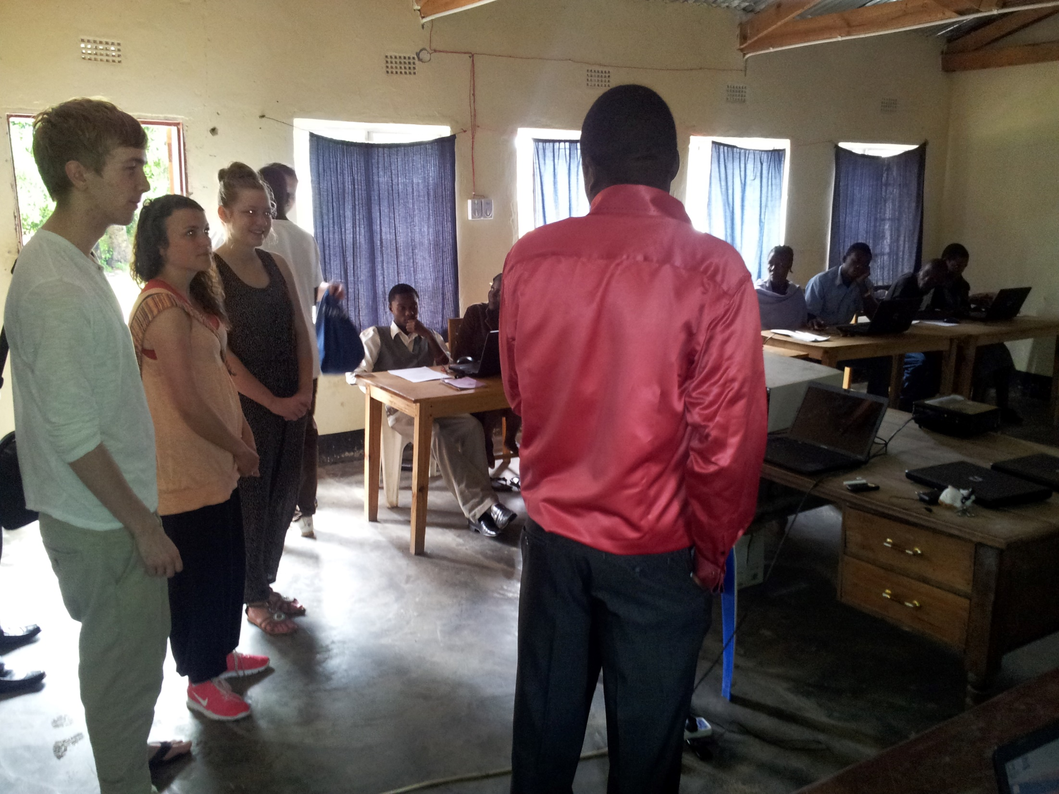
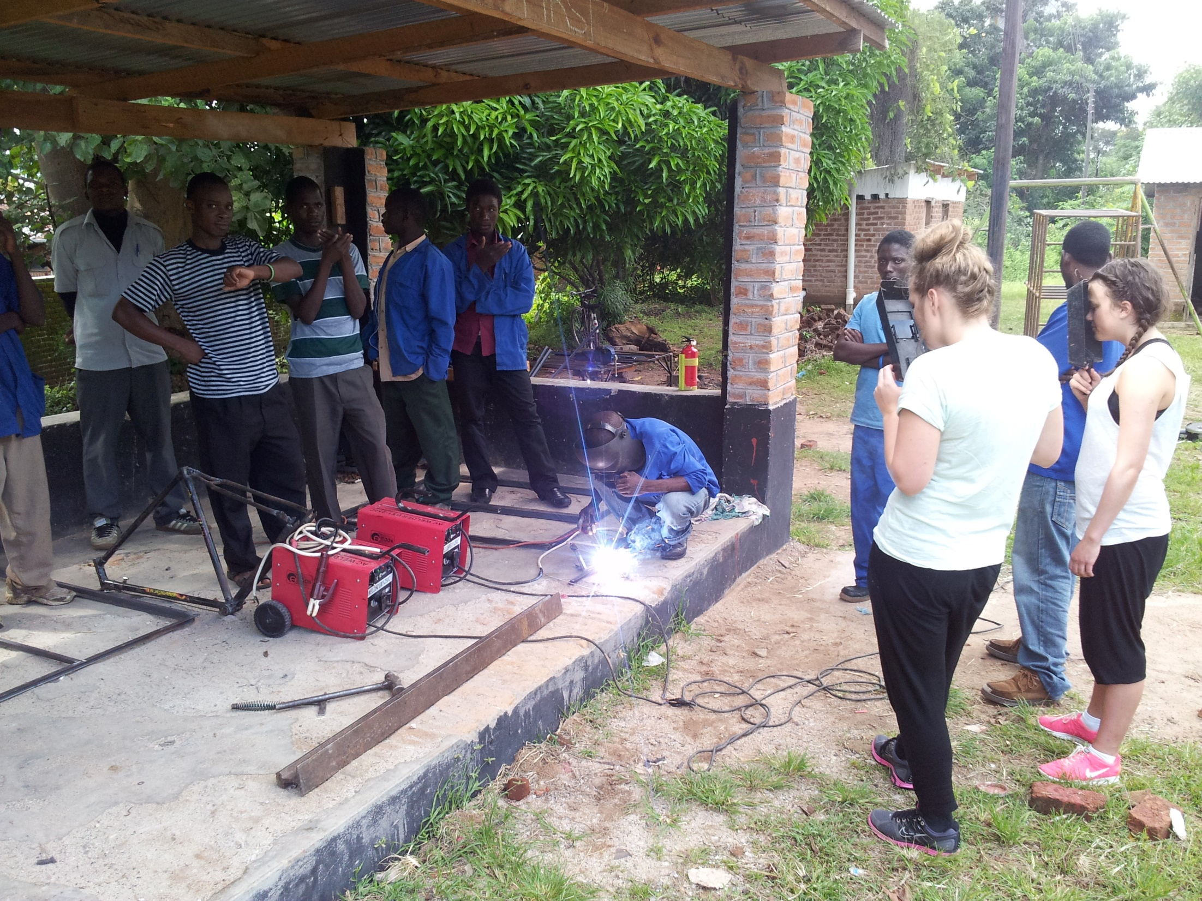

Slide 13
YouthCode (Youth and Community Development Organisation)
Vocational Skills Centre
5 skills
Welding and Fabrication
Tailoring
ICT
Electric installation
Carpentry
Entrepreneurship
Mandatory for all vocational skill students
Trainees in local businesses
Cultural Centre
Cultural School
Music Festival (since 2015)
Restaurant (outsourced to ensure fixed income)

Slide 14
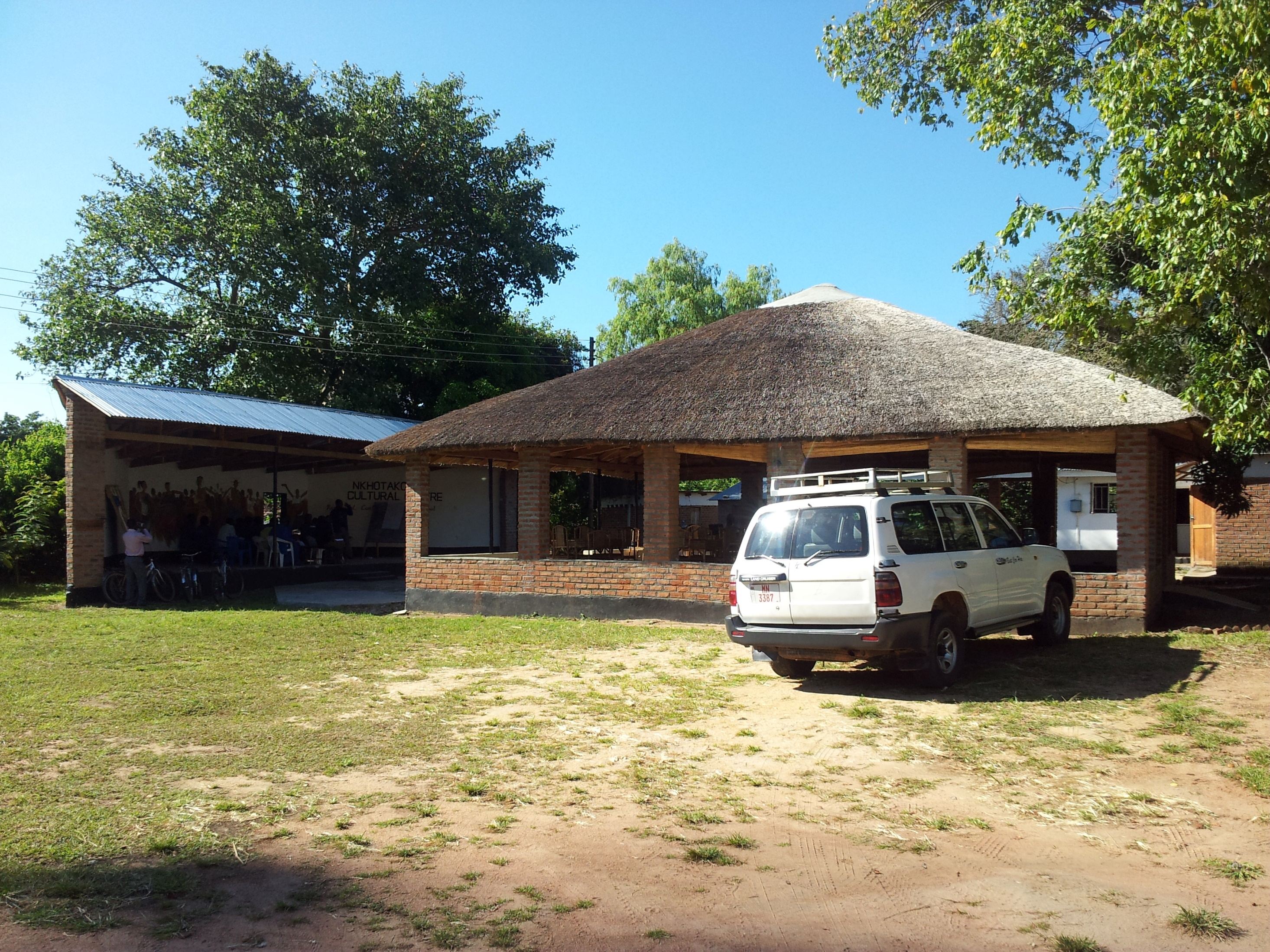

Slide 15
Achievements for Flora Upper Secondary School and YouthCode in Nkhotakota in Malawi through the work of Prosjekt Malawi UB
In Florø
Bringing english into the school environment through working with partners in Malawi
Students and teachers have learned a lot about bilateral work
Introduced international aid work to several generations of students and teachers
Raised local avareness about international issues, both at school and in the greater community
We have made the world smaller through globalisation
In Nkhotakota
Established a well renowned Vocational Skills Centre
More than 1000 students have been educated within five highly demanded skills
Most of these 1000 now have a full time job witihin their skill, many of them in their own companies
Established a Cultural Centre with weekly lessons in music, dance and art
Established an annual Music Festival with local, national and international artists and more than 2000 visitors each year

Slide 16
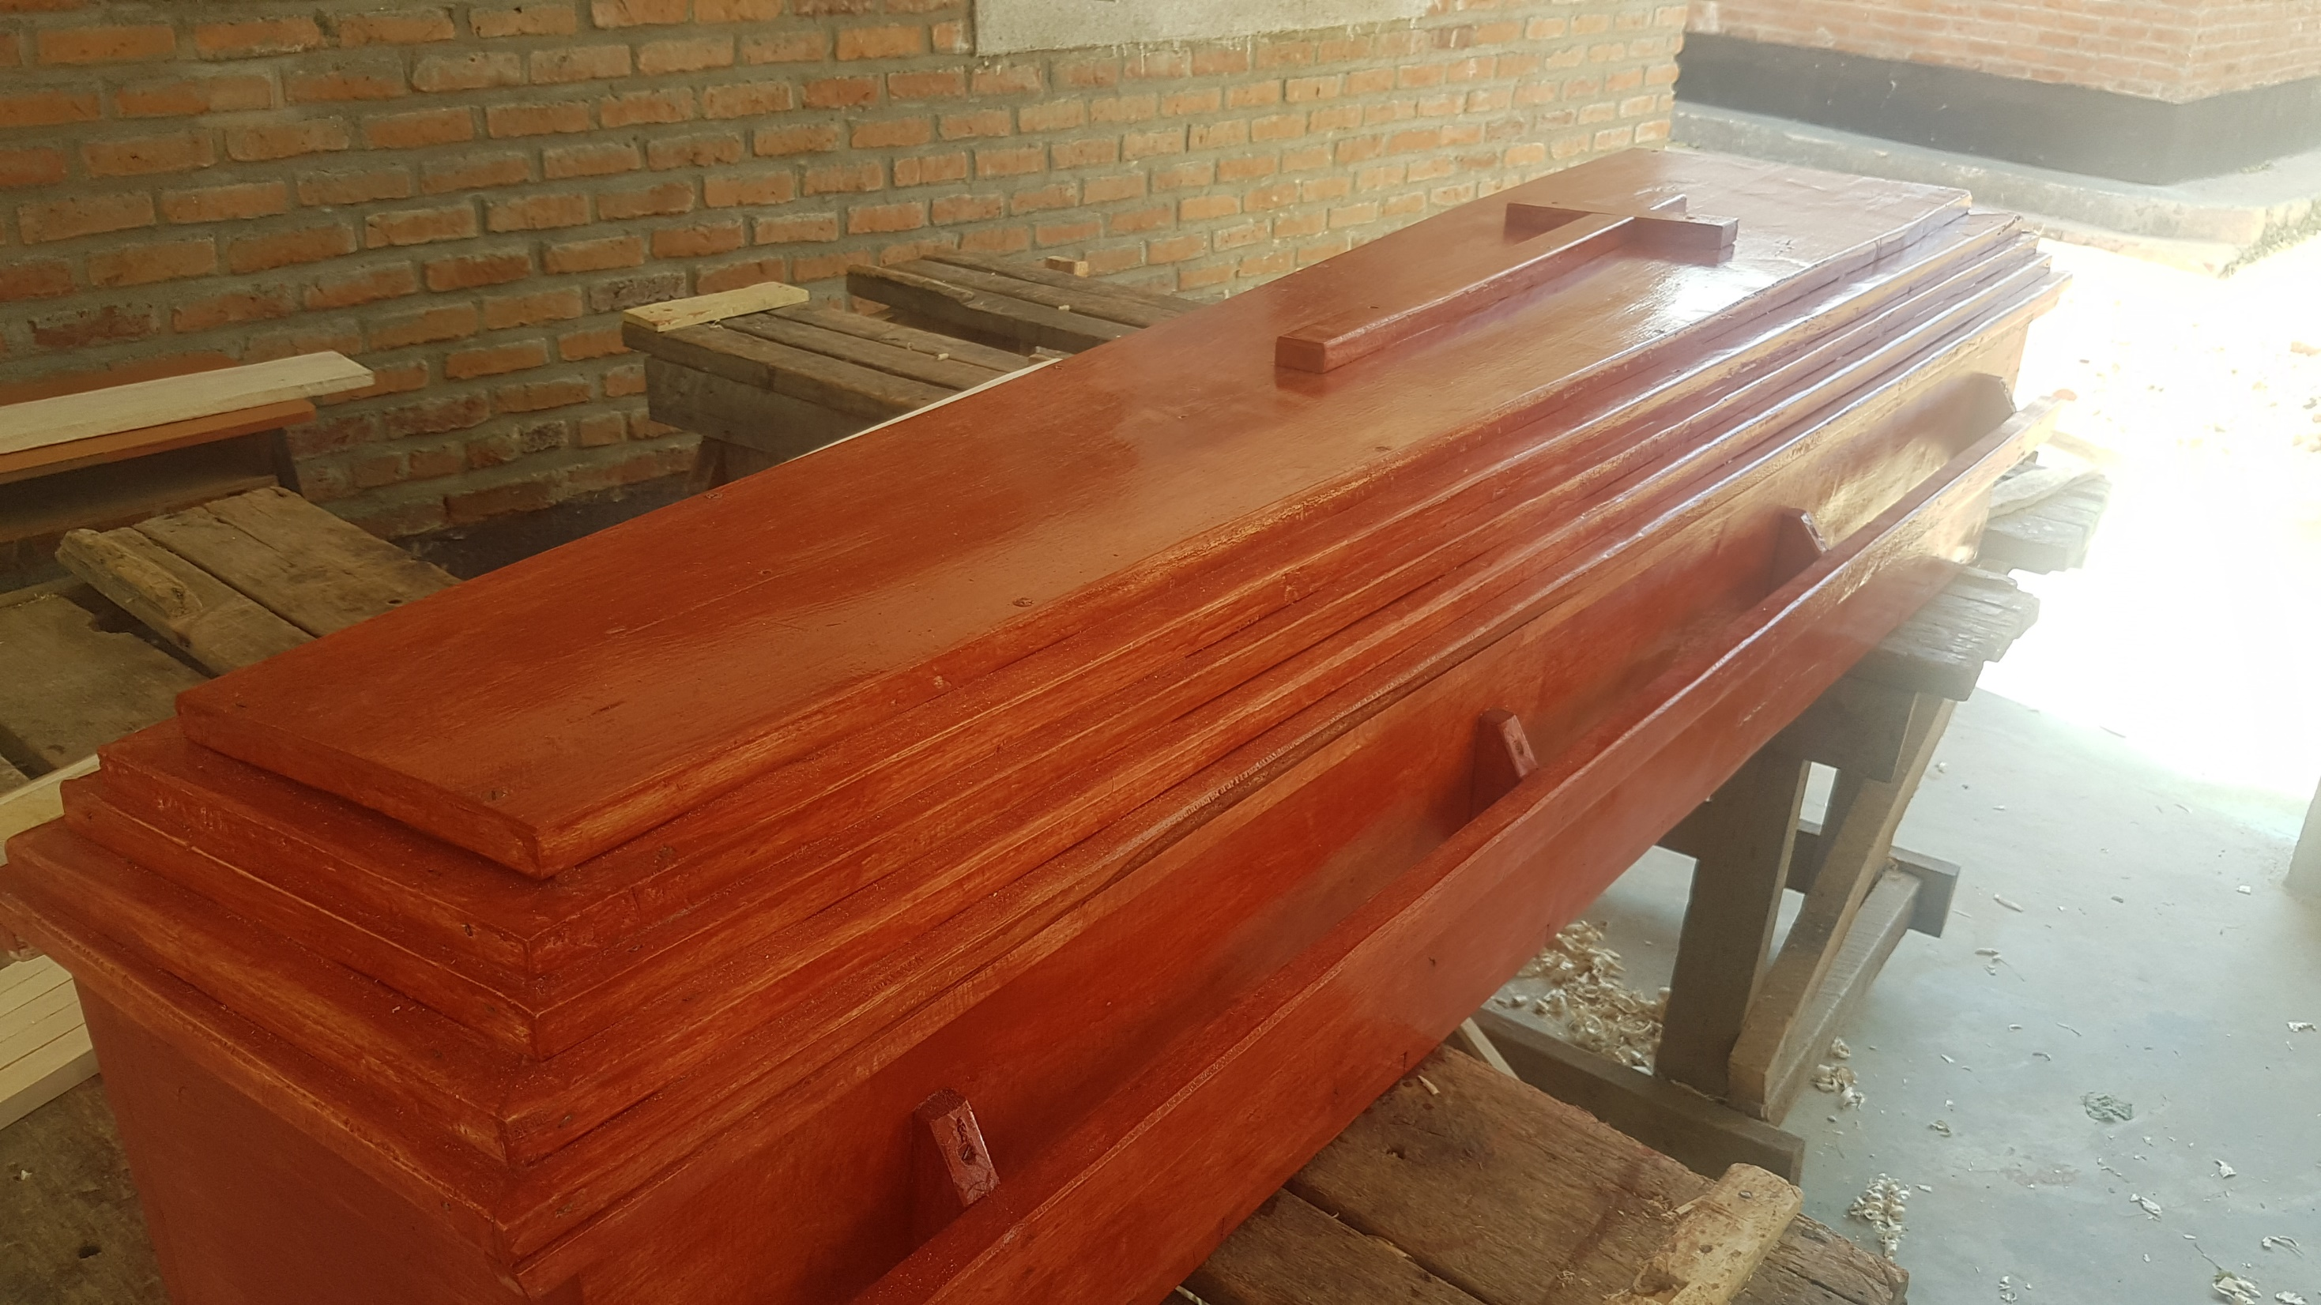

Slide 18
If you want to learn more ☺
https://www.facebook.com/prosjektmalawiub
https://www.facebook.com/youthcodemalawi
https://www.facebook.com/kumudzikuwale
https://www.facebook.com/floravgs

