Slide 1
Traveling to new teaching adventures 2019-1-BE02-KA229-060207_4
Assessment for students
October-November 2019

Slide 2
Belgium
24 students answered the questionnaire.
Norway
37 students answered the questionnaire.
Aged between 17 and 18 years old
Romania
15 students answered the questionnaire.
Aged between 10 and 16 years old
All of them are in middle school
Portugal
132 students answered the e-form
Aged between 10 and 18 years old
Most of them are in middle school

Slide 3
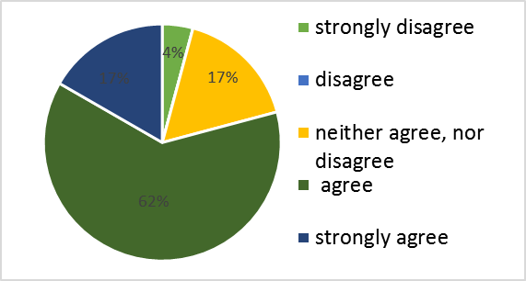
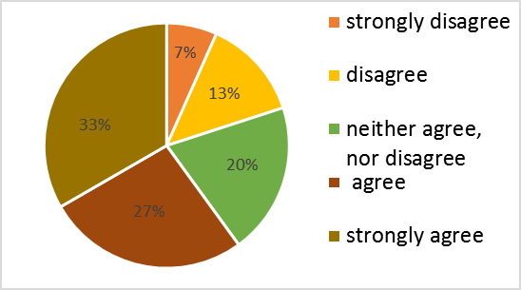
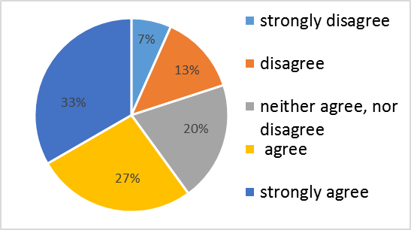
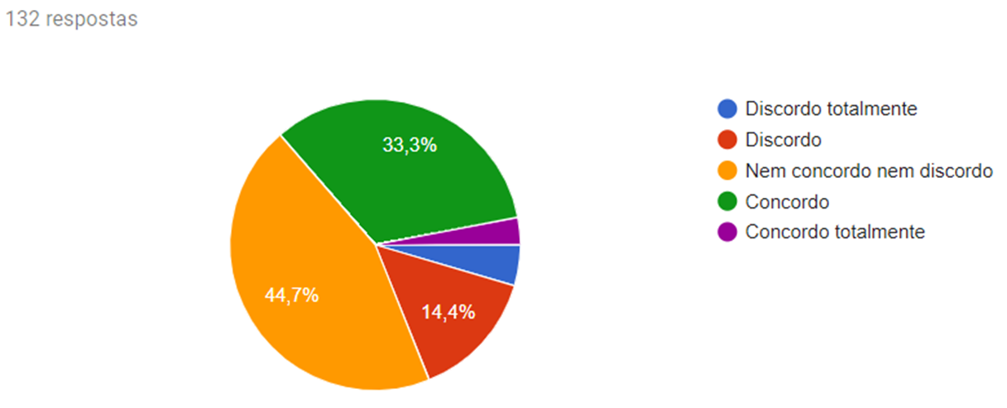
The lessons are attractive in your school.
Belgium
Norway
Romania
Portugal
Most of the students agree, neither agree or disagree.
.

Slide 4
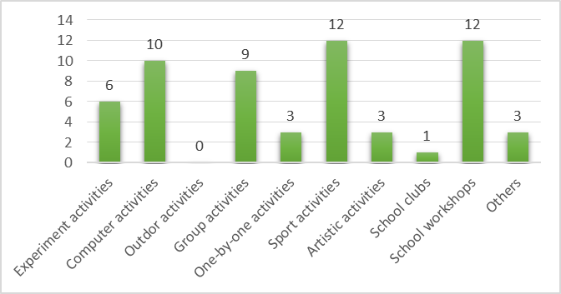
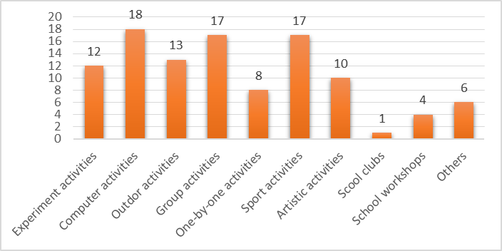
Which of the following school activities do you like most? Why?
Belgium
Norway
Sport and computer activities was the most most chosen item besides group activities and school workshops.

Slide 5
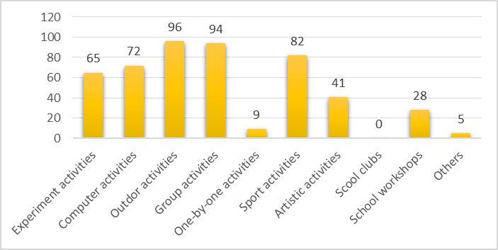
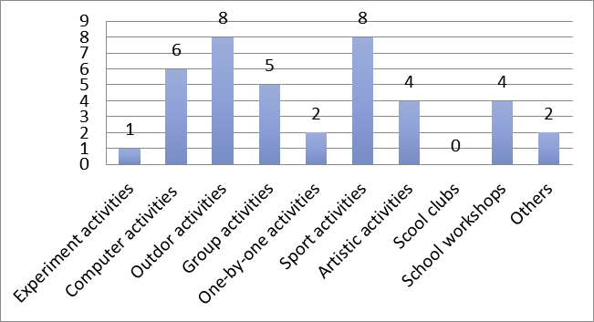
Which of the following school activities do you like most? Why?
Portugal
Romania
Sport and outdoor activities was the most chosen item besides group activities and computer activities.

Slide 6
Others school activities:
Working at the shop
Every hour sport
Like to work in groups
Use technology
Experiment, and find solutions to different problems
International day
Fundraising-day
Be creative and to use my hands
RRR school workshops: learn how to protect the environment
Physical education and sport because we go to a sport base every week.

Slide 7
Which of the school subjects do you like most? Why?
Belgium
Logistic assistant
Working on cars
Metal work
Sports
General subjects
Woodwork
Computer lesson
Shop assistant
Vocational training
Social skills
Work outside
Math
Art
Cooking
Looking Karrewiet (news)
“Logistic assistant because I like it, I can learn a lot of things for a later job, we play games and can work together
Working on cars because I can learn a lot about cars
Metal work because I can learn a lot of my job as a welder, is fun, we learn a lot of new things, we like the teacher
I like Sports because is fun, I like moving
I like Computer lessons because I like computers, the classes are fun, I also like to look at the news edition.
Shop assistant because we can work together.
Vocational training because we can do things for real”.

Slide 8
Which of the school subjects do you like most? Why?
Norway
English
Norwegian
Gym classes
PE
Biology
History
Religion
Children health
Social studies
Science
Computer science
Math
Entrepreneurship
Chemistry
Law

Slide 9
Portugal
Students made their choices based on their their preferences and skills.
The school subject most referred was Sports because students like outdoor activities and group work.
They also chose Maths, ICT and History because they like work on these areas and learn more about it.
Languages were the less preference.
A few students don’t have a favourite subject.

Slide 10
Romania
“The physical education and sports classes are held outside and at the sports base. I play a lot during this class.
Sport
Math
Romanian
English
Music
Arts
Speech therapy
Kinetotherapy
School Workshops
Math is fun, I like to calculate and to learn how to do calculations; without mathematics you cannot get hired anywhere. I like that the teacher brings us the tablets and we do calculations on them.
Music helps me calm down.
I like Workshops because I meet other children and do interesting things.
Romanian helps me writing better.
I like English because I am learning new words and I can talk to children from other countries”.

Slide 11
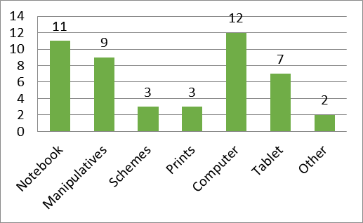
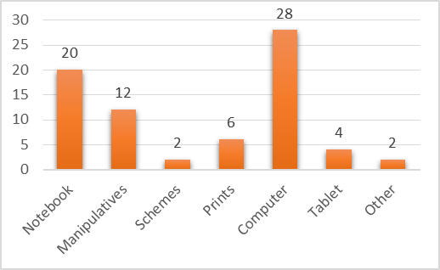
You learn easier if you are using:
Belgium
Others:
Video
My brain
Stappenplannen
Going home
The easier way to learn chosen by the students were: computer, notebook, manipulatives.

Slide 12
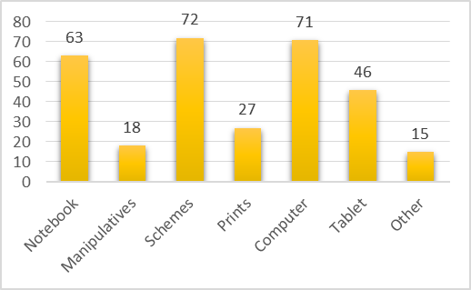
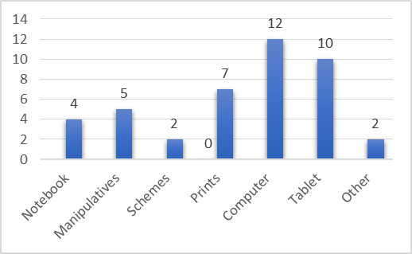
Portugal
Romania
The easier way to learn chosen by the students were: schemes, laptop/computer, tablet, prints, notebook and manipulatives.

Slide 13
What do you think is a good way to learn in your opinion?
Norway
Belgium
Paying attention and listening to the teacher
The teacher has to explain more
Some rest in the classroom
More free time
Searching on Google
On the computer and doing experiments
Shopping and working at the shop
We have to feel good, we have to be patient , students with autism also have the right for own goals and don't have to do what others say , we have to do our best and be strong , we have to build up our intelligence although we are not so smart
A good explanation
I want to be dismissed earlier from school
Not too much writing and reading
Paying attention
Be smart and use your head
If the teacher has god contact with the students it is much easier to learn.
Good teachers who can motivate their students
Group work and group presentations
Listen to teachers who know what they are talking about
Motivating teachers
Classic teaching and then work with different tasks
Discuss with other students
Learning by listening to the teacher and taking notes
Write
IDK
Talking, discussing
Visually and hearing
Learn by my self, in my own progress
Teacher gives summary after a chapter or theme
Movies
Vary the teaching skills with quizzes and so on
By switching between practical and theoretical methods

Slide 14
What do you think is a good way to learn in your opinion?
Romania
Portugal
Students referred many ways to learn..
They preferred learn by using technologies such as videos, net, research...
They also like to use summaries and writing and reading about the topics.
Another good way to learn is to listen the teacher.
A few said they don’t know what is a good way to learn.
Experiments based learning
Paying attention
Visually and hearing
Given examples
Using manipulatives
Using ICT tools - tablet
Taking more writing notes
By practicing sport, sports help me concentrate better at the classes
By switching between practical and theoretical methods
Teacher gives summary after a chapter or theme
Learning by listening to the teacher and taking notes
Using schemes
Searching on Google
Practical activities

Slide 15
THANK YOU!
The project is financially supported by the European Commission under the Erasmus+ Programme. The European Commission support for the production of this publication does not constitute an endorsement of the contents which reflects the views only of the authors, and the Commission cannot be held responsi­ble for any use which may be made of the information contained therein.

