Slide 2
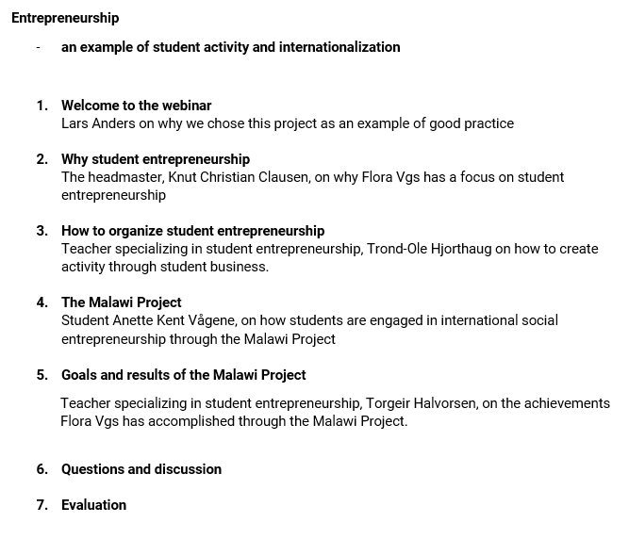

Slide 3
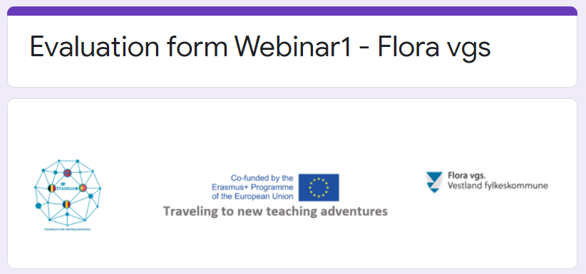
https://forms.gle/xX4XrgHQP2zsEMeH8

Slide 4
