Slide 1
Welcome to Flora upper secondary school
One of many new teaching adventures ☺
Knut Chr. Clausen - headmaster

Slide 2
Our school:
500 regular students
30 language training students
40 adult learners
95 staff

Slide 3
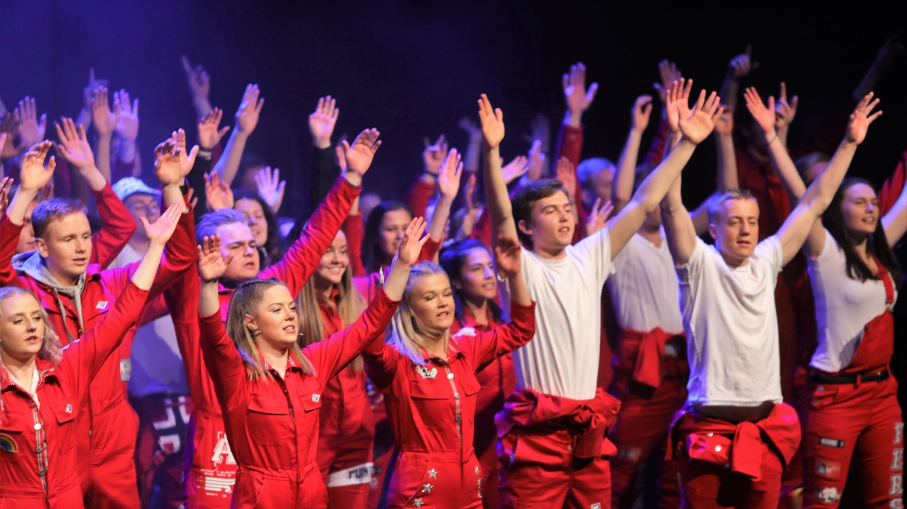
Watch out for the «russen»
Photo: Dag Frøyen – Firdaposten.
Third year students and graduates from the generetal studies celebrating their final year 24/7 …
Notes:
The word russ is probably an abbreviated form of Latin depositurus, which is the futurum participle of the verb deposit 'deposit’. And what they deposit is their final exams ...

Slide 4
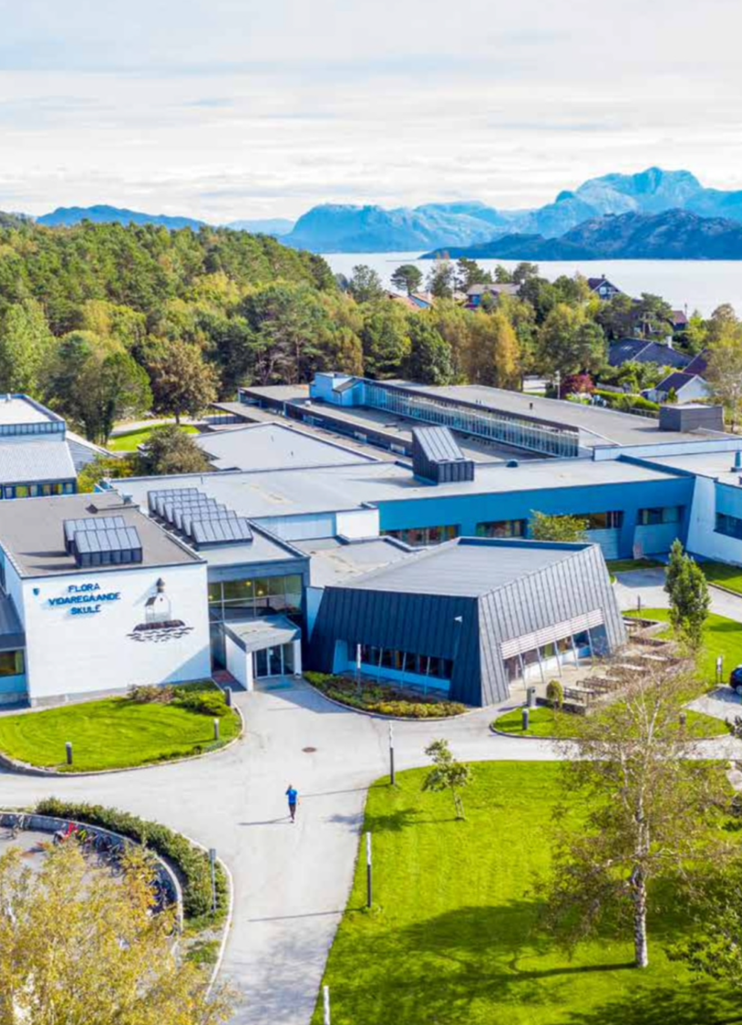
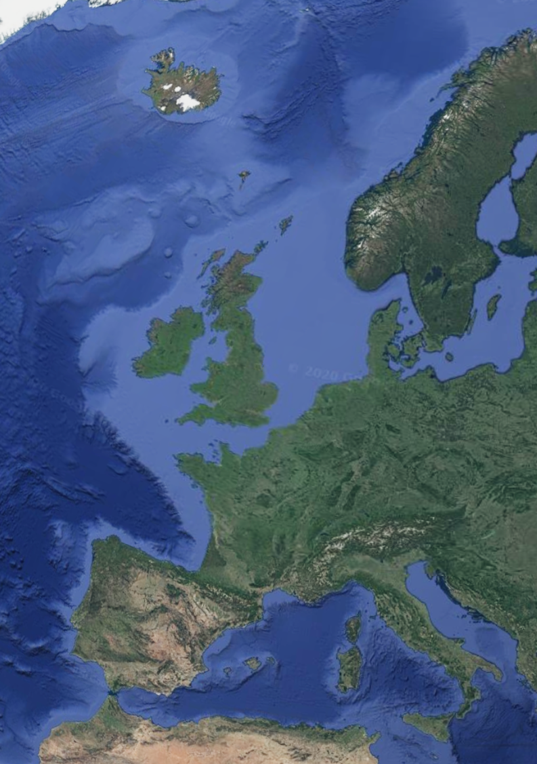
Flora upper secondary school:
Knowledge, inspiration and personal growth for all
550 students
7 programmes (general and vocational)
The Florø area:
On the coast of western Norway
Strong community culture for personal initiative and entrepreneurial mindset both in business and socially
Thriving industries based on recourses like fish, oil, gas, mining and cutting edge technologies within sea farming, hydrogen and maritime construction.
Small public government sector except from social services, health care and education
Demographics:
12 000 people
Lower birth rates
Older population
14% immigrant population
Students from vocational studies find work locally
Students from general studies generally move to larger cities

Slide 5
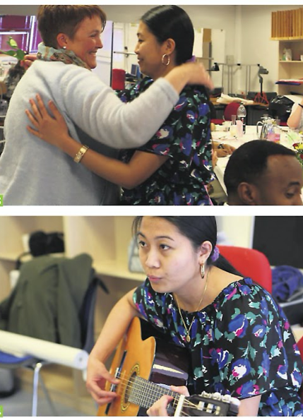
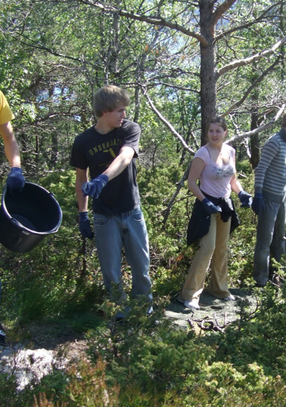
Flora upper secondary: Examples of best practice in building sustainable local communities
School run projects
Preparing young immigrants for upper secondary education
Educating migrants to become certified health care workers in collaboration with local community
Maintenance work on nature trails for the benefit of the local community

Slide 6
In addition to seven programmes with 500 students – we have:
Two groups with language training
Four groups with vocational training for adults
An inclusive environment and egalitarian culture:
Teachers and school management are adressed by first name by students
The education act states that bullying and harrassment is delt with at the highest level in each school
But there is also the 10% rule:
- Students with more than 10% illegal absence from lessons are not granted a right to grades in a subject - and thus will not complete a school year.

Slide 7
Examples of using Youth businesses to facilitate the entrepreneurial mindset for students 16-19

Slide 8
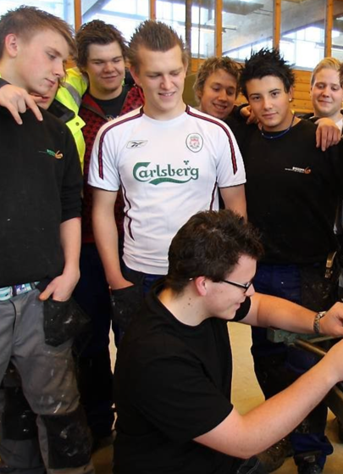
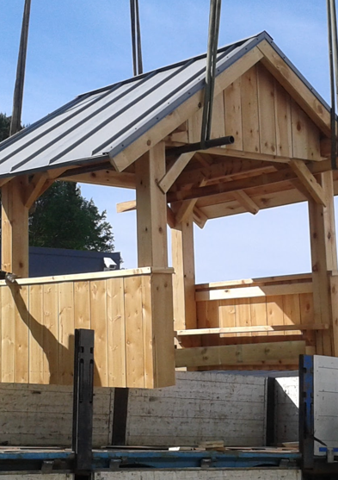
Flora upper secondary: Examples of best practice in building sustainable local communities
Student run projects as Youth Businesses
Students in our Building and construction programme make benches, tables, bus stop shelters and rest huts for the benefit of our local community

Slide 9
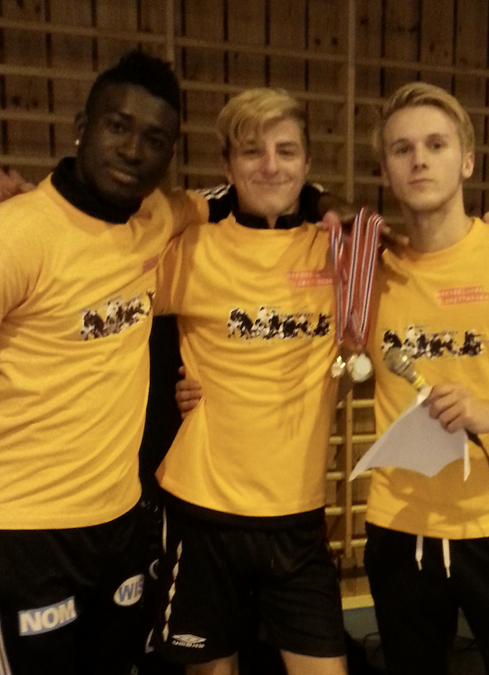
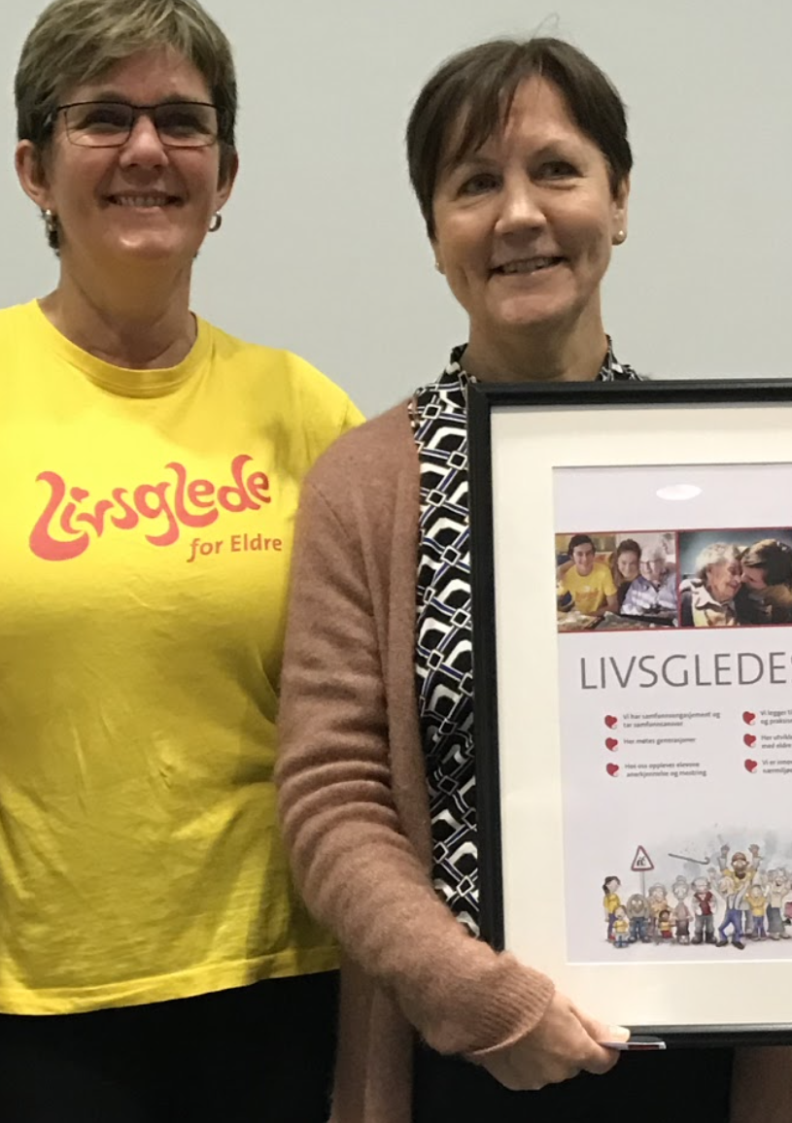
Flora upper secondary: Examples of best practice in building sustainable local communities
Student run projects as Youth Businesses
Students in our sports programme deliver Physical Education (PE) for young immigrants preparing for upper secondary education
Students in our Healthcare, child & youth programme deliver homework assistance to kids in primary school
Students in our Healthcare, child & youth programme as «Yellow angels» visiting homes for the elderly
And organizing “Birthday parties and events” for kids.

Slide 10
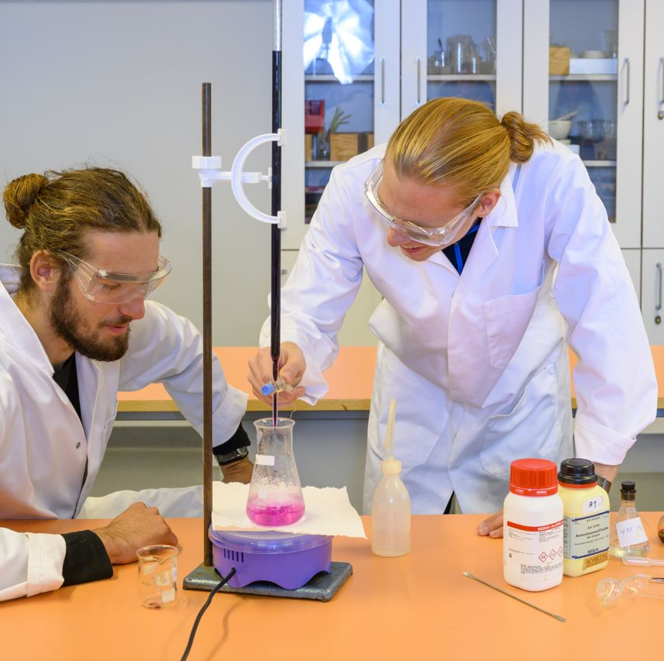
Specialization in general studies

Slide 11
Sports and physical education

Slide 12
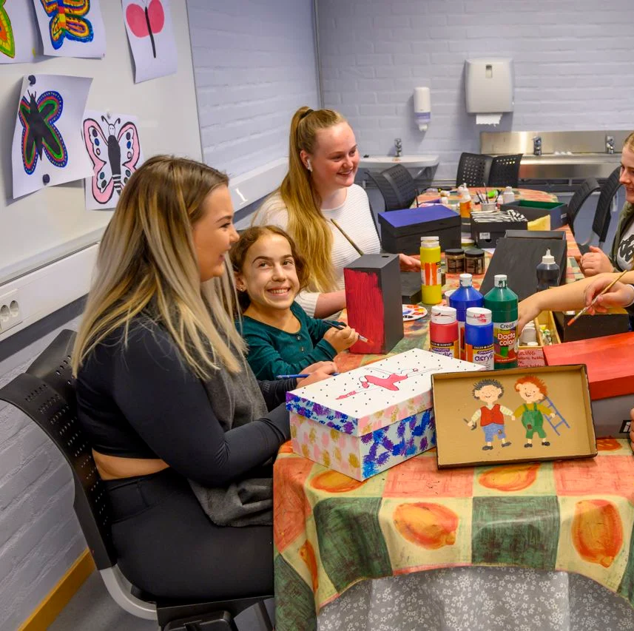
Healthcare, childhood and youth development

Slide 13
Sales, service and tourism

Slide 14
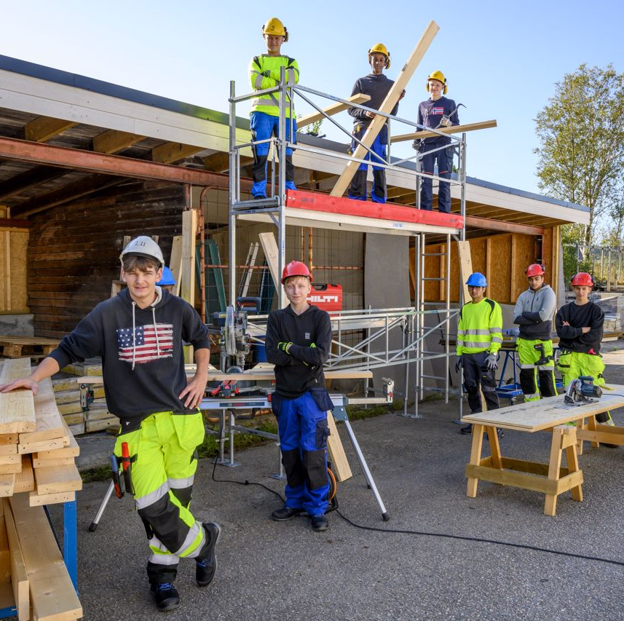
Building and construction

Slide 15
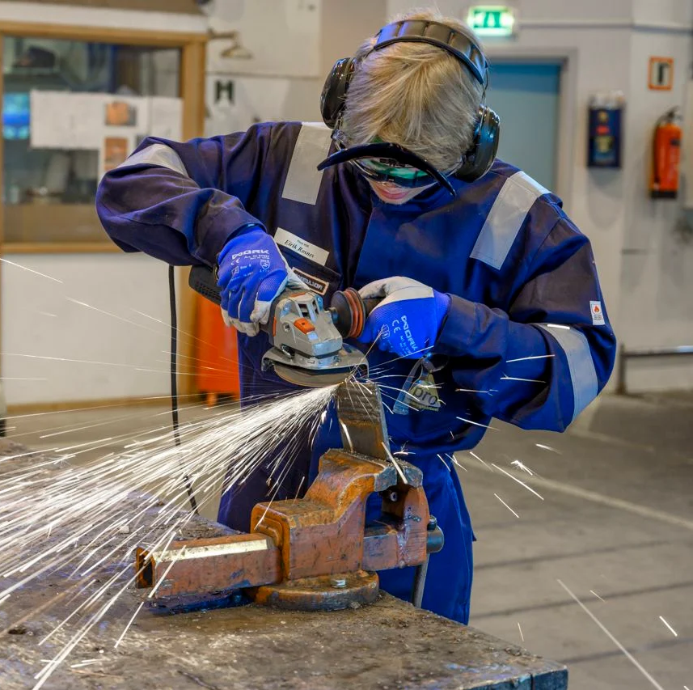
Technological and industrial production

Slide 16
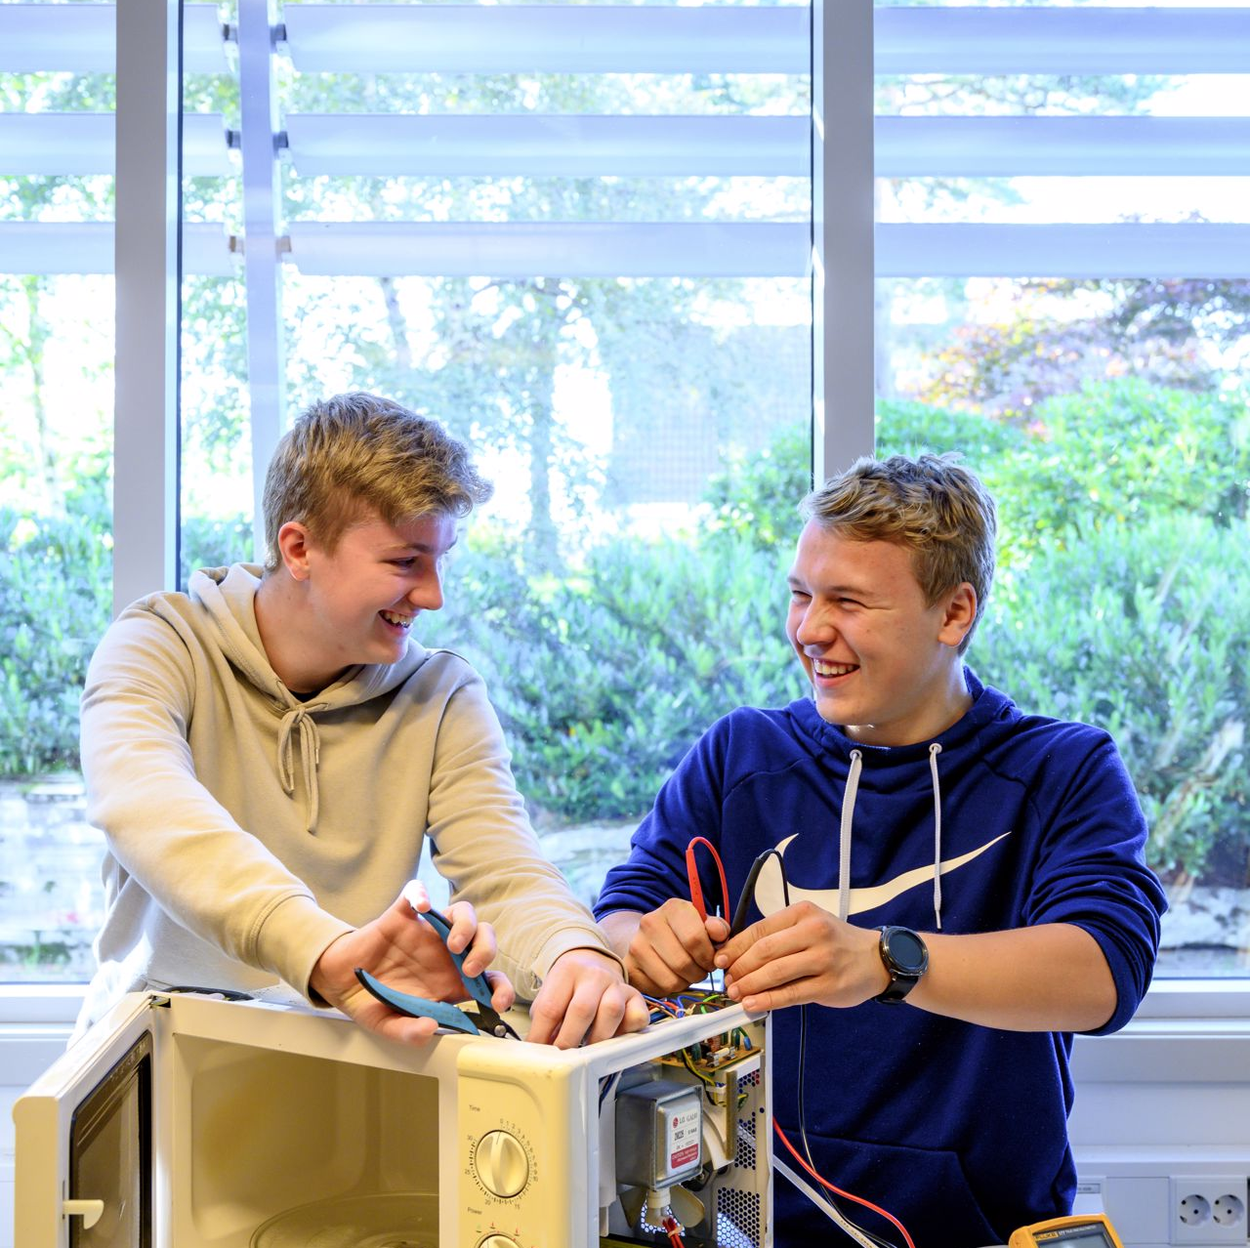
Electrical engineering and computer technology

Slide 17
Specialization in general studies
You choose specialization in
natural science and mathematics
languages, social sciences and economics

Slide 18
Education in Norway

Slide 19
Sports and physical education
You learn
about physical activity and training
training management
about health, nutrition and the structure of the body
theoretical subjects

Slide 20
Healthcare, childhood and youth development
You learn
about health-promoting work
about physical and mental health
about the anatomy of the body
about communication and interaction
about the development of children and young people
about diet, nutrition and hygiene

Slide 21
Sales, service and tourism
You learn
economical and sustainable operations
marketing, entrepreneurship and innovation
administration and digital tools
tourism and travel
customer relations and sales
planning and implementation of security measures

Slide 22
Building and construction
You learn
producing and erecting new buildings and facilities
renovating and maintaining buildings and facilities
climate and technology
using drawings, descriptions and calculations
quality and safety
knowledge about materials

Slide 23
Technological and industrial production
You learn
production planning and production processes
automation and programming of robots
about machinery and production equipment
about vehicles and transport
about chemical processes and chemistry techniques
about health, environment and safety

Slide 24
Electrical engineering and computer technology
You learn
Installation and maintenance of electrical and electronic systems
installing, connecting and programming electrical and electronic systems and installations
repair of electrical equipment
developing new electronic products
configuring and programming equipment and components
safety, security and documentation

Slide 25
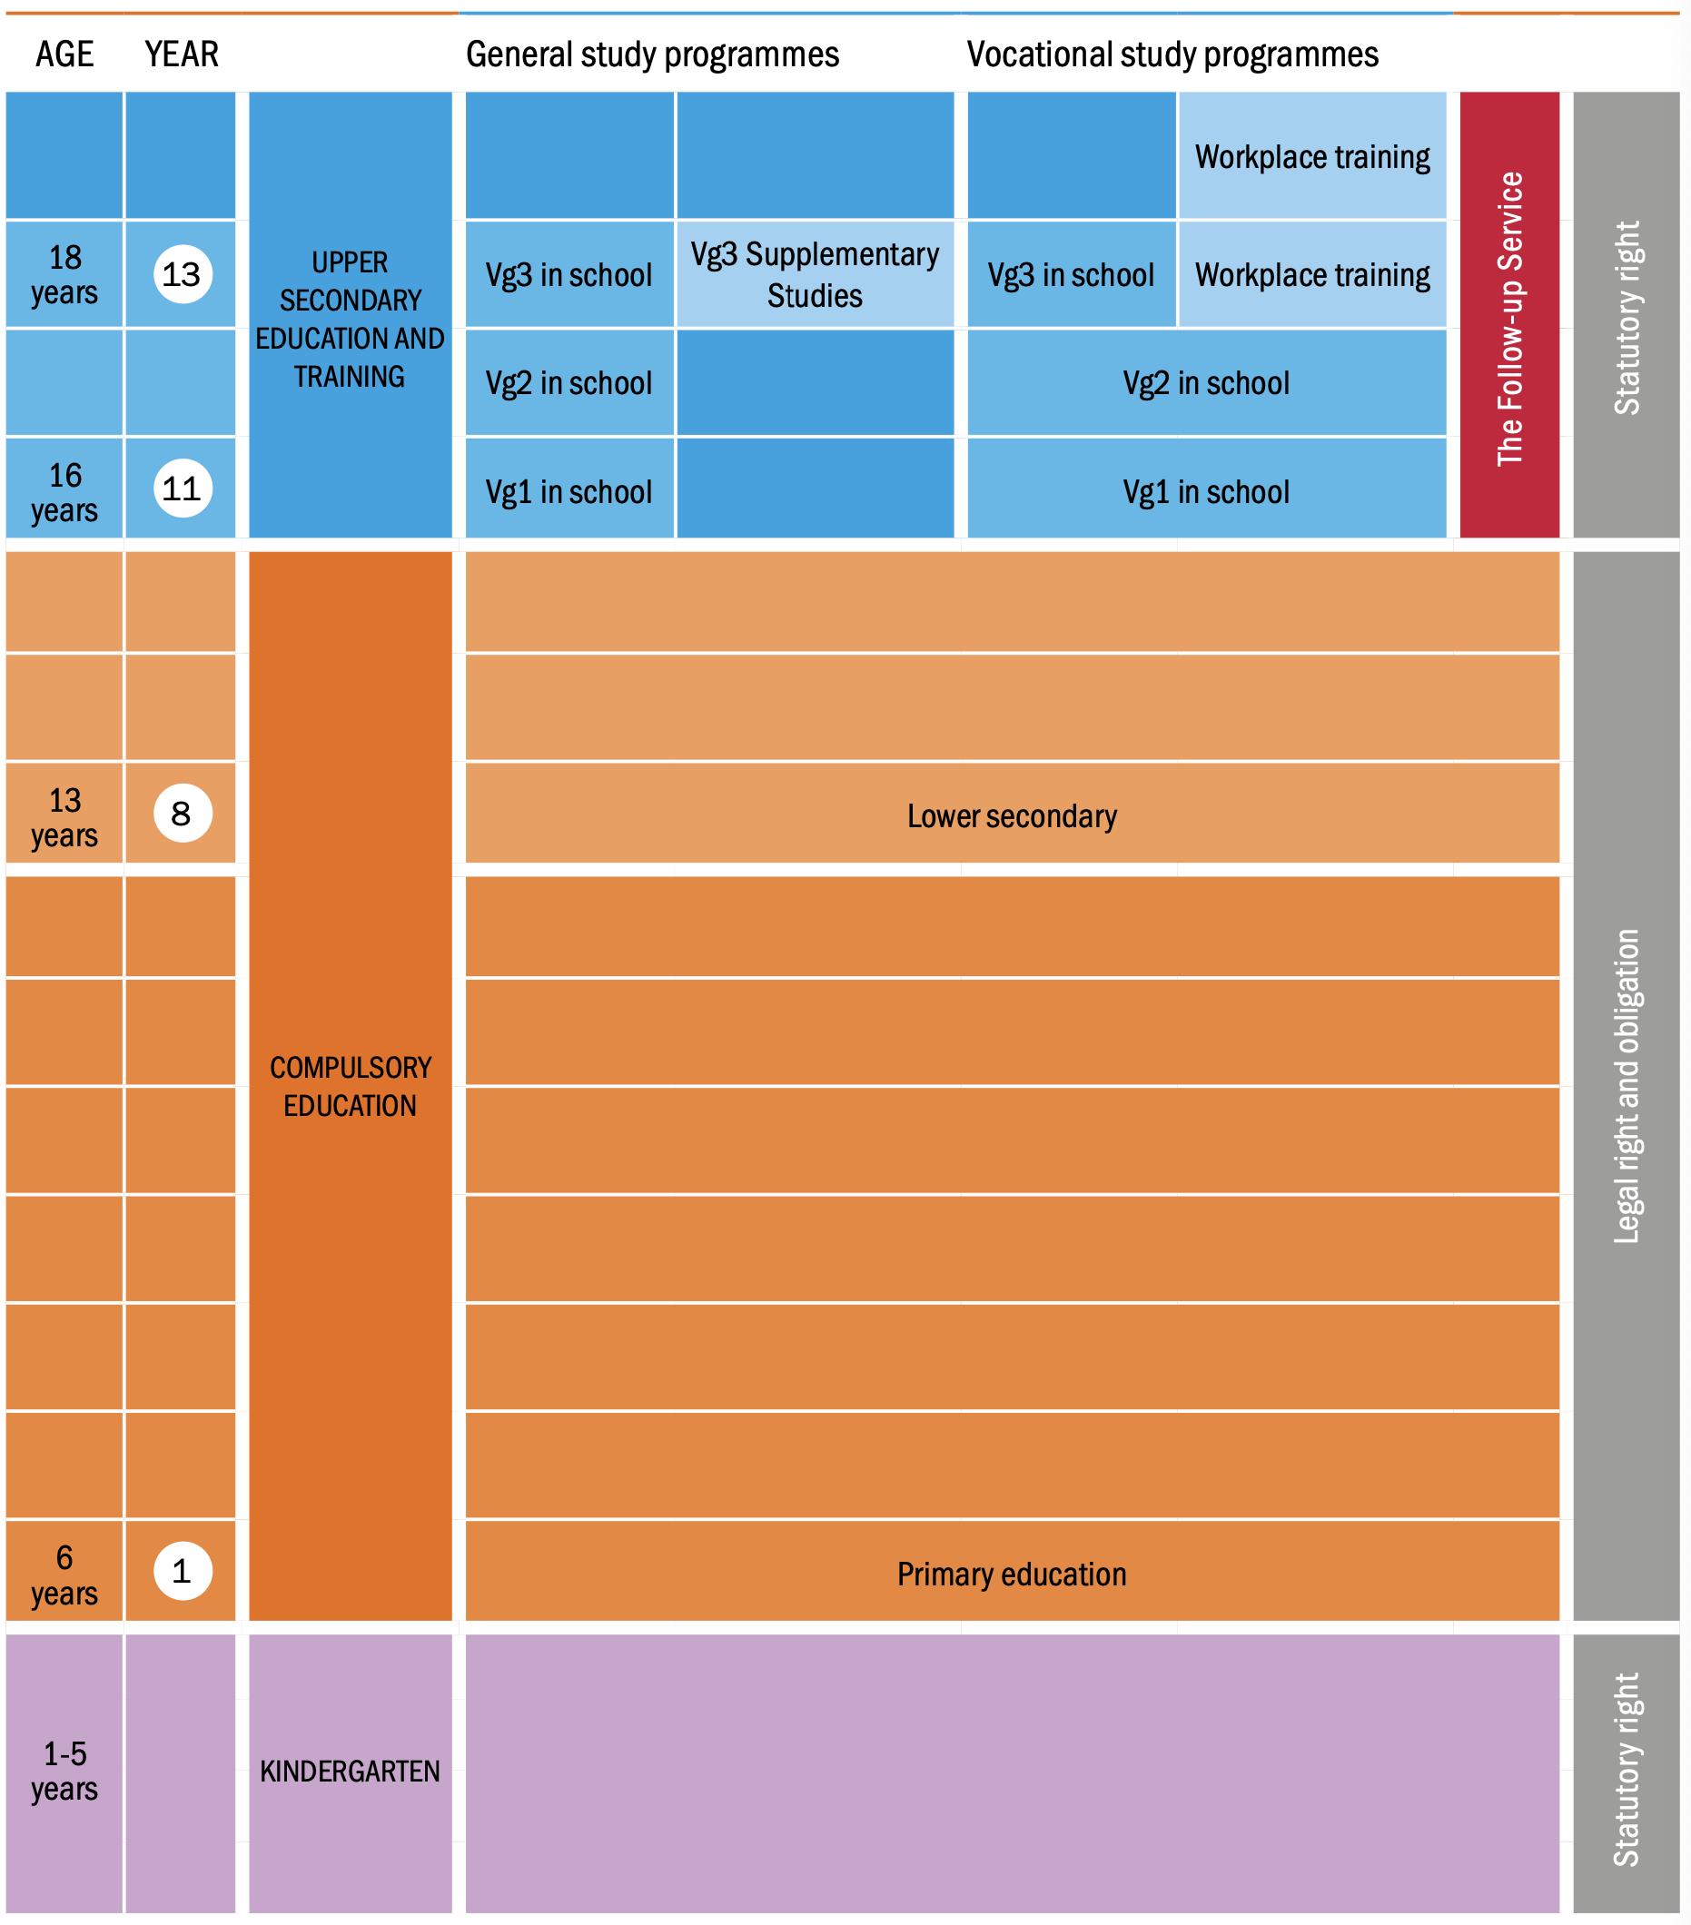
Education i Norway
Notes:
Parents are entitled to a total of 12 months’ leave in connection with the birth and after the birth.

Slide 26
Trends
The ‘70s
Progressive pedagogic. Child centred. Individual needs “Free upbringing” etc.
On collision course with the established school/teacher norms …
The ‘80s
Cold war, beginning awareness on refugees and multiculturalism, ecology and sustainable development. Progressive attitudes on gender roles, upbringing and the changing attitudes on individual vs group/society.
The ‘90s
“The whole human”. The pupil as seeking meaning, being creative, working, literate, in cooperation, and with eco awareness adds up to “the integrated human”. Project work/groupwork as the new methodology
The ‘00s
Basic skills, read, write, mathematics and ICT literacy as transversal (interdisciplinary) parts in all subjects (response to international competition – PISA – testing – education as a competitive advantage in a global world)
In a Norwegian context

Slide 27
The ‘10s
Interdisciplinary topics “Health and life skills”, “Democracy and citizenship”, “Sustainable development”. Promote scientific thinking. Increase completion and reduce drop-out.
Response to matters as:
aging population
low birth rates
make everyone contribute
increased welfare costs
lifestyle issues
environmental issues
national populism, anti-multiculturalism and polarization of political debate
“alternative facts”, conspiracy theories, anti intellectualism
Rebuilding trust in institutions vs. the individuals experiences with institutionally delivered services and alternative approaches
In a Norwegian context

Slide 28
Completion. Avoid dropping out of school. Norway is aiming for 90% completion in upper secondary school
The cost of school drop-outs and late finishers is huge in a generous welfare state:
Costs for the state through social programmes
Reduced income taxes to the state
A specialized labour market
Few jobs for unskilled,
Free movement of certified skilled labour in Europe
requires completion and certified competence for young people to enter the labour market!
In a Norwegian context

Slide 29
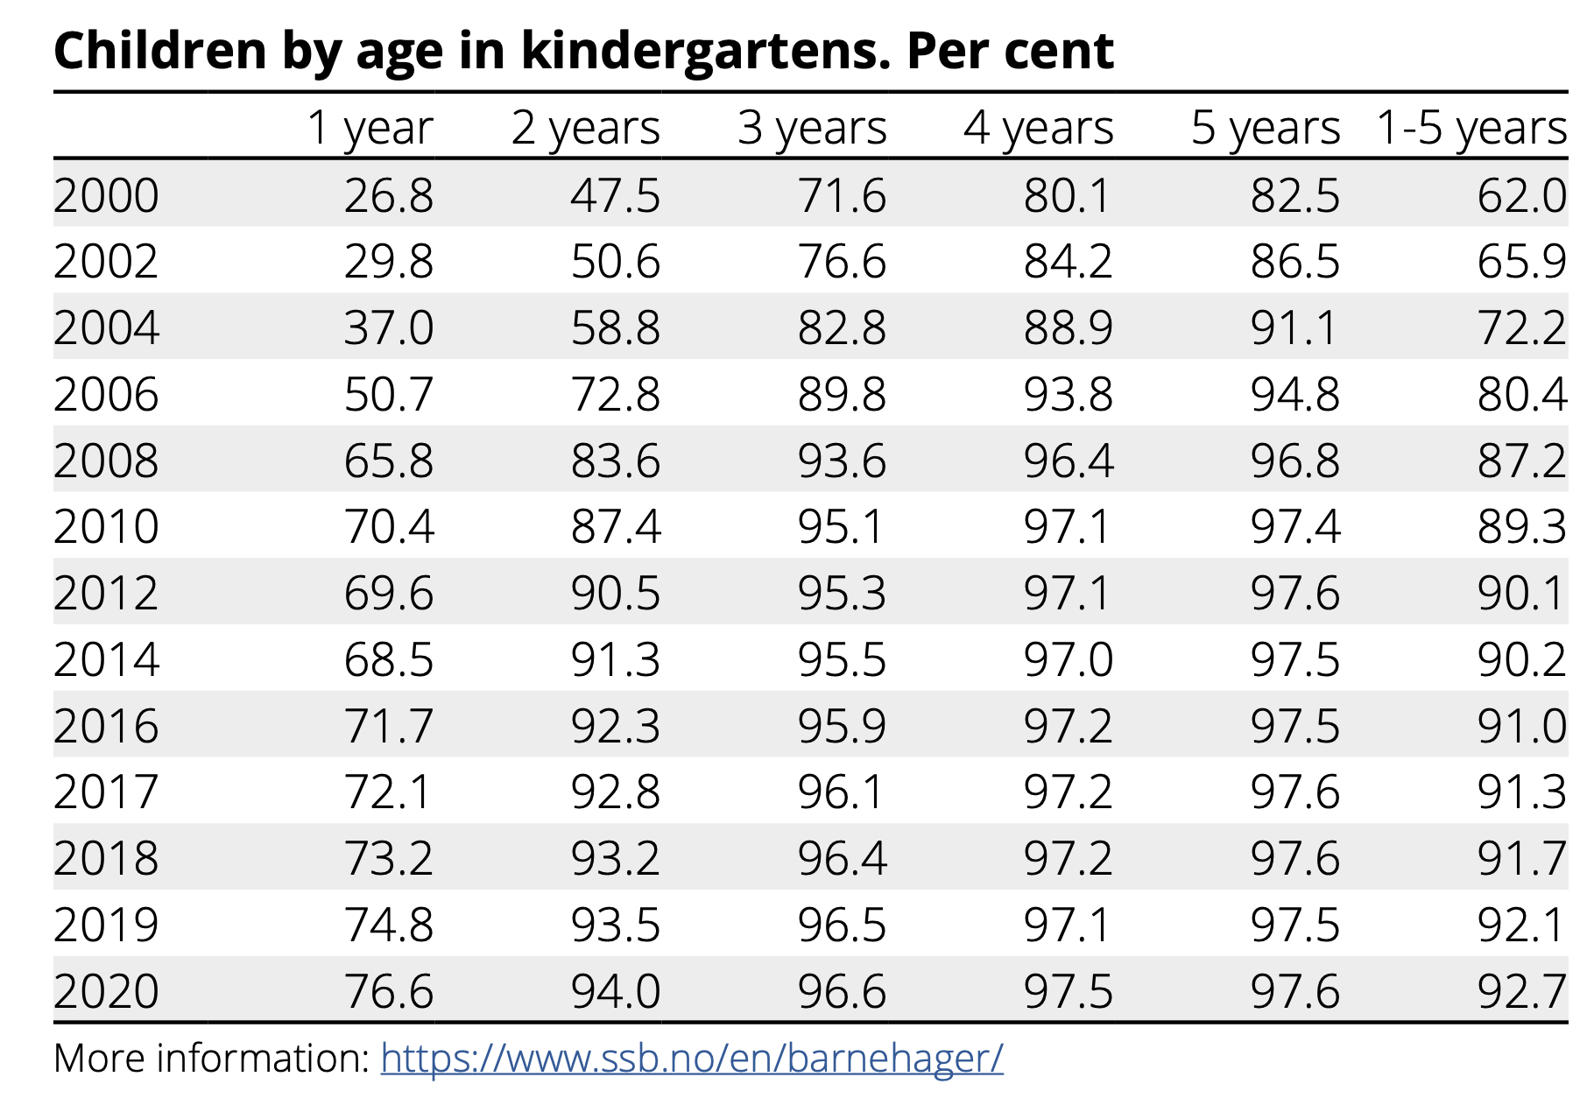

Slide 30
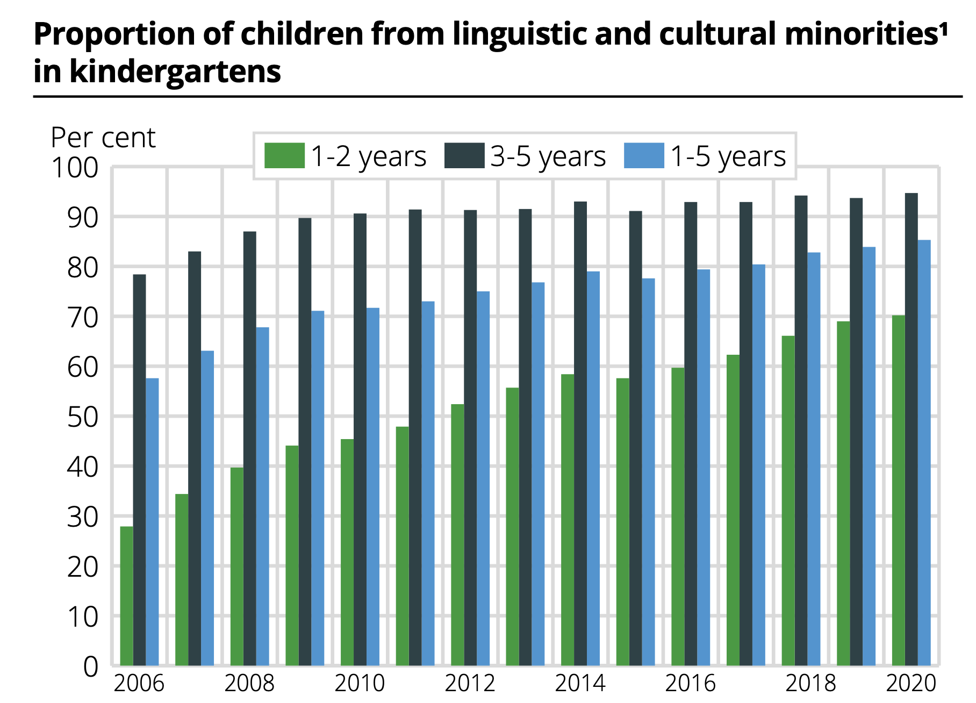

Slide 31
General education vs. special needs education
Teachers up to grade 7 are generalists. From grade 8 until 13 they are specialized in their subjects (approx. 1 year (60 points) of studies) in addition to general teacher training.
Almost all special needs education is delivered within, or close to, the general group. A pupil typically receive special needs education in some subjects.
Teachers therefore often work with pupils with vastly varying needs and abilities.
F or individual reflection: How can teachers that often work with pupils with demanding needs and low abilities, take advantage of this experience when teaching potentially high achieving students?
Question/reflection

Slide 32
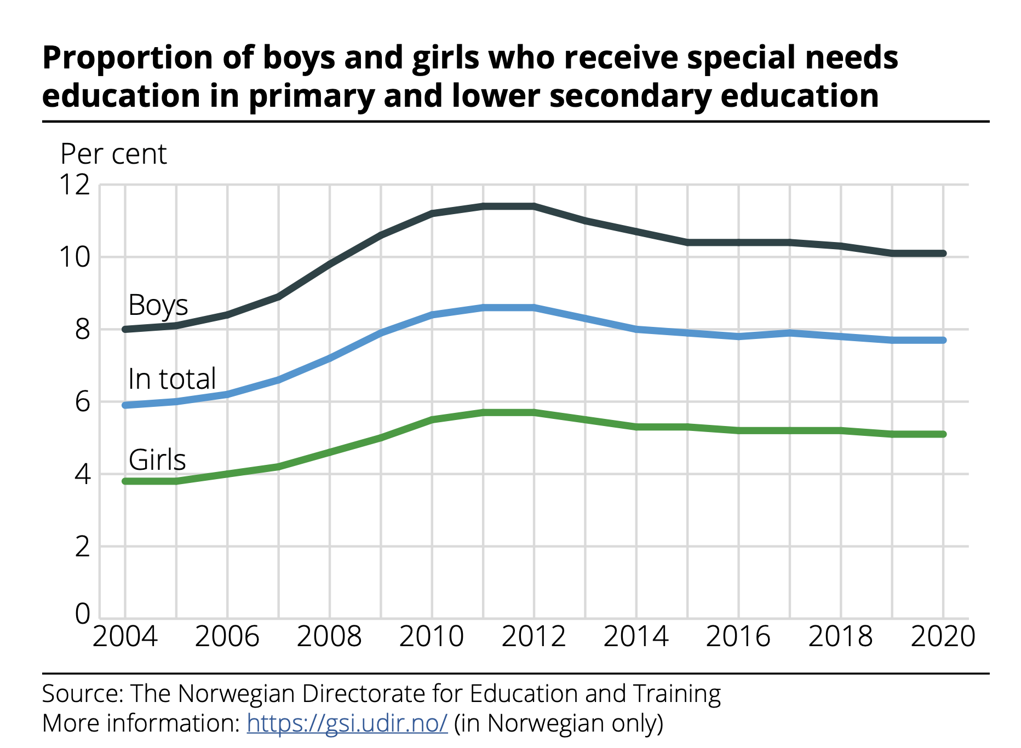

Slide 33
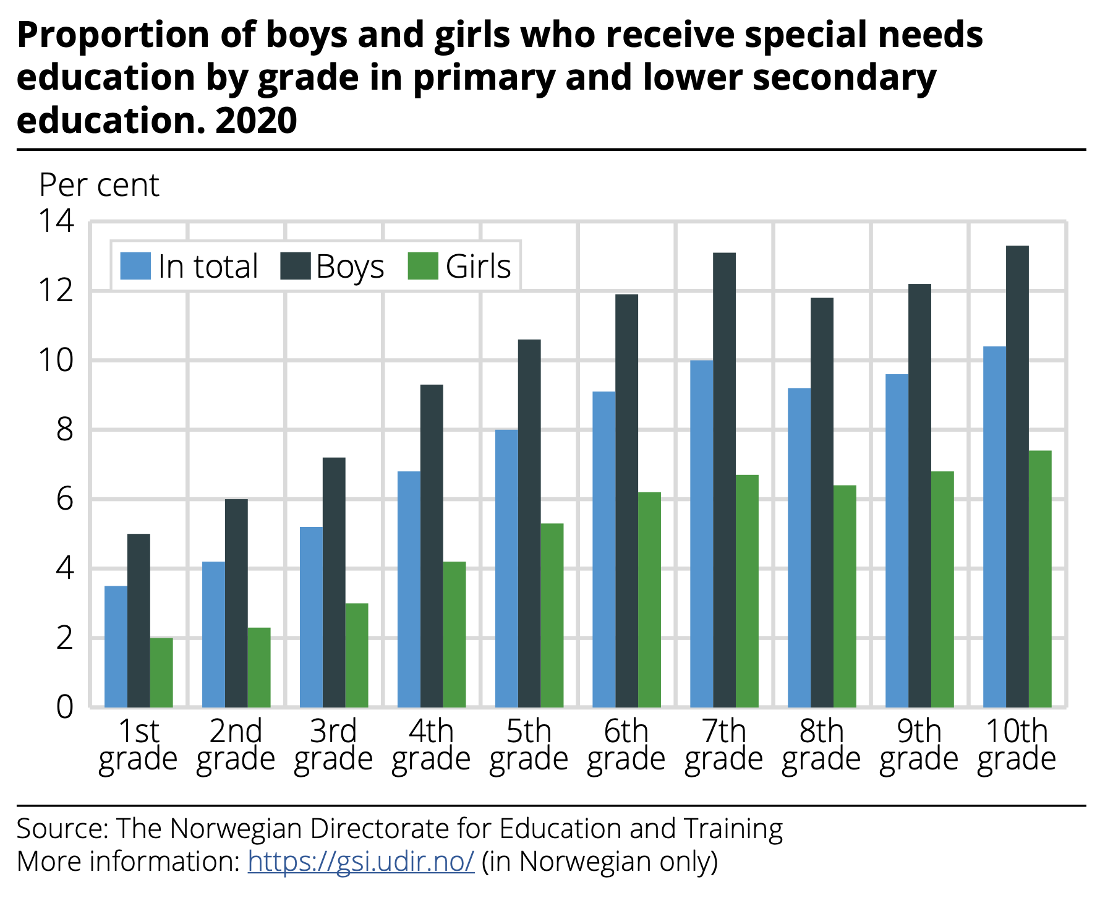

Slide 34
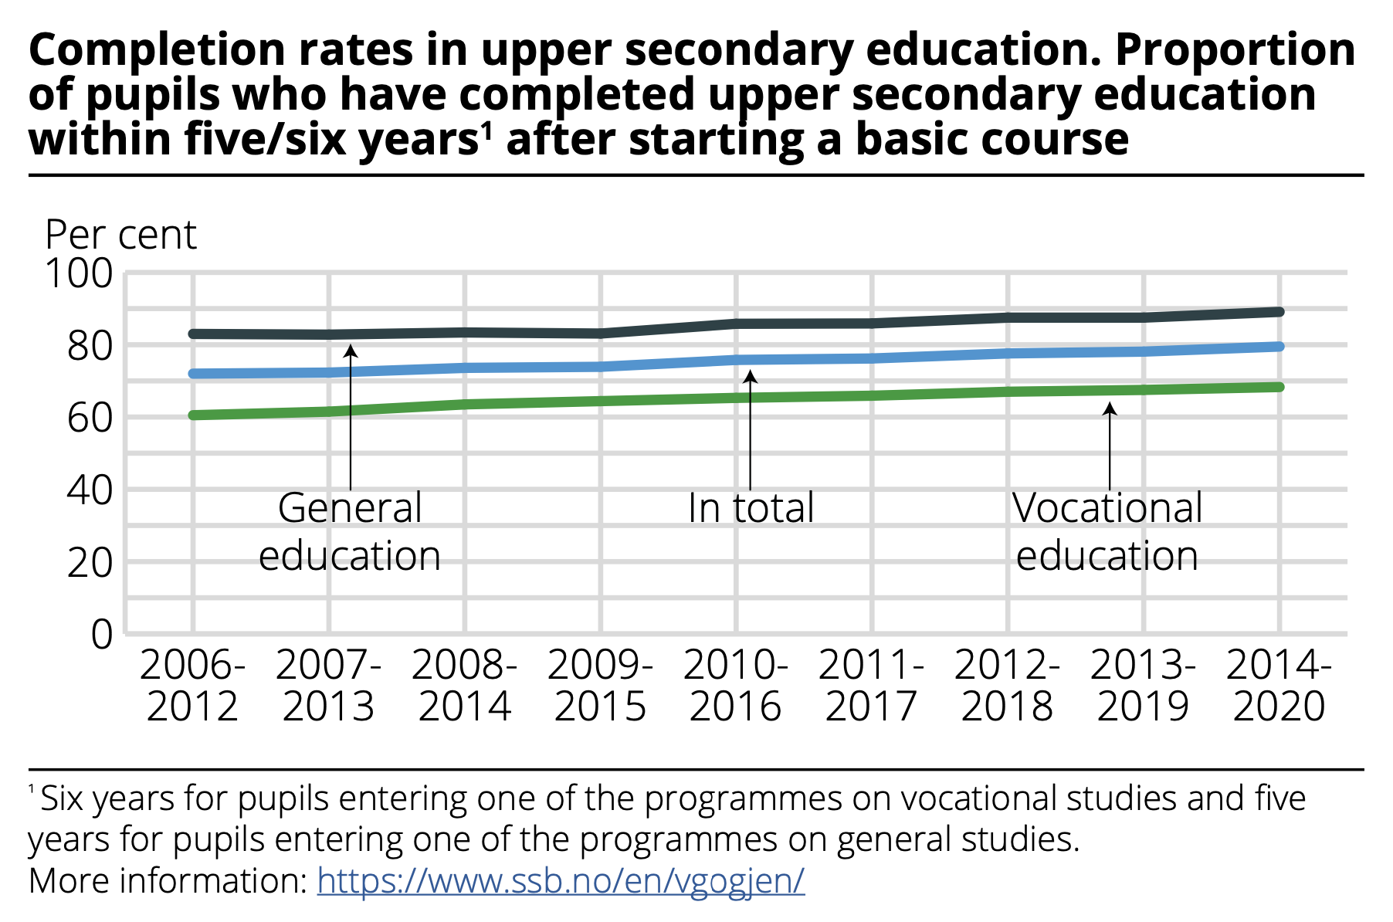

Slide 35
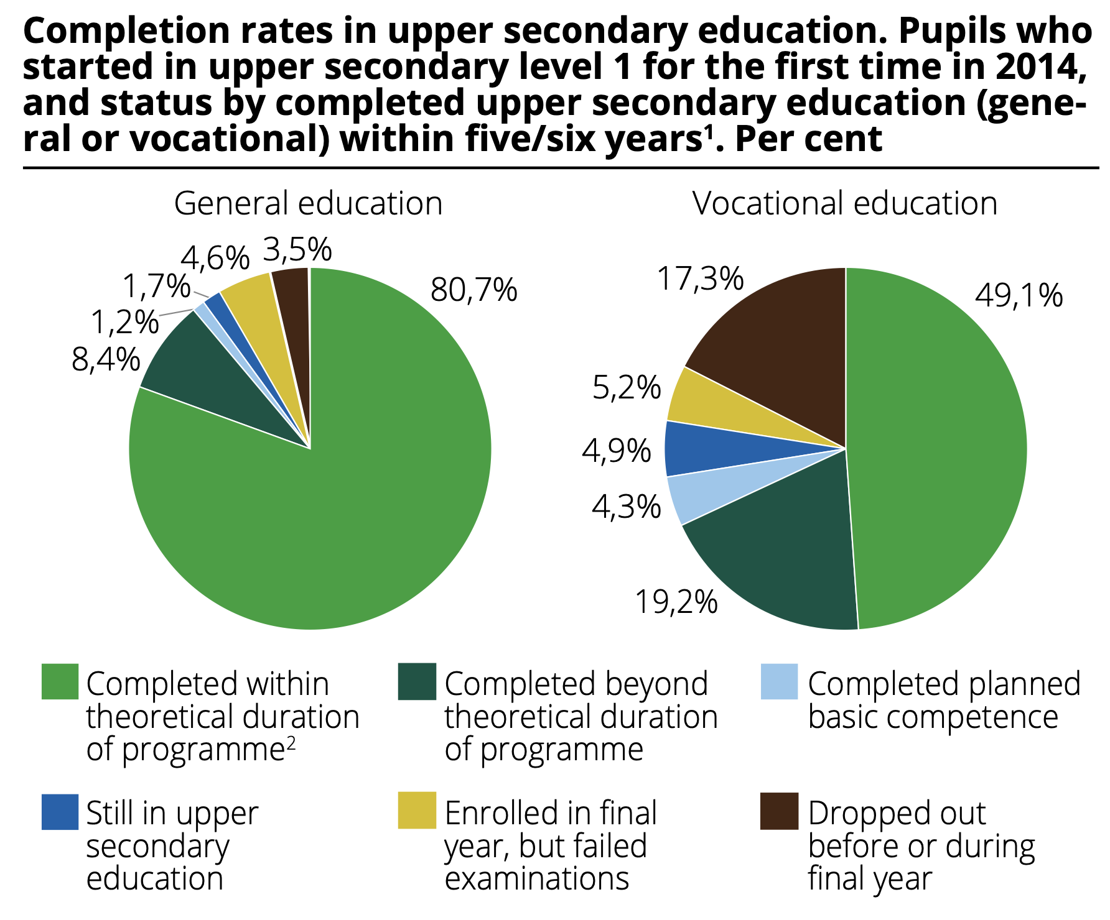

Slide 36
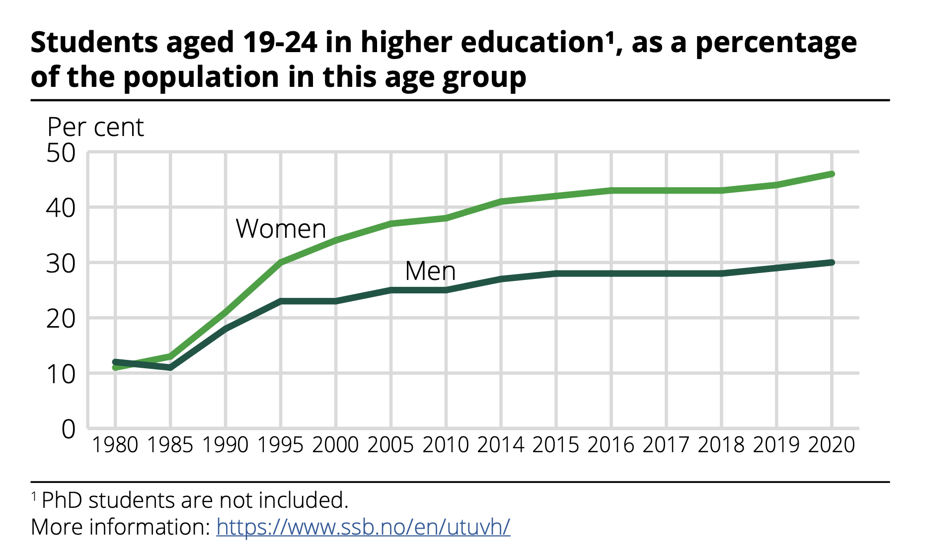

Slide 37
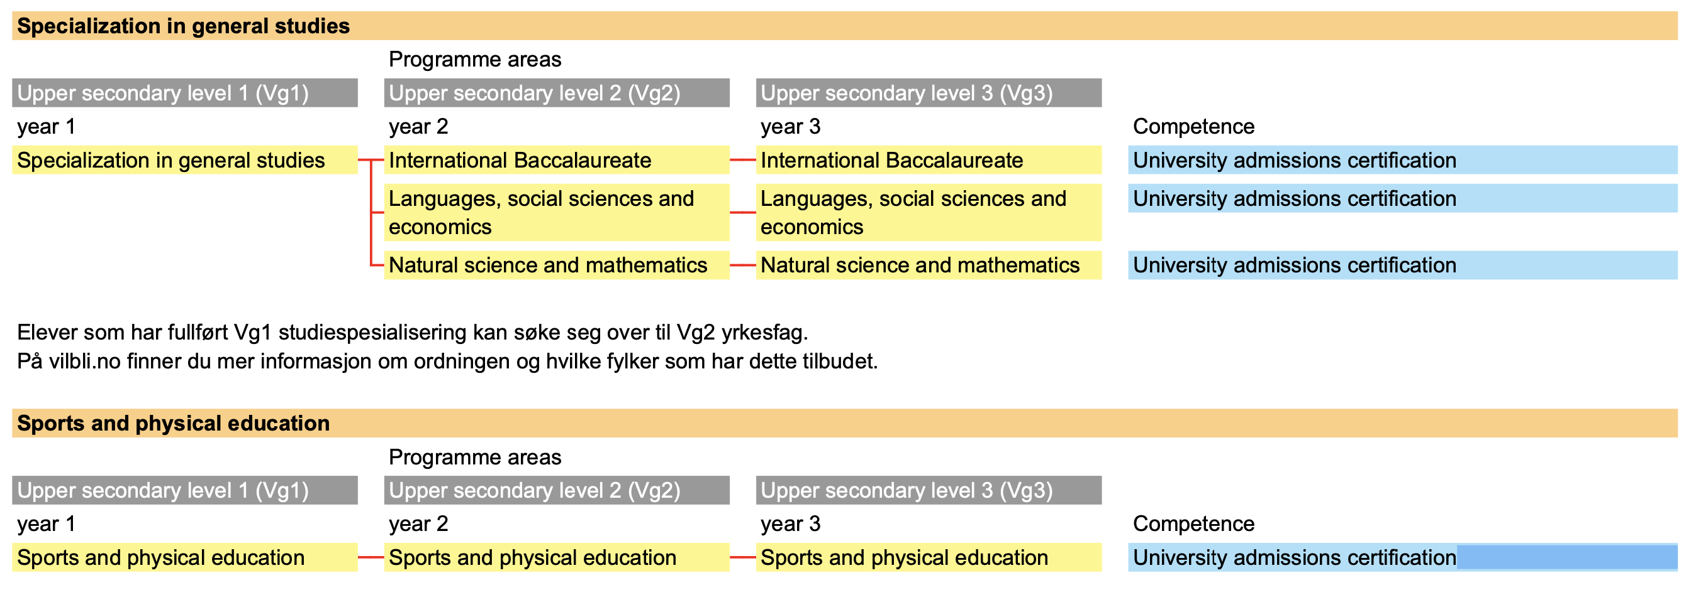

Slide 38
General studies VG1 (upper secondary)
Common core subjects (842 timer)
140 English
113 Foreign language level I /
113 Foreign language level II
56 Geography
140 Mathematics 1P (practical) /
140 Mathematics 1T (theoretical)
140 Natural science
113 Norwegian
56 Physical education
84 Social science

Slide 39
General studies VG2 + VG3
VG2
Common core subjects:
112 Foreign language level I /
112 Foreign language level II
56 History
84 Mathematics 2P (practical)*
112 Norwegian
56 Physical education
VG2
Common core subjects:
113 History
168 Norwegian
56 Physical education
84 Religion and ethics

Slide 40
Teachers!
1 week planning – 38 weeks teaching.
Teaching hours (60 min) - average 14.
Other work at school (60 min ) average 16
Work at home or wherever (60 min) 13
At total of 43 hours a week is 5,5 hours more than average workforce in Norway and is paid back as leave during school holiday ....
«A teacher in summer and bear in winter»

Slide 41
Assessment related to the specific subjects.
Year 1 – 7 - NO GRADES
Year 8 – 13 GRADES
In subjects Grade 1 – 6 (2 required to pass)
The grading of competences in subjects are separated from behaviour and attitudes, and from students pre-conditions and abilities.
Two exceptions:
Physical education. Effort, fair play and progress within ones own abilities is part of the grades. Being active is a public health issue and should be promoted!
Undocumented absence for more than 10% of lessons deprives a student the right to assessment with grades.
As assessment is a right for the students, it is a duty for the teachers to give an assessment if the teacher has sufficient factual foundations for an evaluation

Slide 42
Regulations to the educations act
Assessment before completion of course All assessment before completion of course is formative assessment for learning. This should be an integrated part of teaching and shall promote learning, adapt teaching to students needs and increase their competence in subjects. Formative assessment for learning can be oral or written. In the formative assessment for learning in subjects the student shall: a. take part in assessing their own work and reflect upon their learning and progress in the subjects taught. b. understand what they shall learn and understand what is expected from them c. be told what they master d. receive guidance on how to keep working to increase their competence. Formative assessment for learning shall be used to monitor if the student has sufficient gains from the teaching provided.

Slide 43
Democracy and participation. School shall provide the pupils with the opportunity to participate in and learn what democracy means in practice.
«The school must be a venue where children and young people experience democracy in practice.»
The pupils must experience that they are heard in the day-to-day affairs in school
They must gain experience and practise different forms of democratic participation in the day-to-day work with their subjects,
and through such bodies as pupil councils and advisory bodies.
The dialogue between teacher and pupils, and between the school and the home, must be based on mutual respect.
When the voices of the pupils are heard in school, they will experience how they can make their own considered decisions. Such experiences have a value in the here and now, and prepare the pupils for becoming responsible citizens in society.
From the core curriculum

