Slide 1
Traveling to new teaching adventures 2019-1-BE02-KA229-060207_4
Assessment for parents
October-November 2019

Slide 2
Belgium
2 parents answered the questionnaire.
Norway
NA – due with the students age
Romania
15 parents answered the questionnaire.
Portugal
24 parents answered the e-form

Slide 3
Why did you choose your’s child school?
Parents chosen their child’s school due to:
Proximity their residence;
Confidence in school work, therapies offered;
The school offers specialized services, suitable for own child;
Upon recommendation;
Diverse, varied, interactive and interesting activities;
A team of professionals.

Slide 4
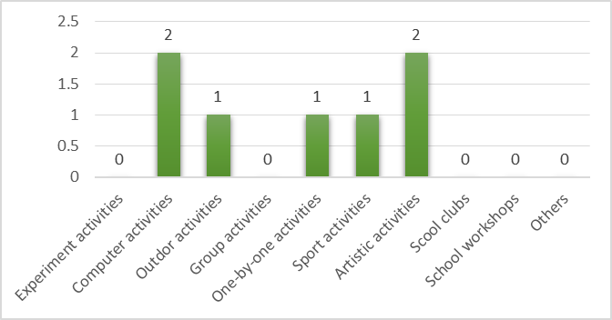
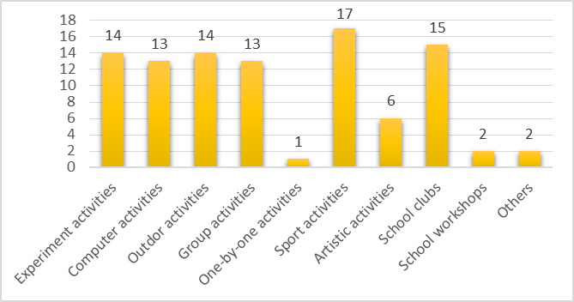
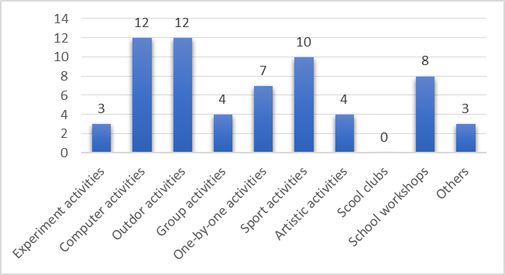
Which of the following school activities does your child like most?
Belgium
Portugal
Sports, school clubs, outdoor activities, computer activities were the most chosen items;
Group activities, school workshops and experimental activities also achieved a good rate.
Romania

Slide 5
Which of the school subjects does your child like most?
Belgium
Drawing
Crafting
Art
Sports
Language
Portugal
Parents think that their child’s favorite subjects is:
Maths
Sports
English
They justified their answers by saying that the subjects are important to the future and because they like it.
Math
Physical education and sport
Drawing
Romanian
Music
English
Biology
Geography
Romania

Slide 6
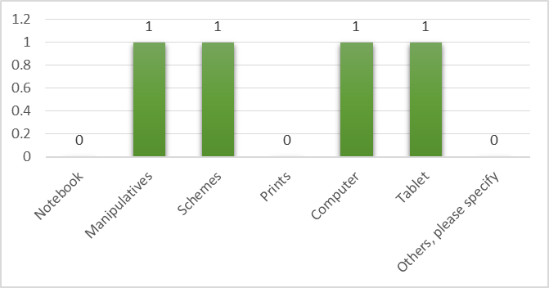
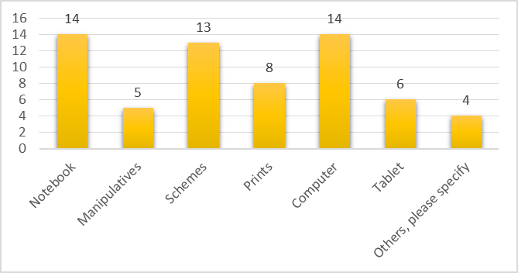
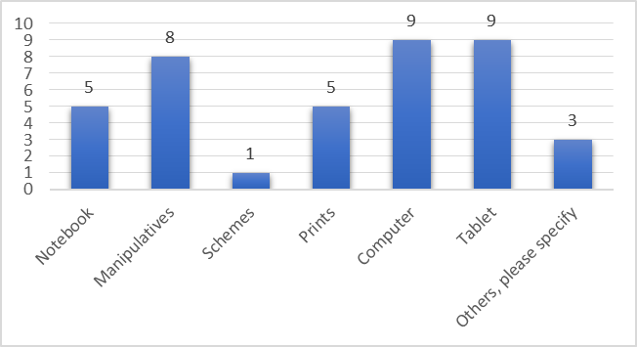
Your son/daughter retains (learns) easier when he/she is using:
Belgium
Portugal
Others:
Games
Practical activities
Experiments
Romania

Slide 7
What activities your child does like when he/she is at home?
Parents identified the following activities :
Watching TV
Listen to music and play games on electronic devices
Reading
Drawing
Sports
Cooking
Playing outside
Walking in the park
Lego
Puzzle

Slide 8
How do you think your child learns easier?
Parents referred different ways to learn:
Game-based activities
Practical activities
Educational games on tablet and computer
Additional worksheets
Based on experiments and manipulatives activities
Outdoor activities
Small group activities
One by one activities
They think the easier way is to do summaries and use the computer.
Another good way to learn is to listen the teacher.

Slide 9
THANK YOU!
The project is financially supported by the European Commission under the Erasmus+ Programme. The European Commission support for the production of this publication does not constitute an endorsement of the contents which reflects the views only of the authors, and the Commission cannot be held responsi­ble for any use which may be made of the information contained therein.

