Slide 1
Almeirim group of schools
2nd webinar
Evaluation

Slide 2
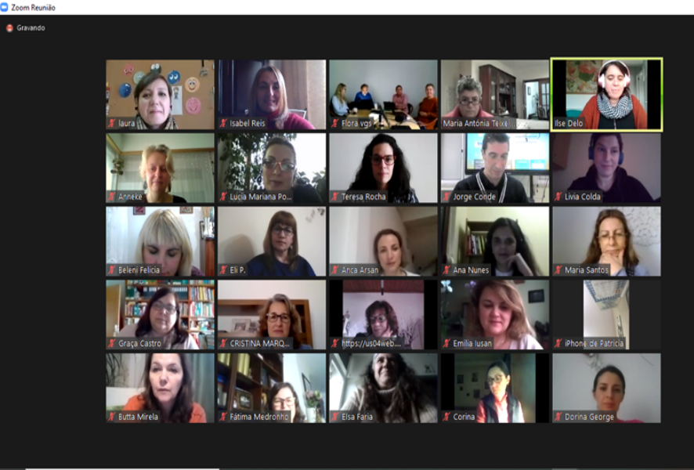
The webinar was attended by 55 people

Slide 3
It was evaluated by 44 people

Slide 4
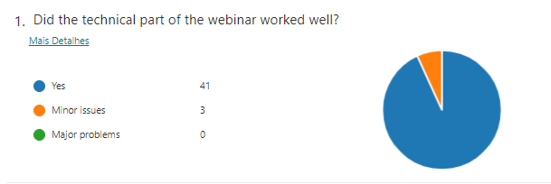
Question 1:

Slide 5
Question 2:
Internet connection was the only problem referred in the answers

Slide 6
Question 3:
More than 75% of the participants considered the webinar very useful.

Slide 7
Question 4:
The answers were different but most of them referred that the webinar made clearer the importance of emotions in school activities.
The practical part of the webinar and the project results were referred as being very important.

Slide 8
Question 5:
Thank you for the kind words of all participants!

