Slide 1


Traveling to new teaching adventures
2019-1-BE02-KA229-060207_4
Teacher satisfaction questionnaire
- 1 year project implementation -
May - June 2020
Cluj-Napoca, Romania

Slide 2
The teacher satisfaction questionnaire consists of two parts.
The first part contains questions regarding the development of the project during the first year of implementation
( September 2019 - June 2020).
The second part of the questionnaire - optional - contains questions regarding the current situation due to COVID-19 pandemic with a direct impact on the implementation of the project in the first year of development.
This information can help and can improve some aspects of the project.

Slide 3
Romania
Norway
20 teachers answered
the e-form.
4 teachers answered
the questionnaire.
Belgium
Portugal
6/7 teachers answered
the questionnaire.
1 teacher answered
only the first part of
the questionnaire.
4 teachers answered
the e-form.

Slide 4
All the answers to the question about the teacher’s motivation for
choosing to get involved in this project have in common the following
ideas:
Sharing teaching methods, knowing and experiencing different realities;
Being very interested how other schools in Europe work with their students;
Getting to know new activities to use in own schools;
Discovering new interactive and innovative teaching methods;
Exploring new teaching methods using ICT tools;
Improving students’ learning abilities;
Eliminate routine activities and create tools to trigger creativity in teaching
methods to give students;
Learning new abilities and skills;

Slide 5
All the answers to the question about the teacher’s motivation for
choosing to get involved in this project have in common the following
ideas:
Knowing and discovering new schools and cultures (students - colleagues -
new people);
I really believe in “internationalization” in education. I believe that we will learn a lot
from each other. This will make us more complete teachers and schools.
The desire to be active in a project where students can learn different ways to study;
Improving the teaching methods and the student's learning experiences;
Enriching own teaching methods;
The project is an important way to develop both professionally and personally;
Knowing other schools’ reality and getting information about methodologies to
implement in own class.

Slide 6




student's learning
experiences
Europe
enriching
new
sharing
implement
creativity
experiencing
improving
information
innovative
teaching
active
activities
knowing
ICT tools
discovering
develop
cultures
professionally
students’ learning abilities
interactive
exploring
different
desire
personally
What was your motivation for choosing to get involved in this project?
KEY WORDS

Slide 7
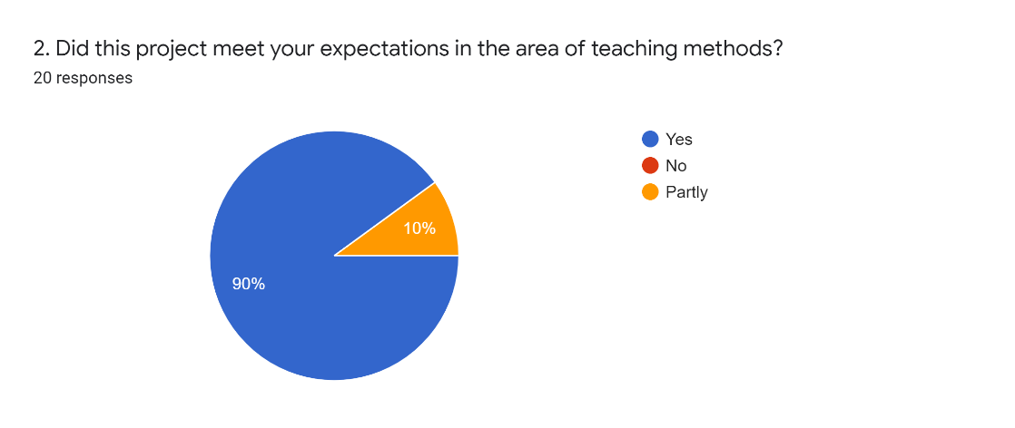
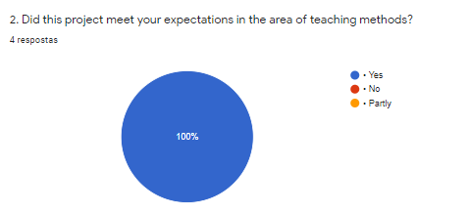
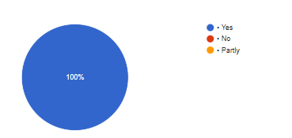

Did this project meet your expectations in the area of teaching methods?

Slide 8
Did this project meet your expectations in the area of teaching methods?
Most teachers responded that the project met their expectations.
Those who responded with NO pointed out that they were the organizing country this
time and they have shared their experience with everyone. Due to Covid-19 pandemic
the next mobility was postponed making it
impossible to observe and learn about
other teaching methods. (one of the most
important objectives of this project).

Slide 9

How did the training/ dissemination activities help you in your act of teaching in the classroom?
To acknowledge the good work and implement it in my classroom.
What I have experienced has helped me to broaden the range of teaching strategies and provide more appropriate responses to students' educational needs.
Helped me to create a better lessons content and to use interactive methods.
Throughout the dissemination activities I discovered interesting applications such as Actionbound, that helped me in my online work.
Learning how to use BeeBoot and other computer apps.
Here are
some answers!
I tried some new activities with my own students, but I’m still interested how everyone works in their school. We tried to speak English themselves and we learned each other words in our own language. The barrier between two languages, between two foreign countries, disappeared for a moment. All thanks to the activity were they were “forced” to work together.
In the mobility to school in Belgium, for instances, I observed/learned a lot. It was a very enriching week. I have already applied some strategies, especially with an autistic student. I changed my way of acting, for example to guide the student in the time of tasks and breaks. It was also important to find his potential and help him to succeed.

Slide 10
How did the training/ dissemination activities help you in your act of teaching in the classroom?
As a conclusion, it can be highlighted that the teachers had a positive experience both as a result of the direct participation in the mobility of the project and in the dissemination activities of the project.
These experiences are a starting point in adapting, innovating and developing teaching methods.
The training and the dissemination activities gave motivation to find more interesting ways to pass on the information to the students and to find more innovative methods to help them experience the new knowledge.

Slide 11


Does distance learning fulfill your needs and your students, too?
Due to COVID -19 pandemic, the teachers answered to the following questions:
What is the biggest
advantage
of distance learning?
Would you like to continue
distance
learning in the
future?
Name some platforms you use for online learning.
Online learning has a positive impact on
my learning students and my teaching
methods.
Please, evaluate a quality of distance
learning in your class.

Slide 12
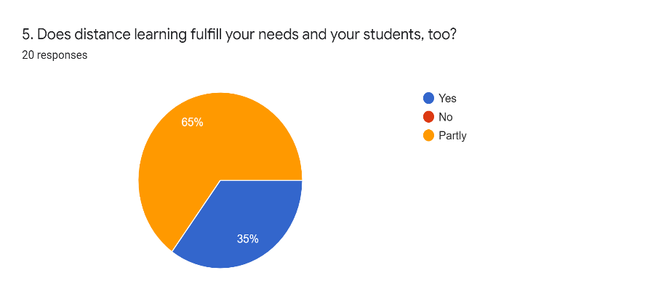
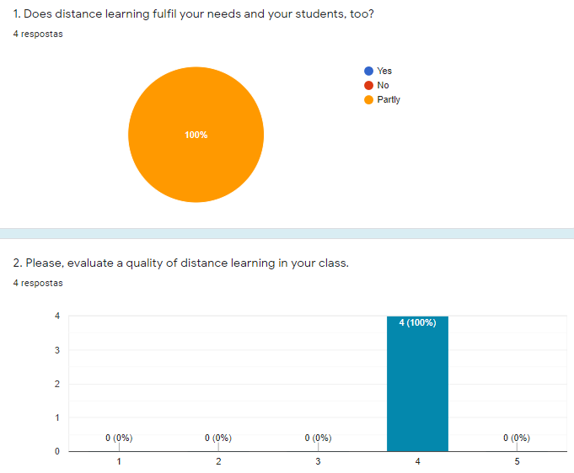


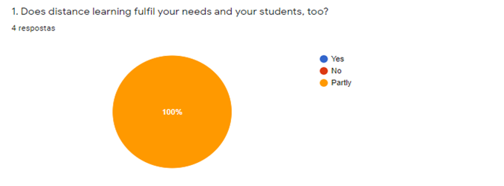
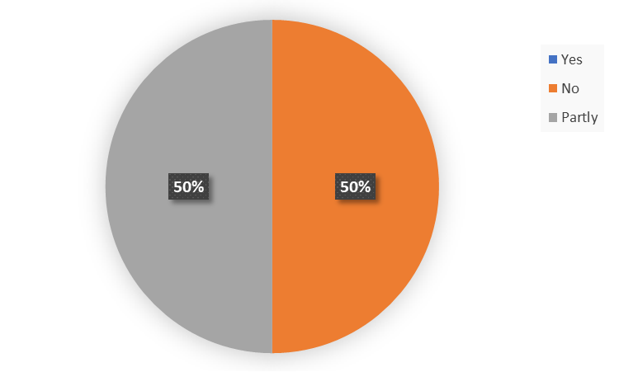


Does distance learning fulfill your needs and your students, too?
Looking on the answers, the most answer was “partly”.

Slide 13
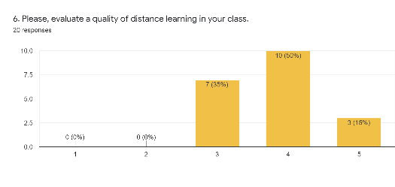


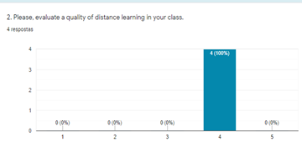

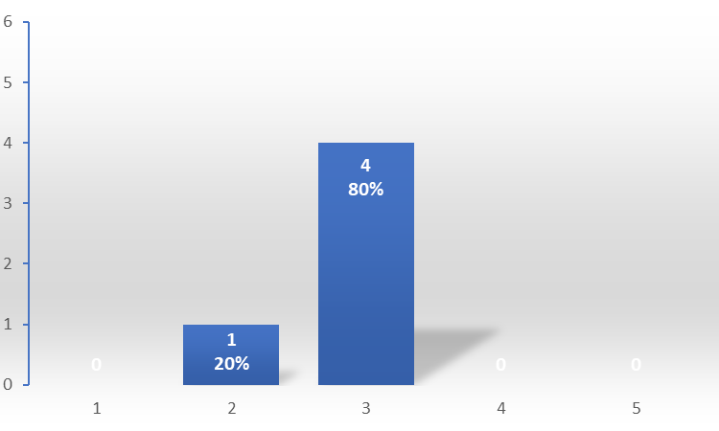

Analyzing the answers given regarding the quality of distance learning on a scale from 1 to 5
- 1 represents “poor” and 5 “great” -
most teachers evaluated the online educational
act having a value of 4, the online activity being
“good” (18 answers), and a number of 11 teachers
evaluated the quality of online teaching/ distance
learning as an “average” (11 answers - value 3) .

Slide 14
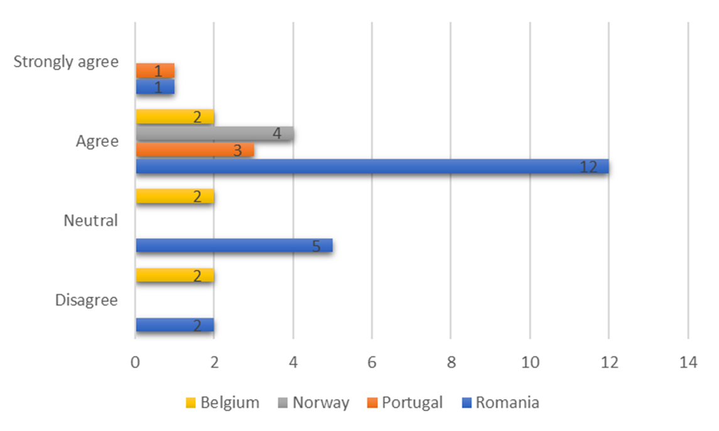
Online learning has a positive impact on my learning students and my teaching methods.
Presentation Designed

Slide 15
To the question of what is the biggest advantage of distance learning the most
relevant answers were:
  The use of the newest information technologies.
  Opportunity to manage your own learning process.
  Access to all the information through the internet.
  Ability to learn through distance.
  Ability to choose when to learn.

Slide 16
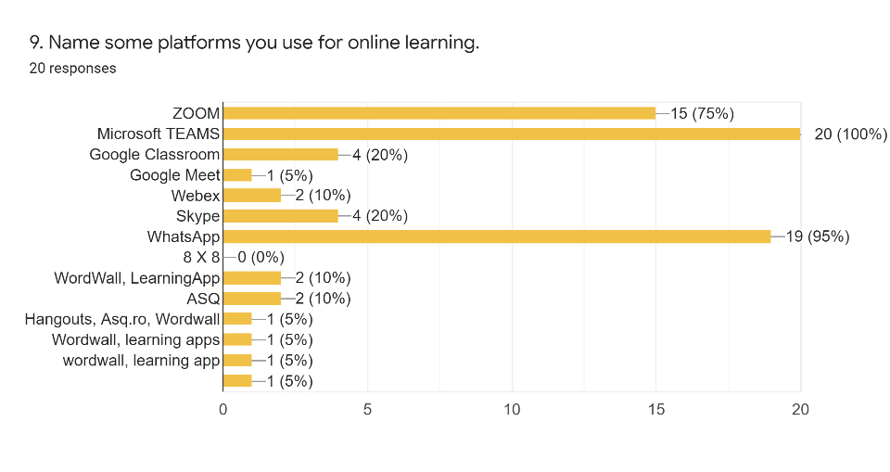


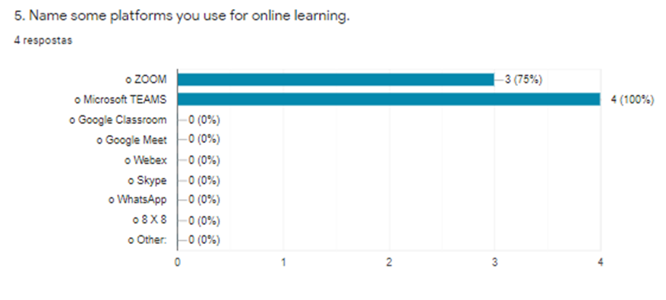


No. | Platforms
1 | ZOOM;Microsoft TEAMS; WhatsApp
2 | ZOOM;WhatsApp
3 | ZOOM;WhatsApp
4 | ZOOM
5 | ZOOM;Microsoft TEAMS;Skype;WhatsApp; Facebook groups
6 | ZOOM; Microsoft TEAMS
No. | Platforms
1 | Microsoft TEAMS
2 | Microsoft TEAMS
3 | Microsoft TEAMS
4 | Microsoft TEAMS

Slide 17

The most common platforms that were used during the online activities:
Microsoft TEAMS
ZOOM
WhatsApp
Skype
Others:
Wordwall
LearningApp
ASQ.ro
JITSI MEET
SEESAW
Presentation Designed

Slide 18
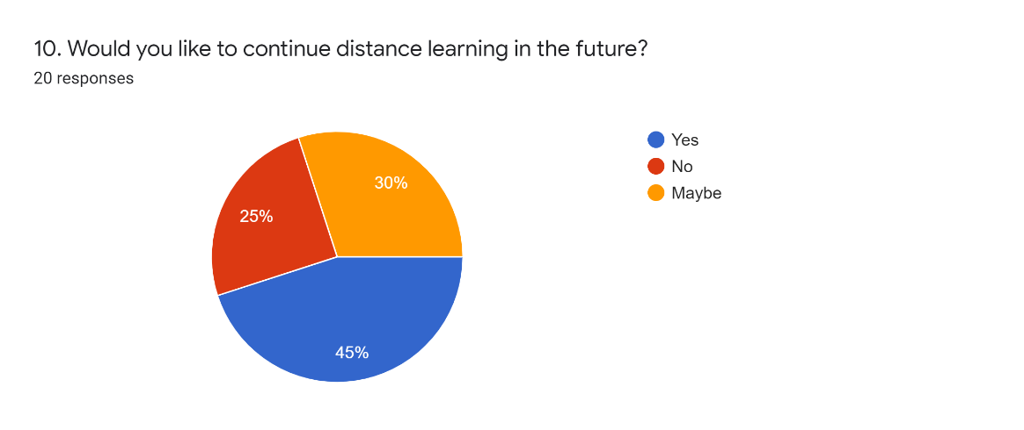
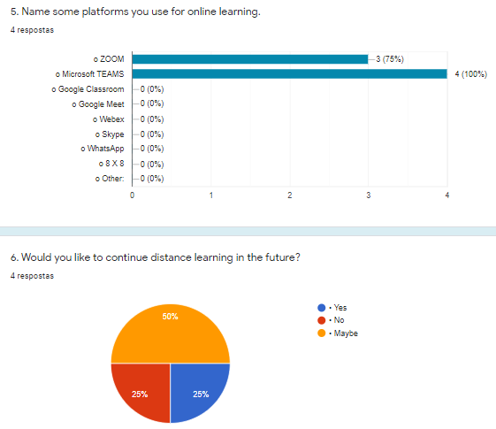
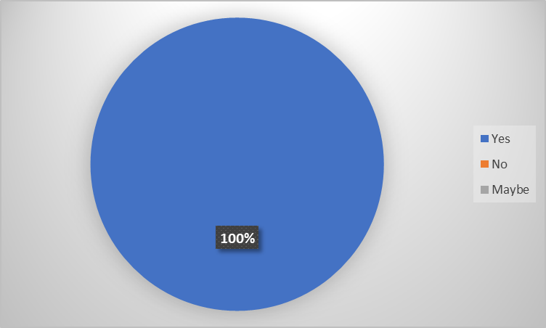
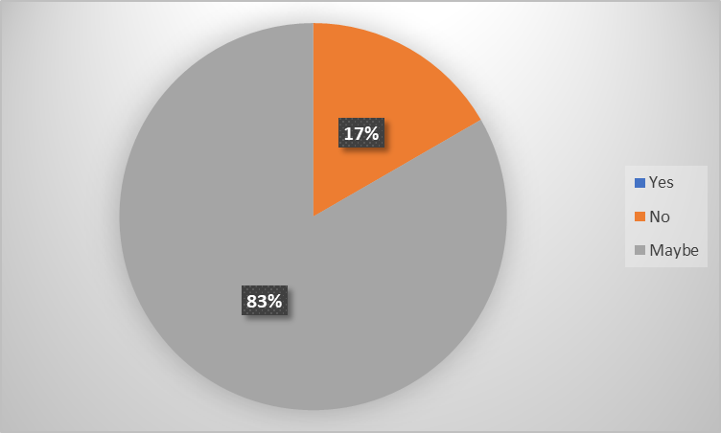
Would you like to continue distance learning in the future?

Slide 19
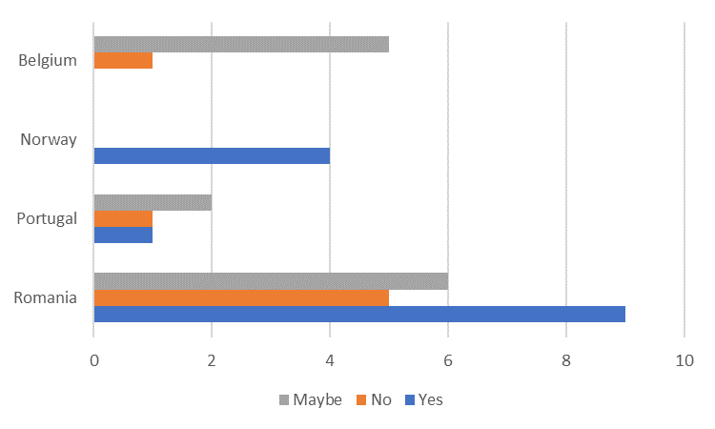
Would you like to continue distance learning in the future?
Regarding online activity in the future, most teachers either agreed
or answered "maybe".

Slide 20
Conclusions:
One year after the implementation of the project, we agree that
the project has not achieved fully its objectives - due to the unpredictable
situation of COVID -19 pandemic.
The attractive, unique and innovative project activities have been
implemented with a positive impact on teaching methods and students’
learning experiences.
Most teachers responded that the project met their expectations.
Also the training/ dissemination activities helped teachers and students,
too. They have a positive experience both as a result of the direct
participation in the mobility of the project and in the dissemination activities of the project.
The online school - the distance learning - was an unforeseen
moment at the beginning of this school year, but we all quickly adapted to
the situation; the project activities taking place online.

Slide 21


Although the future is uncertain and unsecure we will continue to implement the
project activities and to travel to new teaching adventures!
THANK YOU!

