Slide 1
Traveling to new teaching adventures 2019-1-BE02-KA229-060207_4
Assessment for teachers
October-November 2019

Slide 2
Belgium
20 teachers answered the questionnaire.
Norway
10 teachers answered the questionnaire.
Romania
15 teachers answered the e-form.
Portugal
70 teachers answered the e-form

Slide 3
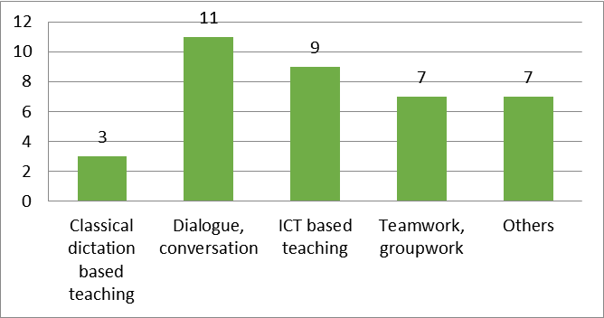
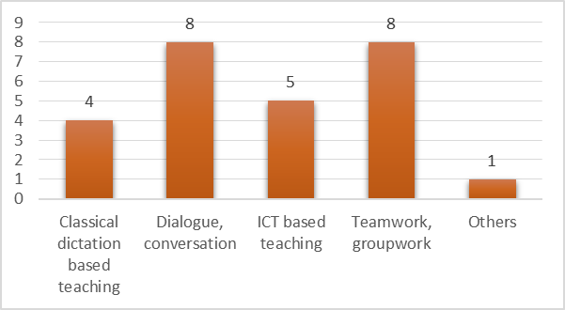
Which is your favorite teaching method?
Games
Coaching
Brainstorming
Internship in group
Vocational training outside the school,
guiding students in real work situations
Small projects
Self-discovering
Role-play and simulation
Experiments
Musical aspects combining with the teaching content
Learning from mistakes + problem solving
Combination of the things above
Belgium
Others
Give question about the classmates
Norway

Slide 4
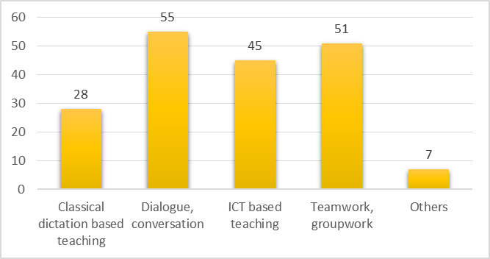
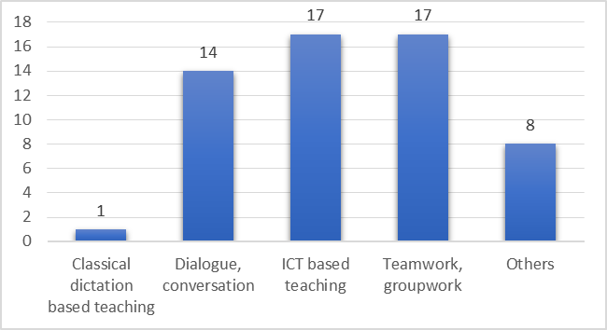
Which is your favorite teaching method?
Portugal
Teachers referred that their favorite teaching method are dialogue and conversation and team and group work.
A few teachers use experimental activities as their favorite teaching method.
Romania
Others
Interactive methods
Learning by discovery
Practical applications
Educational game
Brainstorming
Role play
Learning through cooperation
Small projects

Slide 5
What teaching methods do you use in your class?
Belgium
Groupwork
Games
Wordweb
Instruction
Class discussion
Quiz
Contractwork
Demonstration
Kahoot
Instruction movies
Individual work
ICT
Programming and coding
eTwinning
Internship in groups
Thinking in groups
Class conversation
Jigsaw
Different corners
Independent work
Educational conversation
Tutor learning
Active task
On paper
Independent research
Dialogue
Working together
Coaching
Brainstorm
Projects
Learning by discovering
Games
Experiments
Musical tasks
Learning from mistakes

Slide 6
What teaching methods do you use in your class?
Norway
iPAds
Books
Loud speaking
Dialogue/Conversation
ICT based teaching
Teamwork/Groupwork
Writing text --> Response -groups
Groupwork after introduction
Classic teaching with board/projector
Solwing problems/tasks alone or in small groups
Small group teaching
Lectures
Teaching with dialogue
Individual work

Slide 7
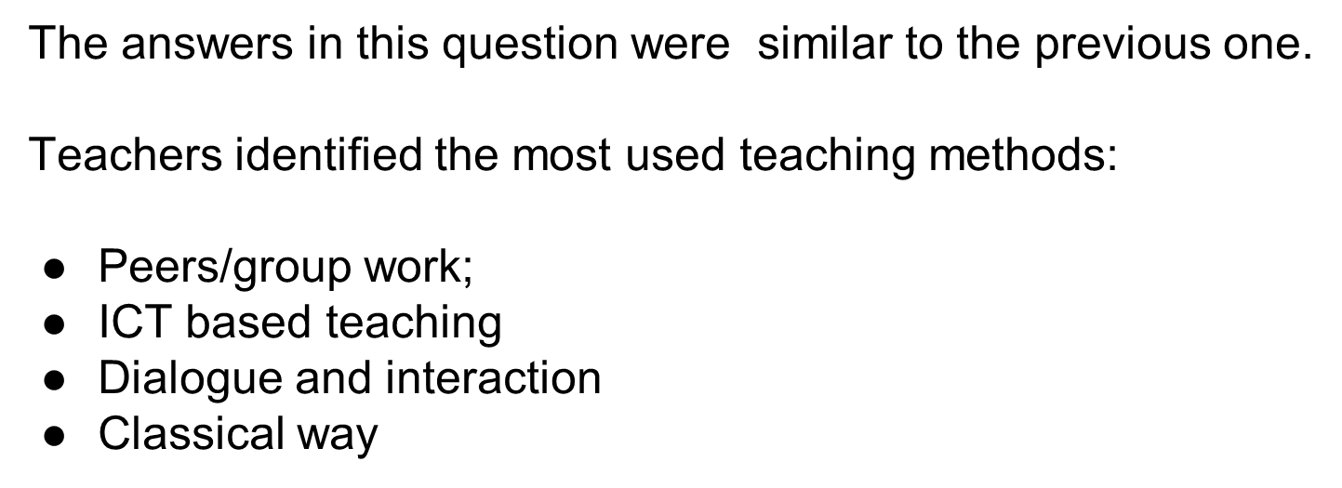
What teaching methods do you use in your class?
Portugal

Slide 8
What teaching methods do you use in your class?
ICT teaching
Teamwork
Educational games
Brainstorming
Learning by discovering
Teaching based on dialogue, Conversation , discussions, observation
Teaching by project method
Role –play
Social stories
Learning through co-operation
I know-I want to know - I learned
One by one activities
Romania

Slide 9
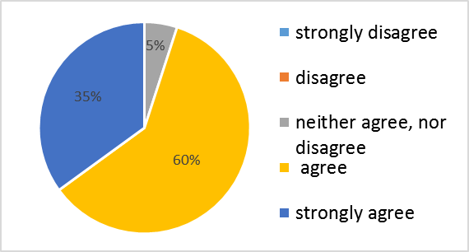
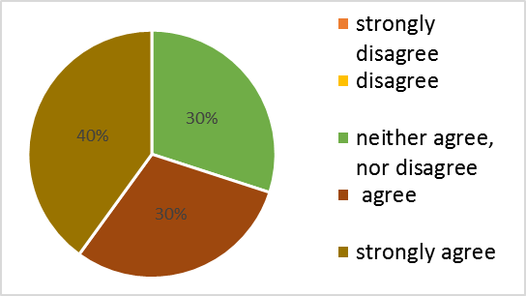
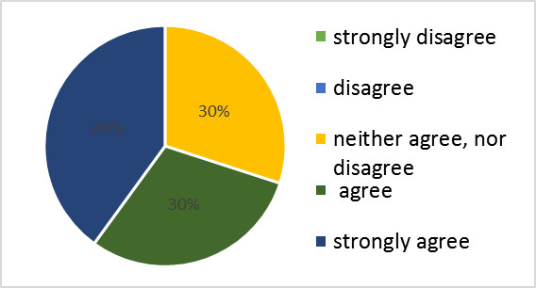
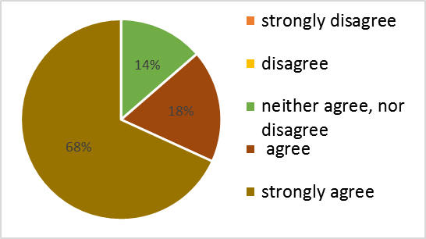
”The use of ICT in education is not a caprice, but a necessity." The lessons are more attractive and respond to the needs of 21st century students.
Norway
Belgium
Portugal
Romania
Most of the teachers agree with the use of ICT.

Slide 10
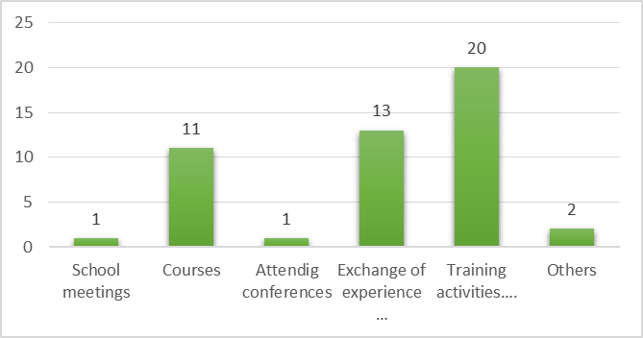
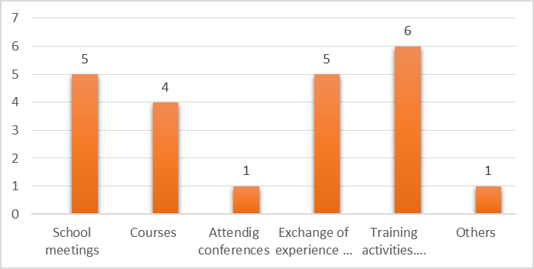
Which of the following options are most useful for your professional development (improving the act of teaching in the classroom)?
Belgium
Norway
Teachers considered the best way to improve their professional development by:
exchanges of experience with professionals from other institutions / organizations;
training activities, visits to similar institutions

Slide 11
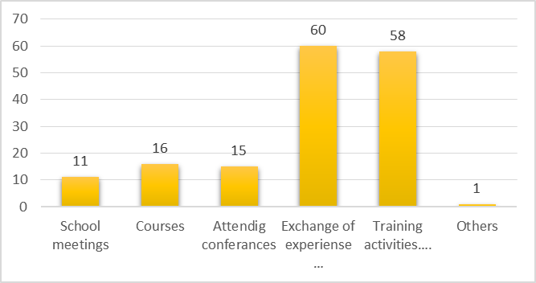
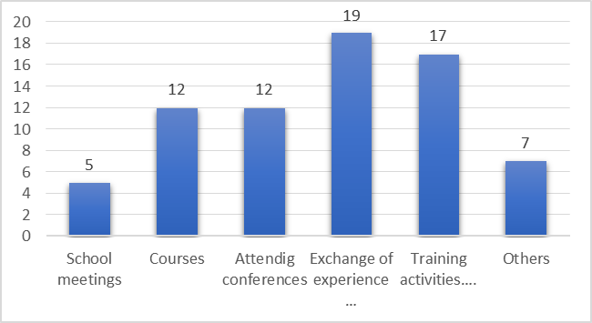
Which of the following options are most useful for your professional development (improving the act of teaching in the classroom)?
Portugal
Romania
Teachers considered the best way to improve their professional development by:
exchanges of experience with professionals from other institutions / organizations;
training activities, visits to similar institutions

Slide 12
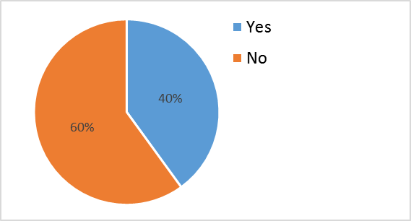
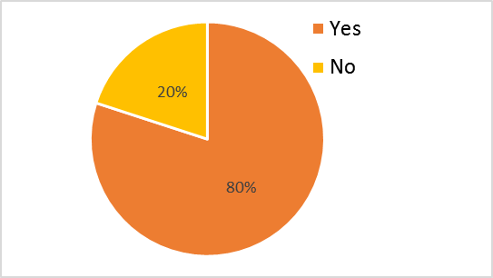
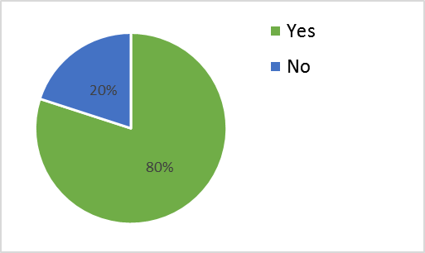
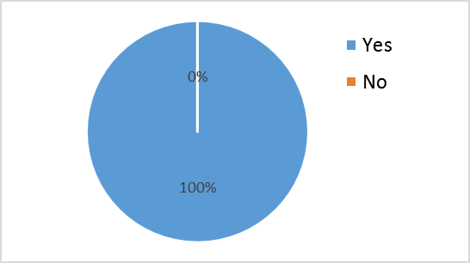
Are you interested in participating at the activities of the project „Travelling to new teaching adventures”?
Belgium
Norway
Portugal
Romania
Most of the teachers would like to participate in this project.

Slide 13
Please list 3 competences that you would like to achieve / consolidate by participating in the activities within the project.
Teachers would like to achieve the following competences:
To know and improve different teaching methods
To improve their skills on ICT;
To share ideas and collaborate with the partners from European schools;
To know other educative realities and also European countries;
Exchange good teaching methods and strategies;
The ability to constantly provide innovative elements in the didactic activity.

Slide 14
THANK YOU!
The project is financially supported by the European Commission under the Erasmus+ Programme. The European Commission support for the production of this publication does not constitute an endorsement of the contents which reflects the views only of the authors, and the Commission cannot be held responsi­ble for any use which may be made of the information contained therein.

