Slide 1
WEATHER IN MY TOWN
( IVANIĆ -GRAD,CROATIA)
Leonarda Bunjevac, 7.C
Oš Đure Deželića Ivanić-Grad
Croatia

Slide 2
SUNDAY May 14th 2017.

Slide 6
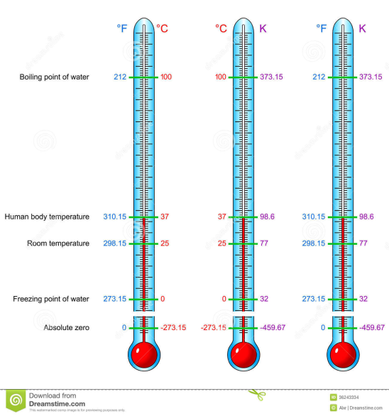
T = 17°C = 290 K= 63° F
T ( K) = 273K + T (°C) | T (°C) = T (K) -273K
T(°F) = 1,8 T(°C) + 32 °F | T(°C) = (T(°F) - 32 °F)/1,8
CONVERT
( klick on the picture)

Slide 7
The temperature scales were/are been used :

