Slide 1
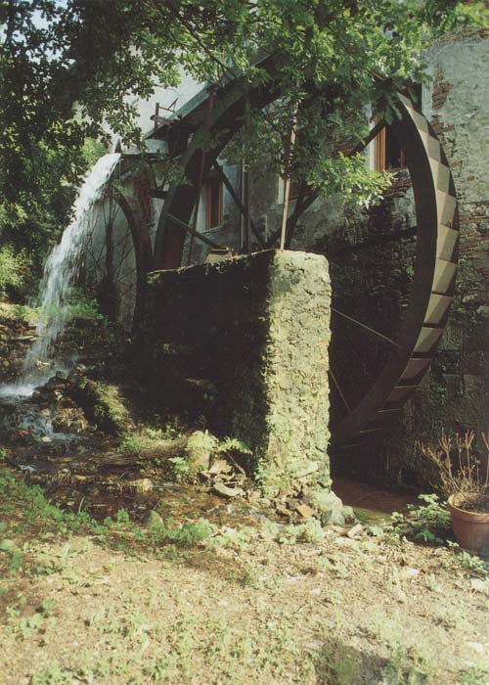
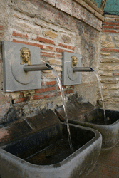
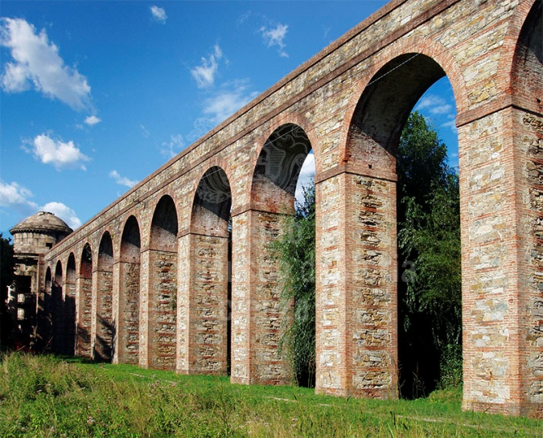
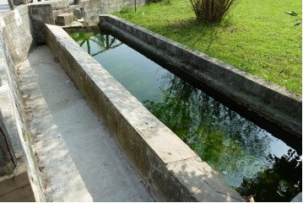
“WATER ARCHITECTURE”: It’s a form of architecture, in which
the main role is played by the water. This architecture was used in the past to carry out simple daily functions. Watermill wheels, the old washing basins, the aqueduct ( to Guamo is the only in the Compitese ) and the many public fountains are part of this type of architecture.
Notes:
“WATER ARCHITECTURE”: It’s a form of architecture, in which the main role is played by the water. This architecture was used in the past to carry out simple daily action. They are part of this type of architecture the wheels, the old washing, the aqueducts ( to Guamo is the only in the Compitese ) and the fountains are part of this type of architecture.

Slide 2
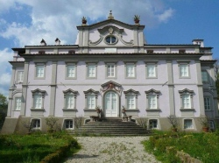
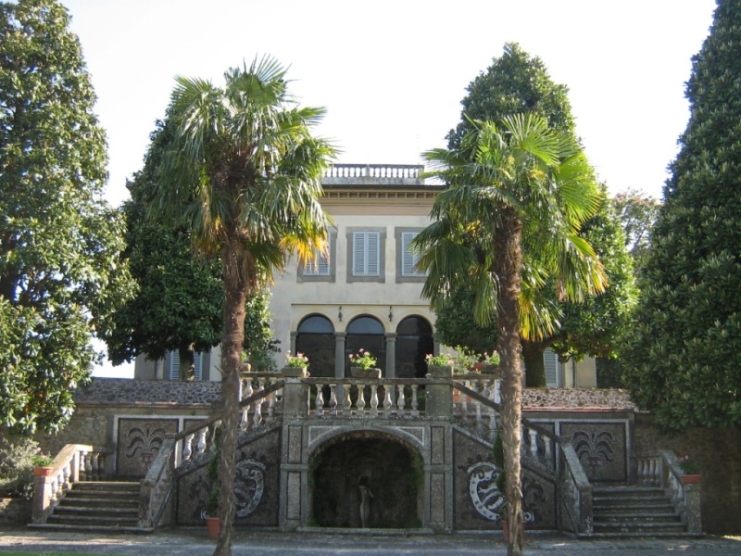
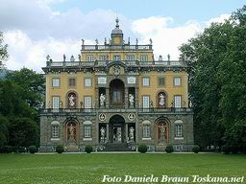
The numerous historical villas in our city council
Notes:
“VILLA”: It’s a historic home of stately countryside, it is characterized by a wall, a gate and a garden.

Slide 3
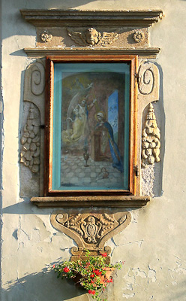
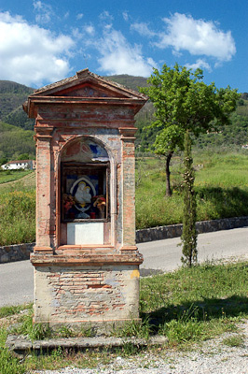
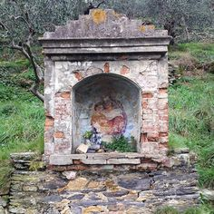
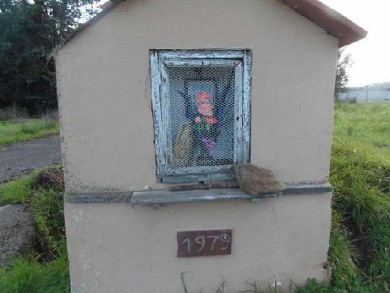
Marginette
Notes:
“MARGINETTA”:It’s a small chapels that found by the roadside. Iside there is a statue or a religious image that represents the Virgin Mary or Christ

