Slide 1
HERE WE ARE!
CLASS 2G VILLORBA
THIS YEAR WE’LL WORK WITH ROBOTS!!!
NICE TO MEET YOU!!!!!

Slide 2
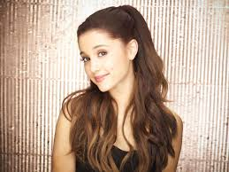
GIORGIA
Hello, my name is Giorgia and I’m 11 years old. I’m from Visnadello , I play volleyball, I love dogs and dolphins but now I have only 3 fish. My favourite subjects are History, Music, my favourite singer is “ ARIANA GRANDE “ and my favourite color is blue .
Bye Bye!

Slide 3
LUCIA
Hi,I’m Lucia.I’m 11 years old.
I live in Fontane. I am tall and thin; my hair is brown, I’ve got brown eyes. My favourite color is green and my favourite subject is music.My favourite food is pizza! I’ve got a dog,Terry. I play tennis and guitar.
Bye Bye!

Slide 4
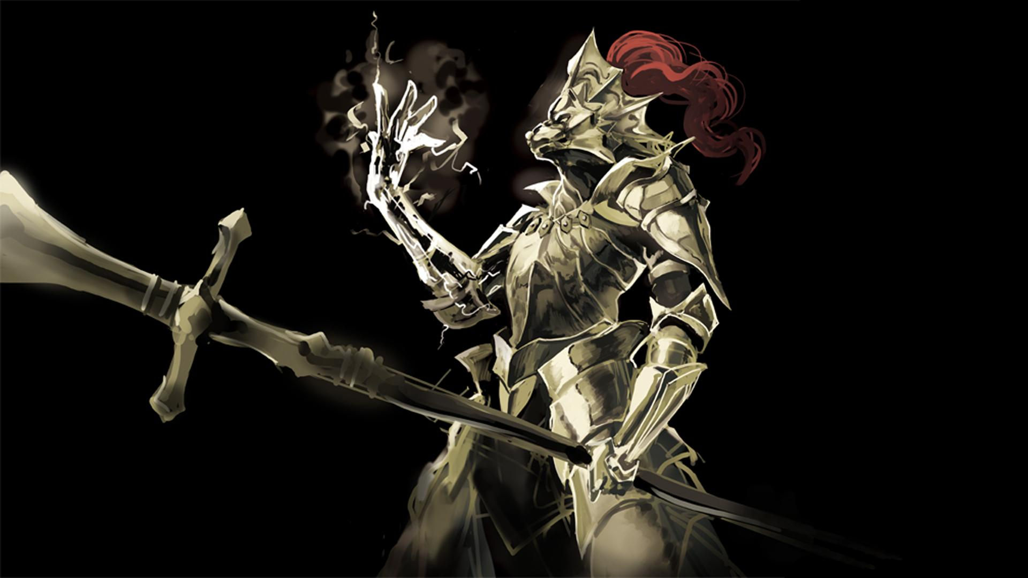
GIUSEPPE ARTUSO
Hello, my name is Giuseppe, I‘m 10 years old. My favourite colors are green and light-blue, my favourite animals are wolf, tiger, eagle and leopard. My favourit sport is basket.
I’ve got a cat and two tortoises.

Slide 5
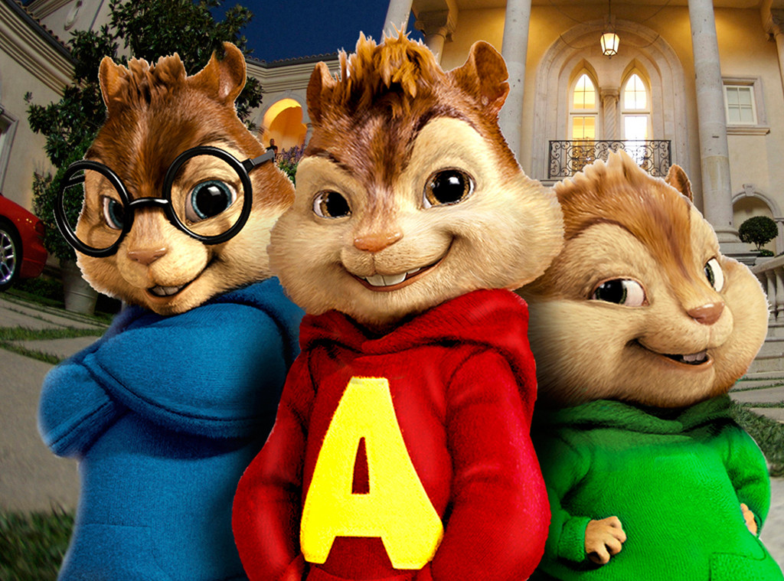
GIUSEPPE MATTEO
Hello, my name is GIUSEPPE MATTEO
I’m eleven years old.
I’m thin, I’ve brown hairs and brown eyes.

Slide 6
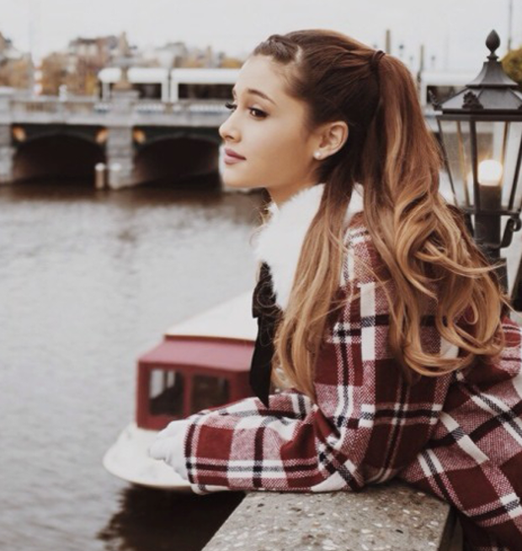
GIOIA
Hello,
My name is Gioia Scandiuzzi and I’m eleven years old. I live in Villorba, Italy, and I attend the “Giuseppe Scarpa” 1° secondary school.
I play volleyball and I like fantasy book.
My favourite subject is art.
My favourite singer is Ariana Grande.

Slide 7
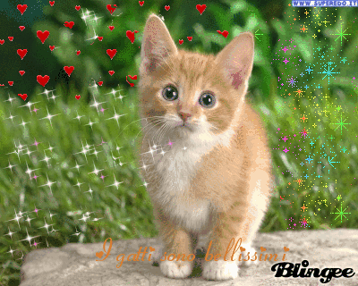
LAURA
Hello,
My name is Laura. I’m 11years old. I live in Villorba Italy.
My family is compound from 5 people: 2 brother Daniele and Alessio, dad Roberto and mum Claudia. I have also 2 cats: Laila and Simba. My favourite colours are white, blue and purple.
I like playing dance and reading fantasy book.
My favourite subject is art. My favourite singer is Ariana Grande.

Slide 8
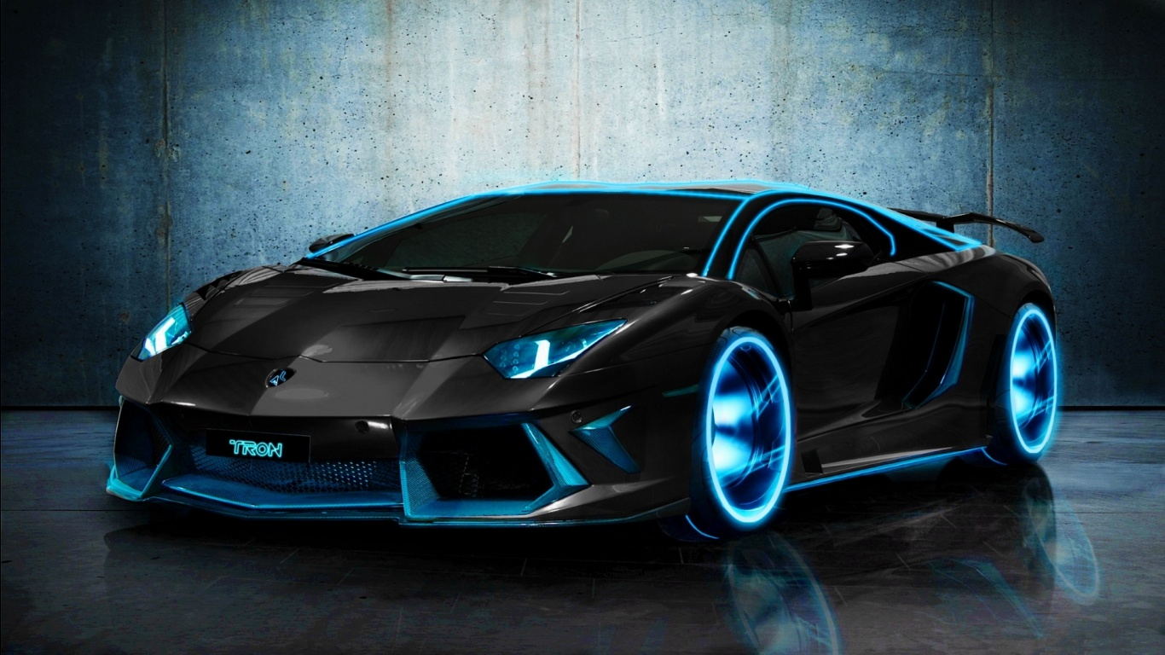
LUCA
My name is Luca. I’m 11 years old. I’m very tall and thin. My favourite sports are rugby and basket, my favourite subyect is science .

Slide 9
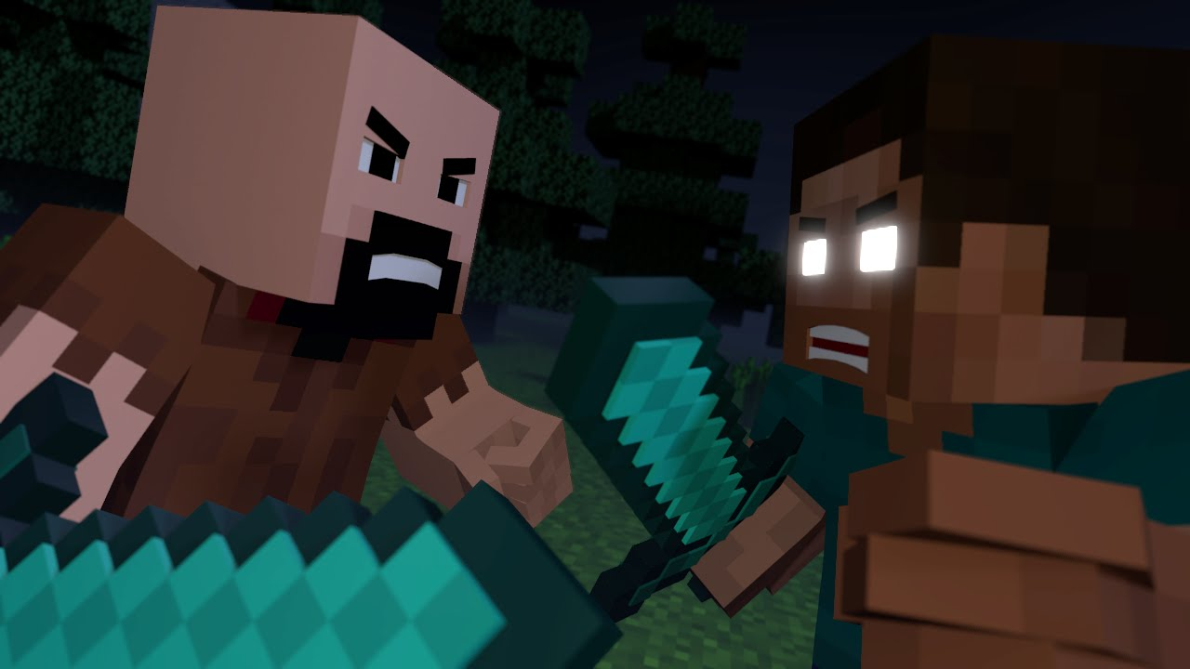
RICCARDO
Hello, my name is Riccardo Ghedin Ghedin. I’m 11 years old and I live in Villorba near Treviso. I have a little brother of 7 years and his name’s Nicolò. My parents’ name are Guglielmo and Silvia . I attend the 1° class in the middle school “ Giuseppe Scarpa”. I have a red cat, Garfield. My favorite sport is swimming . I like to play videogame and hate doing homworks.

Slide 10
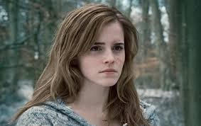
Marica Michielin
Hi, my name is Marica and I’m eleven years old. I’m from Villorba. My birthday is on thirteen of May and my sign of the zodiacal is the BULL. My favourite food is pizza and I love sky-blue! My favourite subjects are history, music and gymnastic while I am bering the gography.
Hello, Marica!

Slide 11
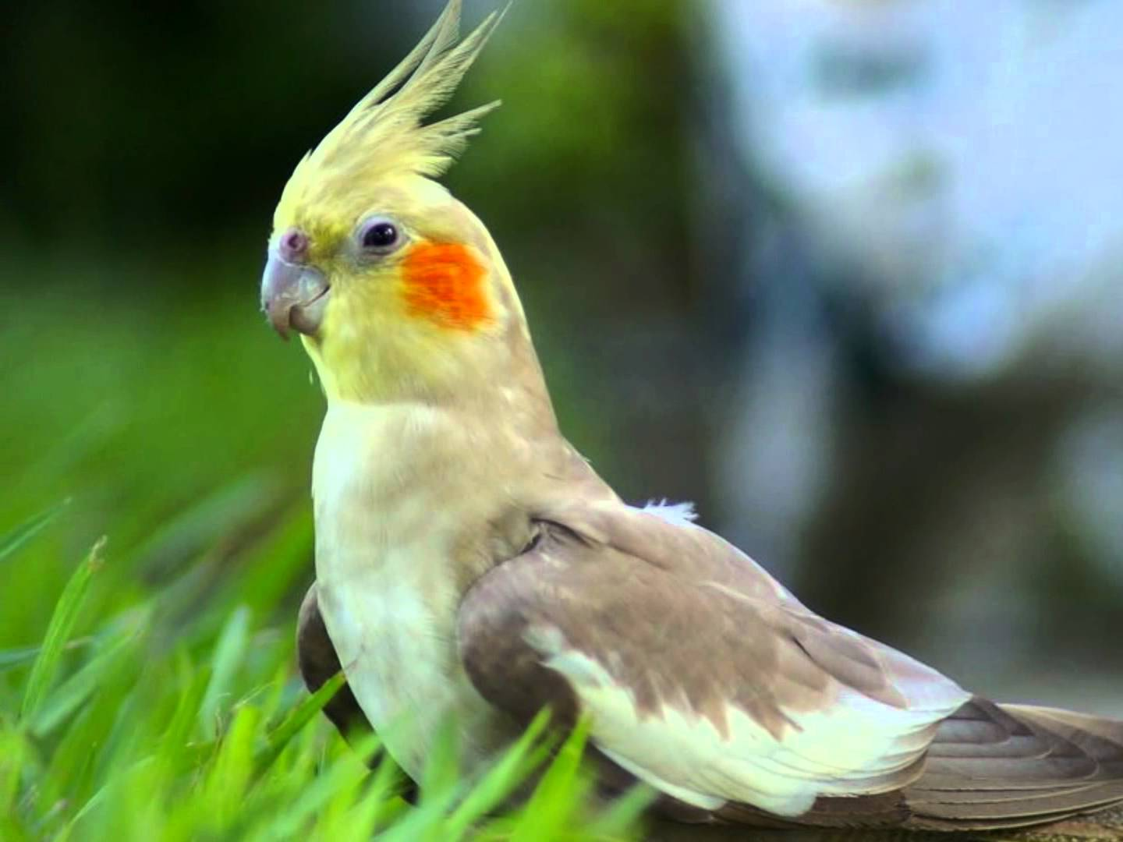
MATTEO SIMIONI
Hello everybody!
My name is Matteo, I’m 11 years old and I go to the Giuseppe Scarpa middle school in Villorba, in the north of Italy.
I live in Lovadina, in the north of Italy too.
I play piano and I sing very well. Music is my life!!
I swim and I love water, that’s the reason why my favourite color is blue.
I like literature, science, art and english. Bye!!!

Slide 12
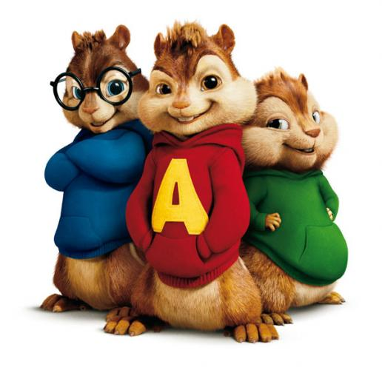
MOHAMED WAHMANE
My name is Mohamed Wahmane and I’m eleven years old .
My favourite sports is football and my best friend is Luca.
I live in Villorba, in the north of Italy.
I go to the “Giuseppe Scarpa” middle school.
My favourite color is red and I like math, gym, music and literature.
Bye!!

Slide 13
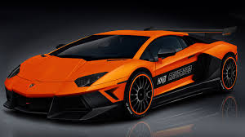
oscar
Ciao mi chiamo Oscar Lancini ,ho 11 anni.Ho gli occhi azzurri.Mi piace giocare a calcio e a tennis;mi piace guardare la tv e non mi piace andare a scuola.
Hello,my name is Oscar Lancini,I am 11 years old. I like playing football and tennis,I like watching TV and I don t like going to school.

Slide 14
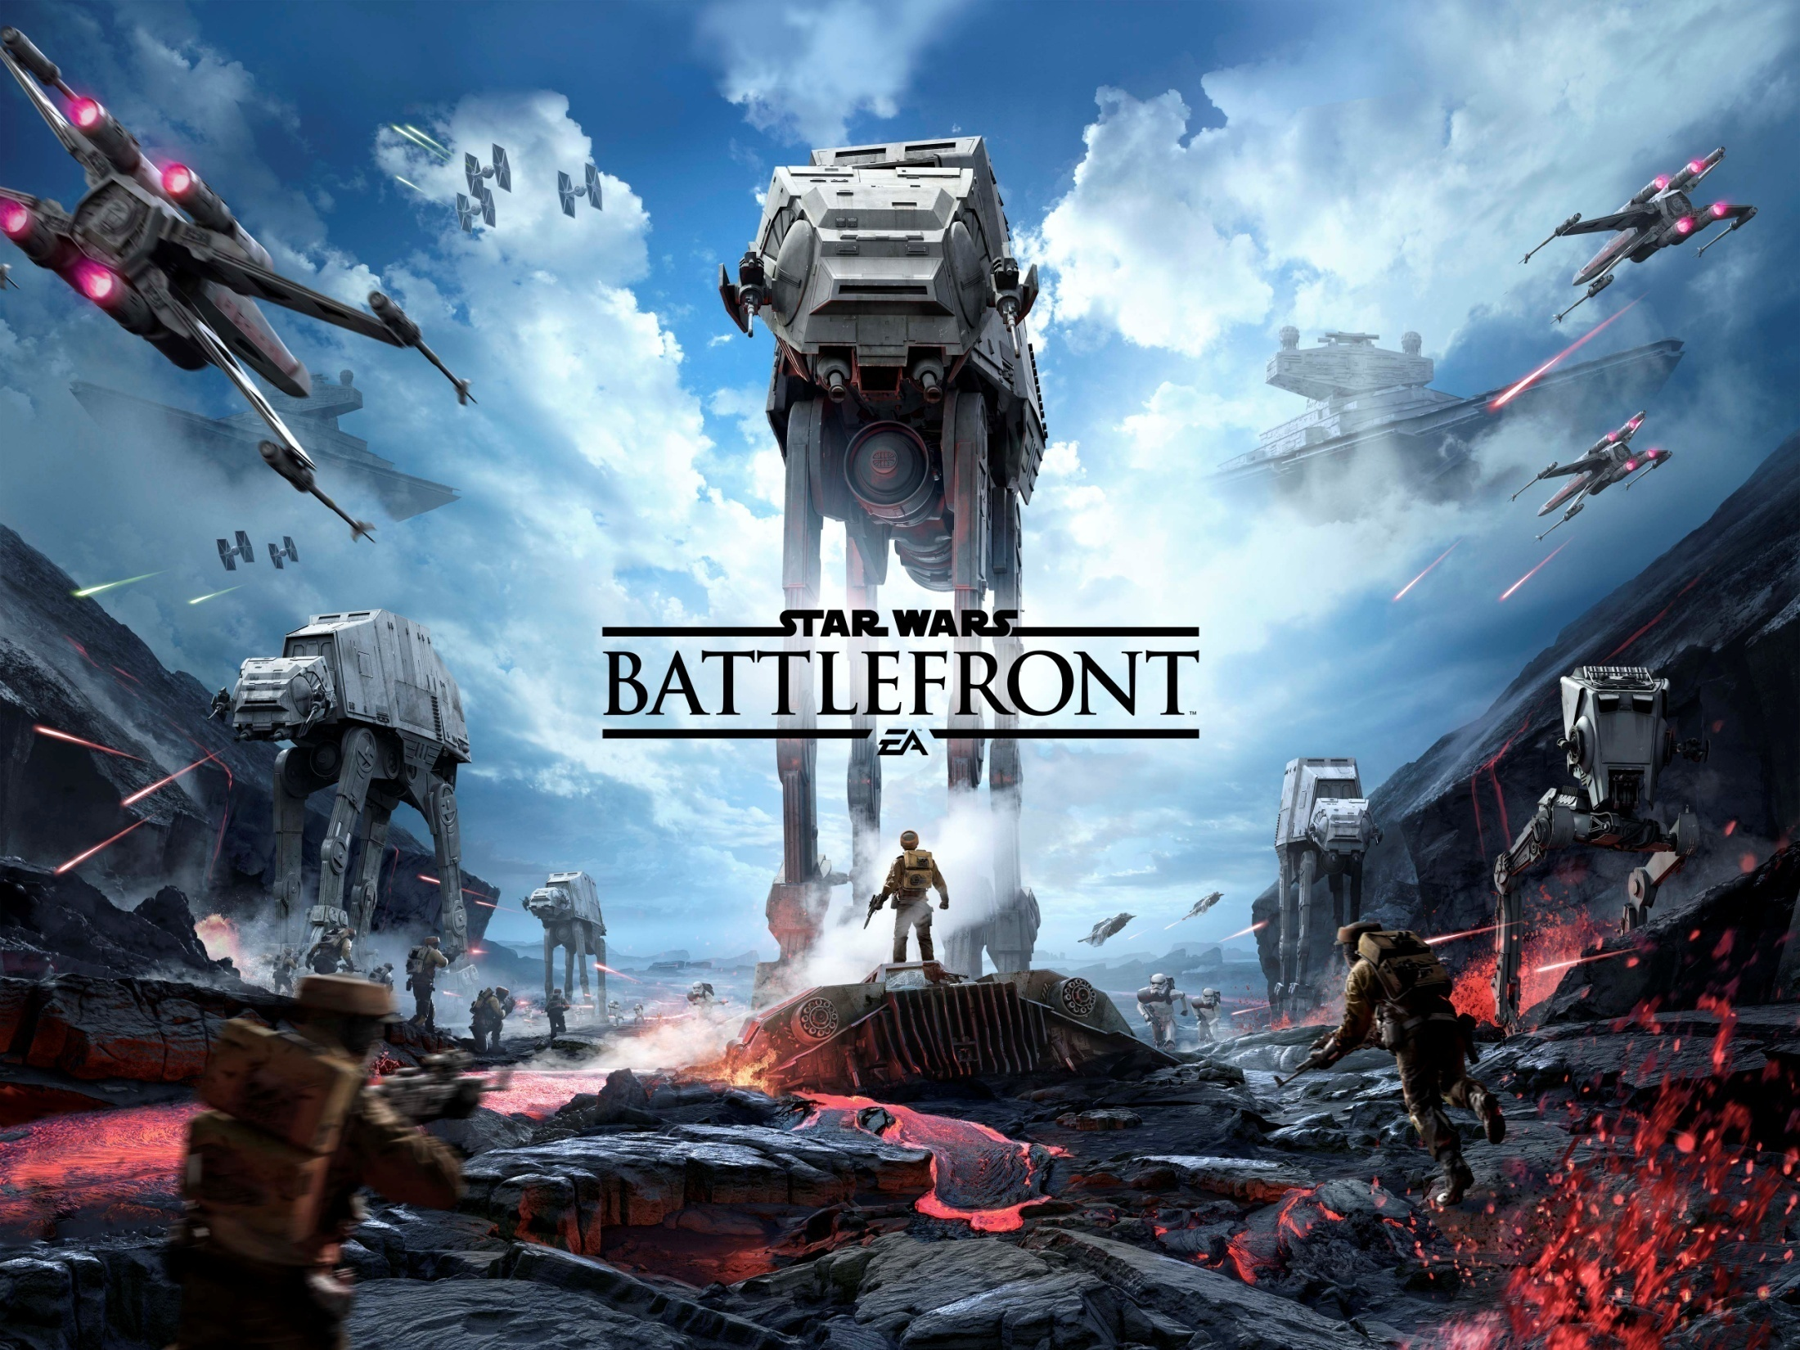
Alberto
MI chiamo Alberto Fantin ho 11 anni sono robusto,sono alto,porto gli occhiali e ho i capelli marroni e gli occhi verdi.
My name is Alberto Fantin, I am eleven ears old, I am fat, tall, I wear glasses, I have brown hair and green eyes.

Slide 15
SARA BETTIOL
Hello,my name’s Sara. I live in Villorba, Italy. I’m 11 Years old. I’m student at “G. Scarpa “ school. My favourite animals are cat and horse and my favorite colors are purple and pink . I practise artistic gym. My favourite singers are One directon and Ariana Grande and my favourite tv show is
“ cake boss”.

Slide 16
DONITA BAJRAKTARI
Hello my name’s Donita . I live in Italy, in Santandrà .
I’m 11 years old. I’m student at “G. Scarpa” school . My favourite animal is horse and my favourite coulors are pink and water-green. I love One direction, and my favourite tv shows are “I carly” and “Victorious”.

Slide 17
VALENTINA
Mi chiamo Valentina Brait ho 11 anni e mezzo e sono nata il 16 giugno 2004.
Porto qualche volta gli occhiali.
Mi piace la pallavolo e infatti la pratico!
Il mio telefilm preferito è i-carly,il mio attore preferito è Robert Pattison.
La mia band preferita sono gli One Direction!!!!!!
Ciao ciao!
My name is Valentina Brait. I’am 11 years old.
My favorite sport is volleyball and my favorit movien is i-carly.
My favorite actor’s Robert Pattison.
My favorite band are One direction!!!!!!
Bye bye!

Slide 18
BETTY
Hi, I’m Betty!
I’m italian and I’m 12 years old.
I’m a student at “Giuseppe Scarpa” 1st Secondary School in Villorba, Treviso, Italy.
It’s a small school with over 200 students.
My favorite school subjects are english and french.
One of my hobbies is reading. I like reading because it teaches us many beautiful and important things that improve our personal culture.
My favorite movie is “Big Time Movie” and my favorite band is OneDirection. They are a great music band!
My favorite sport is volleyball; I’m on the Fontane volleyball team under 13.
I live in a big house with my parents and my three brothers. We have also three dogs: two males Pedro, Willy and a female Frida. They are very funny.
Bye bye!

Slide 19
SEE YOU VERY VERY SOON!!!

