Slide 1
Romanian astronomers

Slide 2
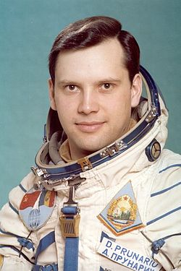
Dumitru Dorin Prunariu
este primul cosmonaut român.
Is the first romanian astronaut.
By
Popa Alexandra
Neatu Riana

Slide 3
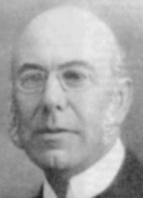
Nicolae C. Coculescu (born July 31, 1866, Craiova, Romania) was a Romanian astronomer.
He was a professor of astronomy at the University of Bucharest.
In 1908 he founded the Astronomical Observatory in Bucharest.
He is known for his studies of Celestial mechanics.

Slide 4
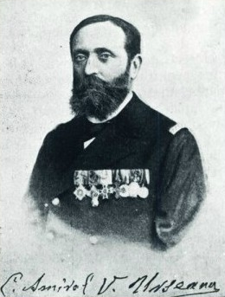
Vasile Urseanu (born January 9, 1848 Bucharest) was a Romanian admiral, founder of the Astronomical Observatory of Bucharest, today Astronomical Observatory Vasile Urseanu.

Slide 5
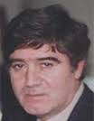
Harald Alexandrescu
El a fost un astronom roman.
He was a romanian astronomer.
Fabiana
Denis

Slide 6
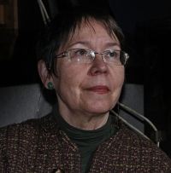
Magdalena Iolanda Stavinschi is a Romanian astronomer.
Director of the Astronomical Institute of the Romanian Academy in 1990-2005.

Slide 7
By 6th grade A students
Secondary School Ion Tuculescu
Craiova
Romania

