Slide 1
Garden Cress
Rzeżucha

Slide 2
Short information about Garden Cress
It is a rather fast-growing, edible herb.
This annual plant can reach a height of 60 cm with many branches on the upper part.
When consumed raw, cress is a high-nutrient food containing substantial content of vitamins A, C and K and several dietary minerals.
Garden cress is genetically related to watercress and mustard, sharing their peppery, tangy flavour and aroma.

Slide 3
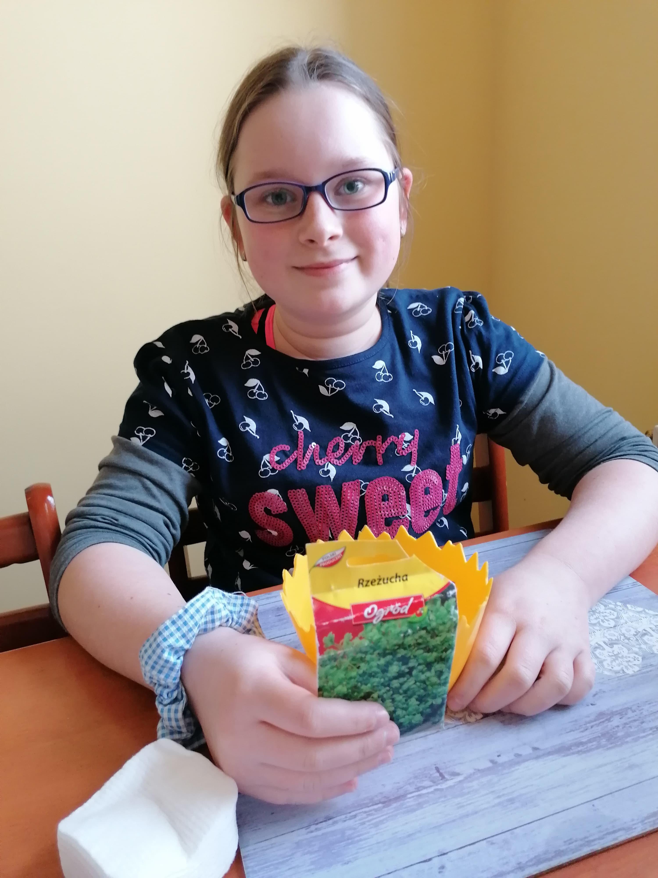
My Garden Cress
It was planted on Friday 27th of March 2020

Slide 4
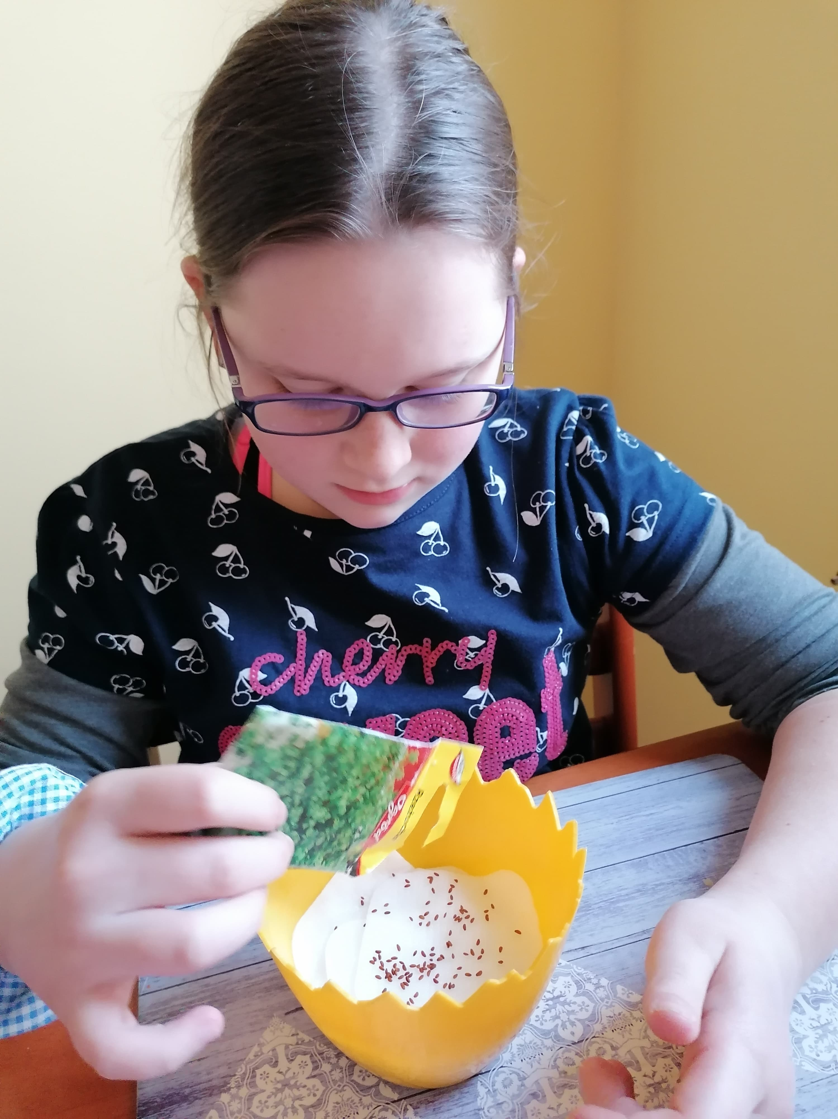
How I planted my Garden Cress
First
Next
At the End
I put cotton pads on the bottom of the flowerpot
At the end I poured some Garden Cress seeds into the flowerpot
Next I poured water into the flowerpot

Slide 5
My Garden Cress is ready to grow
This is how my Garden Cress looks like at the beginning

Slide 6
Day 2
We can see Garden Cress seeds. They are bigger than yesterday and we can see that they are starting to open

Slide 7
Day 3
The leaves are starting to grow.
I added some water today to the flowerpot

Slide 8
Day 5
Look at how fast the Garden Cress has grown!
Now we can see lots of green leaves.
They are longer everyday!

Slide 9
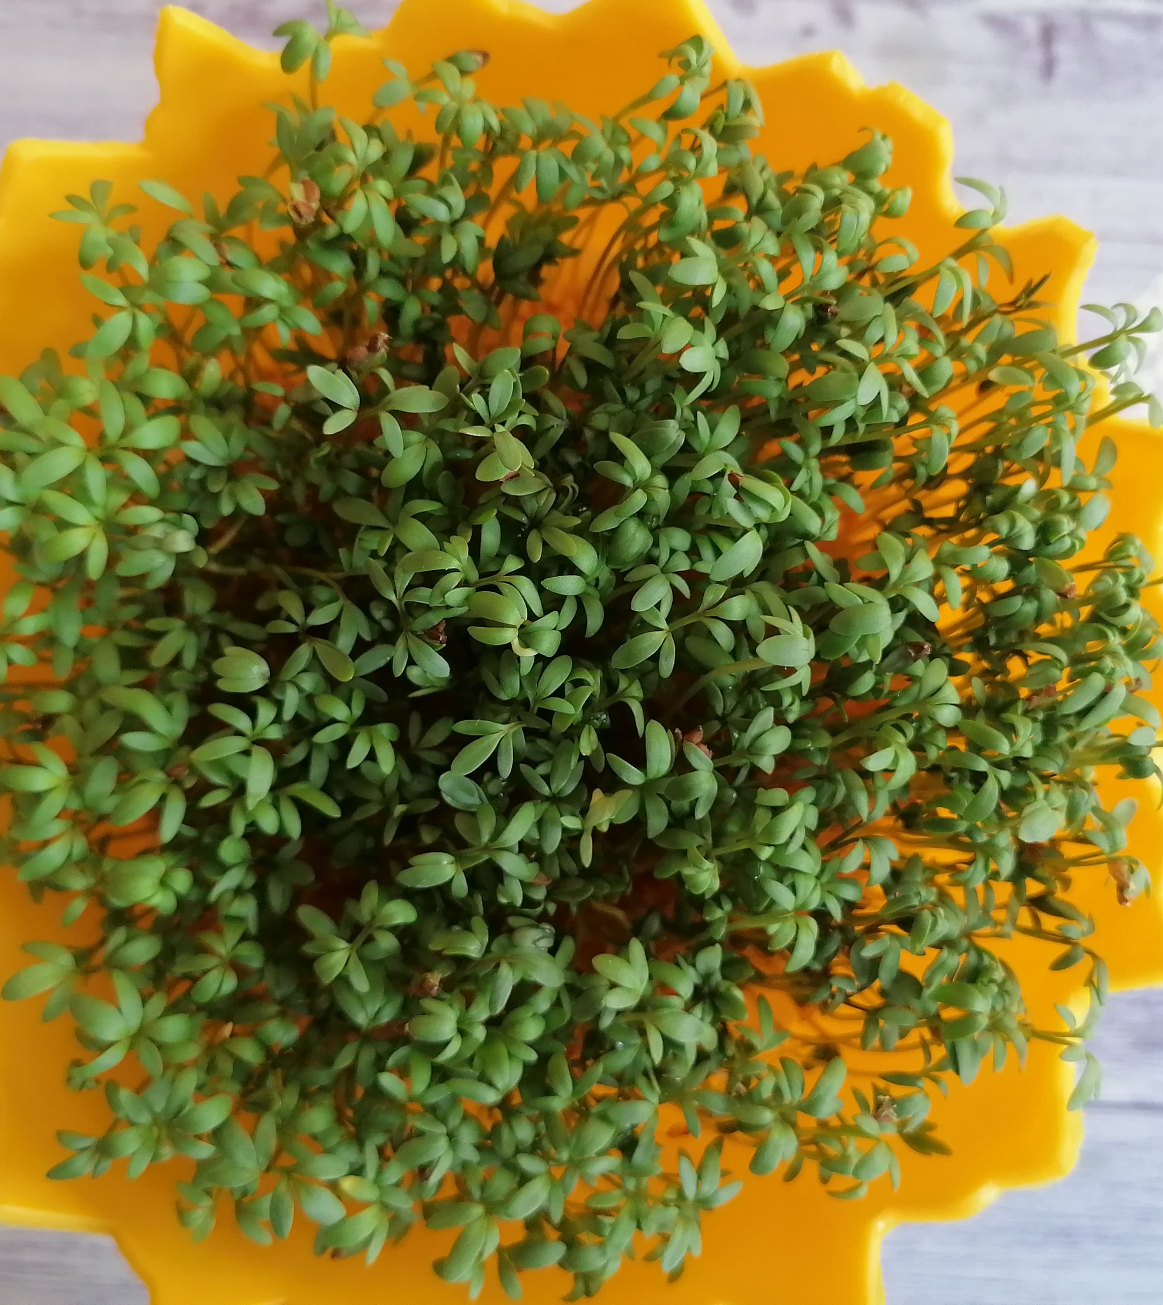
Day 7
My Garden Cress is ready!

Slide 10
Look how big it is!

Slide 11
It’s time to eat ☺
My Garden Cress is spicy, but it tastes good

