Slide 1
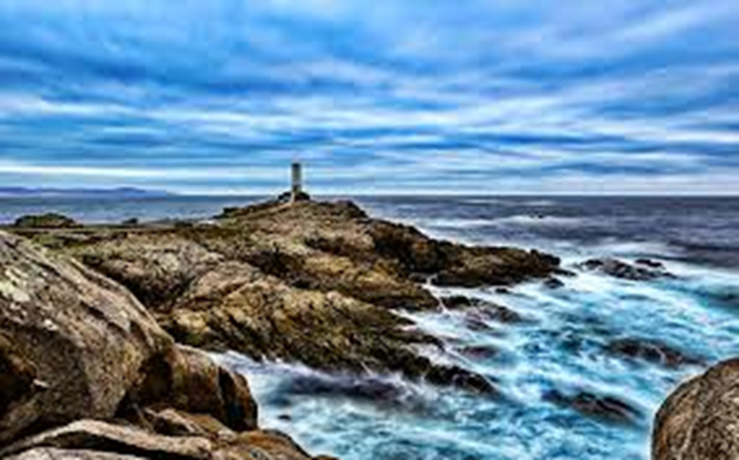
LIGHTHOUSES IN SPAIN

Slide 2
The story of Spanish lighthouses
In the past, the history of the lighthouses, have accompanied men and helped navigation in order to discover, conquest and have contributed to the progress of humanity.
The disappearance of the Roman Empire reduced navigation. The abandonment caused most of the lighthouses to be ruined or demolished.
Around 1200 BC, the lighthouses made their appearance in the Mediterranean thank to the Phoenithians, a population that began to expand towards the sea bringing forward a profitable trade with all the other populations who went beyond the colums of Ercules.

Slide 3
The lighthouse way
This route has 4 parts . Most of them are in Galizia and after in all the Spain. The main characters of this way are the lighthouses.
The lighthouses are white.
First Stop: you start walking at Malpica. There is the first lighthouse that is the smallest of this way.
Second Stop: you start walking in Migna. There you start an exausted way to reach la vixer Do Faro. After leaving it, you go to the lighthouse of Roncudo, then you walk to arrive to the port of Corne and finally to the beach of Osno.
Third Stop: this walk contects Ponceso to l’Axe. There are a lot of birds flying over us.
Final Stop: you start from the lighthouse of the l’Axe which can be reached through the long route of Insua. Finally, you see the last lighthouse in the Lourdio beach.

Slide 4
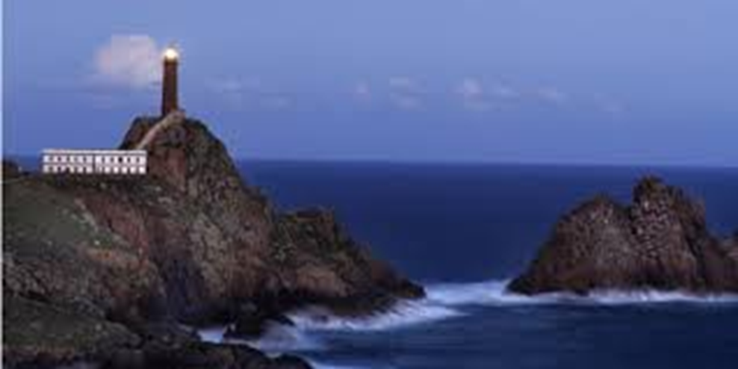
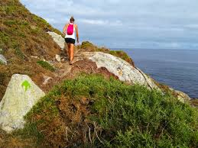
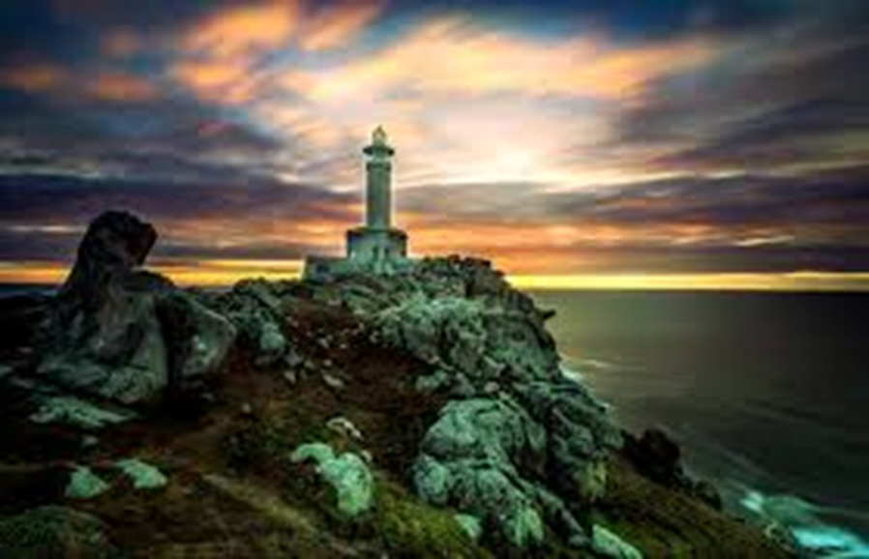

Slide 5
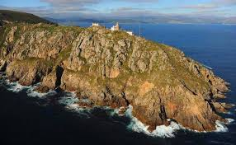
The most important lighthouses
Tower of Hercules (A Coruña)
Cabo Finisterre (A coruña)
Chipiona (Cádiz)
Cabo Formentor (Mallorca)
Porto Pí (Mallorca)
Punta Anaga (Tenerife)

Slide 6
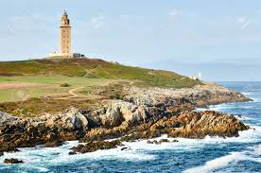
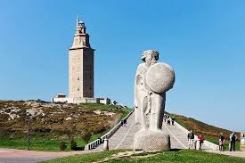
Legend of Ercule
According to the legend, in fact, the mythical Greek hero had come in search of the giant Gerione who ruled the lands between the Duero and the Tajo, in order to free the people from its immense power.
The clash between the two lasted three days and three nights, at the end of which Hercules had prevailed over the giant, had cut off his head and buried her near the sea.
To commemorate his victory he built a lighthouse tower on the mound near which he founded a city to which he gave the name of Crunia, in memory of the first wife who had lived in that place and with whom the hero had fallen in love.

Slide 7
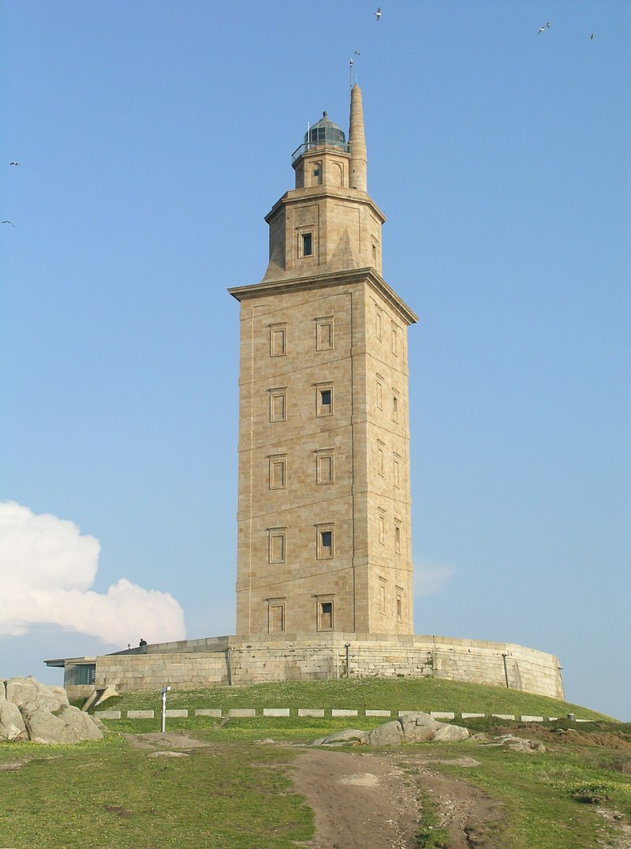
The story of the lighthouse of Ercole
The Tower of Ercules is a lighthouse of Roman origin on the peninsula of the city of A Coruña, in Galicia, Spain.
Since 2009 it has been included in the UNESCO World Heritage Sites.
It is considered the oldest still functioning lighthouse in the world.

Slide 8
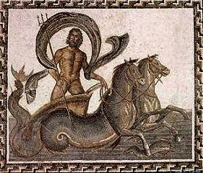
Anastasia’s legend
The legend of Anastasia talks about a very ancient Spanish lighthouse.
In this lighthouse lived Anastasia, a tall, blond girl with blue eyes. She used to go to a close village where there was a boy called Pachin who was in love with her, but Anastasia did not love him. One day Anastasia, while looking at the sea from her lighthouse, she noticed there was a group of sirens. She fell in love with one triton. Many days after, Pachin was very concerned because Anastasia did not appear in the village. Then Pachin bought the lighthouse and he named it ‘Anastasia’, because he didn't know anything more about her, she seemed disappeared.

Slide 9
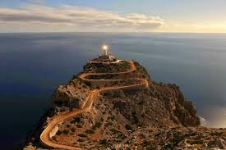
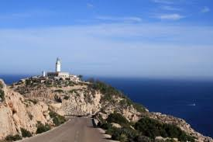
Saracen towers
We’ve discovered that lots of Saracen towers in the South of Italy were built at the same time and with the same structure of some Spanish lighthouses.
At that time, the South of Italy was under the Spain control, and for that reason, these lighthouses might be done by the same kings, and have the same function, even if they didn’t share the same name.

Slide 10
THANKS FOR THE ATTENTION!

