Slide 1
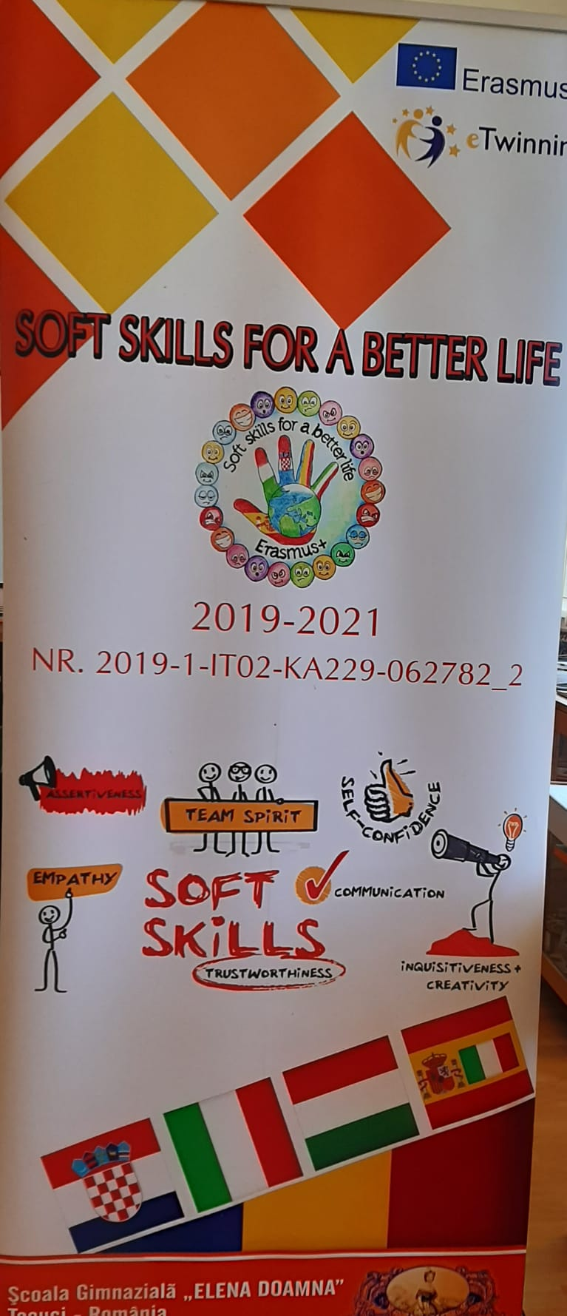
Erasmus + SOFT SKILLS FOR A BETTER LIFE
APRIL, 8TH 2022
School ,,Elena Doamna” – Tecuci
class 1ST
Teacher: Cocolici Anișoara

Slide 2
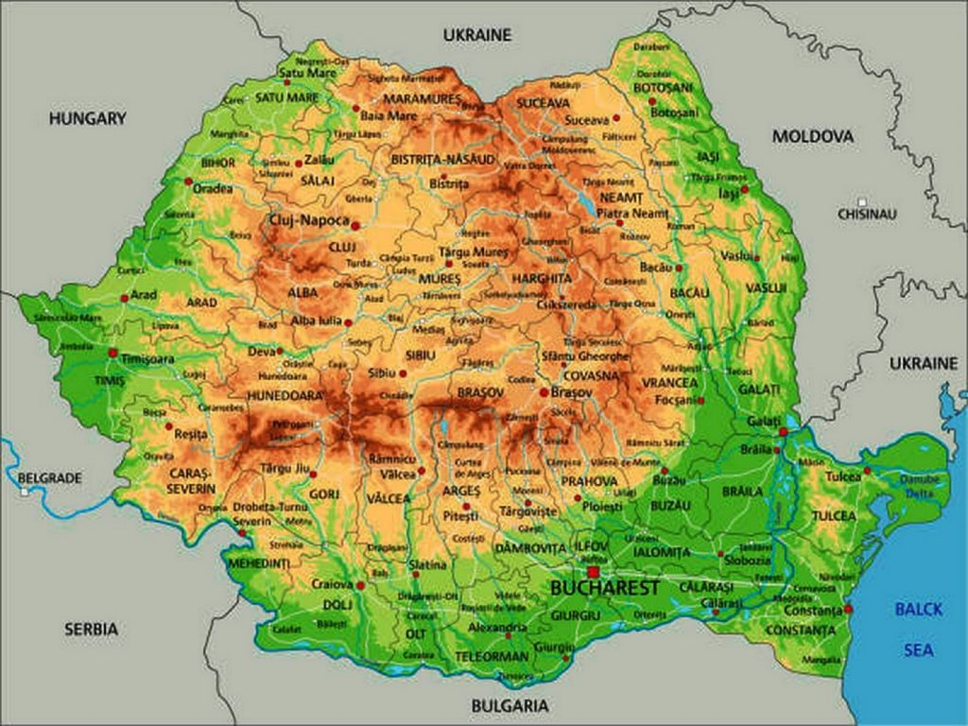
ROMÂNIA - the map of our country

Slide 3
The Romanian flag

Slide 4
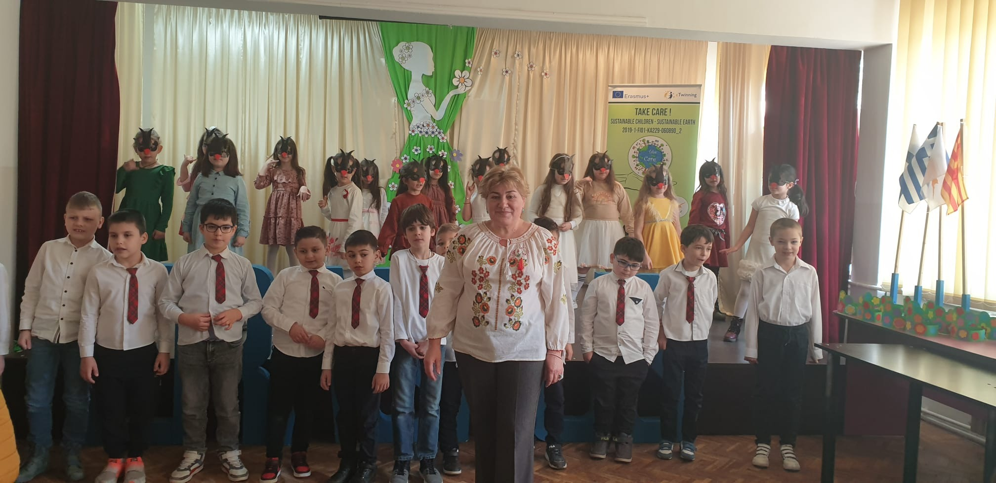
Our class

Slide 5
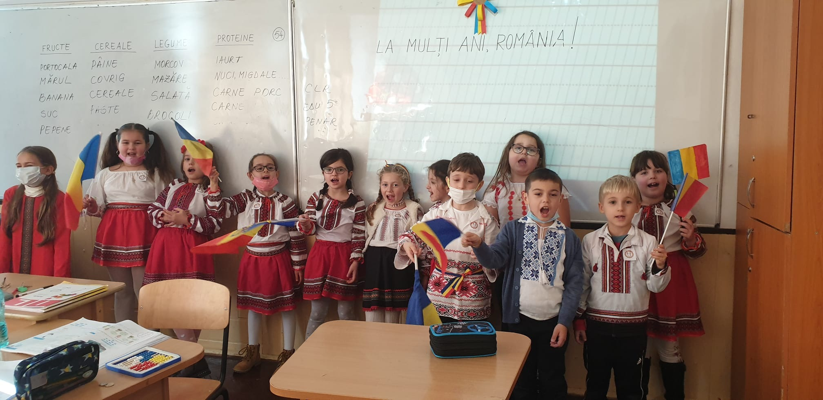

Slide 6
A few words in romanian language
mama
tata
școală
carte
proiect
plastilină
Bună ziua!
Bine ați venit!
Mulțumesc !
La revedere!

Slide 7
Erasmus + SOFT SKILLS FOR A BETTER LIFE
APRIL, 8TH 2022
Primary School Brodarica, Šibenik
2nd grade
Teacher: Ivana Križanac

Slide 8
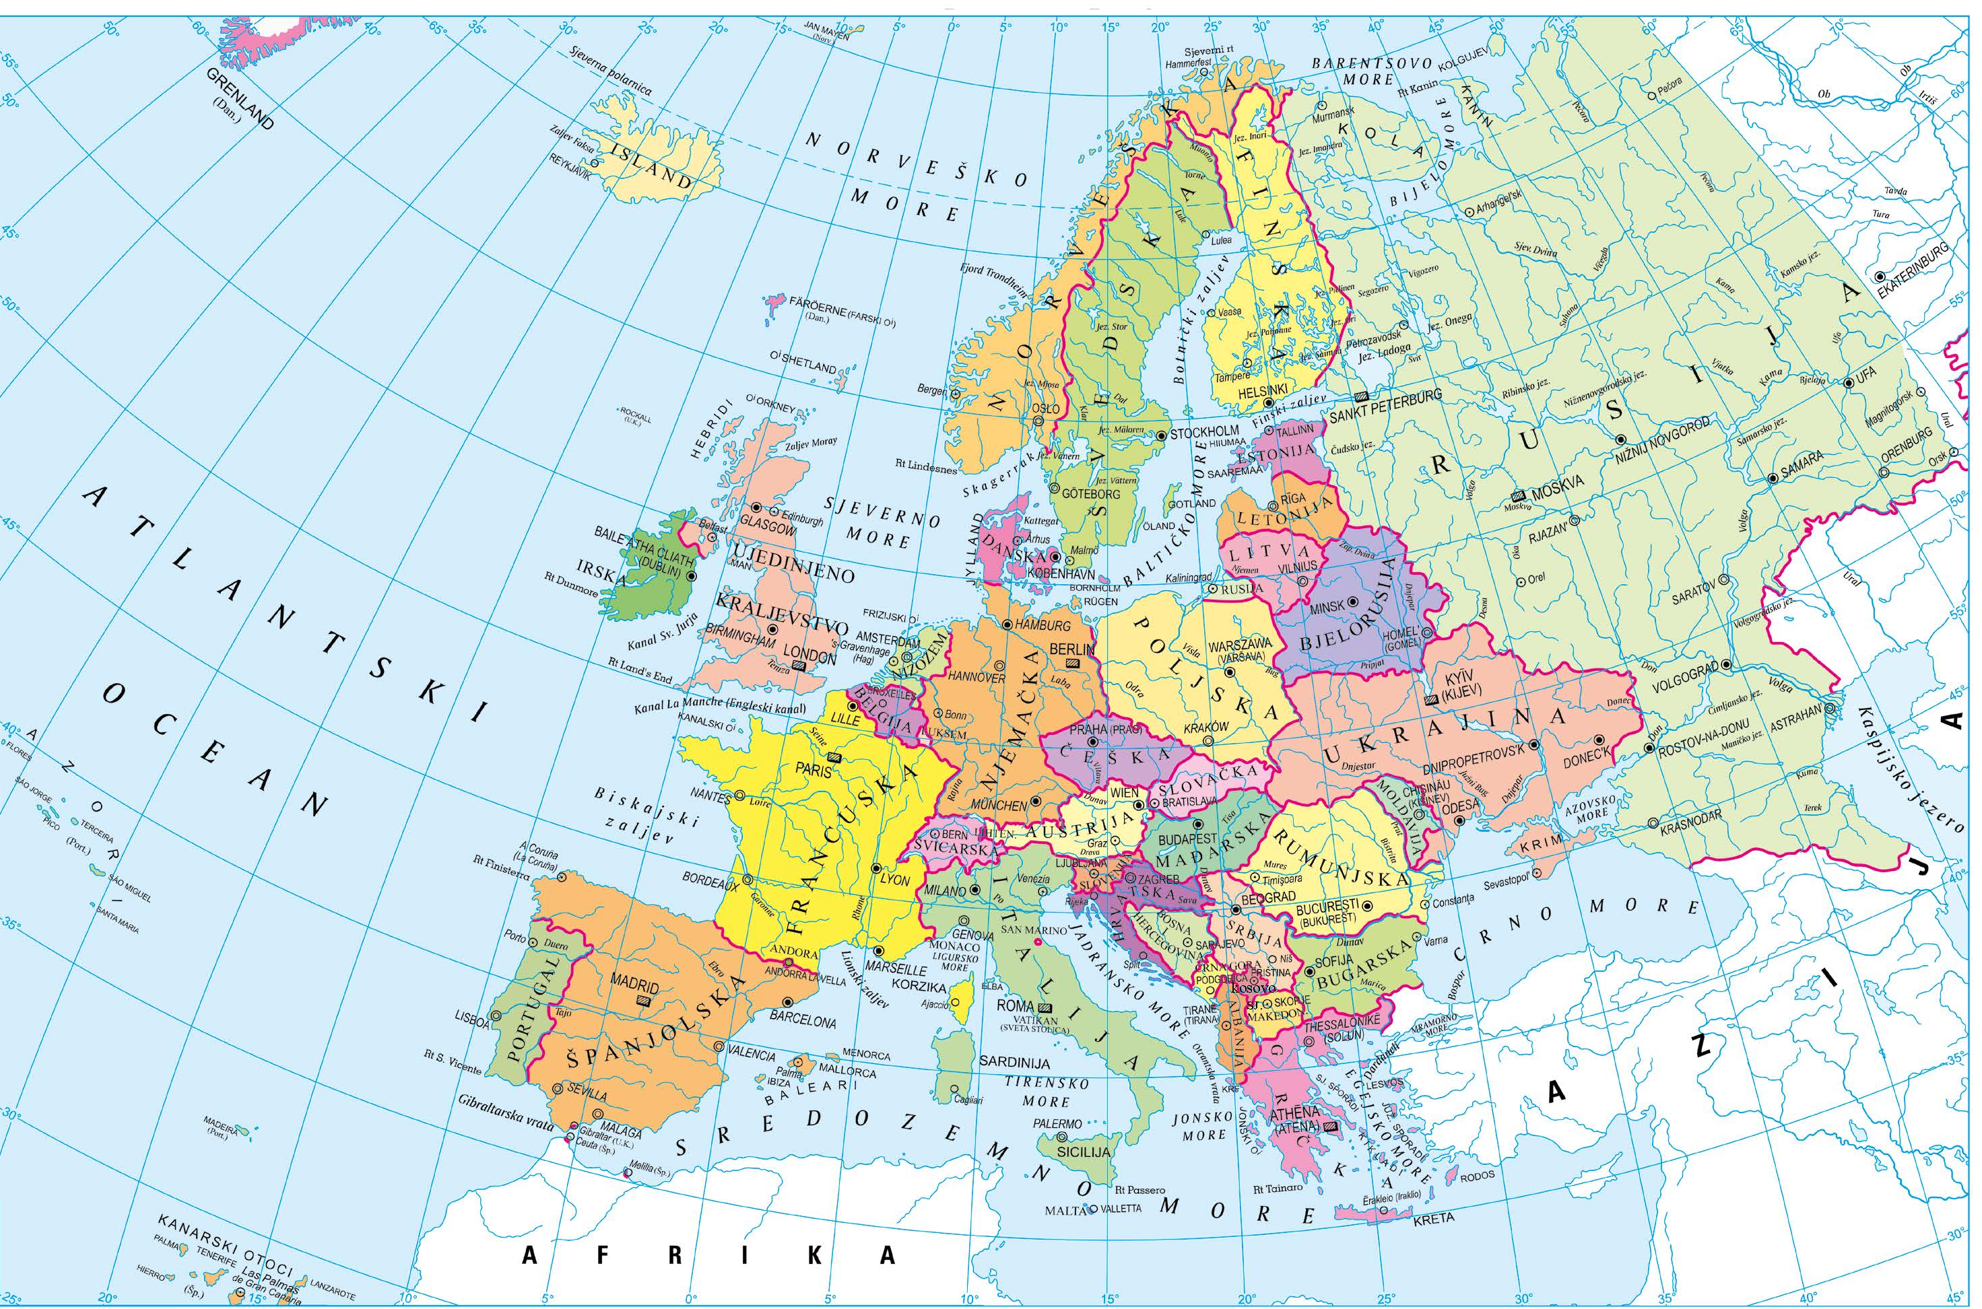
CROATIA - the map of our country
Romania
Croatia

Slide 9
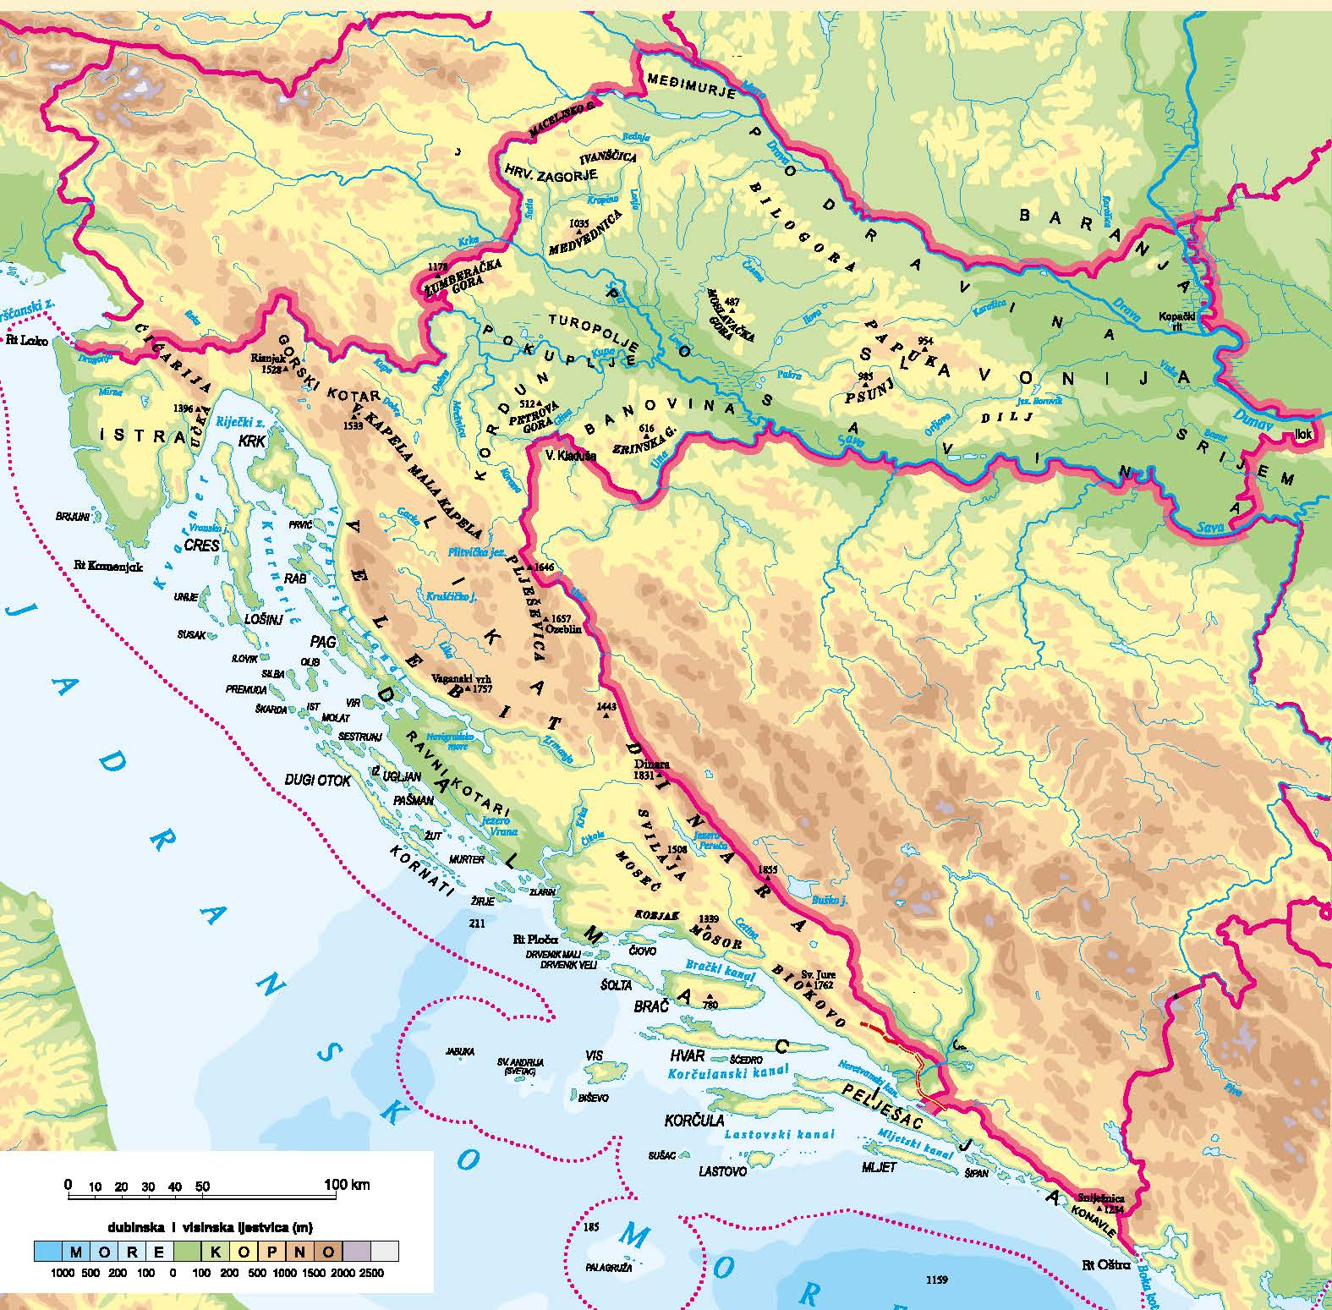
CROATIA - the map of our country

Slide 10
The Croatian flag

Slide 11
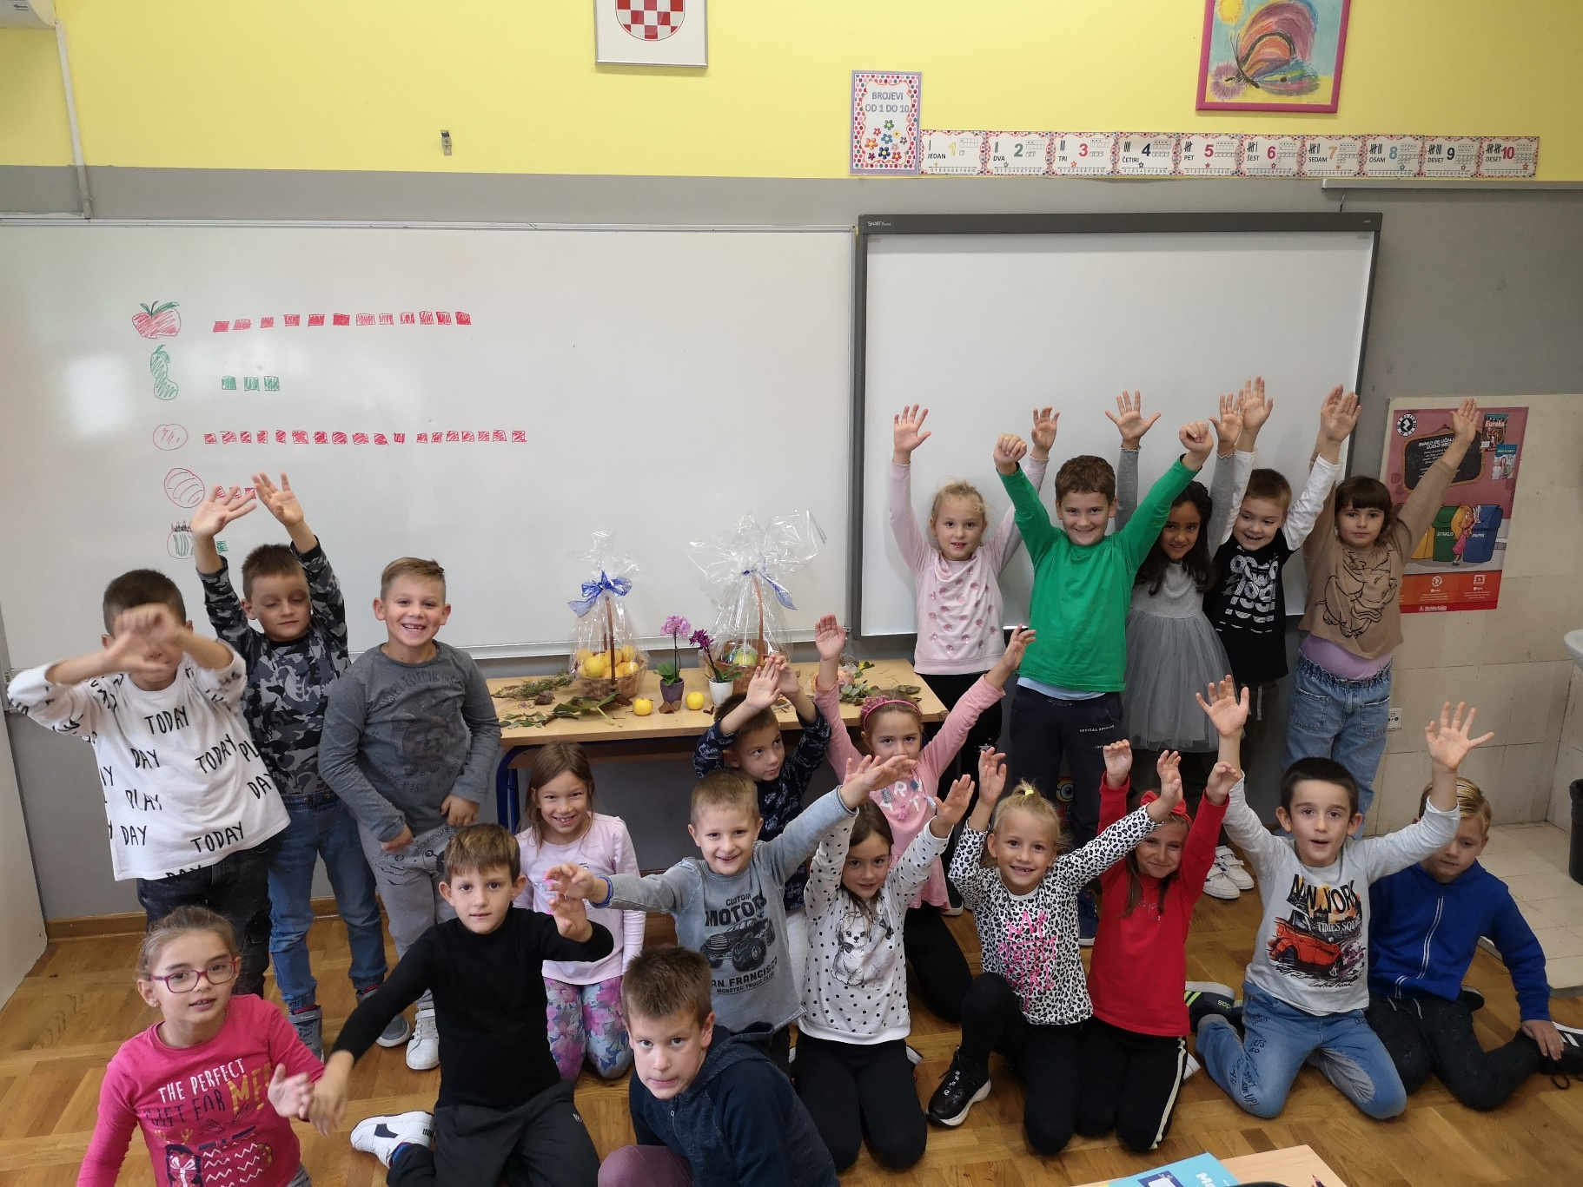
Our class

Slide 12
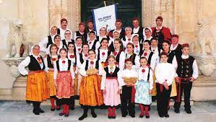
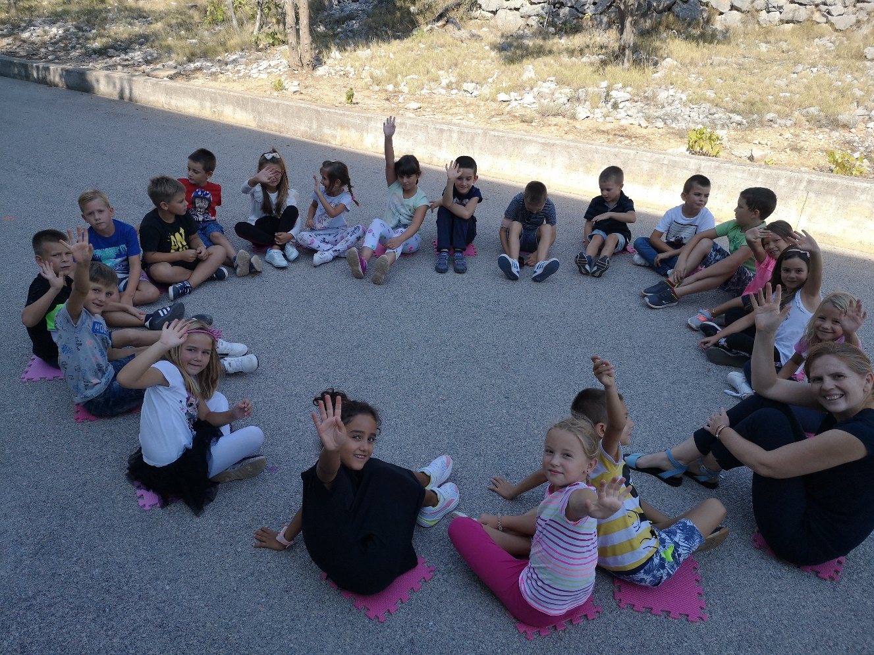
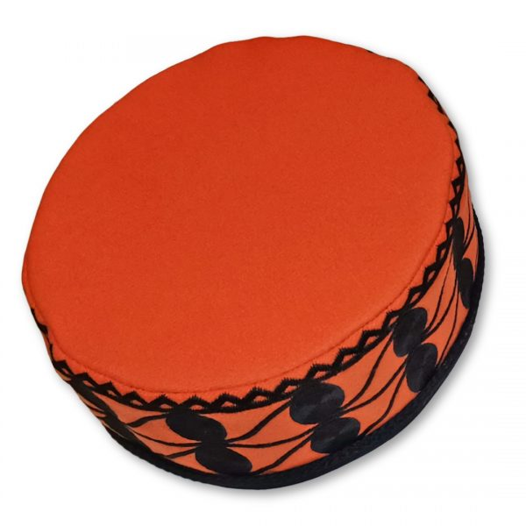

Slide 13
A few words in Croatian language
mama
tata
škola
knjiga
projekt
plastelin
Dobar dan!
Dobro došli!
Hvala!
Doviđenja!

Slide 14
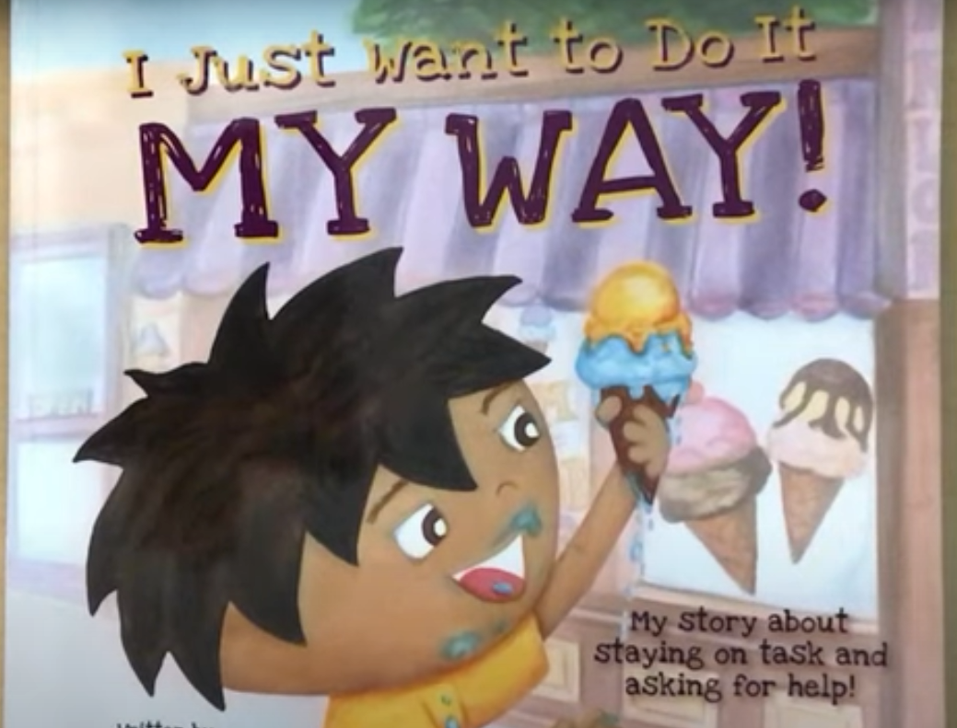
I JUST WANT TO DO IT MY WAY! written by Julia Cook

Slide 15
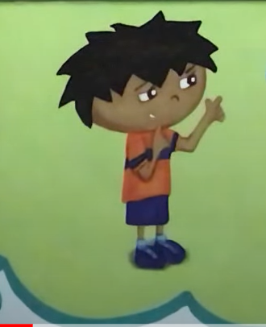
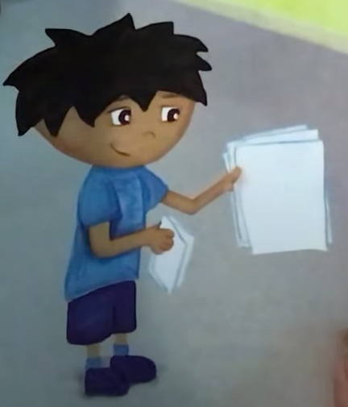
Characters
RG

Slide 16
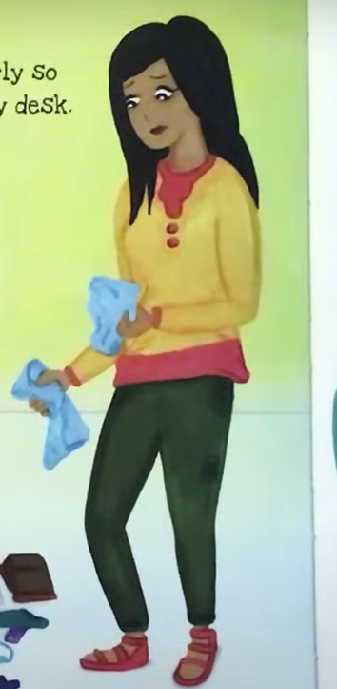
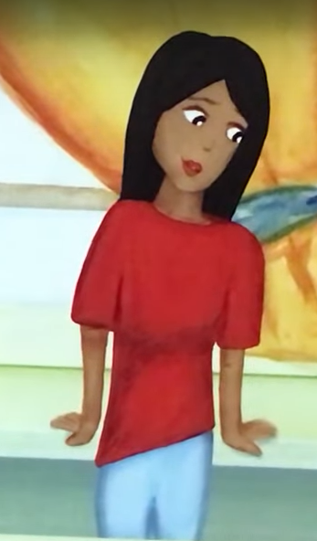
RG’s mom

Slide 17
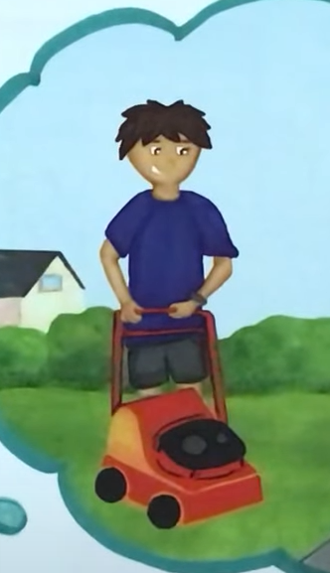
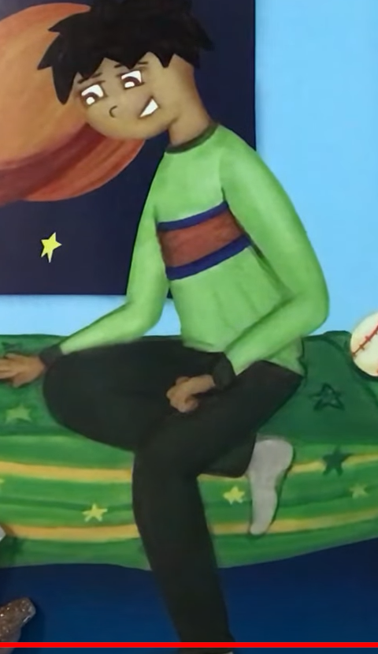
RG’s dad

Slide 18
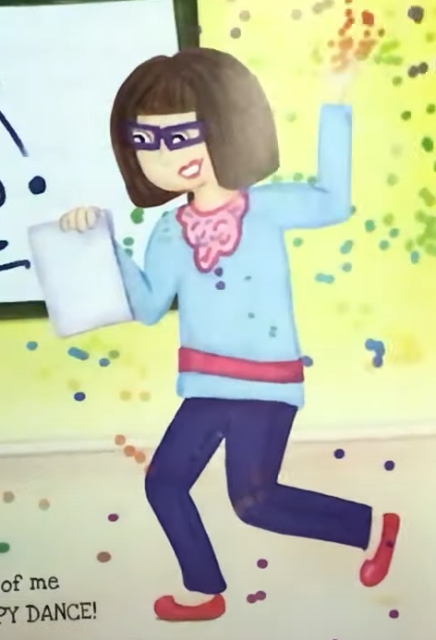
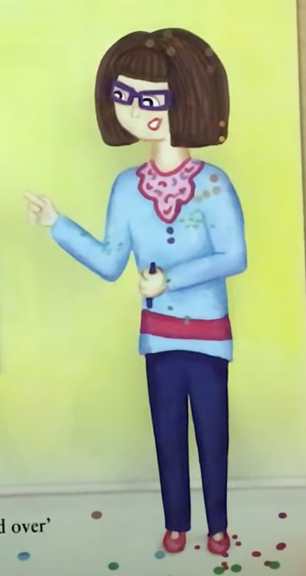
RG’s teacher

Slide 19
And now we are modeling the characters from plasticine... GOOD WORK!

Slide 20
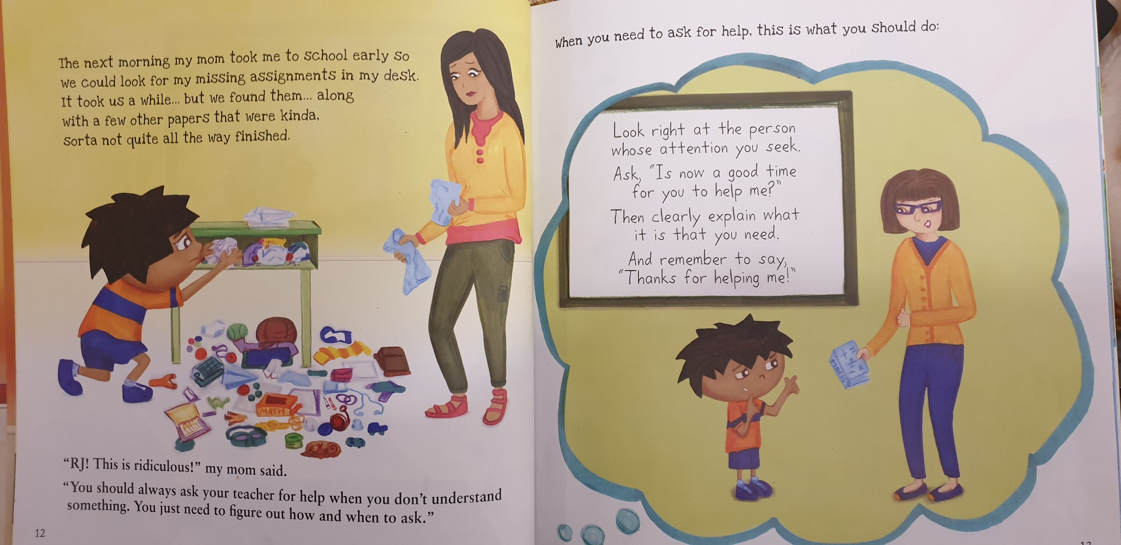
AFTER...

Slide 21
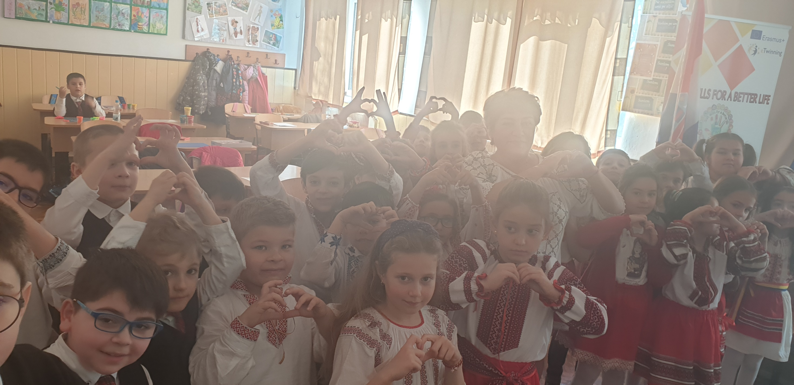

Slide 22
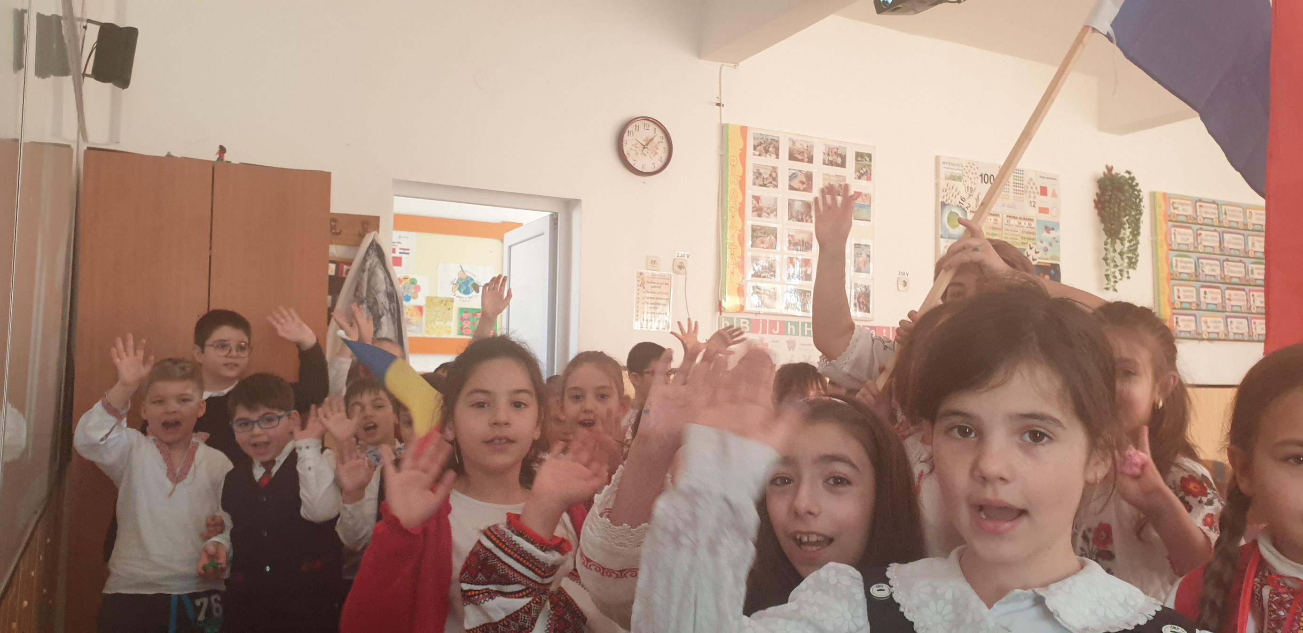

Slide 23
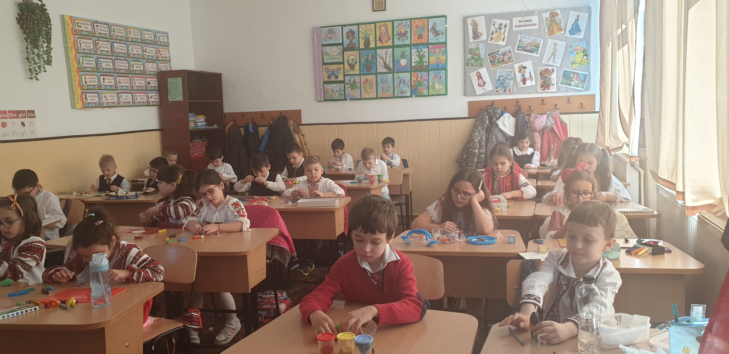

Slide 24
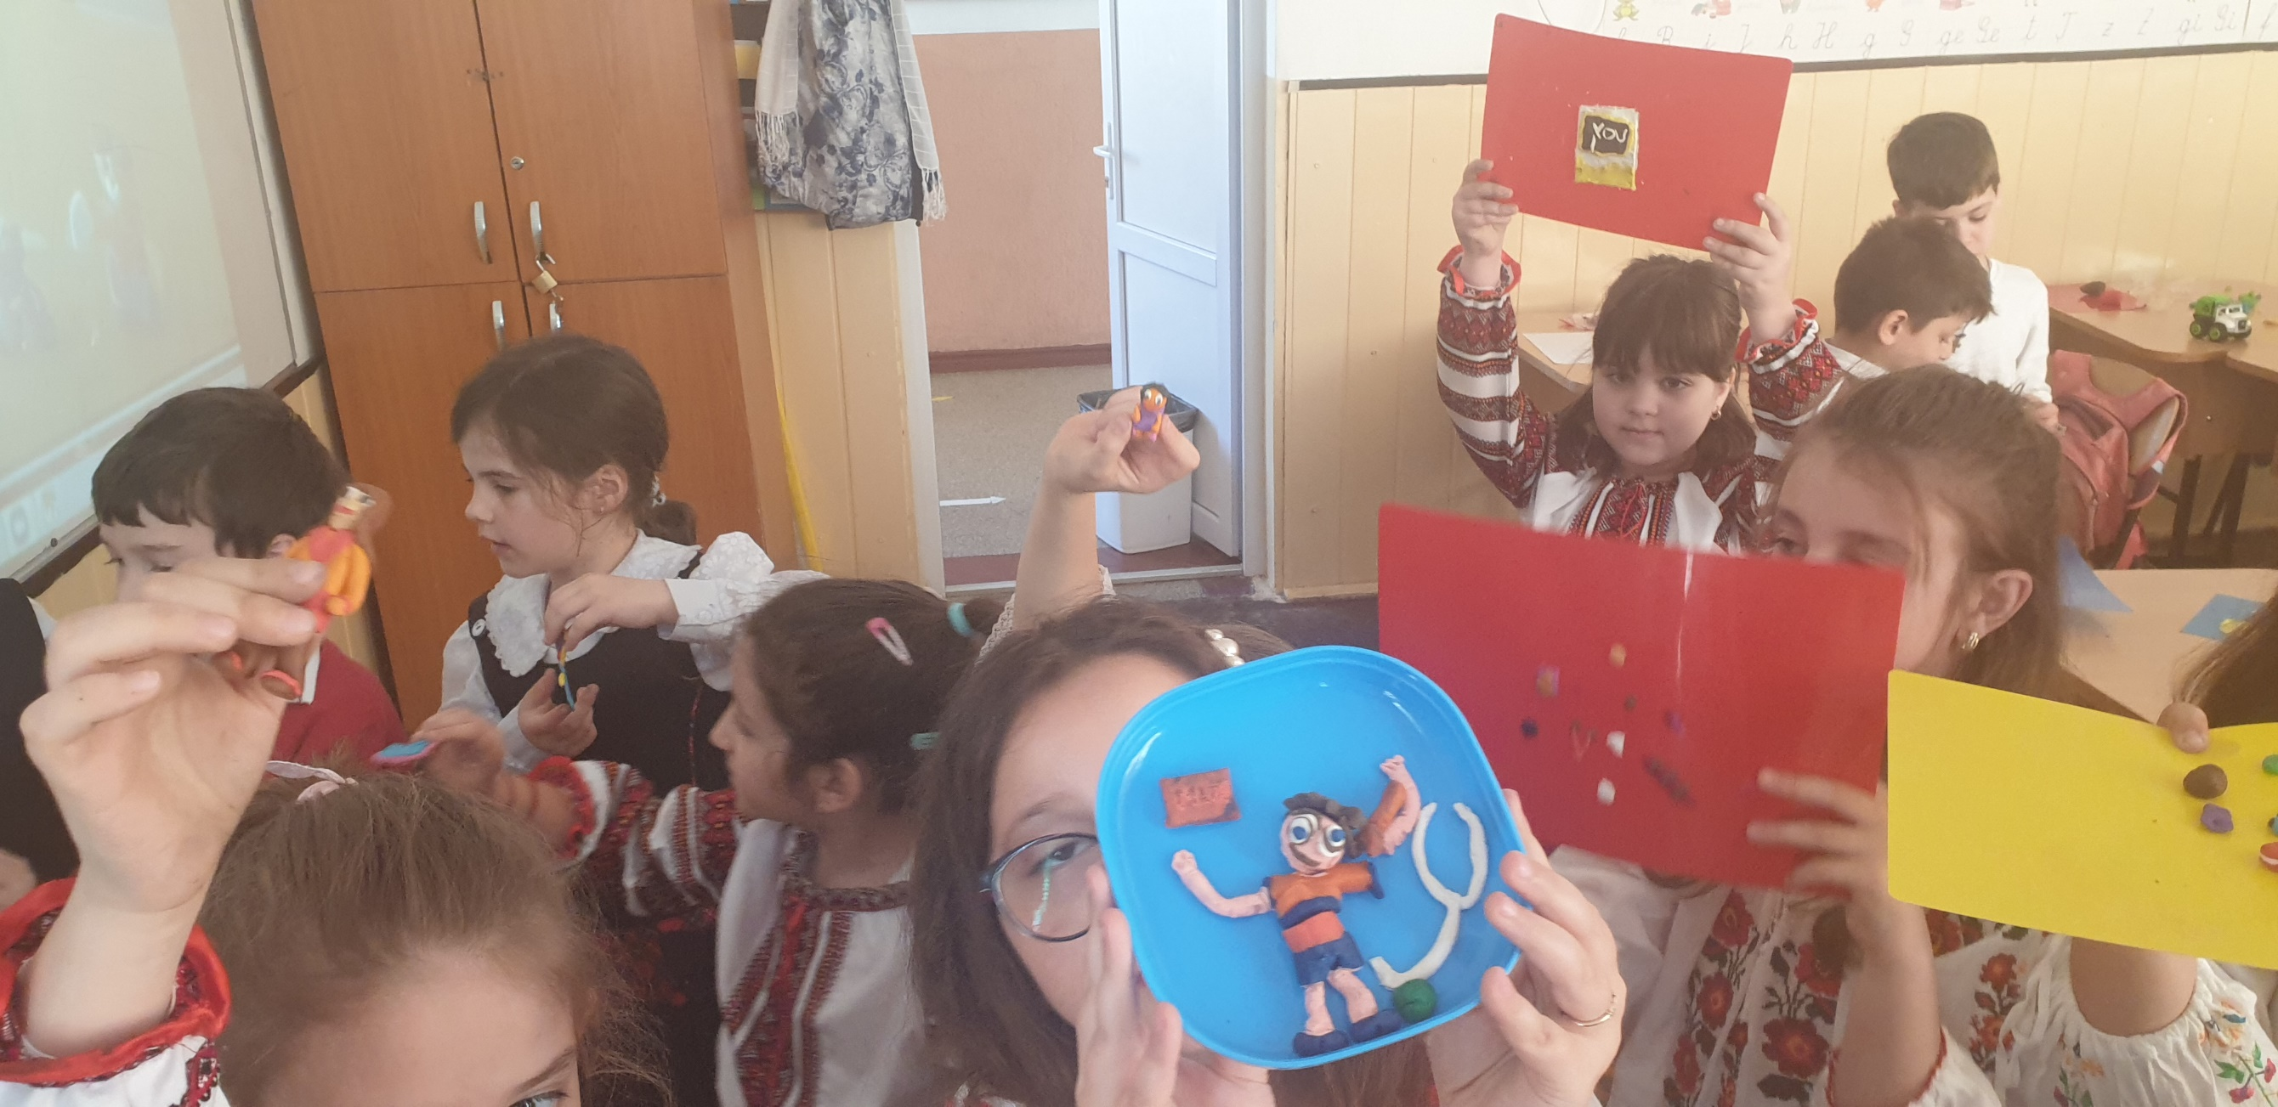

Slide 25
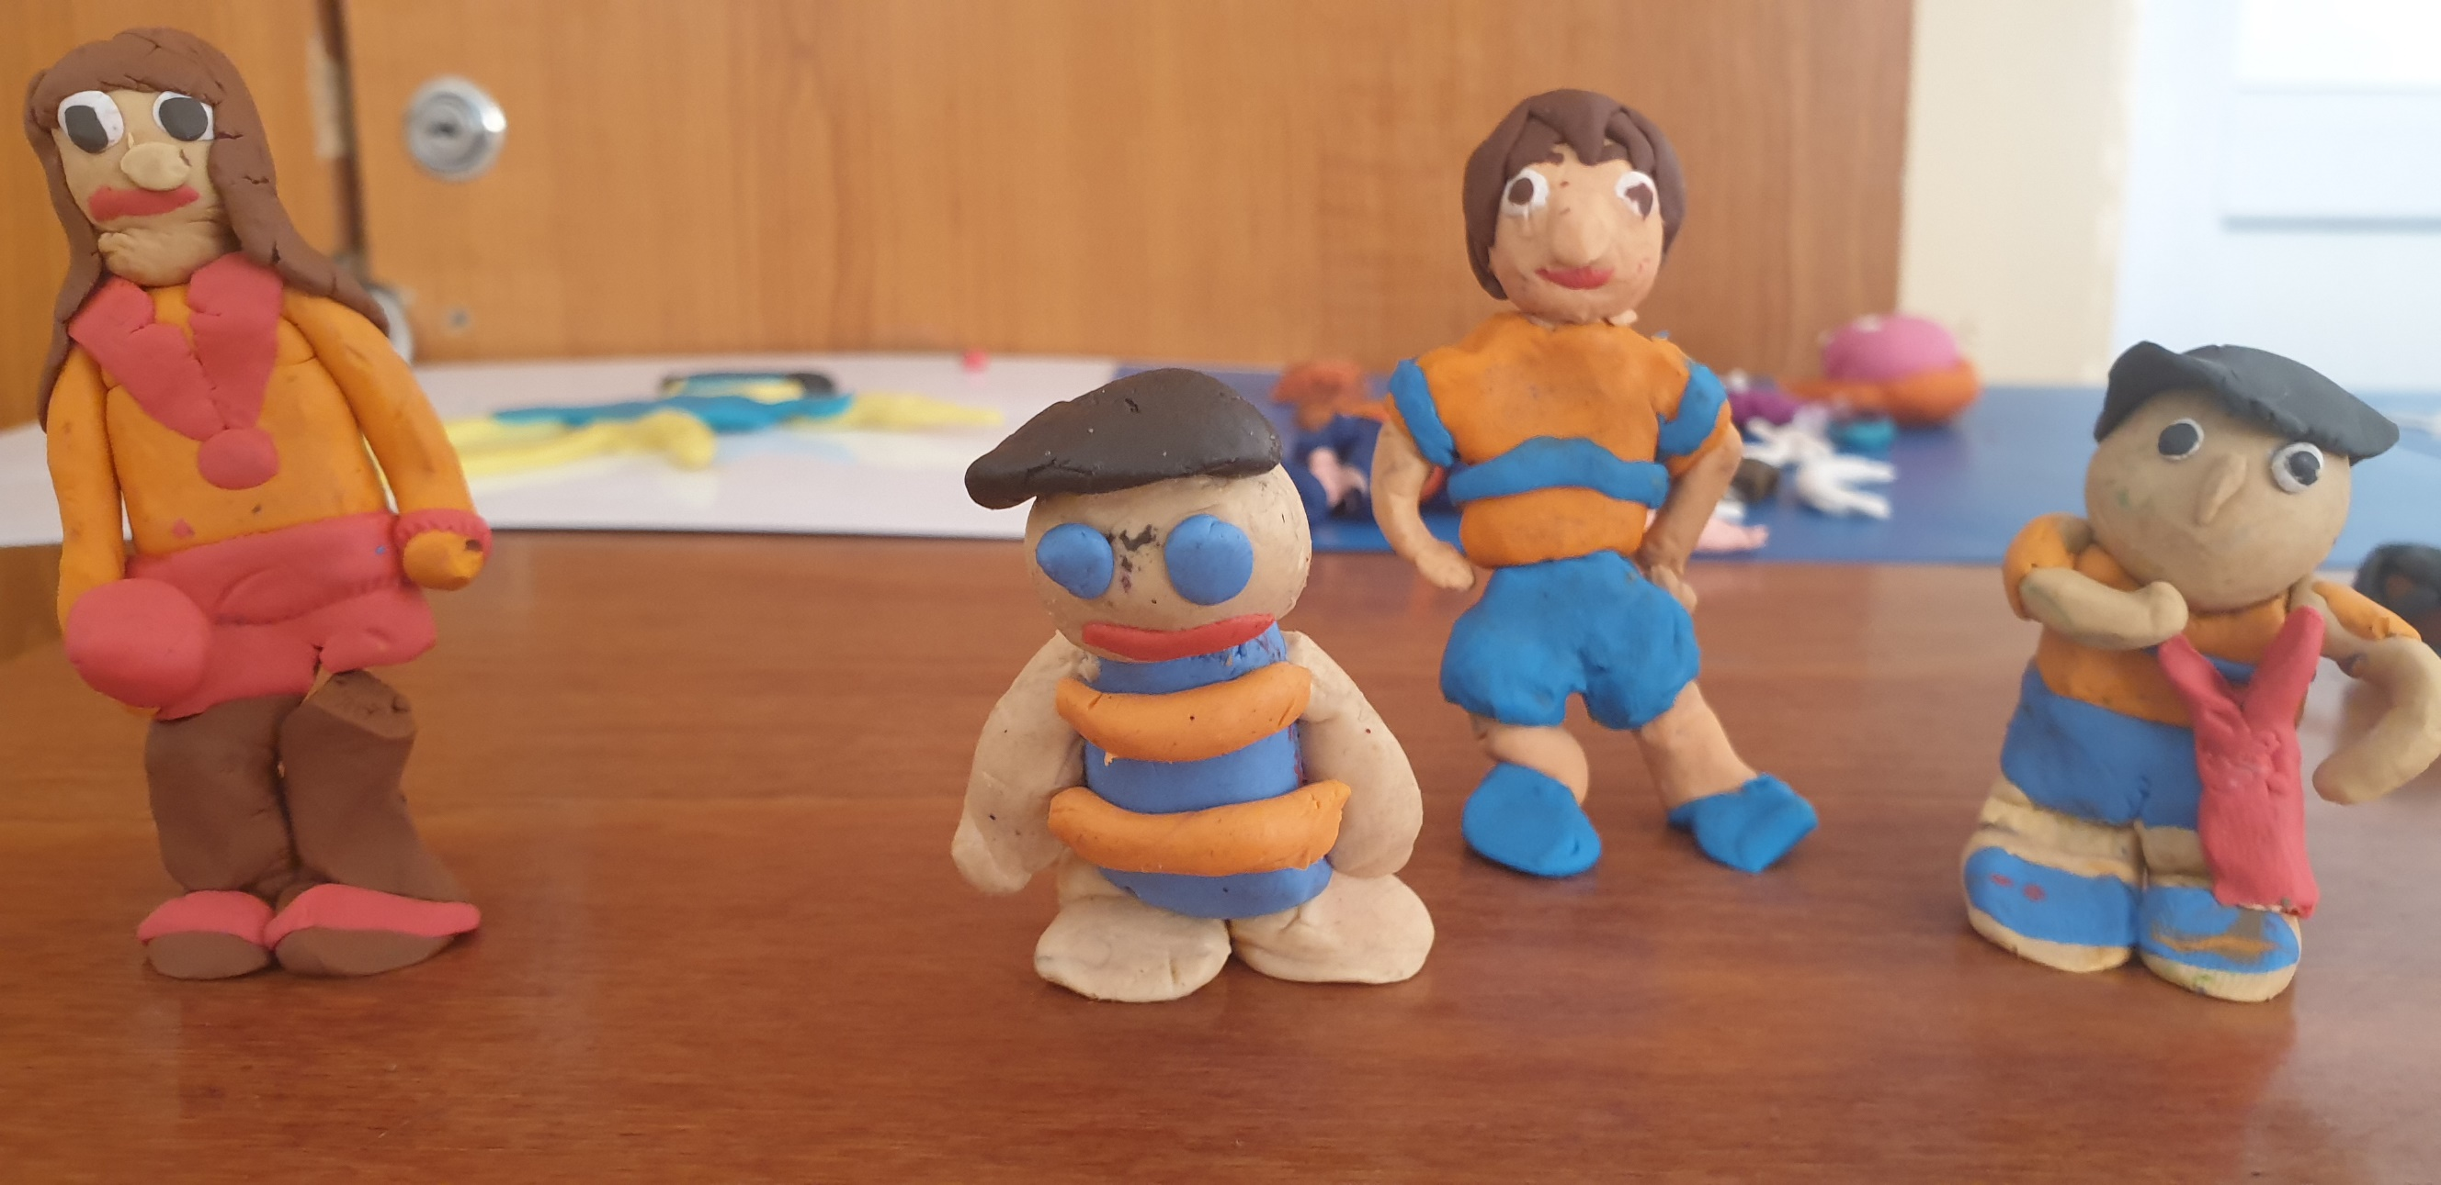

Slide 26
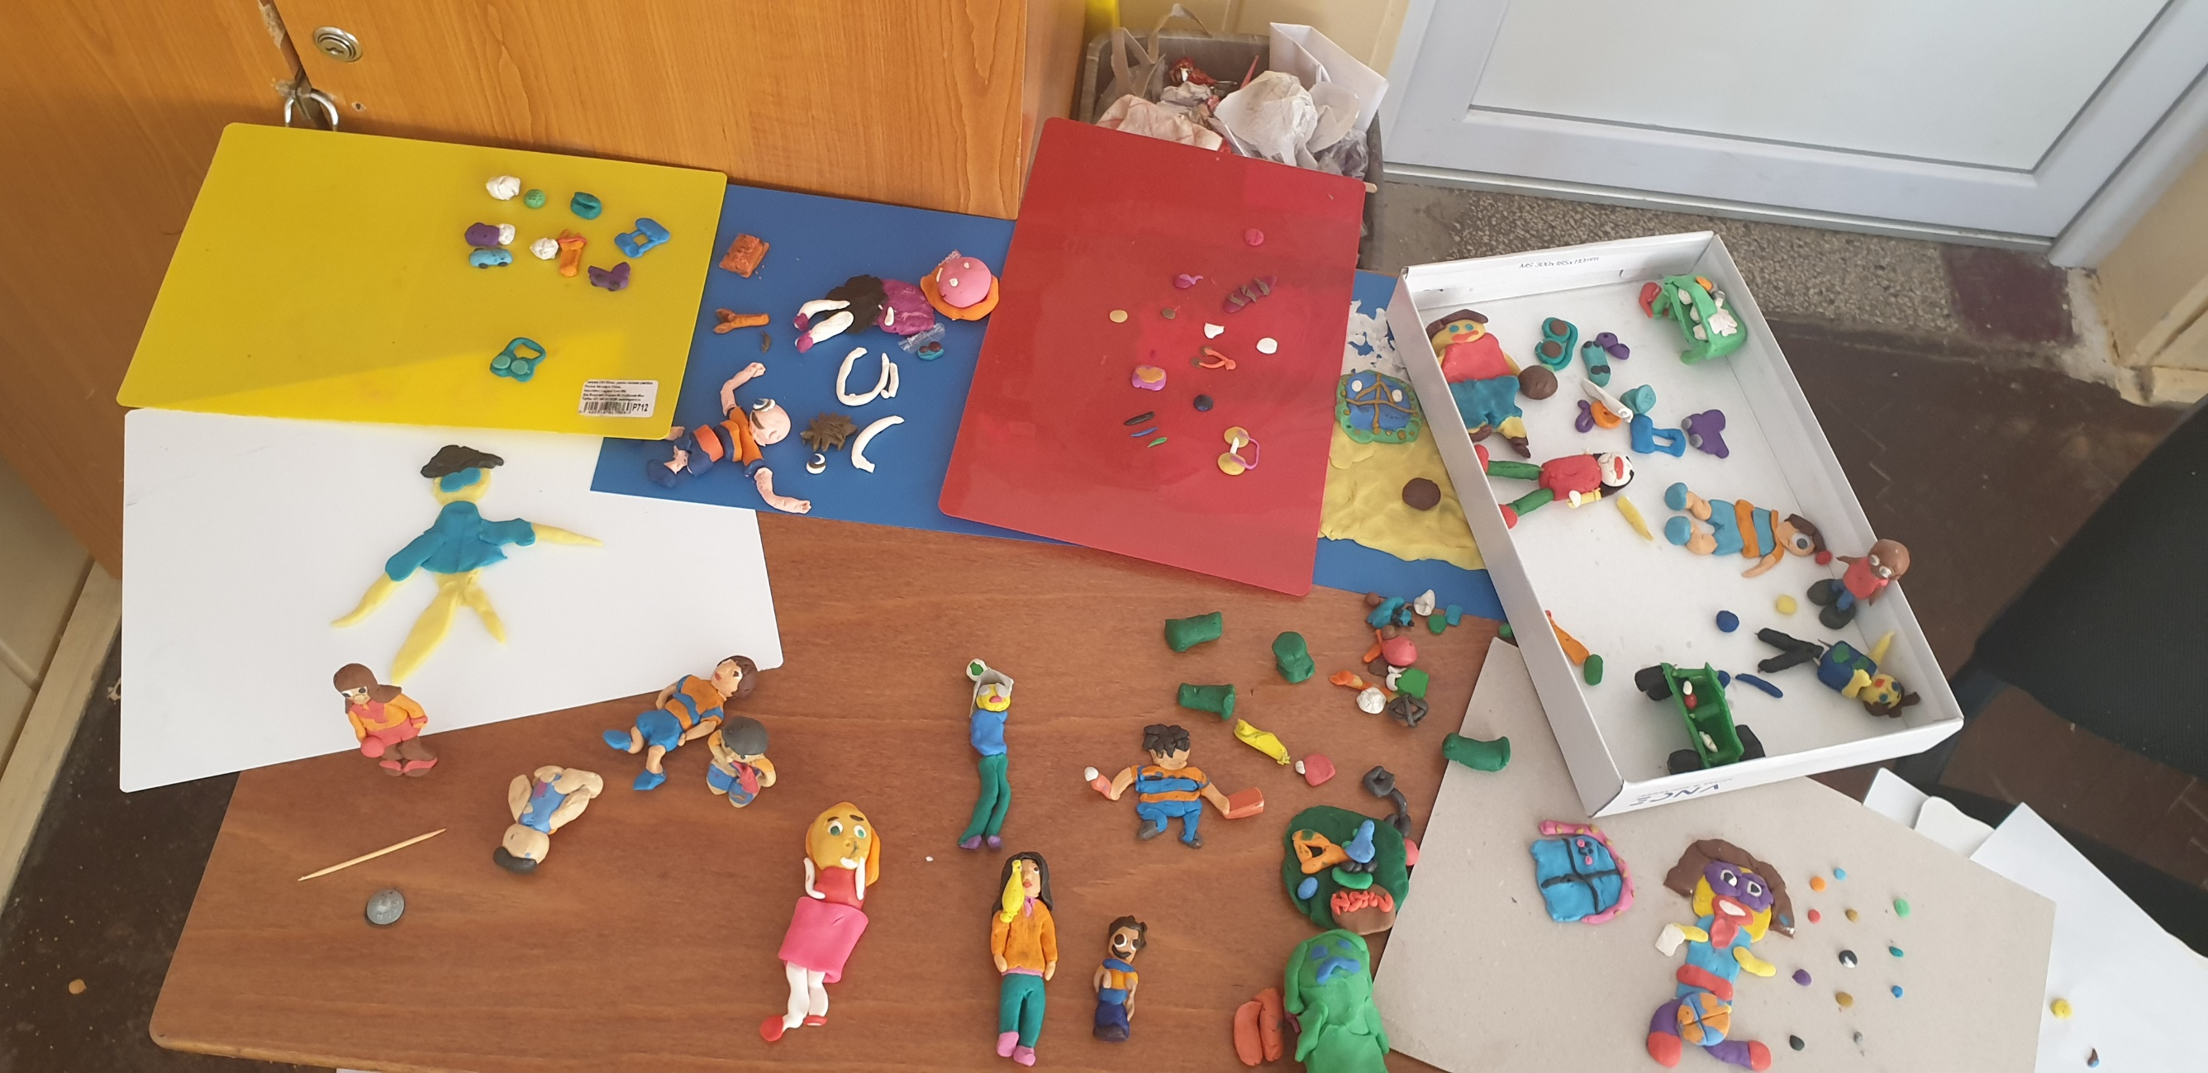

Slide 27
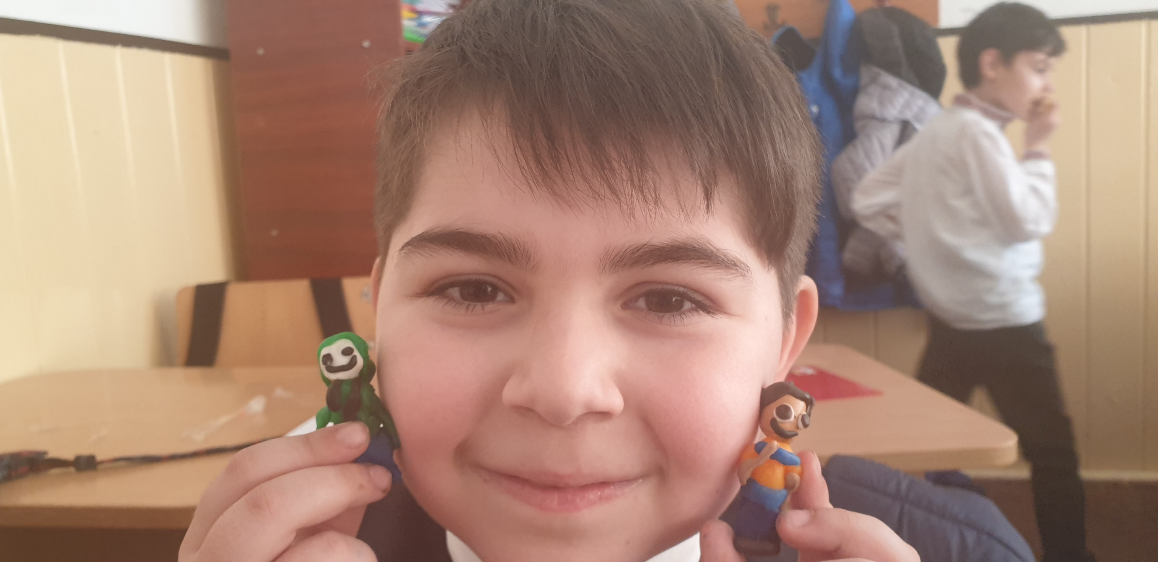

Slide 28
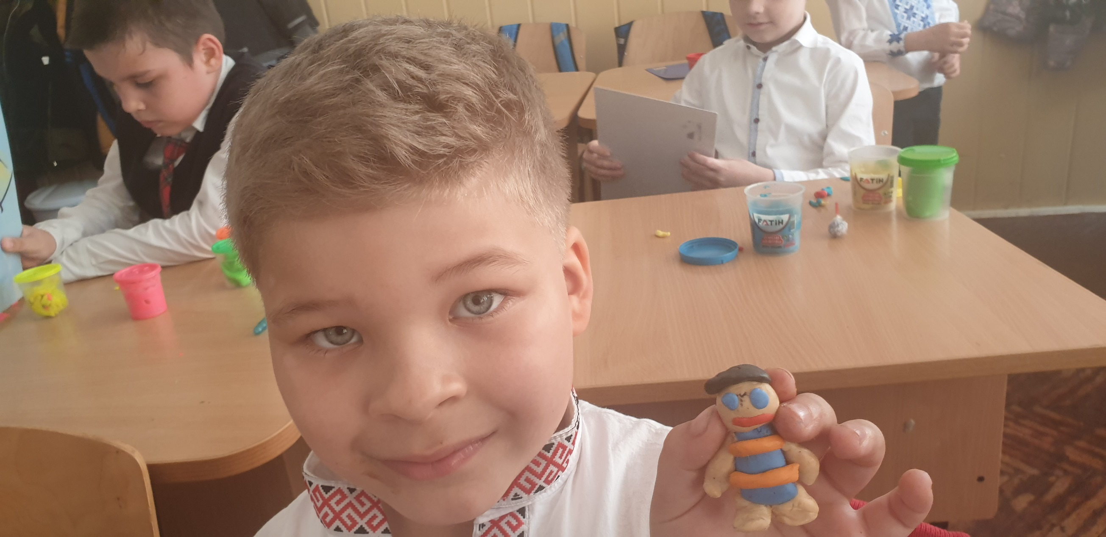

Slide 29
I JUST WANT TO DO IT MY WAY! written by Julia Cook
Thank you for your wonderful collaboration, Croatia!
Thank you for great collaboration, Croatia!
The end...

