Slide 1
MASS MEDIA IMPACT OVER CORPOREAL IMAGE IN TEENAGERS
TV

Slide 2
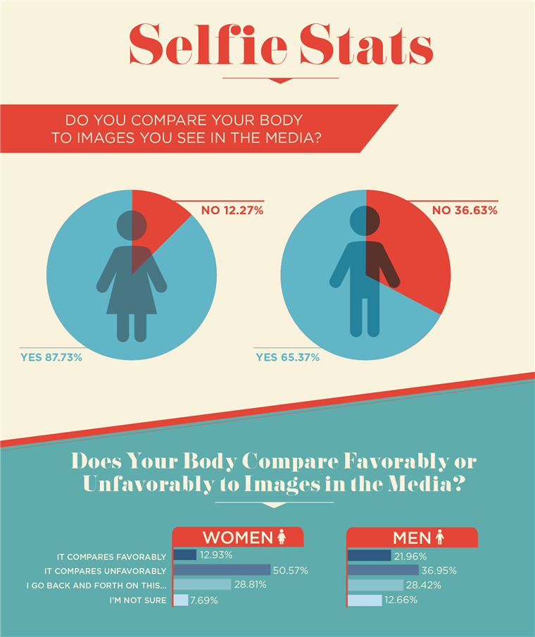
Instagram’s Influence On Negative Body Image
It’s official — Instagram is the worst social media site for mental health. All social media sites have a potentially detrimental effect on the way we feel, but Instagram, with its heavy focus on imagery, has a particularly negative impact on one specific area: body image. Instagram isn’t the instigator of body image issues, of course, but instead a heavily-filtered reflection of a culture that objectifies, sexualises and commodifies the human body, while promoting unattainable and unrealistic standards of what beauty is.

Slide 3
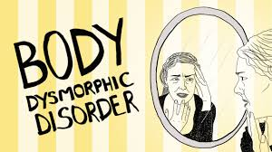
Beauty is subjective, yet rarely seen in the beholder’s reflection. Global research by Dove discovered just 4 percent of women find themselves beautiful, while simultaneously, 80 percent acknowledge all women have something beautiful about them. This negative self-perceptions begins a young age, with girls as young as six-years-old having expressed body-related anxiety. If unchecked, such bodily insecurities can turn into Body Dysmorphic Disorder (BDD), causing “persistent and intrusive preoccupations with an imagined or slight defect in one’s appearance,” leading to “severe emotional distress and difficulties in daily functioning.”
Social media sites, particularly Instagram, have been challenged to do more to combat this growing societal concern. But how can we take control and learn to love our bodies, when the forces of society thrive on us feeling insecure in our own skin?

Slide 4
Say hello to the beauty industry

Slide 5
A persuasive and pervasive money-making machine convincing the masses we need to improve our appearance. More and more of us don’t like the way we look. As a result, this industry — the cousin of fashion — is growing rapidly. At twice the rate of the developed world’s GDP, to be precise. Skin care alone is worth $24 billion per year, make-up $18 billion, haircare $38 billion. A report by the British Youth Council, A Body Confident Future, highlighted the “massive” role such industries have in setting idealised images of beauty.

Slide 6
It’s not hard to see why. From a young age, we are all immersed in an environment rigidly defining beauty on their behalf, from adverts to fashion magazines to billboards to Hollywood. Look around you, and you’ll see a variation of all shapes and sizes, with no two bodies the same. Look at the media, and the same perfectly honed (and electronically retouched) body shapes appear, over and over again. Women are expected to defy logic by attaining the “curves in the right places and not much everywhere else” look. Men are expected to do their best impression of Lou Ferrigno’s Incredible Hulk, with bulging biceps, washboard abs, a full chest and muscular legs

Slide 7
Men, Muscle Mass And Eating Disorders
Body images issues aren’t exclusive to women, though. Men used to be conditioned for nonchalance, a squirt of Old Spice and a hurried sink wash. But a shift in masculine stereotypes has seen the male population become more concerned their bodies’ appearance. Last year it was reported eating disorders had risen 70 percent in men, in only a six year period. In another study, 45 percent of men said they’ve experienced a period of “bigorexia,” an obsession with muscle building. Although gender bias with body image issues can make it more difficult for men to speak openly about their insecurities, the insecurities are certainly there.

Slide 8
Profit — The Reason Your Body Isn’t Good Enough
Sadly, we live in a world where conglomerates like Goldman Sachs question whether curing illness is a sustainable business model. Western culture’s portrayal of conventional beauty is moulded by the same profit-making agenda. Body positivity and revenue don’t fit. If encouraged to age gracefully and embrace wrinkles, would people spend millions on expensive skin care? If encouraged embrace our natural hair, would people use straighteners, or buy hair-thickening shampoo?
Anxiety around appearance isn’t vanity or a case of millions wanting to look nice. Consumer culture consistently tells us we need things to be successful and happy. Advertising no longer sells products, it sells lifestyles. The beauty industry sells us the idea that a beautiful appearance, dictated by their idea of beauty, is the key to success and self-worth. We want to look good because we’ve been told looking good is living a successful life. But the people shaping this falsehood earn money from our endeavours to look “better

Slide 9
“Beauty is about being comfortable in your own skin. It's about knowing and accepting who you are.”
― Ellen DeGeneres

