Slide 1
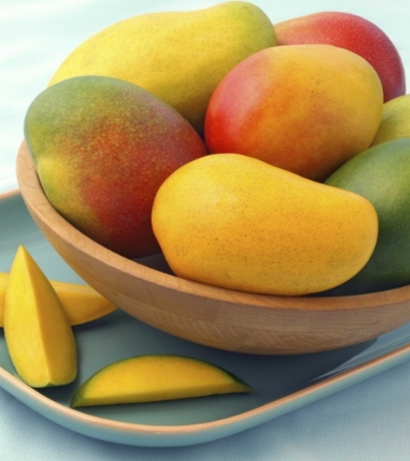
Mango
Nicolae Daniela-Andreea

Slide 2
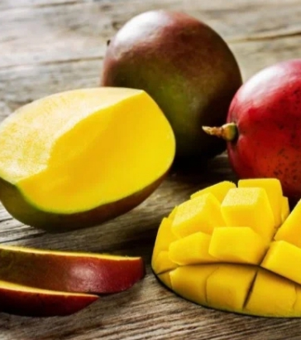
Nutritional benefits of mango
Nutritional benefits of mango
Mango is a low-calorie fruit that is high in fibre, and is a great source of vitamins A and C. It also contains folate, B6, iron and a little calcium, zinc and vitamin E. Mangoes are a good source of antioxidants, containing certain phytochemicals such as gallotannins and mangiferin which have been studied for their health benefits.
Just 80g of mango (2 x 2 inch slices) counts as one of your five-a-day. This one portion will provide 53 calories, 11g of naturally-occurring sugar and just over 2g of fibre.

Slide 3
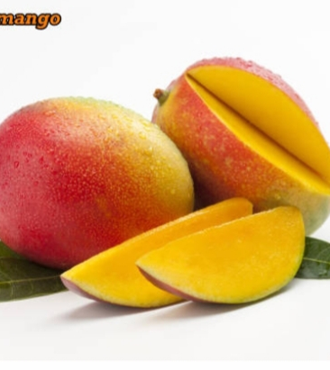
History of mango
Most of these species are found in nature as wild mangoes. The genus belongs to the cashew family Anacardiaceae. Mangoes are native to South Asia,^{[1][2]} from where the "common mango" or "Indian mango", Mangifera indica, has been distributed worldwide to become one of the most widely cultivated fruits in the tropics. Other Mangifera species (e.g. horse mango, Mangifera foetida) are grown on a more localized basis.

Slide 4
Creamy mango&coconut smoothie
Ingredients
200ml (½ tall glass) coconut milk
(we used Kara Dairy Free)
4 tbsp coconut milk yogurt
(we used Coyo)
1 banana
1 tbsp ground flaxseed, sunflower and pumpkin seed (we used Linwoods)
120g (¼ bag) frozen mango chunks
1 passion fruit, to finish (optional)
Method
Measure all the ingredients or use a tall glass for speed – they don’t have to be exact. Put them into a blender and blitz until smooth. Pour into 1 tall glass (you’ll have enough for a top up) or two short tumblers. Cut the passion fruit in half, if using, and scrape the seeds on top.

Slide 5
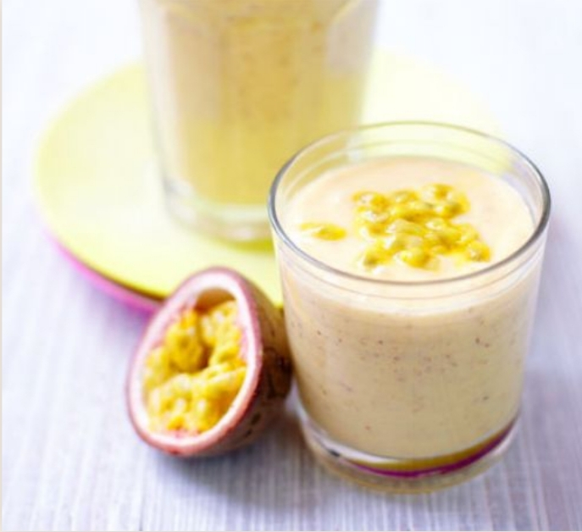

Slide 6
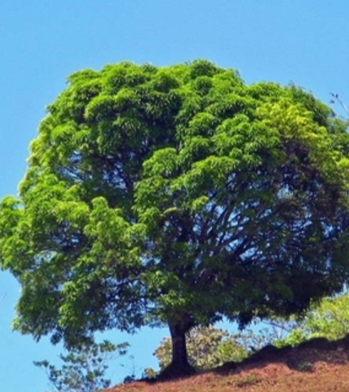
What mango symbolizes
This captivating fruit tree is mystical and fascinating: Mango is the food of the gods. The Mango tree is the symbol of love, wealth, fertility and even immortality. In India, the leaves of Mango trees are used in wedding ceremonies in order to ensure that the couple bears many children.

