Slide 1
THE RASPBERRY
Scientific name: Rubus idaeus
Upper class: Idaeobatus
Classification: Species
Păștiță Cristina-Mădălina
CLASA A IX-A C

Slide 2
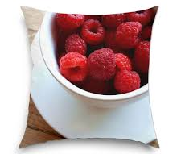
Nutrition facts of 1 cup of raspberry
Calories: 64
Protein: 1.5 g
Fat: 0.8 g
Carbohydrates: 15 g (of which 8 g of fiber and 5 g of sugar)
Vitamin C: 54% of the recommended daily dose
Vitamin K: 12% of DZR
Folic acid: 6% of DZR
Manganese: 41% of DZR
Other vitamins: vitamin B6, calcium, magnesium, phosphorus, zinc or copper.
Raspberries also contain significant amounts of antioxidants such as beta carotene, lutein or zeaxanthin.

Slide 3
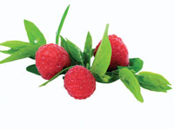
The origins of the raspberry
Raspberry (Rubus idaeus) is a shrub, evergreen, with creeping shoots, with straight stems, arched to the tip, with straight spines, like needles, often placed only on the underside. The raspberry belongs to the Rosaceae family.
The fruit, which is called raspberry, is red in color, with a pleasant smell and sour-aromatic taste. Raspberries are grown for two reasons: for fresh fruit consumption and for industrial processing
Raspberries bloom from May to July. It grows spontaneously in rocky places, forest lights, hilly and mountainous regions. It can be found throughout Romania, being a plant specific to temperate climate areas.
Examples of raspberry varieties: Polka, Heritage, Cayuga, Ruvi, Citria, Opal, Latham, Willamette, Veten, Noma, Sugana, Laszka.

Slide 4
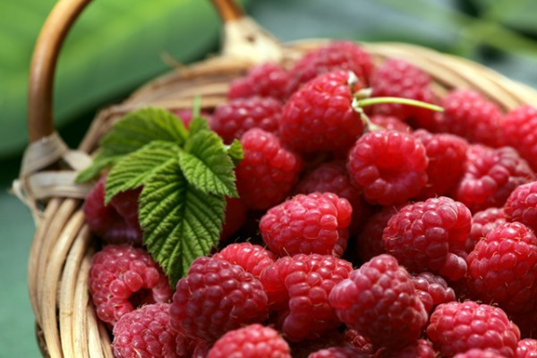
The benefits of raspberry consumption
Raspberries are not only tasty, but also have many benefits for your health, being a rich source of vitamins, minerals and valuable nutrients.
Fight with cancer
Maintains cardiovascular health
Beneficial effects on fertility
Helps eliminate extra pounds
It has anti-inflammatory properties
It strengthens the immune system
Beneficial for diabetics
Relieves pain caused by arthritis

Slide 5
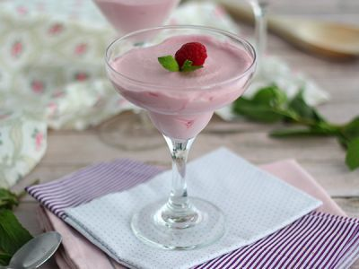
Raspberry mousse recipe
Ingredients
250 g raspberry
60 gr sugar
150 ml cream for cooking
2 drops of gelatin
Method of preparation
Put the cream in the refrigerator if it is not cold. Put the gelatin soaked in cold water. In a pan, put the raspberries and sugar and mix. Leave on medium heat, stirring occasionally for approx. 5 minutes.
Strain the contents to remove the seeds and pulp. Then add the gelatin to the heated sauce and mix well.
Beat in the sour cream.
Add the hot raspberry sauce over the cream. Turn off the mixer and gently mix with a spatula to mix.
Pour into champagne glasses and chill for at least 4 hours.

Slide 6
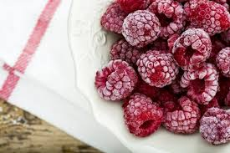
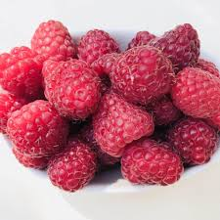
FRESH or FROZEN
Raspberries can be fresh or frozen. You must know, however, that when the raspberry is thawed it will not have the same firm appearance as the fresh one, but it will be just as sweet and delicious.
Raspberry is a berry fruit that stimulates the health of a person regardless of the form in which it is consumed.

Slide 7
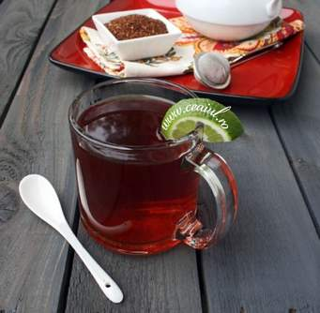
The benefits of raspberry tea. It strengthens the immune system
Due to the amount of vitamin C, a powerful antioxidant, raspberry tea strengthens the immune system and makes it resistant to diseases and especially seasonal viruses.
Raspberry tea also stimulates the healing of cells affected by free radicals and prevents degenerative diseases.

Slide 8
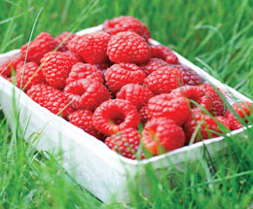
CURIOSITIES
Who doesn't know that oranges are high in vitamin C? Raspberry, however, contains far more vitamin C than oranges.
In addition, raspberries are an excellent source of dietary fiber, being also low in calories. Fibers play an important role in protecting the digestive tract, fulfilling the function of "sweeps" which helps to expel unwanted residues and substances from the body.
At the same time, raspberries are rich in potassium, calcium and vitamin A. Who would have thought that these tasty fruits hide so many benefits?
The earliest writings on the cultivation of raspberries are dated from the year 4 AD.
As Americans are in love with peanuts, So do Russians in love with raspberries, which they call malina (малина).

Slide 9
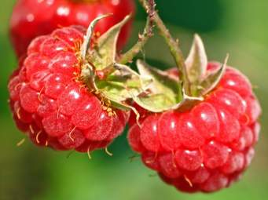
5 more curiosities
Who is the world free that produces the largest amount of slag in the world market? Who can be outside Russia ?! I just told you that the Russians are in love with raspberries!
Raspberries and leaves from the raspberry plant are used in folk medicine in Russia to treat colds, flu, having properties that help lower the temperature.
In Russian folk medicine, dried raspberry fruits are also used for their diaphoretic properties (causing sweating).
Raspberry improves the color and condition of the skin, being especially recommended for women. Raspberry seeds contain 22% fat, which is why they are often used, along with fresh raspberry leaves and fruits, in cosmetics.
Raspberry is a good friend to those who struggle with the pounds, wanting to lose weight. A 100 grams of raspberries offers only 41 calories. These very tasty berries contain sugars - glucose and fructose - which are necessary for the proper functioning of the brain and cardiovascular system.

