Slide 1
Let’s get acquainted!
Balvi Primary school
Form 6a
Class teacher – Dina Kravale

Slide 2
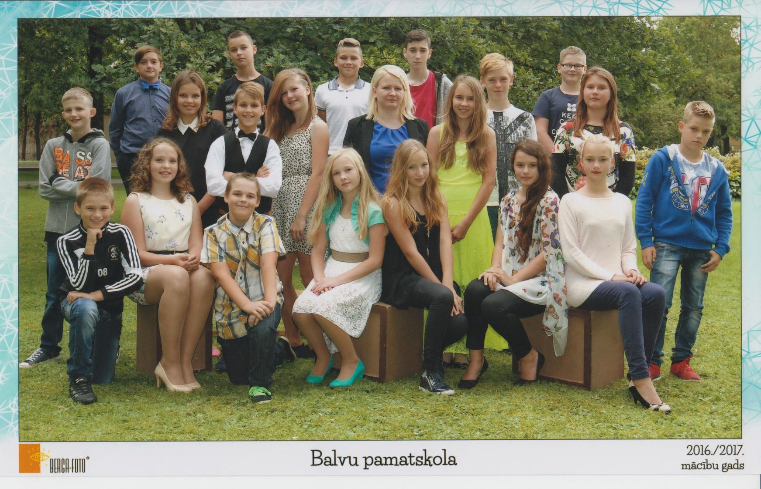
This is our class and our class teacher

Slide 3
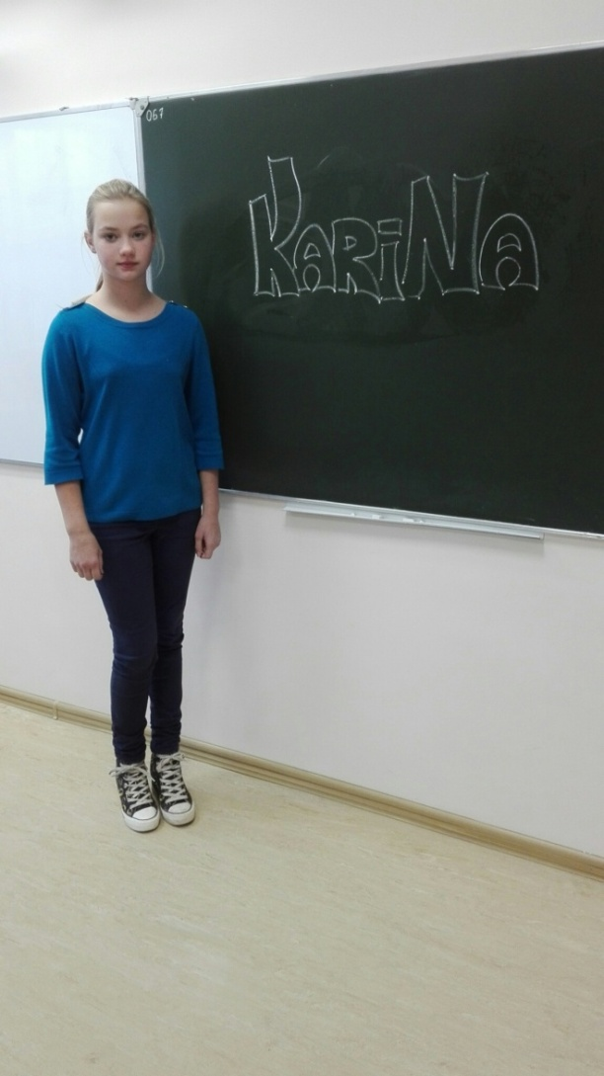
Karīna Andronova
12 years old. I study in Balvi PMy name is Karīna. I am rimary school, Form 6a. I live in Berzkalne. I can speak Russian very well.

Slide 4
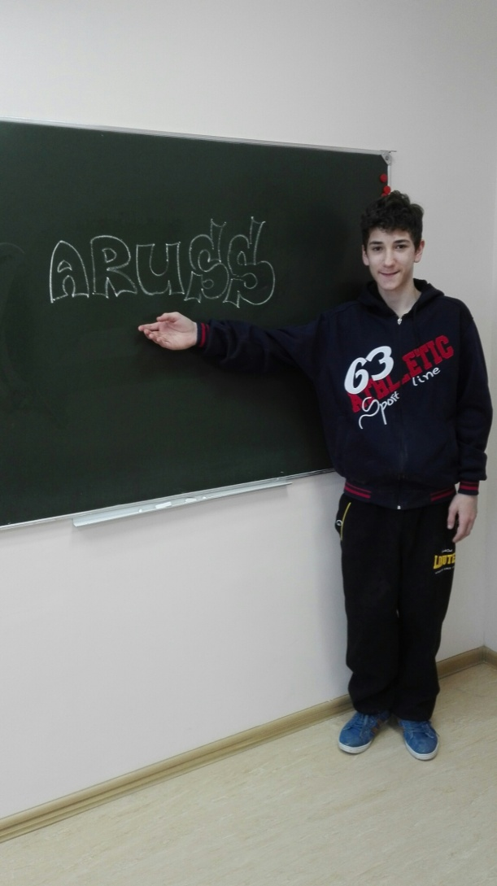
Aruss Apsītis
My name is Aruss. I like snowmobiles and different vehicles. I like to fix and mend different things that are broken. I spend my free time with my friends.

Slide 5
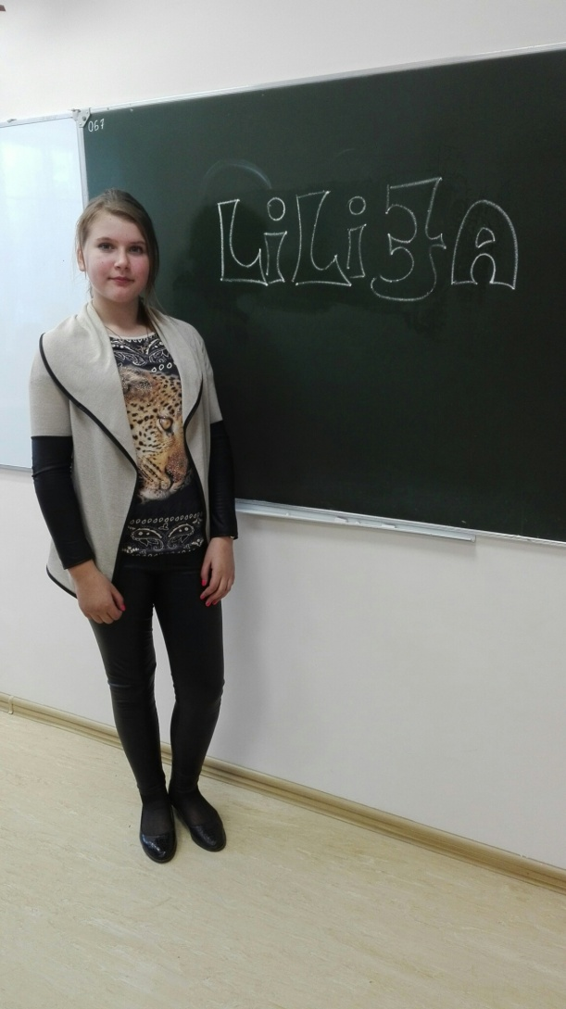
Lilija Atkačūna
My name is Lilija. I like drawing and running. I am very active. I like sports. I like spending time with my friends.

Slide 6
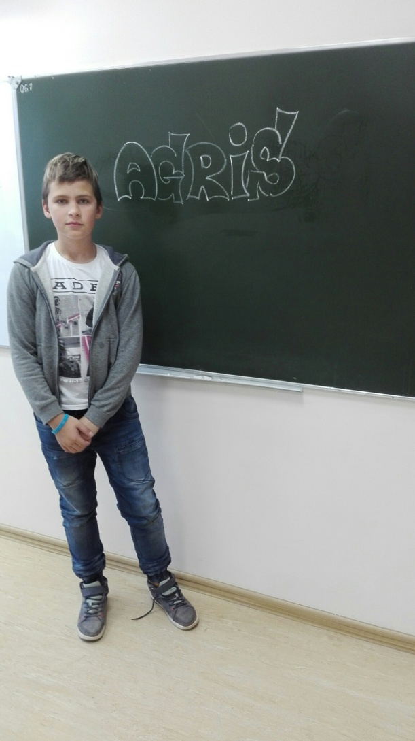
Agris Balodis
Hey! My name is Agris. I am 12. My birthday is on the 29th of Apil. I like cars and BMX. I am really positive person. My best friends are Ralfs and Daniels.

Slide 7
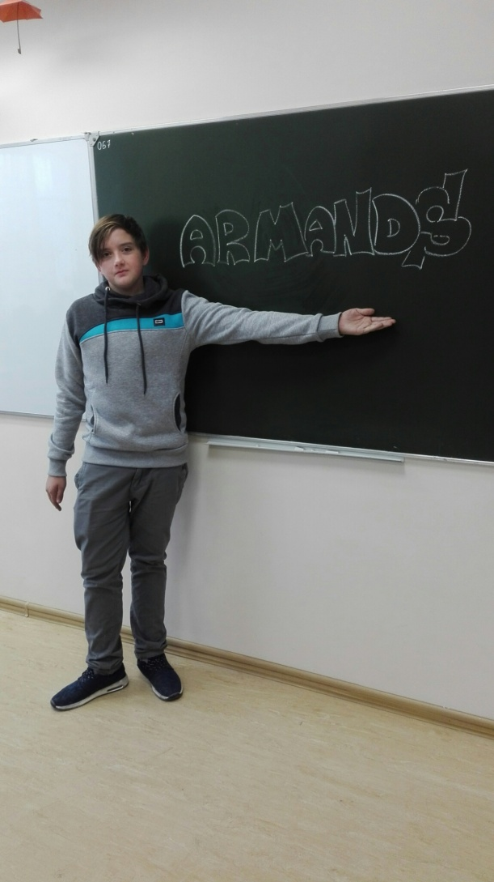
Armands Baraņņiks
My name is Armands. I live in Balvi. I like motorbikes and motorcycle race. I have two motorbikes, and I like to different stunts. I am not afraid of falling and hurting myself.

Slide 8
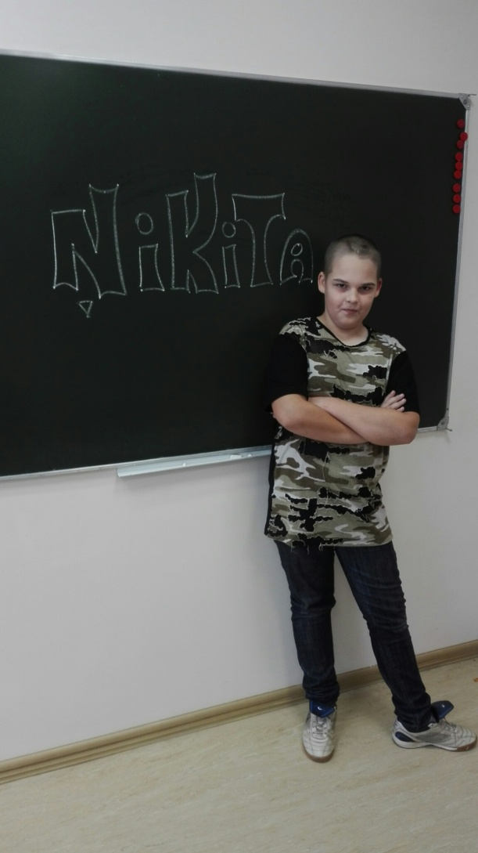
Ņikita Buklovskis
My name is Ņikita. I like playing football. I also like drawing. My favourite subject is mathematics. I can speak Russian very well.

Slide 9
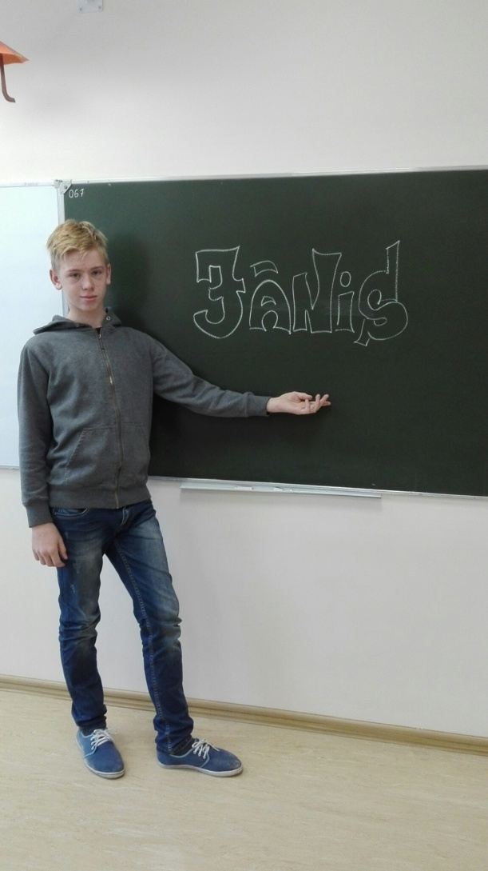
Jānis Gabranovs
My name is Jānis. My birthday is on the 19th of January. I have two cats. I like sports, but I don’t like English. I play computer games and walk with my friends in my free time.

Slide 10
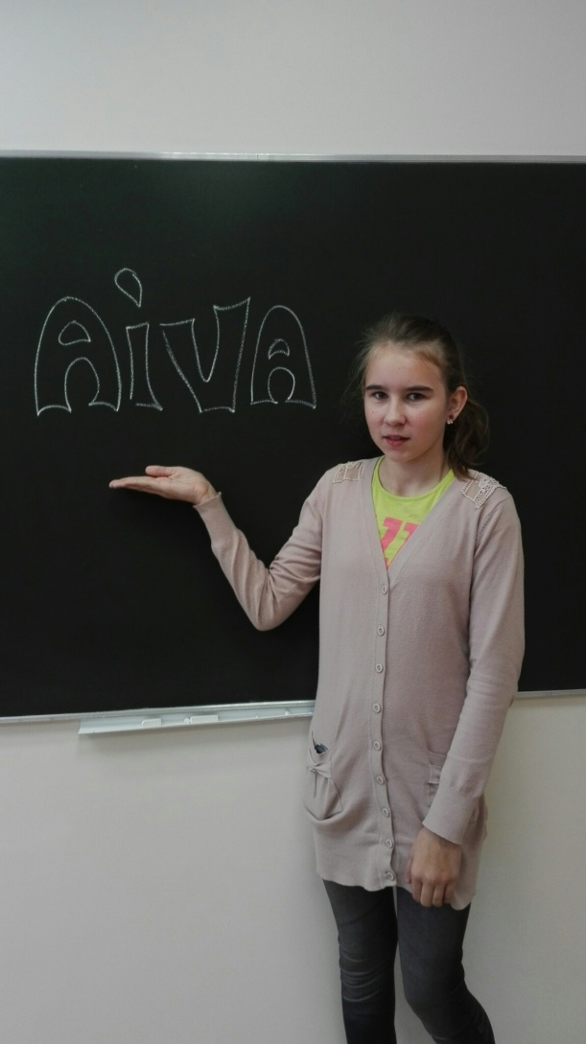
Aiva Keiša
My name is Aiva. I study in Balvi Primary school Form 6a. I live in Lazduleja. I am 12. My birthday is on the 25th of February. I have two sisters and one brother. I like walking. I don’t like looking after my little sister.

Slide 11
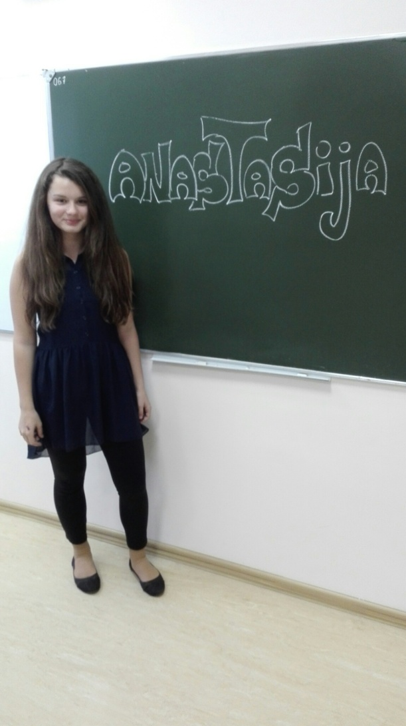
Anastasija Klija
My name is Anastasija. I study in Balvi Primary school Form 6a. I live in Kubuli. My birthday is on the 8th of December. I am 11. I study also in Music school and in Sports school. I can play the piano very well. I can speak Russian very well.

Slide 12
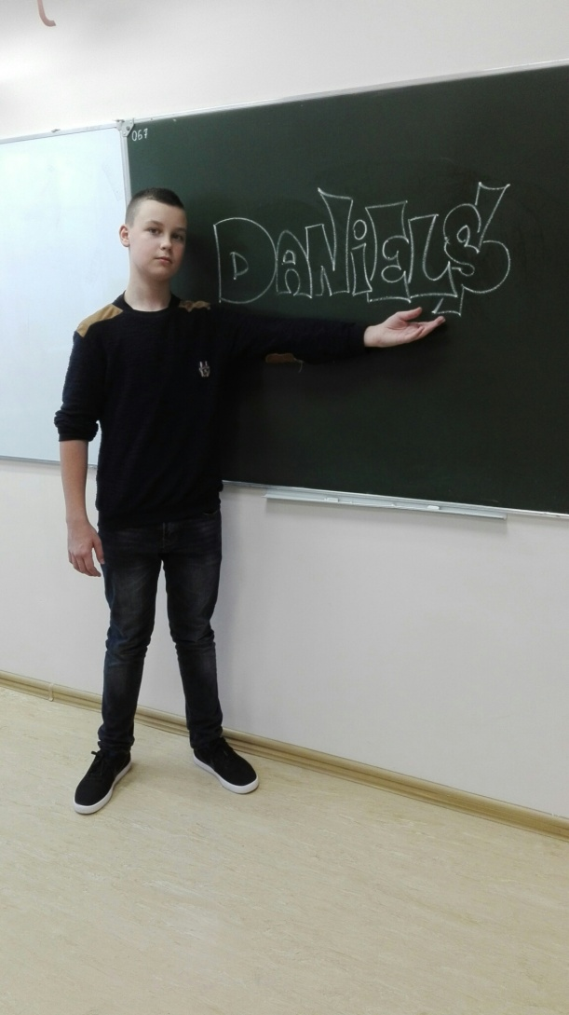
Daniels Košļevs
My name is Daniels. I am 12. I live in Balvi. My hobby is drawing and playing the guitar. I study in Balvi Primary school Form 6a. I can speak Russian very well.

Slide 13
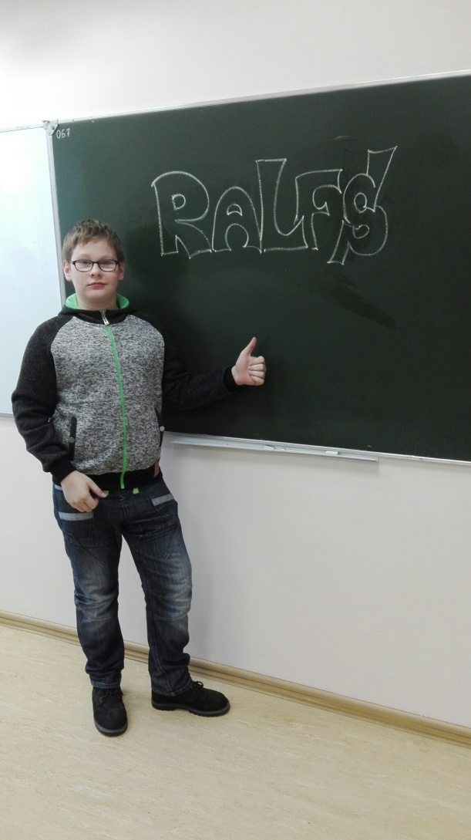
Ralfs Kukulis
My name is Ralfs. I am 12. I like sports and different activities. I like computer games, too. I am also very talkative.

Slide 14
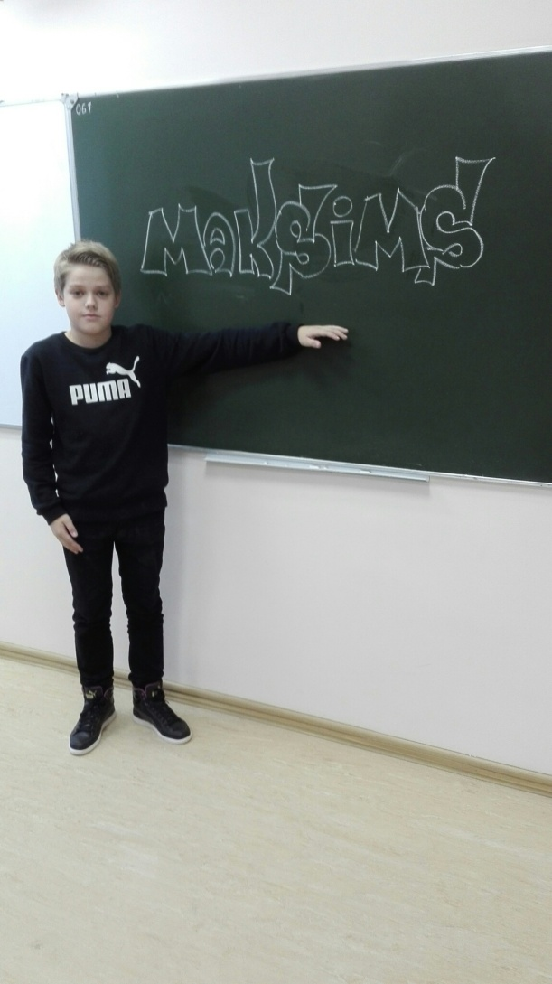
Maksims Kuļbackis
My name is Maksims. I like sports. I play hockey and go sledging in winter. I play football in summer. I like computer games and spending free time with my friends. I can speak Russian very well.

Slide 15
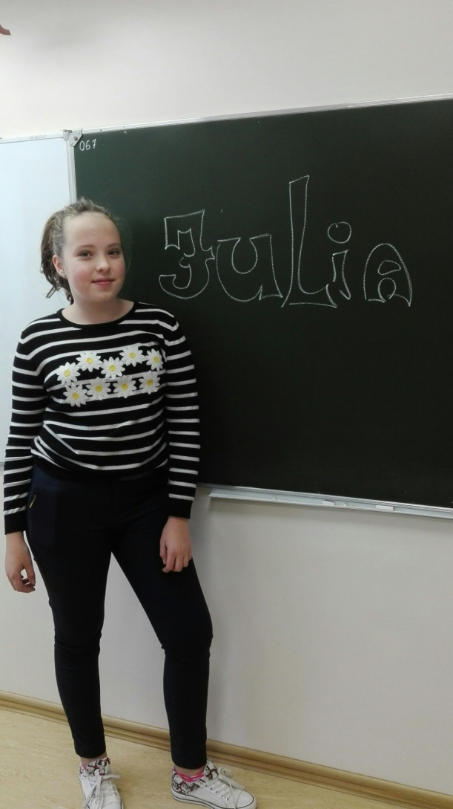
Jūlija Kuzņecova
My name is Julia. I am 12. I live in Balvi. I study in Balvi Primary school Form 6a. I like home economics and art. I study also in Art school, because I like drawing very much. I like animals. I can speak Russian very well.

Slide 16
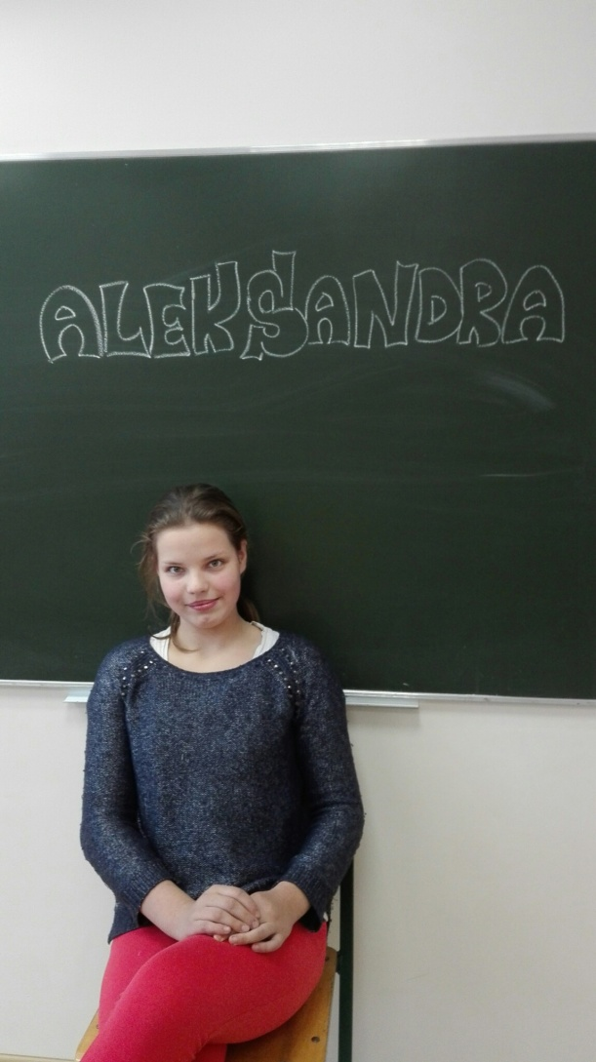
Aleksandra Lazdiņa
My name is Aleksandra. I study in Balvi Primary school Form 6a. I like green colour. I am 13. I like animals. I am very friendly. I like writing poems.

Slide 17
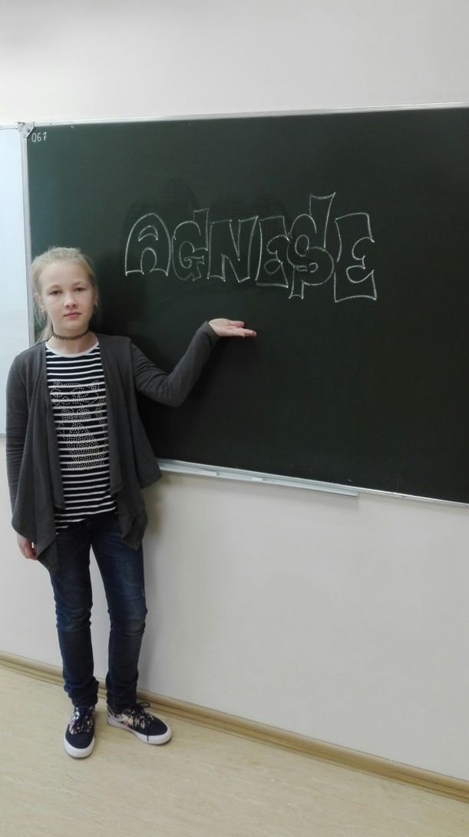
Agnese Loča
My name is Agnese. I study in Balvi Primary school Form 6a. My favourite subjects are sports, maths, IT and home economics. I study also in Music school. I play the piano very well. I have two cats. My hobby is cycling and skateboarding.

Slide 18
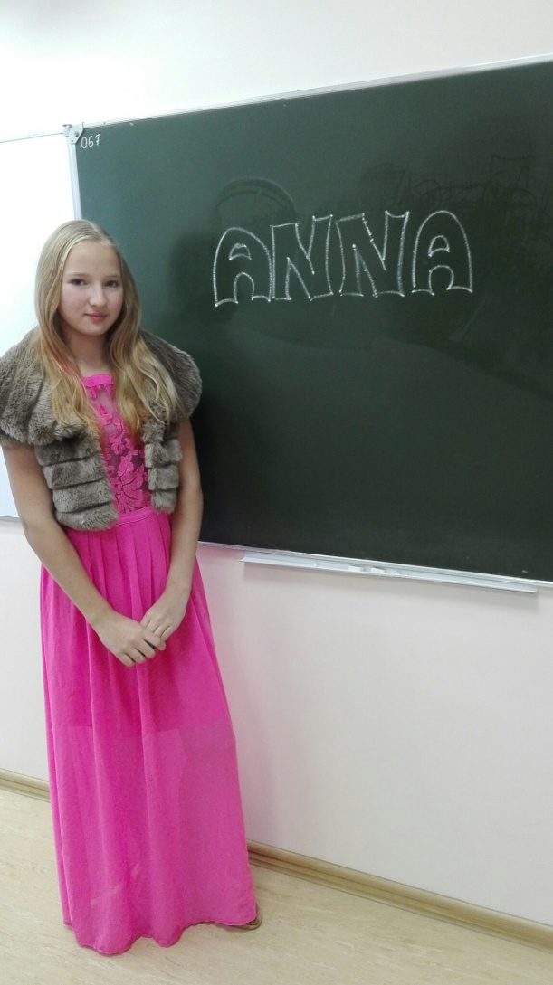
Anna Logina
My name is Anna. I live in Balvi. I study in Balvi Primary school Form 6a. I study also in Music school. I have trainings in athletics and volleyball. I like sports. I have two cats and one dog. I like cooking.

Slide 19
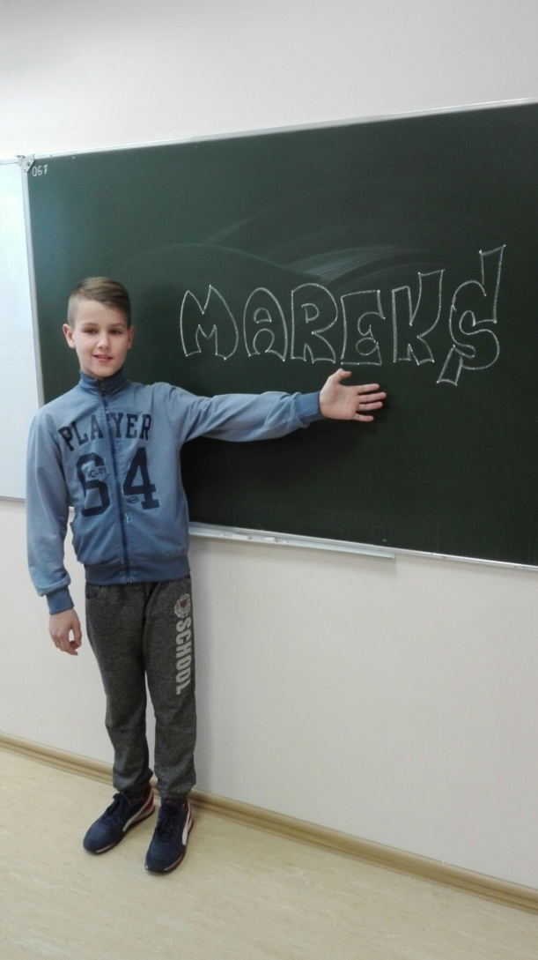
Mareks Ņikuļins
My name is Mareks. I live in Balvi. My hobby is driving a car and motorcycle.

Slide 20
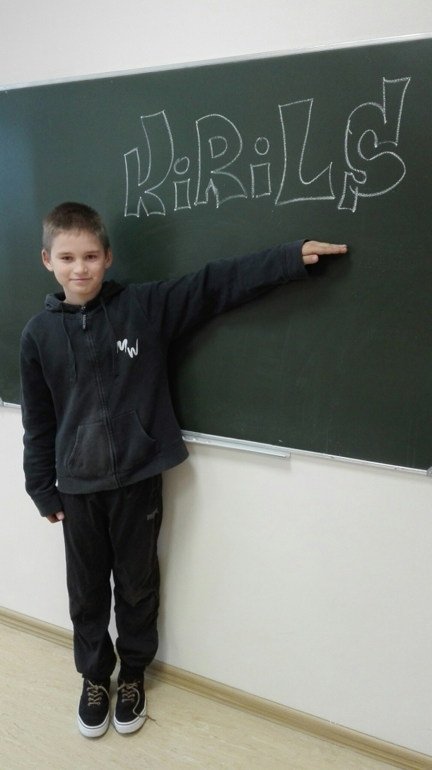
Kirils Razumeiko
My name is Kirils. I am 12. I study in Balvi Primary school Form 6a. I like spendind my free time outside. I can speak Russian very well.

Slide 21
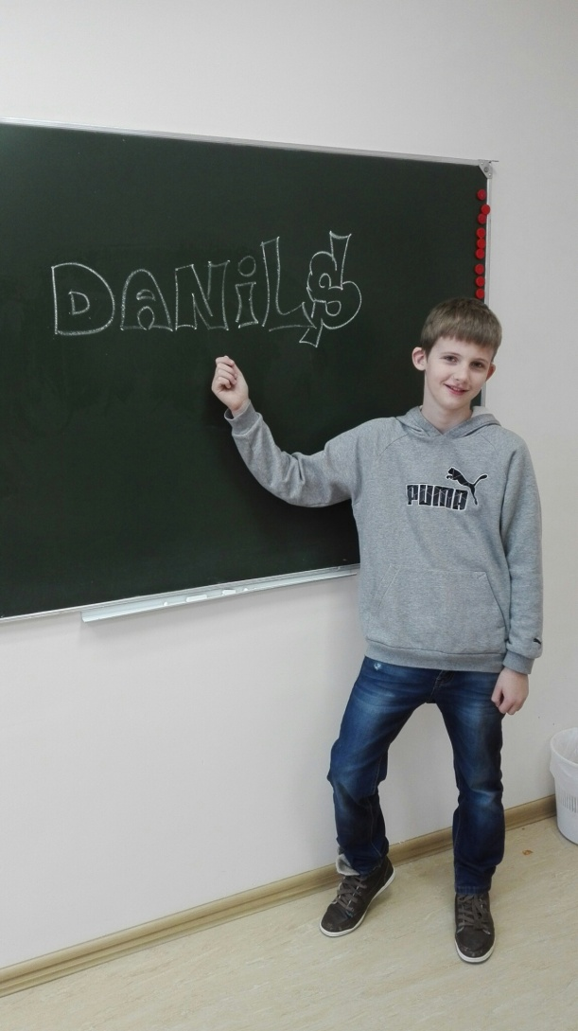
Danils Smuškovs
My name is Danils. I like playing football and volleyball. I like sports. I can speak Russian very well.

Slide 22
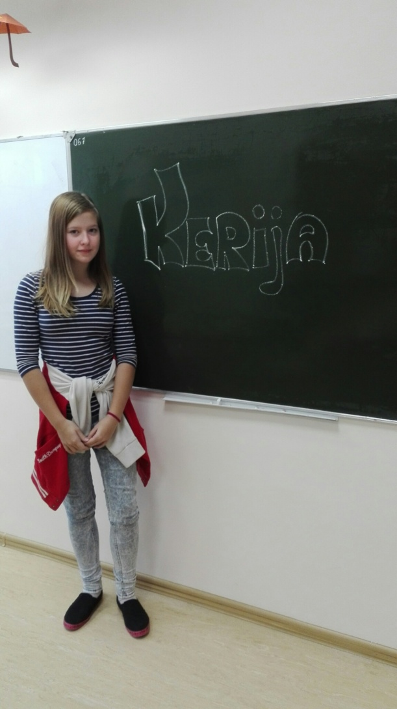
Kerija Žanete Zeltiņa
My name is Kerija. I am 12. I live in Balvi. My birthday is on the 22nd of September. My favourite subject is home economics. I study in Music school. I can play saxophone. I like sports and singing.

Slide 23
Thank you!

