Slide 1
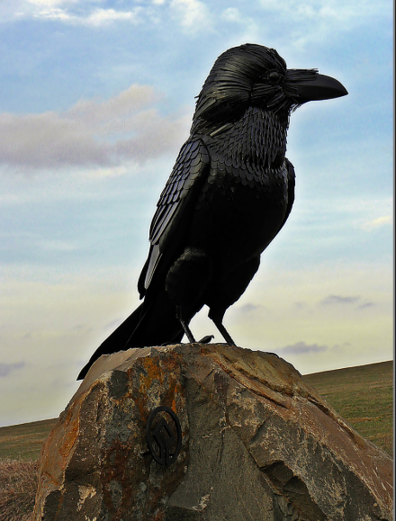
Hollókő
Presented by: Ádám Kávai and Gergő Vértes

Slide 2
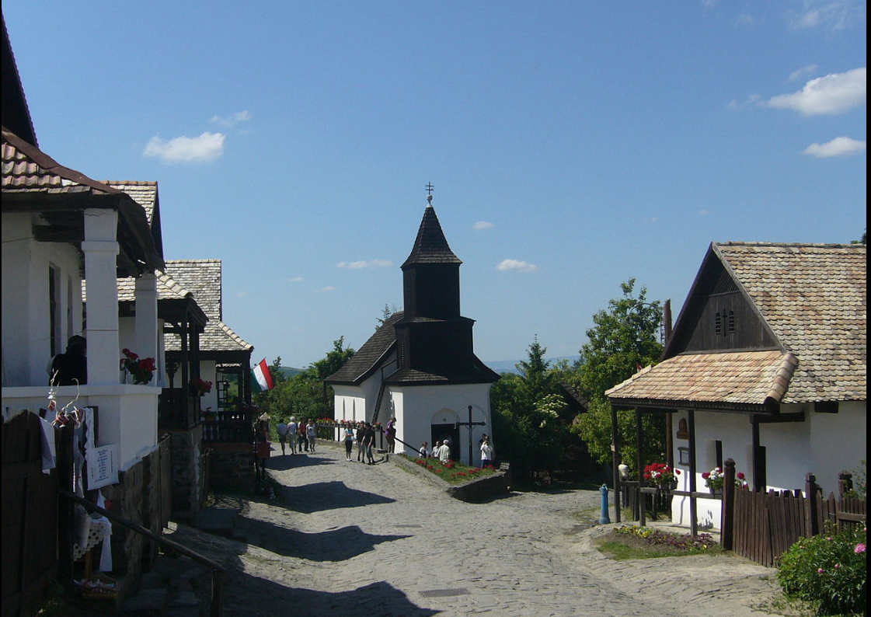
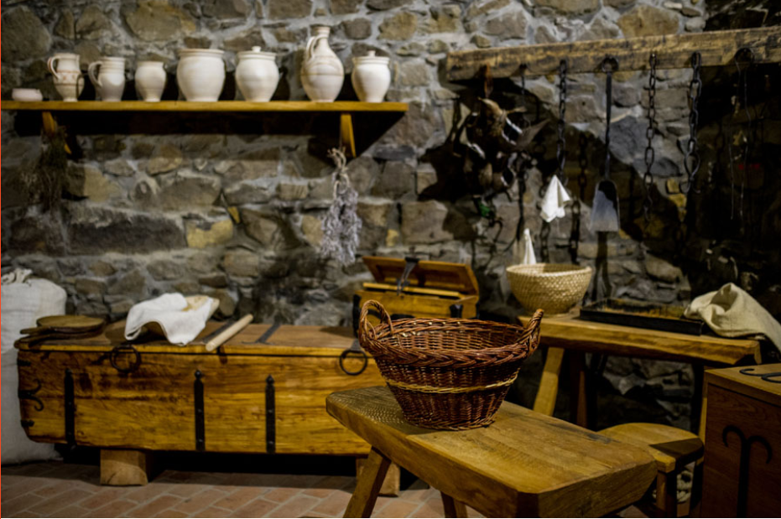
Hollókő village
Part of UNESCO World Heritage
Medieval village located in Nógrád
One road village with small houses

Slide 3
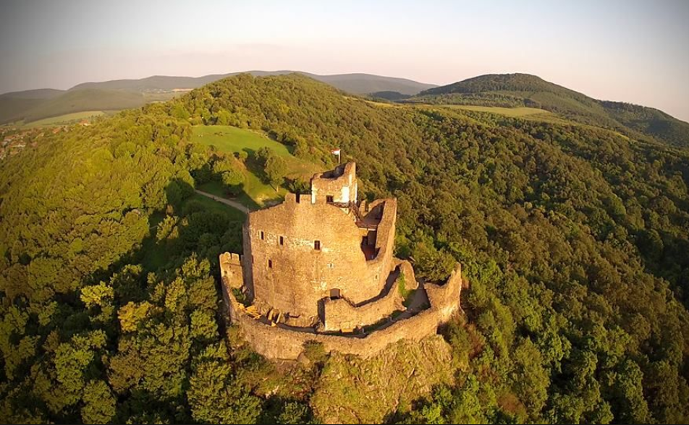
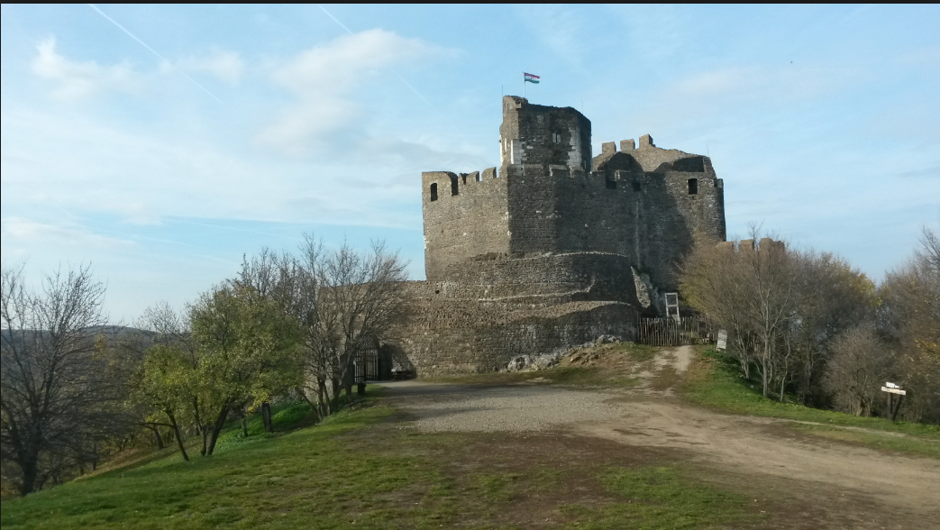
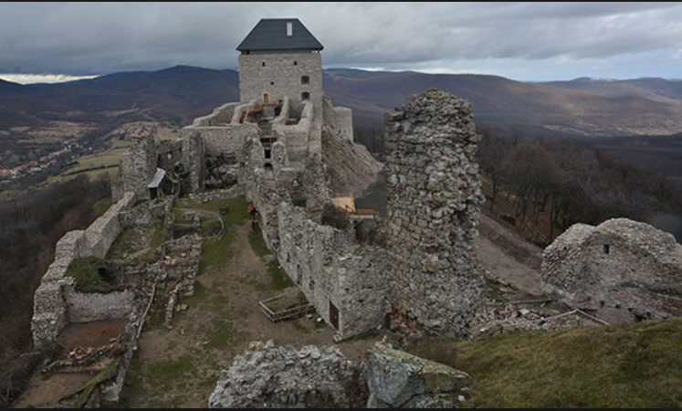
Hollókő Castle
Medieval castle
Built in 13th century
Damaged by Turkish army in16th century

Slide 4
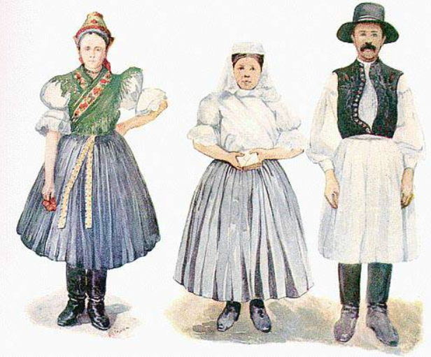
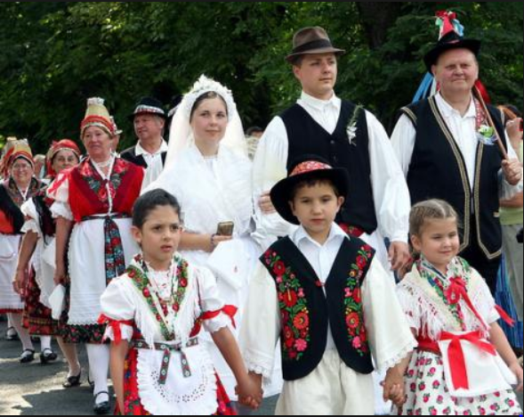
Hollókő residents
People live there named Palóc
They have unique dress
They wear it now

Slide 5
Thank you for the attention!
Source:
Wikipedia
UNESCO official website
Photo by Balazs Szabo

