Slide 1
CARNIVAL IN EUROPE
PROJECT ETWINNING.

Slide 2
ITALY

Slide 3
ITALY

Slide 4
GREECE

Slide 5
FRANCE

Slide 6
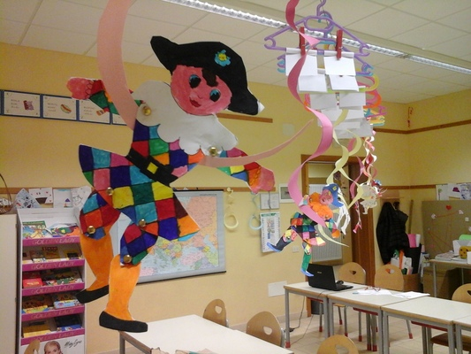
GREECE

Slide 7
SPAIN

Slide 8
SPAIN

Slide 9
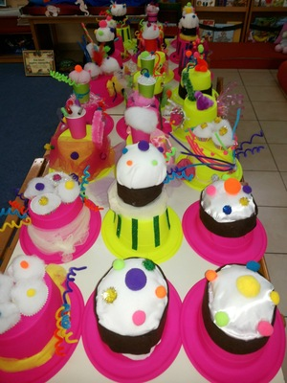
PATRAS
GRECEE

