Slide 1
My country croatia
Varaždin

Slide 2
Croatia is a country in the southern Europe

Slide 3
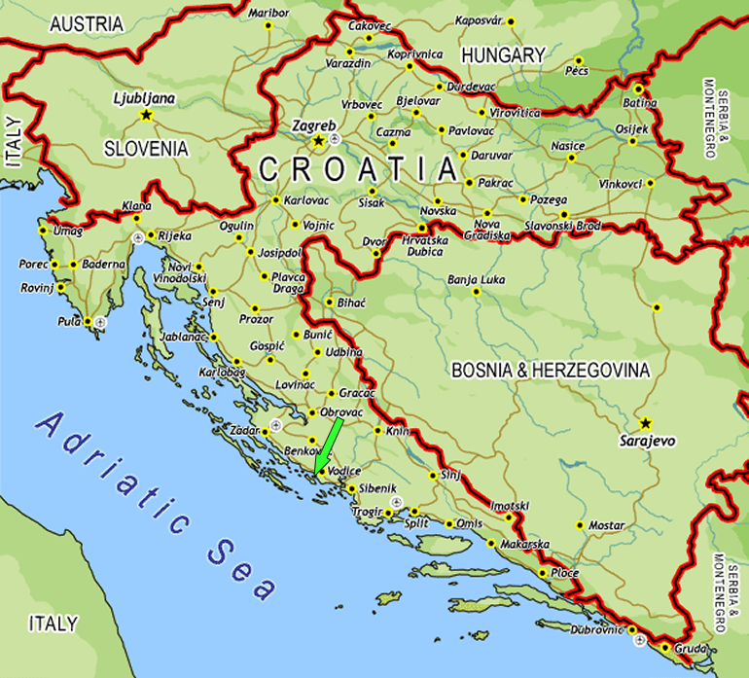
CROATIA
Croatia is a medium-size European country.
Its position is both central European and Mediterranean, as well as Pannonian-Adriatic.

Slide 4
CROATIA
Republic of Croatia is proclaimed on 25th of June 1991. It is our Statehood Day.
Croatia is defined as a unitary and indivisible democratic and social state.

Slide 5
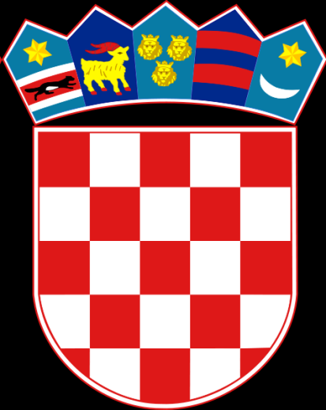
CROATIAN NATIONAL FLAG
Croatian National flag is a red-white-blue tricolor with the historic Croatian chequered coat of arms (25 red and white fields) and stylized crown with five smaller shields featuring coats of arms.
The red-white chequered coat of arms on a shield has been the symbol of Croatian statehood ever since the early times.
The beginnings of the coat of arms date back to the 11th century – from the period of the Croatian kings.

Slide 6
CROATIAN ANTHEM
The Croatian anthem Lijepa naša (Our Beautiful Homeland) is written in 1835. (Antun Mihanović ) and set to music in 1846. (Josip Runjanin).

Slide 7
Croatian kuna
The official Croatian currency is Croatian kuna –HRK (1 HRK = 100 Lipa).

Slide 8
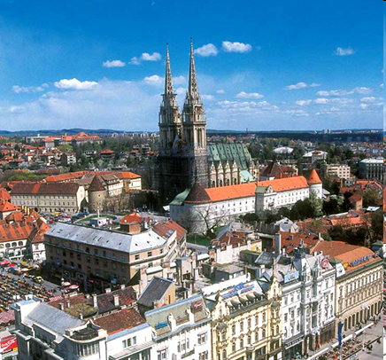
The capital is Zagreb. Zagreb is also the biggest city (1,5 million of people).
It borders with Serbia, Hungary, Slovenia, Bosnia and Herzegovina, Monontenegro and with Italy and Slovenia on the sea (930 km).

Slide 9
Ethnic structure of the Croatian
The ethinc structure of the population of the Republic of Croatia exhibits both high and stable homogeneity.
The majority are Croats (78%).
Other populations include ethnic groups: Serb (14%), Muslim, Slovenian, Italian, Czech, Slovakian, Albanian, Gypsy, etc.

Slide 10
Croatian diocese
The majority of the population of the Republic of Croatia are Roman Catholic (76,6%), while other religions account for 12,3% (other Christian sects, Muslim, atheist,…).

Slide 11
National holidays of Republic Croatia are
1st of January (New Year’s Day)
6th of January (Epiphani)
Easter and Easter Monday
1st of May (Labour Day)
22nd of June (Day of Antifascist Victory)
25th of June (Statehood Day)
5th of August (Homeland Thanks giving Day)
15th of August (the Assumption)
8th of October (Independence Day)
1st of Novembar (All Saint Day)
25th and 26th of December (Christmas holidays)

Slide 12
Varaždin
Varaždin is a town in northwestern Croatia located along the river called Drava and the center of Varaždin County
It has 46,946 inhabitants and covers an area of 59.45 km
It covers 10 settlements : Črnec Biškupečki, Donji Kućan, Gojanec, Hrašcica, Jalkovec, Kućan Marof, Poljana Biškupečka i Zbelava

Slide 13
Economy
The most developed branches of the industry are nutrition (Vindija, Koka), construction (Road, Zagorje-tehnobeton, Hidroing), textile (Varteks, VIS), metalworking (MIV) and woodworking(Mundus)

Slide 14
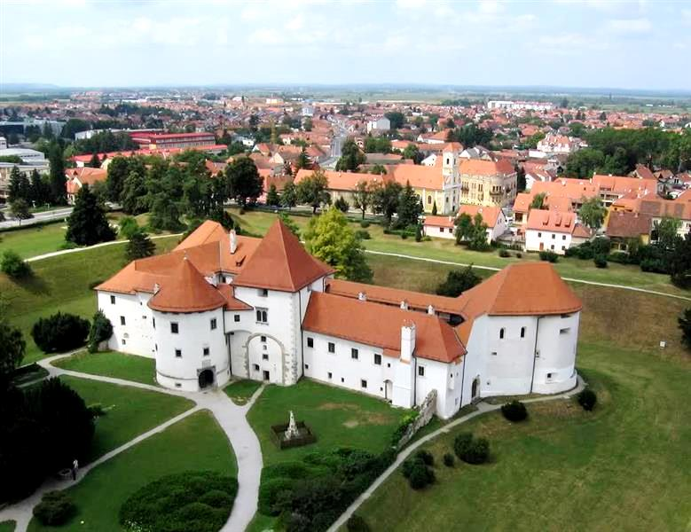
Architecture and sights
The biggest monument of Varaždin is the Old Town fortress, and today it houses the Varaždin City Museum

Slide 15
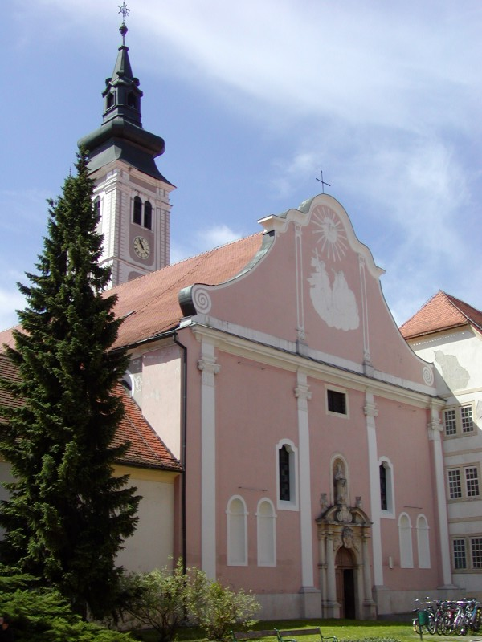
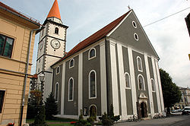
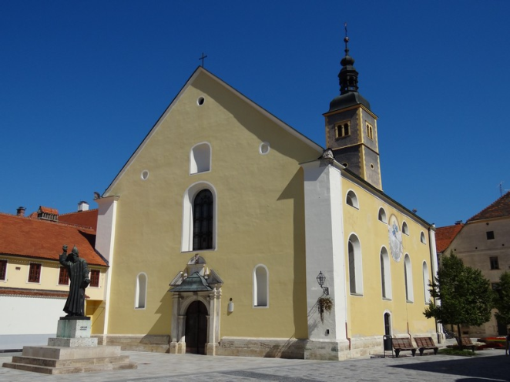
Varaždin has many churches and monasteries, and some of them are:
Church Sv. Nikole
Varaždinska cathedral
Franjevački monastery

Slide 16
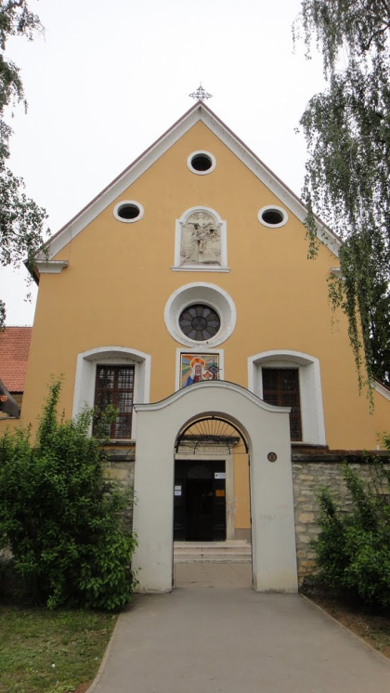
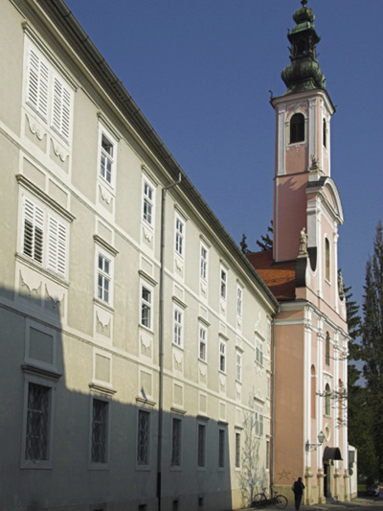
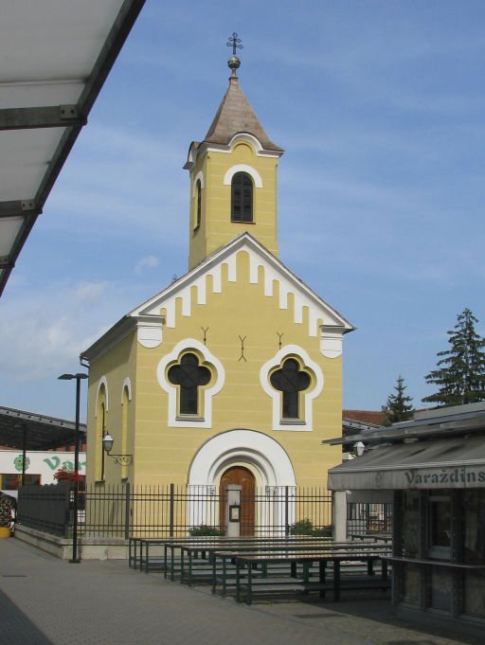
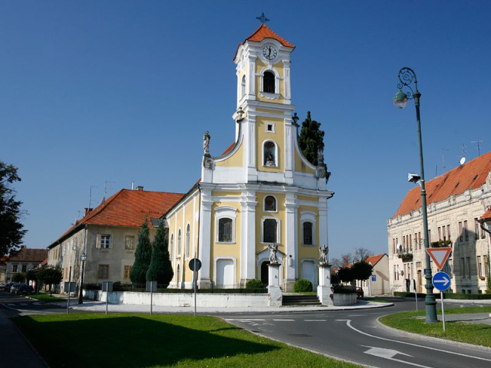
Uršulinski monastery
Kapucinski monastery
Church Sv. Florijana
Orthodox Church Sv. Đorđa

Slide 17
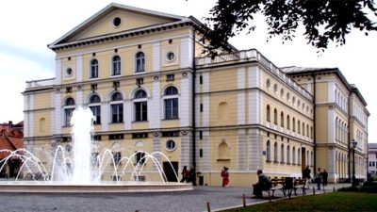
Varaždin also has a Croatian National Theater based on projects by Vienna architects Fellner and Helmer, famous theater builders in Central Europe.

Slide 18
Varazdin has a lot of hotels and apartments such as Hotel Turist, Hotel Varaždin, Hotel Istra, Apartments Maltar and others.

Slide 19
Festivals
From famous cultural events, Varazdin Baroque Evenings, Špancirfest, Trash Film Festival and other cultural events are held in Varaždin.
Cultural and historical attractions of Varazdin are Purgar or Varazdin Civil Guard.

Slide 20
Education
There are seven elementary schools, 12 secondary schools, several faculties and a center for education of children with special needs

Slide 21
Thank you for attention!

