Slide 1
Machine engineering and traffic highschool Varaždin

Slide 2
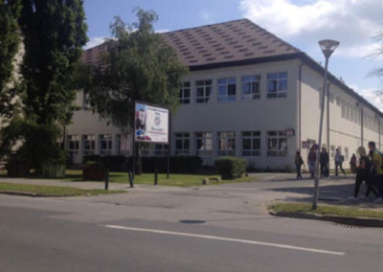
About school
Machine engineering and traffic highschool is placed in Varaždin and has 665 students staggered in 33 classes.
It works as an independed institution since 1992.
The director of the highschool is eng. Milan Žunar.

Slide 3
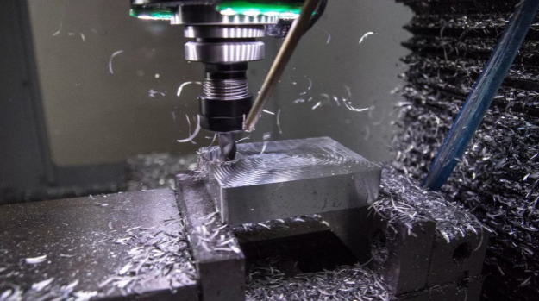
Mechanical computer technician
Duration of education: 4 years
Tasks: It plans the materials, selects tools and machines, operates modes, machine capacities, determines the methods of processing, sequence of procedures, material norms and time of production and control method. It prescribes the quality and precision to be achieved by processing. It checks the quality and function of a finished product, machine or machine element.

Slide 4
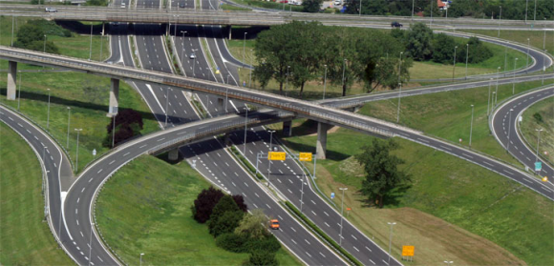
Road traffic technician
Duration of education: 4 years
Tasks: Collecting, analizyng and keeping track of data that are important for completin services in the road traffic are just some of the tasks that the road traffic technician is in charge for.

Slide 5
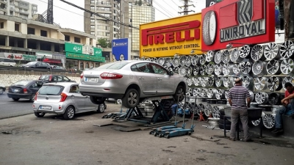
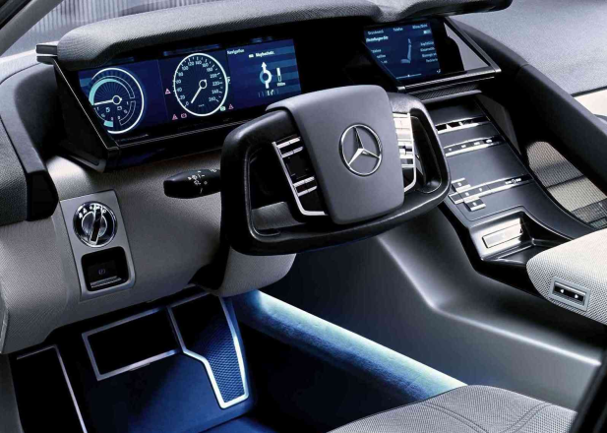
Vehicle technician
Duration of education: 4 years
Tasks: It works in the manufacture, sale and maintenance of road and rail vehicles, repairs and servicing vehicles and monitors the correctness of their work. In production, he plans and prepares work on the production of vehicles and their components, supervises production, and examines the materials in research laboratories.

Slide 6
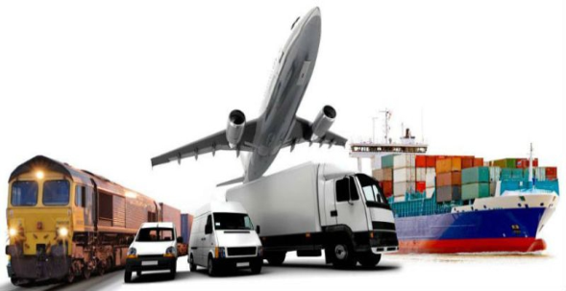
Freight logistics tehnician
Duration of education: 4 years
Tasks: Based on received orders it organises the transfer of goods, receives and issues orders and takes care of its realization and shipping of goods.

Slide 7
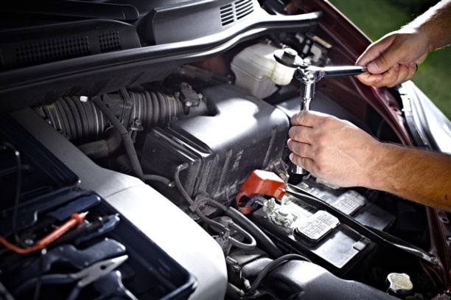
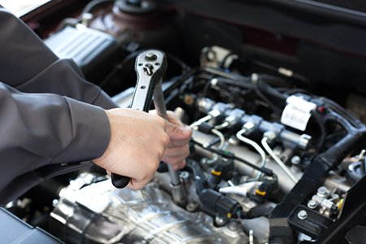
Car mehatronic
Duration of education: 3 years
Tasks: It repairs, tunes and servises motor vehicles. It detects and removes mechanical and electrical malfunctions and damage to parts and assemblies of personal vehicles, commercial vehicles, motorcycles and work machines.

Slide 8
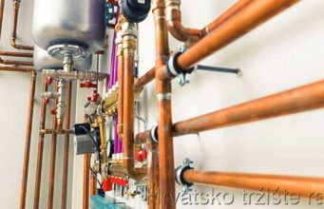
Instaler of home instalations
Duration of education: 3 years
Tasks: It manufactures, assembles, maintains, supervises the operation and servicing of water and gas systems, and heating, cooling and air conditioning systems, the basic tasks are related to the manufacture and installation of elements and appliances for the water supply and gas installation system.

Slide 9
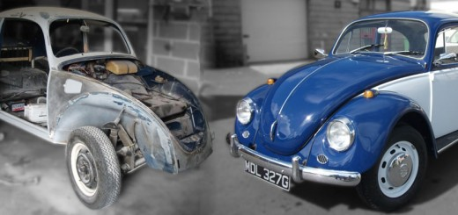
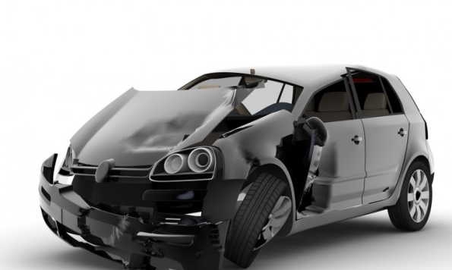
Car bodyworker
Duration of education: 3 years
Tasks: It eliminates mechanical damage on the vechiles body caused by traffic accidents or weather conditions.

Slide 10
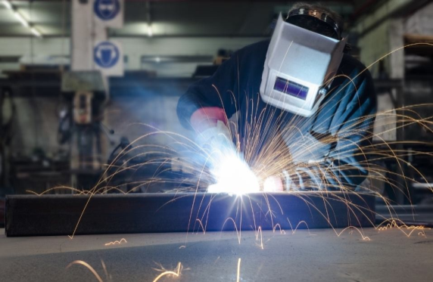
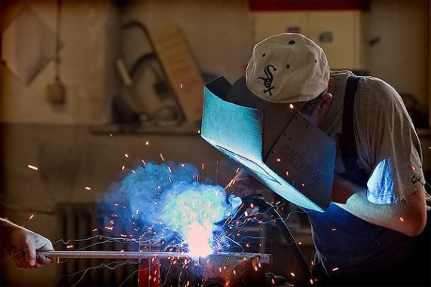
Machinist
Duration of education: 3 years
Tasks: New machines and devices assembly and maintaining of the existing ones. Making new machine elements, establishing failures and fixing them.

Slide 11
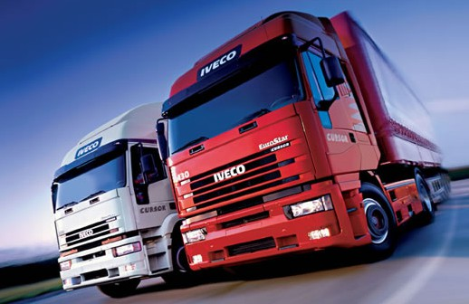
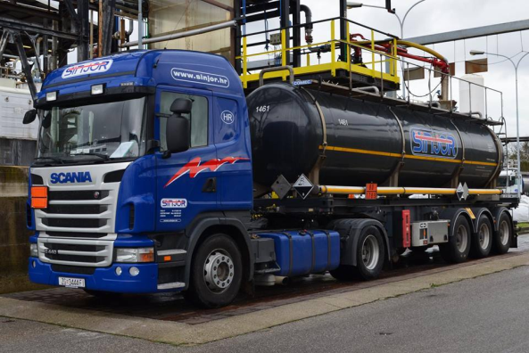
Motor vehicle driver
Duration of education: 3 years
Tasks: Carries out the preparation of a vehicle for transport, supervises loading and unloading of freight, collects cargo and transport documentation. It manages the vehicle during transport in urban, interurban and international traffic. After completing their education, students are trained for C category drivers.

Slide 12
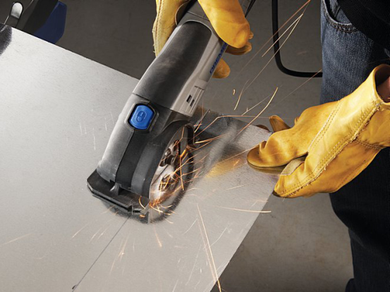
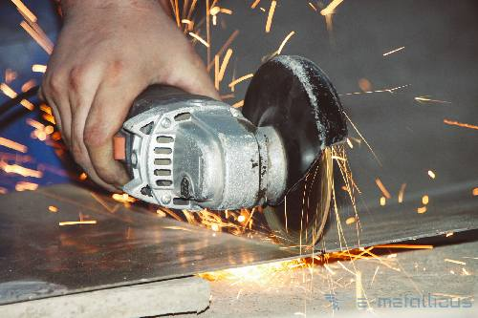
Auxiliar lochsmith
Duration of education: 3 years
Tasks: Training the students for doing simple working operations such as: cutting sheet metals, sawing metal profiles, drilling, minting, welding, grinding and application of paint.

Slide 13
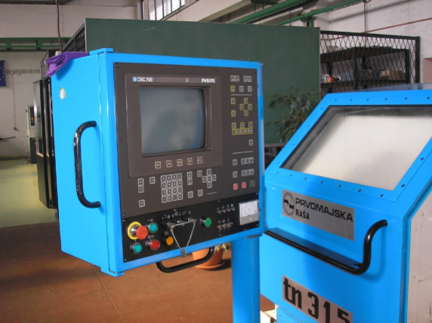
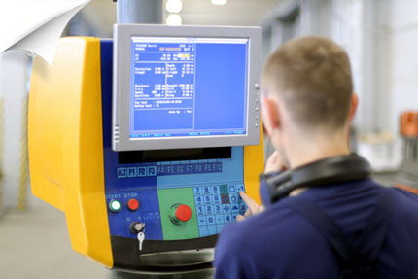
CNC operator
Duration of education: 3 years
Tasks: It works in machine processing companies, maintanance operations and production of machine parts and devices.

Slide 14
THANK YOU FOR ATTENTION!

