Slide 1
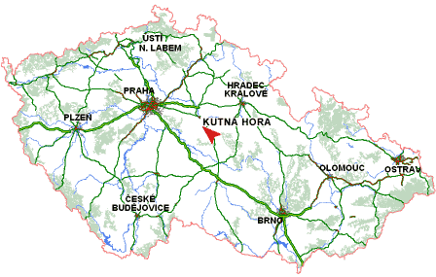
Kutná Hora

Slide 2
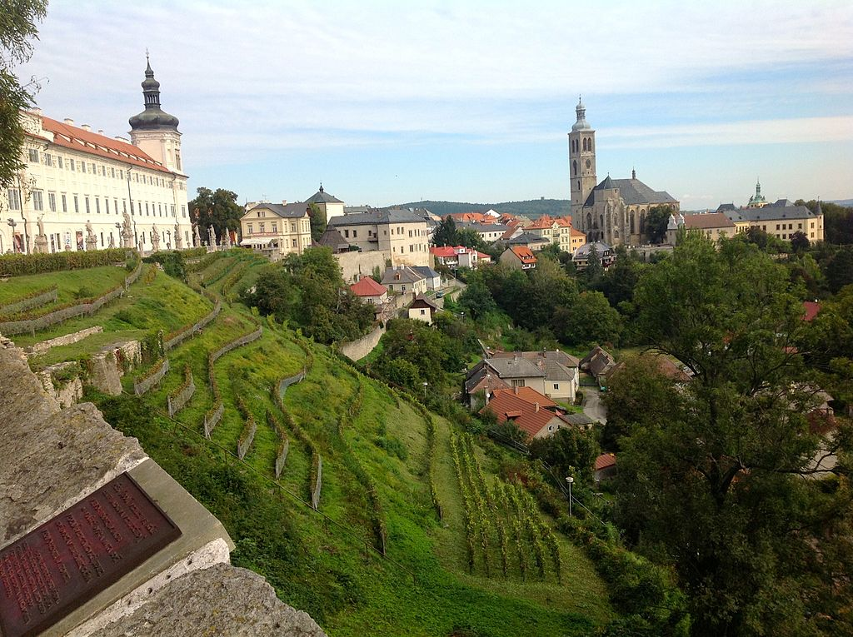
Kutná Hora is a city situated in the Central Bohemian Region of Bohemia, which is now part of the Czech Republic.
Saint Barbara's Church is a Roman Catholic church in Kutná Hora in the style of a Cathedral, and is sometimes referred to as the Cathedral of St Barbara. It is one of the most famous Gothic churches in central Europe and it is a UNESCO world heritage site. It was inscribed in the UNESCO List in 1995.

Slide 3
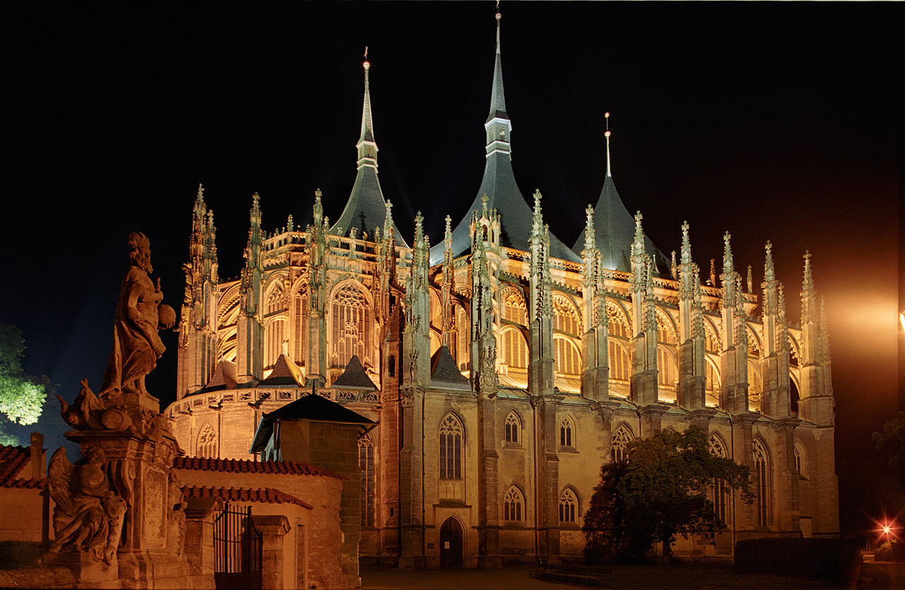
St. Barbara's Church

