Slide 1
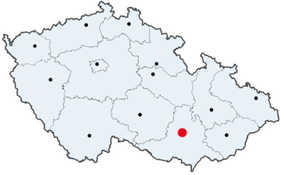
BRNO

Slide 2
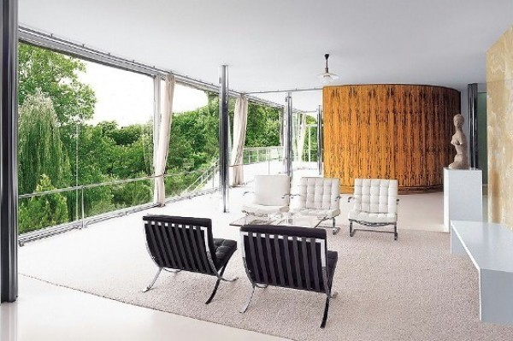
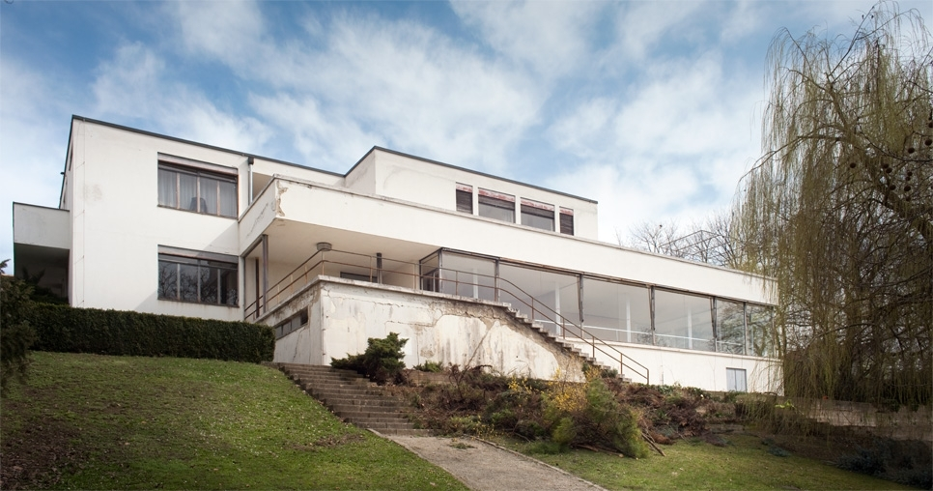
Brno is the second largest city in the Czech Republic by population and area, the largest Moravian city. Brno is the administrative center of the South Moravian Region.
Villa Tugendhat is a historical building in the wealthy neighbourhood of Černá Pole. It was designed by the German architect Ludwig Mies van der Rohe between 1928 and 1930 for Fritz Tugendhat and his wife Greta, the villa soon became an icon of modernism. It was inscribed in the UNESCO List in 2001.

