Slide 1
Sloup v čechách

Slide 2
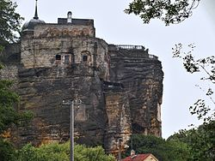
Sloup v čechách
Sloup v Čechách is a historic rock castle nearby Česká lípa from 13th century.

