Slide 1
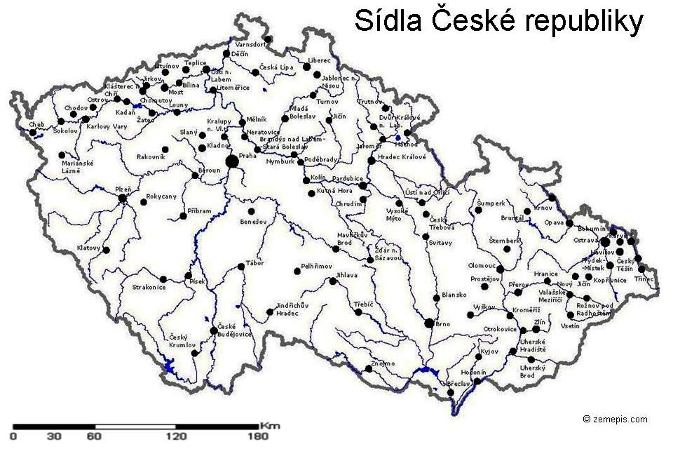
Bohemian Crumlaw
Old Český Krumlov is a UNESCO World Heritage Site and was given this status along with the historic Prague castle district.

Slide 2
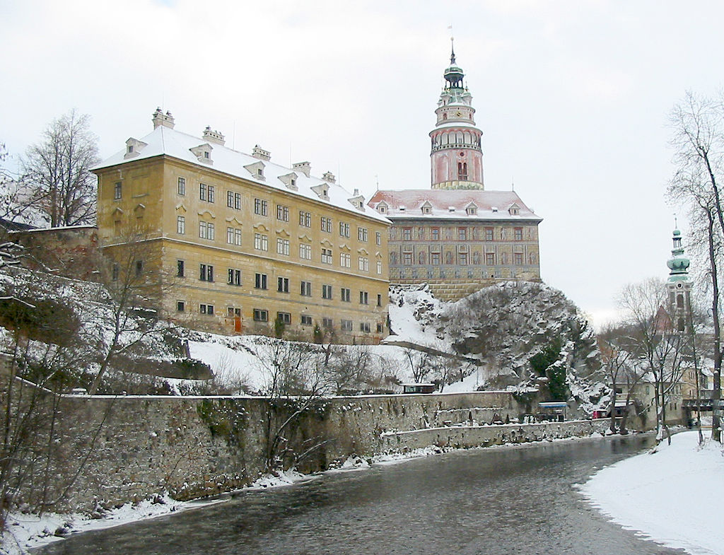

Slide 3
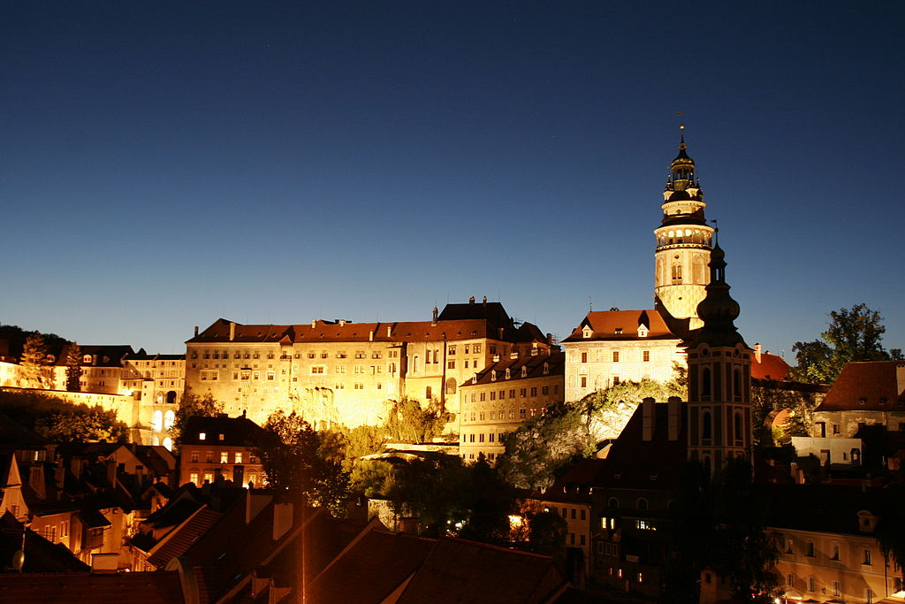
Český Krumlov at night ._.

Slide 4
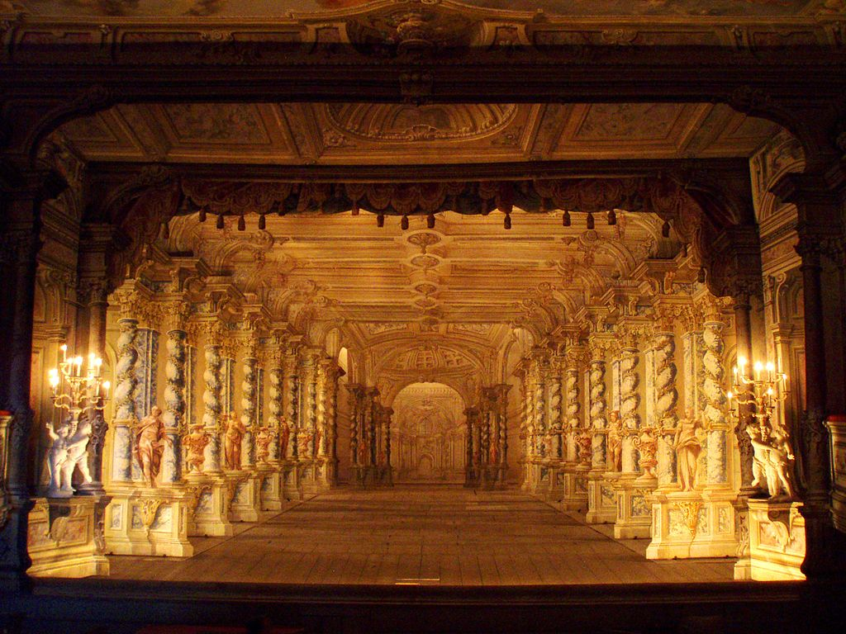
The stage of the castle theatre

Slide 5
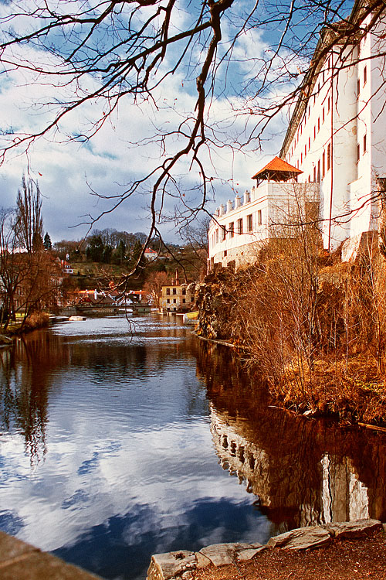
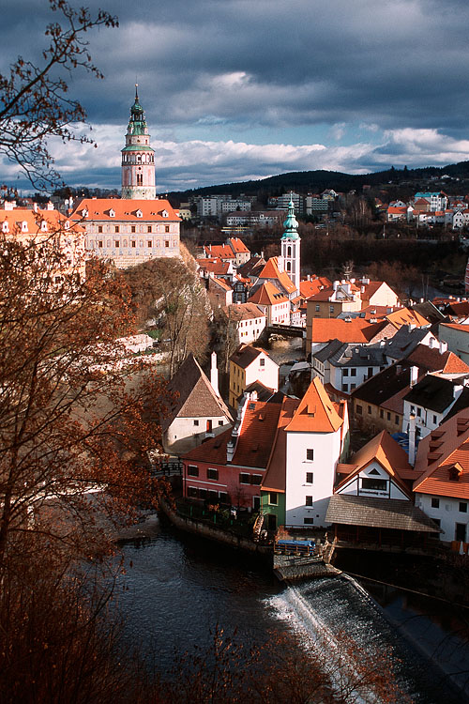
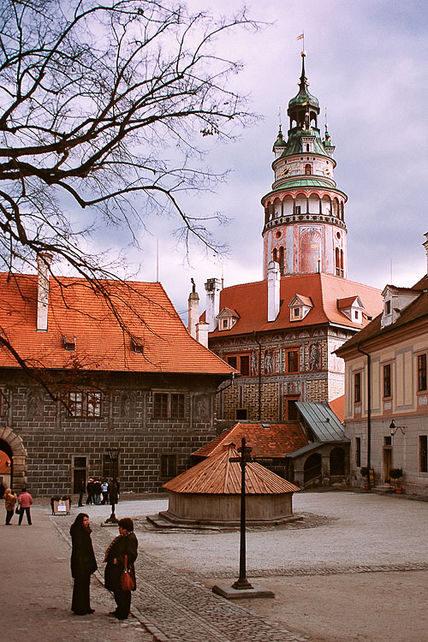

Slide 6
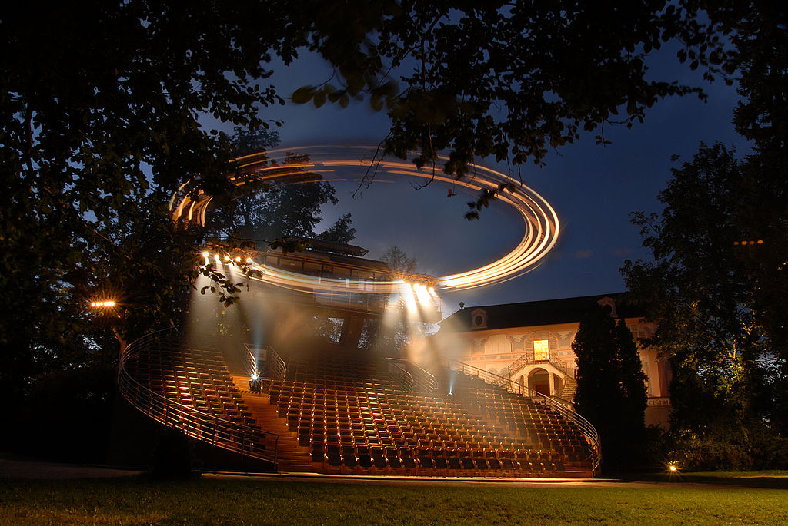
The unique Revolving Theatre in Castle park

Slide 7
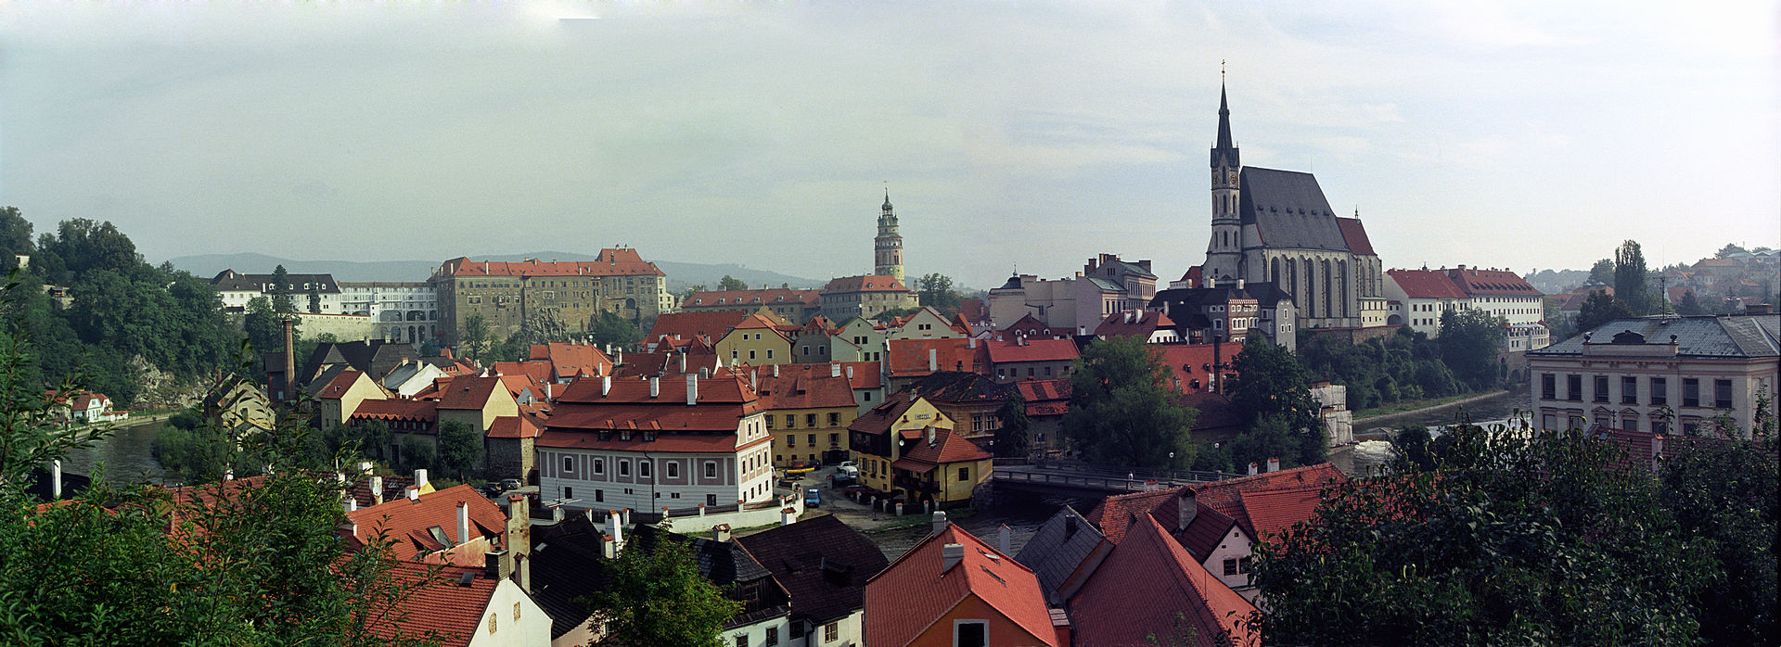

Slide 8
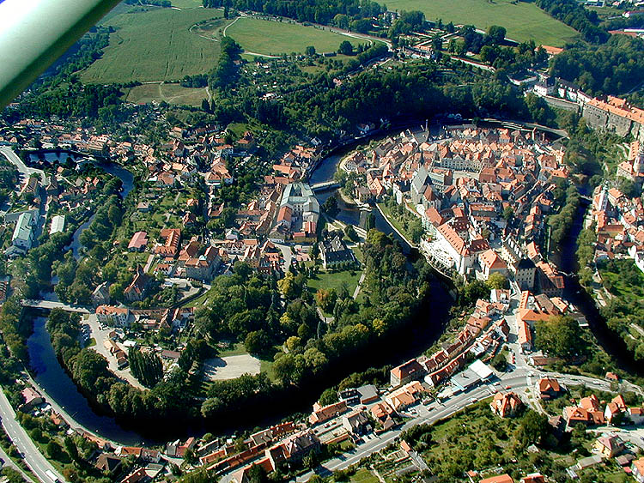

Slide 9
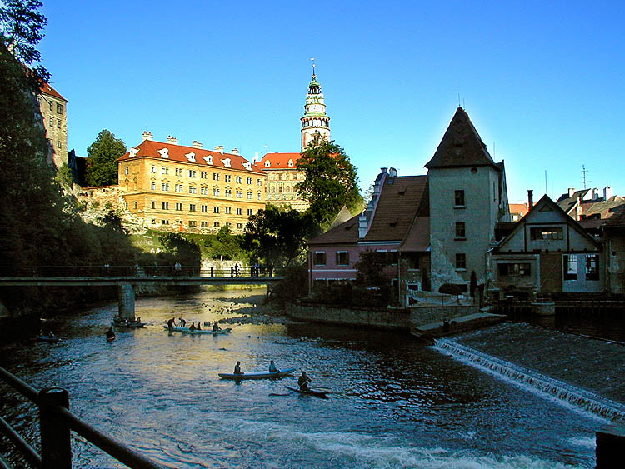
It‘s a beautiful city, yet people admire its river the most. You can see a lot of people rowing there.

