Slide 1
Holašovice

Slide 2
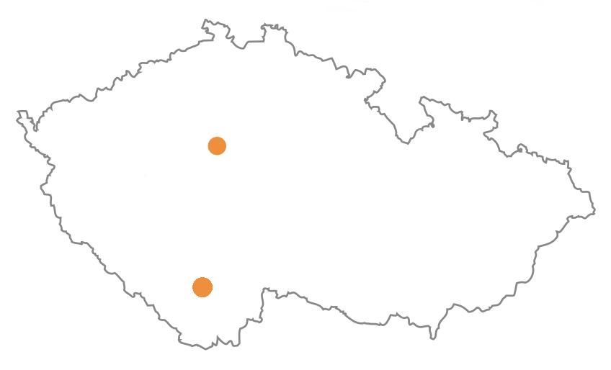
Place
PRAGUE
HOLAŠOVICE

Slide 3
Some informations
The village was based in 13th century
It was put on the list of the UNESCO in 1998
140 people live there
It is worth seeing for beutiful baroque houses

Slide 4
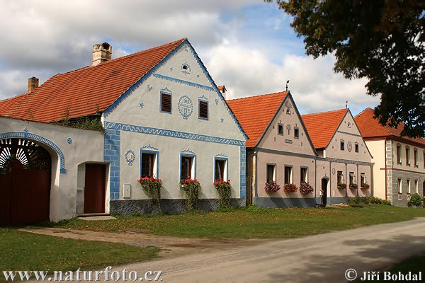
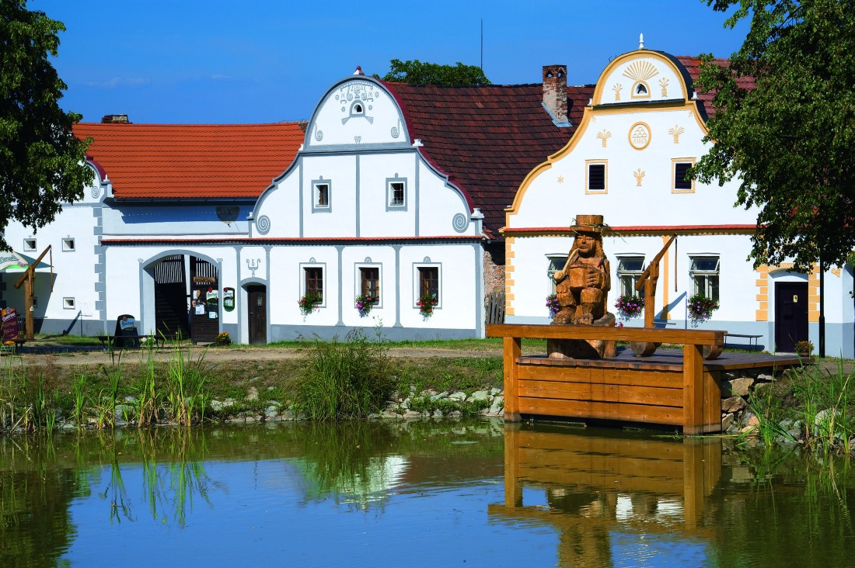
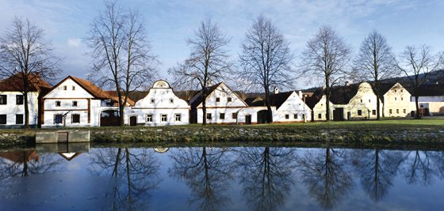
Fotos

