Slide 1
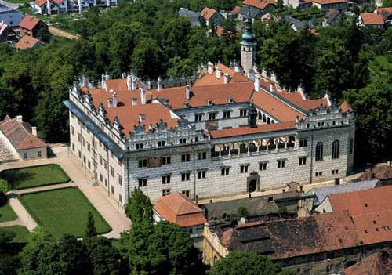
Litomyšl

Slide 2
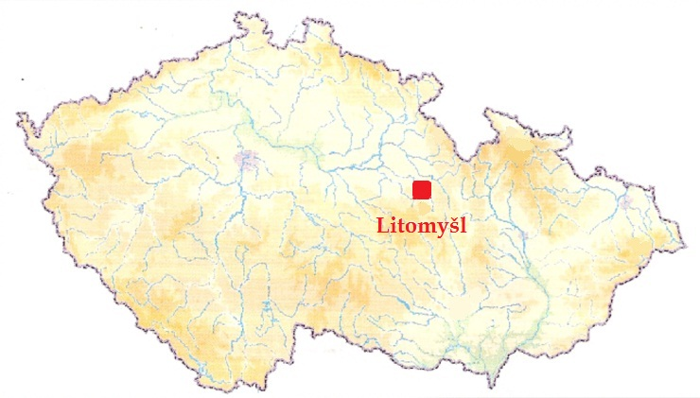
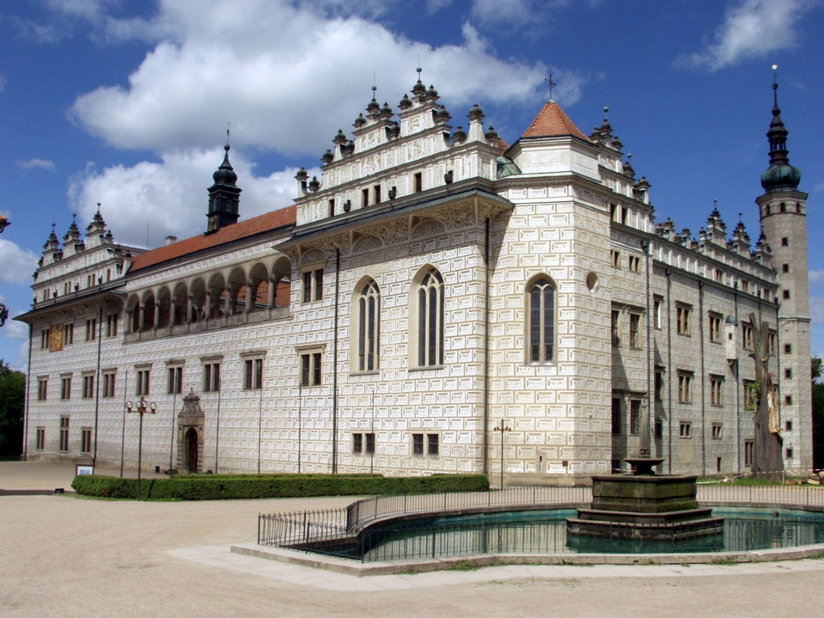
The town called Litomyšl is located on the north-east part of the Czech Republic The town is famous for its chateau which is on the UNESCO list.

