Slide 1
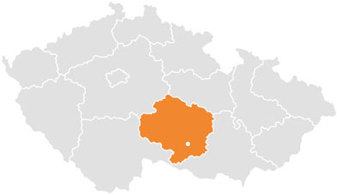
Třebíč
Třebíč

Slide 2
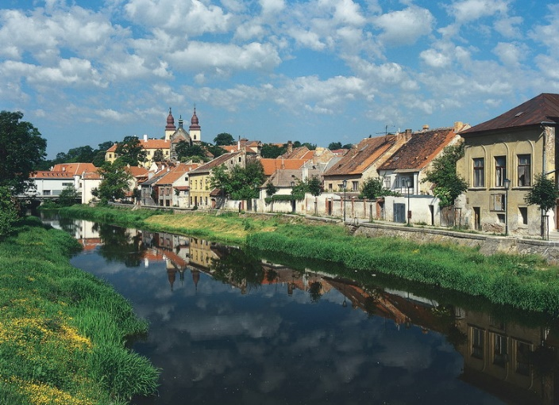
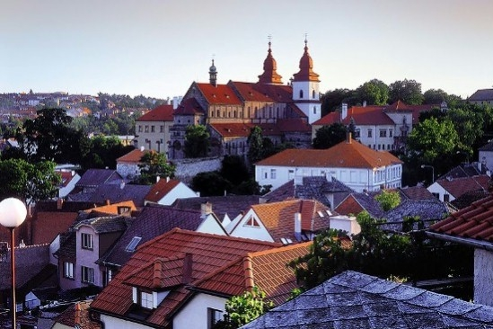
Třebíč is a city situated in the south of Moravia
The population is about 35 thousand.
This city lies on the banks of the river Jihlava.
It is very old town.

Slide 3
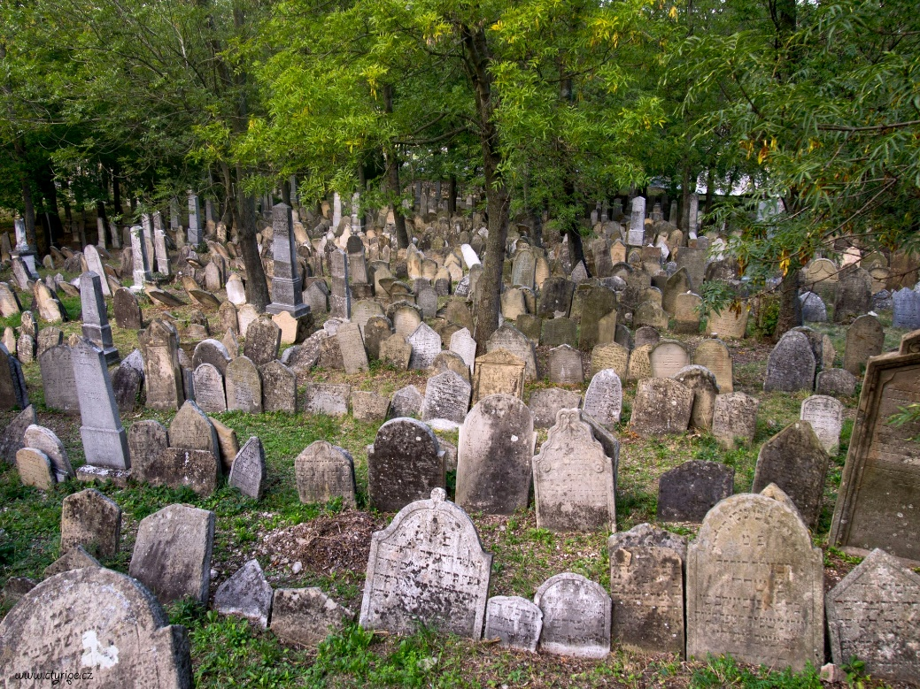
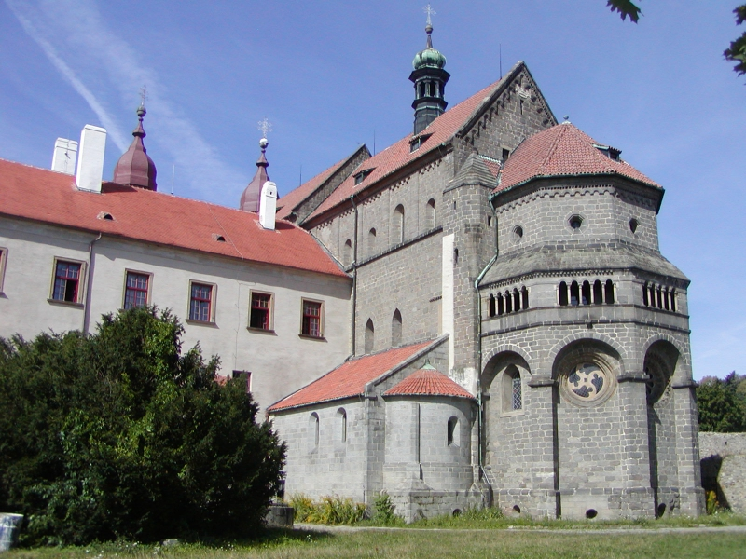
UNESCO memorials
The Jewish quarter and the Basilica of St. Procopius in 2003 were entered into the UNESCO World Heritage List .

