Slide 1
Castle Lednice

Slide 2
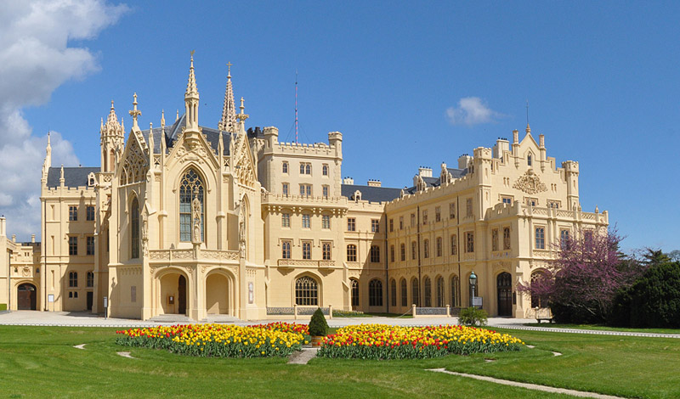

Slide 3
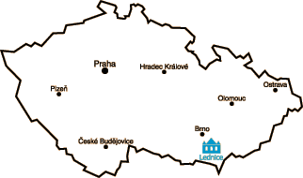
Location
Castle Lednice is situated in south part of the Czech republic.
More accurately it is in village called Lednice.
It stays on the right shore of river Dyje.

Slide 4
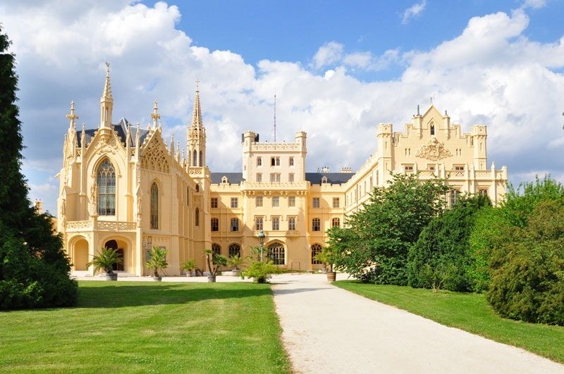
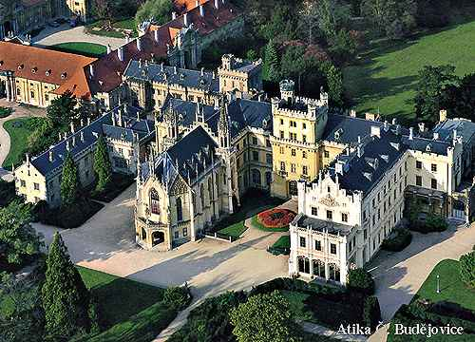
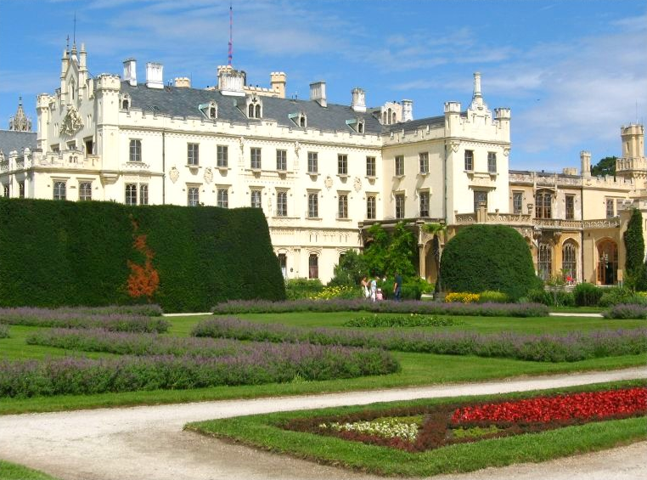
Informations
This castle with really large garden is sorted to most beautiful complexes in the whole country.
Lednice castle is one of the most important expressions of high romanticism in Czech territory.
In December 1996 was registered in the entire Lednice-the UNESCO World Heritage List.

Slide 5
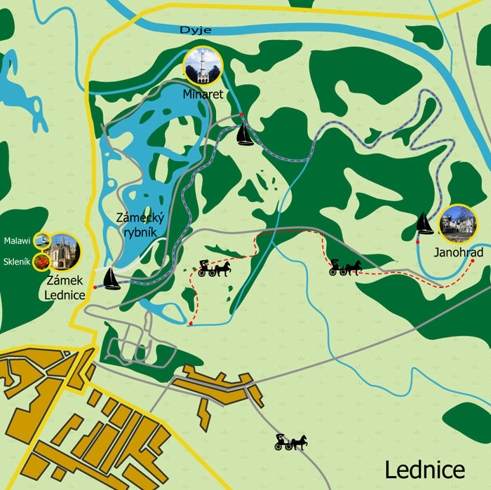
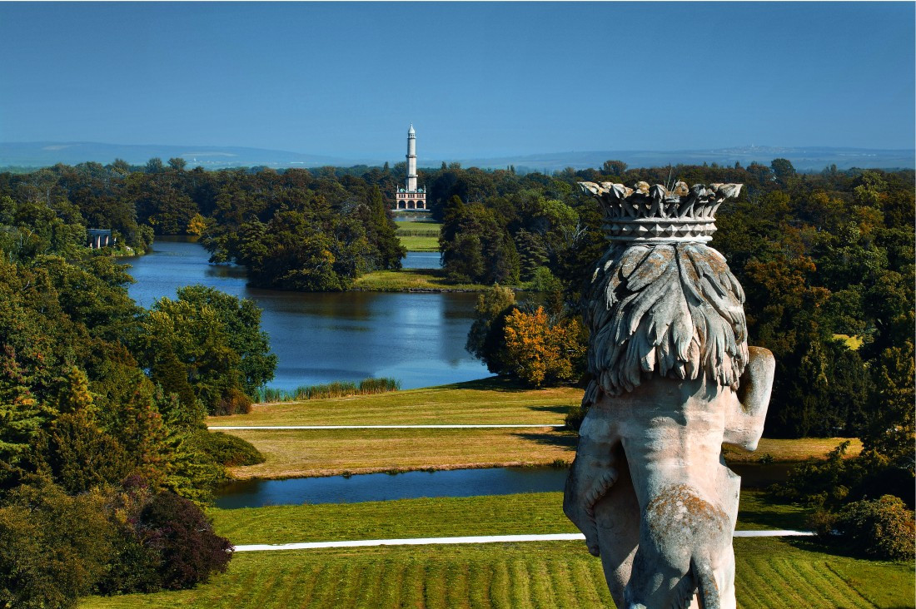
Area

