Slide 1
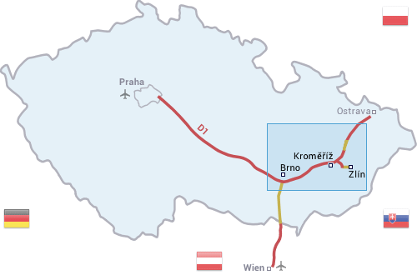
Kroměříž

Slide 2
Kroměříž Archbishop‘s Chateau came in UNESCO in 1998
It is in the south of Moravia near Zlín town
In 1643 there was 30-year-war
Kroměříž was destroyed by L. Torstenson

Slide 3
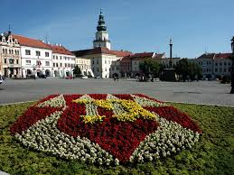
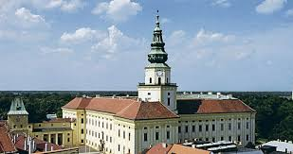
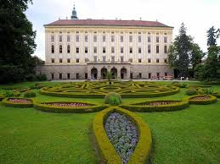
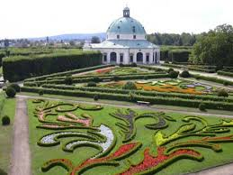
Photos

