Slide 1
Zákupy

Slide 2
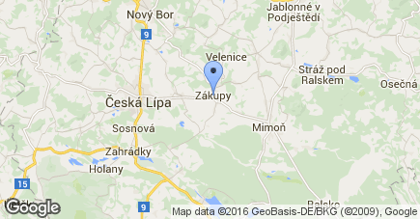
Where is it?
It is a little town near Česká Lípa.
There are 2854 citizens.
It is 32km2 big

Slide 3
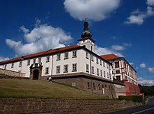
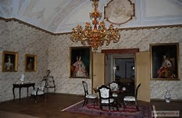
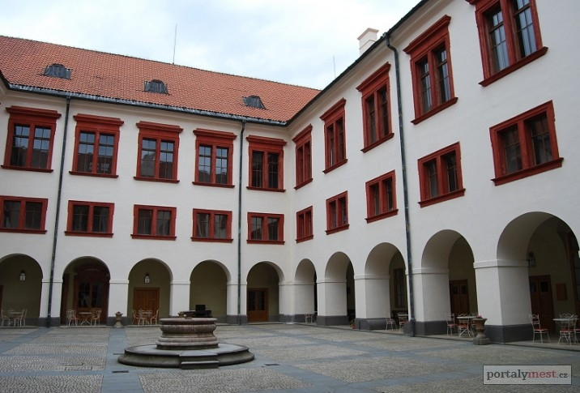
What is there
There is a beautiful castle.

Slide 4
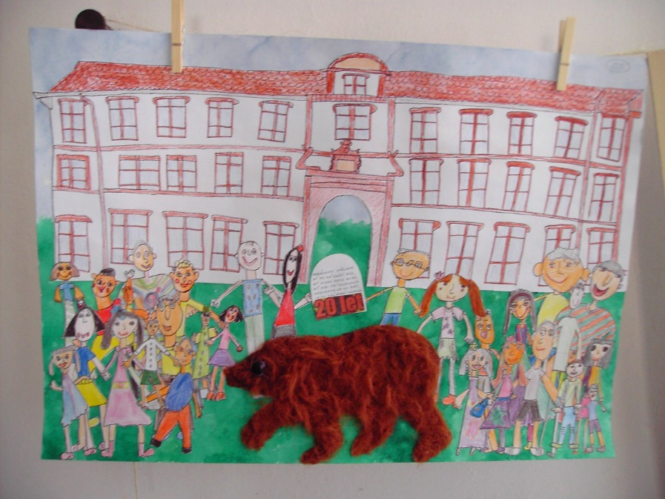
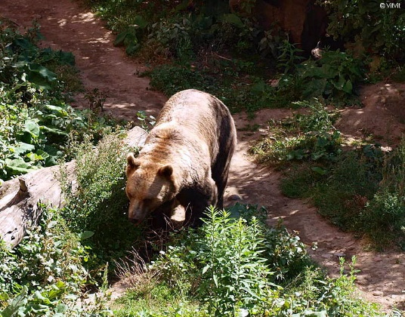
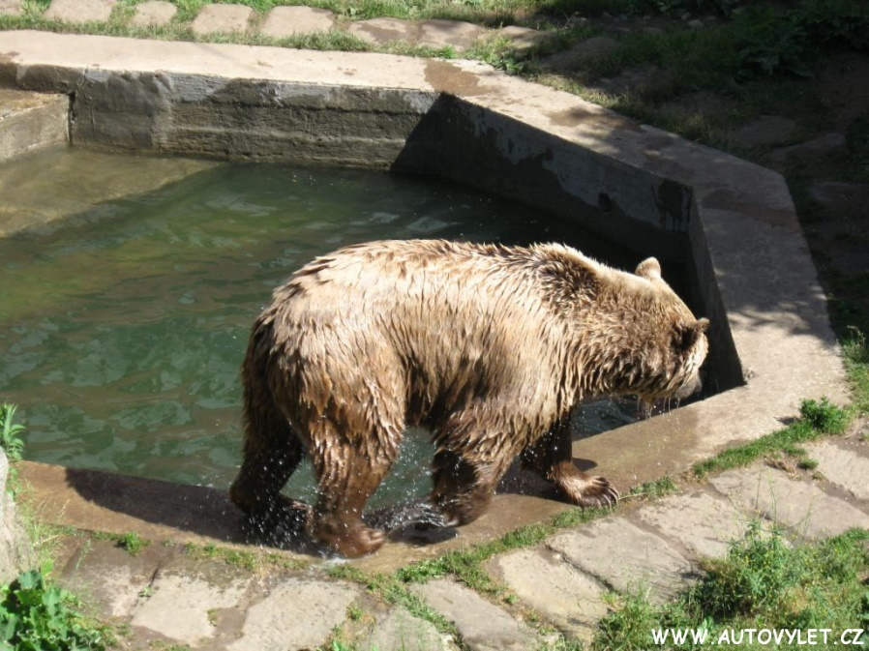
What is there
In the castle there are two bears

Slide 5
Why is it so important
Zákupy was often visited by emperors.The Caste was a private place of Ferdinand I. Good. In 1876 there was meeting between Franz Josef I. and Russian czar Alexander II.. And in 1900 there was mariage between Ferdinand d’Este and Mary Chotková.

